Slide 1

The impact of a changing academic profession on career paths and aspirations
Dr Celia Whitchurch, Dr Giulio Marini & Dr William Locke
Centre for Global Higher Education (CGHE)
UCL Institute of Education, University College London
AMIN (Employability and academic mobility event) University of Warwick January 23rd 2018

Slide 2
Outline
Giulio:
  Introduction to the research
  Research design
Celia:
  Some initial findings out of a comparison of two cases
  First conclusions

Slide 3

Introduction
http://www.researchcghe.org
for imminent working paper

Slide 4

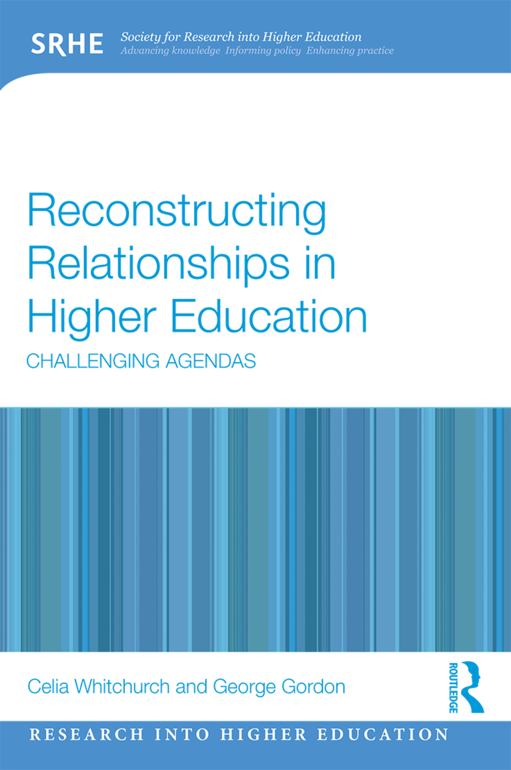
Previous work on which this project builds
Shifting landscapes:
Meeting the staff development needs of the changing academic workforce
William Locke, Celia Whitchurch, Holly Smith &
Anna Mazenod
Higher Education Academy, January 2016
Reconstructing Relationships in Higher Education: Challenging Agendas
Celia Whitchurch and George Gordon
SRHE/Routledge, June 2017

Slide 5
The implications of a diversifying workforce for higher education systems, institutions and individuals
The purpose of this four-year research project is to investigate the implications of the diversification of the academic workforce in the UK and to indicate how higher education institutions might plan strategically for their future staffing needs, and how sector bodies could support this.
In this presentation we look at the individual perspectives within specific conditions (i.e. two institutional cases)
Purpose of the research

Slide 6
Initial premises
UK has 4 nations and 4 sub-country HE systems
Approaches to work and careers may be influenced as much by informal opportunities and relationships as by formal structures and processes
Individuals navigate the structures in which they find themselves (more or less successfully)
Policy interpretations can vary at local level
There are ways in which institutions can optimise ‘bottom-up’ initiatives and dialogue
Greater instrumentality as reflected in, for instance, workload models and an ‘over-engineering’ of ‘teaching- or research-only’ roles, is counterbalanced by accommodations between individuals and local managers that are not necessarily formally articulated

Slide 7
Research Questions
In what ways are academic roles and identities diversifying?
What are the implications for individuals and institutions, locally and globally?
What tensions and/or synergies arise from this diversification, for instance between individual aspirations and institutional missions, structures and processes?
How are such tensions being managed and resolved in optimal ways for individuals and institutions?

Slide 8
Research Design: Three phases
Longitudinal multi-organisational case studies
Analysis of HESA data
First qualitative phase in 8 UK HEI case studies with 8 interviews in each (Autumn 2017)
  6 case studies completed so far with a total of 52 interviews
Surveys in these 8 HEIs (Autumn 2018)
Second qualitative phase (Autumn 2019)
  returning to as many of the original interviewees as possible two years later

Slide 9
Interviews (first & second phases)
Senior institutional leaders (e.g. PVCs) and HR Directors: on institutional strategy, policy & practice
Individuals: on their own careers, work, strategies and prospects
  those in teaching & research, teaching-only and research-only roles
  early, mid- and late career staff
  a range of different disciplines and functions
  those undertaking academic work but not on academic contracts, including ‘third space’ professionals
Middle managers: on mediating institutional policies and supporting staff to develop their careers

Slide 10
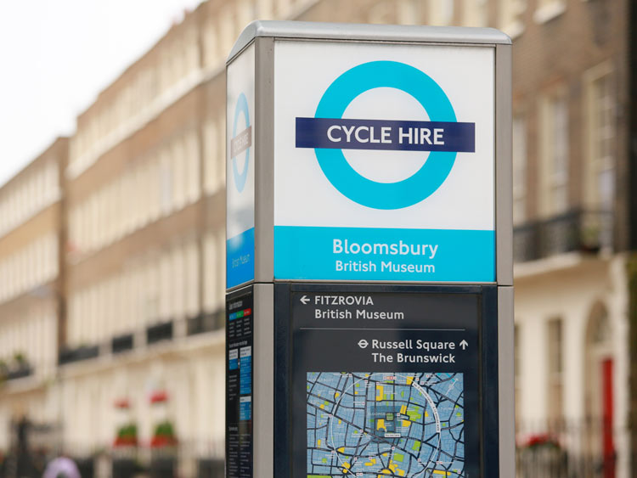
The case study HEIs

Slide 11
By Nation:
England 5
Scotland 1
Wales 1
Northern Ireland 1
By Mission Group:
Russell Group: 4
Post-92 HEIs: 3
Other pre-92 1

Slide 12

Some initial findings from 2 case study HEIs

Slide 13
Types of mobility
Between research and teaching
Between institutions (national and international)
Part-time work in different institutions
Working between institution and community/private sector/professional bodies
Hourly paid contracts in early career
Flexible working to accommodate eg dual careers, child and elder care

Slide 14
Pre-92 Campus
Conservative culture, low turnover, pleasant environment (investment in estates/new build)
Generally stable environment - incremental change
Devolved structure with potential for issues of equity/consistency of treatment
Slowly introducing teaching pathways, rewards and promotion (parity of T&S with T&R)
Thinking about new career/promotion routes eg professional, enterprise/knowledge exchange, leadership pathways

Slide 15
Pre-92 Russell
Inner city, multi-site, geographically dispersed
Market and REF strong management drivers - likely to affect psychological contract (pensions, protected research time)
Strong T&R culture militates against rapid change eg in redefining teaching and innovation pathways
Sense of isolation of rank-and-file staff within formal structures, therefore emphasis on informal networks
Stronger affiliation to Schools than institution

Slide 16
General observations I
Significant numbers of staff have worked in other sectors and enter HE in their thirties or forties
Career issues for both early and mid-careers - difficult to obtain a first permanent post, but mid-careers can also get ‘lost’
Individuals want security but also flexibility
Shift from career ladders to career pathways...
Lack of clarity around job descriptions and assumptions around eg T/R/other proportions

Slide 17
General observations II
Issues over poor performance and “stealing” of academic time eg when workload transferred from poor to good teachers
Activity out-with direct disciplinary role often highly motivating and valued (“succour”)
Often outside HE (eg community, professional bodies)
Also reflects need to keep options open and in some cases have “exit plan”
Criticality of line manager - influence can be disproportionate, positively and negatively

Slide 18
Paradoxes
Fluidity and ambiguity may suit institutions and individuals eg about promotion criteria, value accorded to teaching and innovation, balance of T&R, nature of teaching posts
Academic autonomy may seem less attractive if no support from line manager and mentor
“Wilderness years” become a ‘rite of passage’?
Being “disappointed and relieved” if eg application for research funding fails
Sense of being lucky to work in higher education and yet of “living on a knife edge”

Slide 19
References
HESA (2006-2017) Staff in Higher Education, Cheltenham: Higher Education Statistics Agency.
Locke, W. (2014) Shifting Academic Careers and their implications for enhancing professionalism in teaching and supporting learning, York: Higher Education Academy. https://www.heacademy.ac.uk/node/10079
Locke, W., Whitchurch, C., Smith, H. & Mazenod, A. (2016) Shifting Landscapes: Meeting the staff development needs of the changing academic workforce, York: Higher Education Academy. https://www.heacademy.ac.uk/sites/default/files/shifting_landscapes_1.pdf
Marini, G. & Reale, E. (2015) How does Collegiality Survive in Managerially-led Universities? Evidence from a European Survey, European Journal of Higher Education. DOI doi.org/10.1080/21568235.2015.1070676
Whitchurch, C. and Gordon, G (2017) Reconstructing Relationships in Higher Education: Challenging Agendas, London: SRHE/Routledge

