Slide 1
Engineering with the Trouble: the Engineering Exchange at UCL Sarah Bell 26 January 2018 http://www.engineering.ucl.ac.uk/engineering-exchange @uclengex

Slide 2
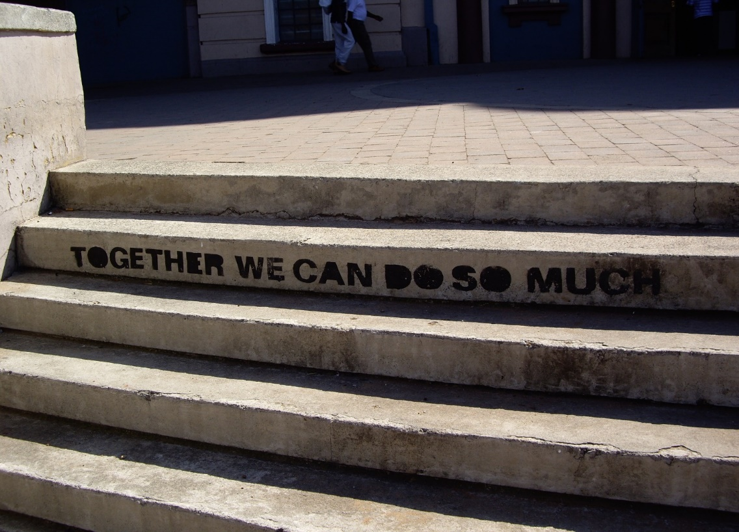
Engineering with the Trouble
The Engineering Exchange
The Trouble
Engineering
Universities
Communities
Engineering with communities
Notes:
Good morning everyone. As I mentioned in my introduction yesterday, I’m here to report back on the Engineering Exchange, which I presented to this network as an idea back in 2014. We’ve been very busy since then setting up and delivering the work, and it’s good to be back to reflect upon that practice. I’ve framed this paper playing off the title of Donna Haraway’s latest book ‘Staying with the Trouble’, so I’m going to think about some of the Troubles we’re facing, and how we work with them.

Slide 3
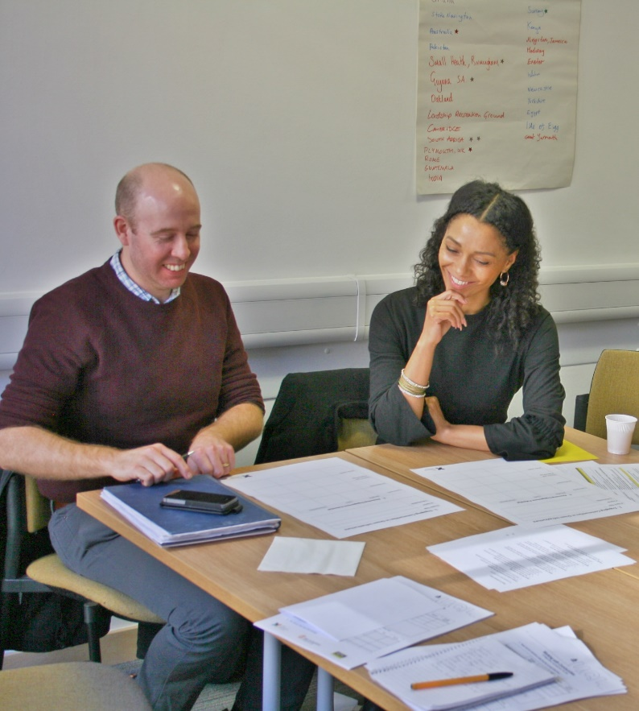
The Engineering Exchange
Established 2014
Two-way engagement
Projects
Events
Training
Faculty and staff, not students
Notes:
The Engineering Exchange started at UCL in 2014 to improve community engagement with engineering research. As a research intensive university, we have a lot support to engage with industry and policy, and we pitch this as addressing the third leg of democracy – directly engaging with local communities. Our focus is research, not teaching. We provide a pro bono engineering service, and we run events where we bring together researchers and community groups to facilitate new projects on particular themes like air pollution and green infrastructure. We also run dissemination events to share project outcomes, and we offer professional training programmes.

Slide 4
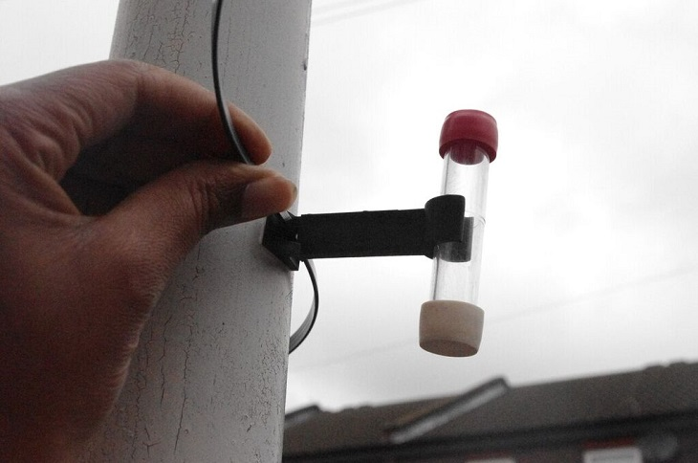
Projects
Air quality monitoring and interventions
Traffic and logistics
Canal transport
Infrastructure planning
Smart cities
Housing…
Notes:
Just to give you a flavour of our projects, we deal with issues like air pollution, designing new barges to open up London’s canal for freight transport to reduce traffic congestion, providing an infrastructure master plan to support a community-led neighbourhood plan, and a review of the evidence for demolition or refurbishment of social housing.

Slide 5
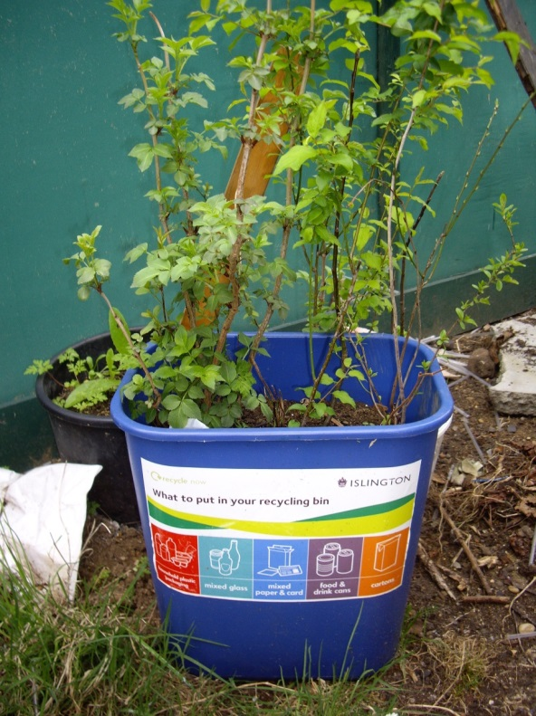
The numbers
2016-17
UCL staff 66
UCL students 13
Members of the public 227
External presentations 10
Projects initiated 19
Projects ongoing 6
CPD participants 13
Community forum participants 62
Notes:
And as an indication of the scale of what we’re doing, we’ve worked with more than 60 staff and more than 200 members of the public, and we’ve got roughly a dozen projects on the go.

Slide 6
Staying with the Trouble
Haraway 2016
Making kin, weaving connections
Compost, cats cradle, octopus, butterflies
Focus on the present
Not dystopian or utopian futures
Anti-ideology
Notes:
And now to Donna Haraway’s book ‘Staying with the Trouble’. The book addresses the question of how should we live in this late Anthropocene, on a planet so damaged by human, capitalist activity, but still with so many possibilities amidst the ruins. The bulk of the book is focussed on inter-species relationships. It talks a lot about kinship, with humans and critters like pigeons, butterflies and octopus. This might seem a long way from engineering in London, but underpinning her approach to ‘staying with the trouble’, is an emphasis on the here and now, taking things as they are, not as they should be or could be. The book is anti-ideology, attending to building relationships, experimenting and taking action, as partial and incomplete as they might be.

Slide 7
The Trouble With… Engineering
Central to modern, industrial and digital development
Future oriented
Serves large organisations
Corporations, military, government
Imbalance in access to technical knowledge
Claims to serve public interest?
How?
Notes:
So if we now think about our own practice in the Engineering Exchange. What is the trouble I’m working with?
Firstly to engineering.
Engineering is central to modern, technological society and economy, but as we’ve already discussed, engineering serves powerful interests within that system – corporations, the military, government. Technical knowledge and services that are central to the future of our modern society and democracy but access to that knowledge is very uneven.
But engineering as a profession makes a lot of claims to be acting in the public interest. It’s in all our ethical codes and all those shiny brochures mis-selling engineering to 18 year old women. So there is something there for us to work with.

Slide 8
The Trouble With… Universities
Source of technical and scientific knowledge
Aligned with powerful interests
Corporations, military, government
Public funding for research and teaching
Impact on economic growth and competitiveness
Political targets
Free speech, fees and debt, elitism
Claim to serve wider public interest?
How?
Notes:
We work in a university, and we’ve got plenty of troubles. Universities are key sources of technical and scientific knowledge. That’s how we justify our existence within this modern, technological society. But that has meant that universities have become aligned with powerful corporate, military and government interests, and now universities are the target of populist politics, fending off attacks about free speech, student debt and generally being out of touch with ordinary people. But universities also make claims to serve wider interests, and so that also gives us another hook to work with.

Slide 9
The Trouble With… Communities
Impacted by the outcomes of decisions taken based on technical and scientific knowledge
Serve local, specific interests and values
Constrained capacity to engage with technical basis for decisions
Constrained capacity to propose viable alternatives
Notes:
And now to communities, who have their own troubles. Local people are at the blunt end of a lot of decisions, often enabled by engineers, that serve the interests of powerful actors. Local communities serve local interests, and so without access to these big, universal sources of technical expertise, are constrained in their capacity to challenge decisions or to propose viable, legitimate alternatives.

Slide 10
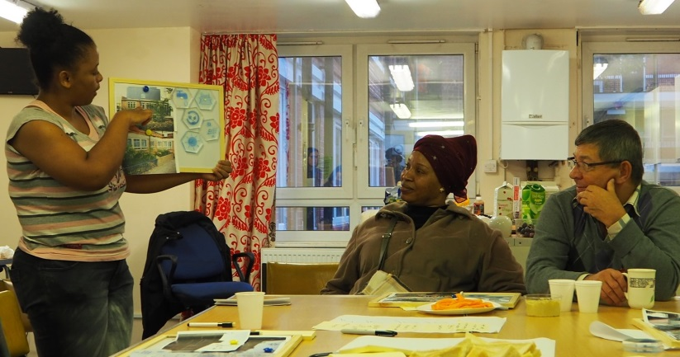
Engineering with the Trouble
Strategically conservative
Serve university and engineering interests
Specific projecst, not root causes
Notes:
So what are we doing in the Engineering Exchange? How are we staying with our troubles?
Firstly, we take both engineering and the university at their word when they claim to serve the public interest. We are not saying the university and engineers should stop serving governments and industry, but that they need to balance that out by working directly with communities. That’s a very conservative line, it’s very modest, we are not addressing any root causes, but it provides the justification for our work.
We focus on specific projects defined in partnership with communities. They are not generally concerned about root causes, and if they are, they are not looking for us to fix them. So we provide specific, tactical support, not systemic critique or political analysis.

Slide 11
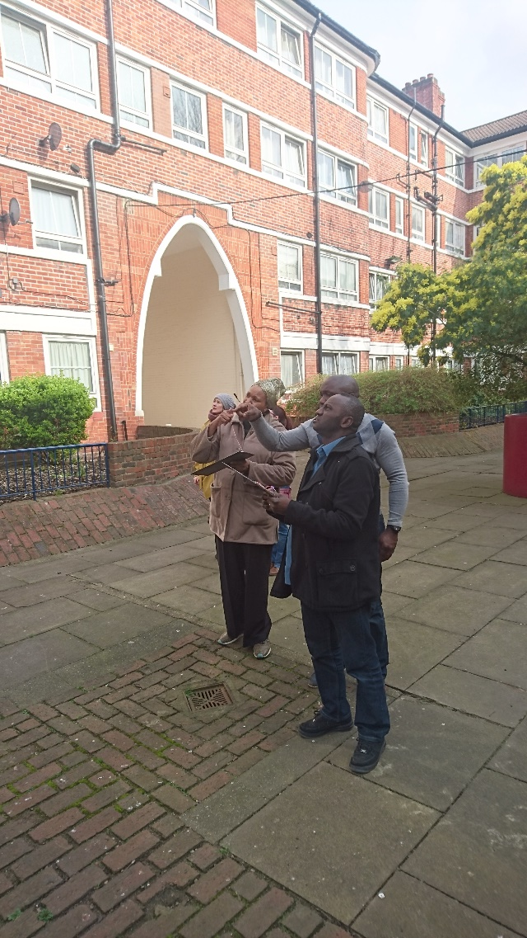
Engineering with the Trouble
Situating technical knowledge
Clients, not kin
Establishment legitimacy, not outsider solidarity
Notes:
Our engineering professionalism serves us well. Our clients value our consultancy model. We try to work with them in the same way as we would work with a corporation or government department. We are not activists. We are engineers. So in that way we depart from Haraway’s model of building kinship ties. Our partners don’t want solidarity, they want legitimacy. Working with us brings the authority of a big university which has some power within structures of our society. This might be troubling for those of us who are conscious of the harm those structures perpetuate, but that’s the trouble we’re in.

Slide 12
