Slide 1






Systematic Review of impact of BCS on cancer outcomes
in Multiple Ipsilateral Breast Cancers (MIBC) - rationale for MIAMI randomised trial
Professor Zoë Winters on behalf of the MIAMI Trialists
Surgical and Interventional Trials Unit
Division of Surgery & Interventional science
University College London, UK
ABS Annual Scientific Meeting 18th June 2018
Notes:
It is a pleasure to have the opportunity to present what the current evidence regarding the oncological safety of BCS compared to mastectomy in treating MIBC on behalf of the MIAMI trialists

Slide 2
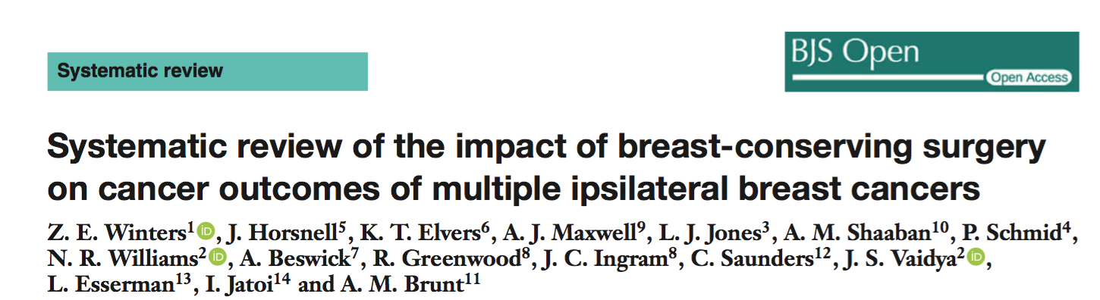
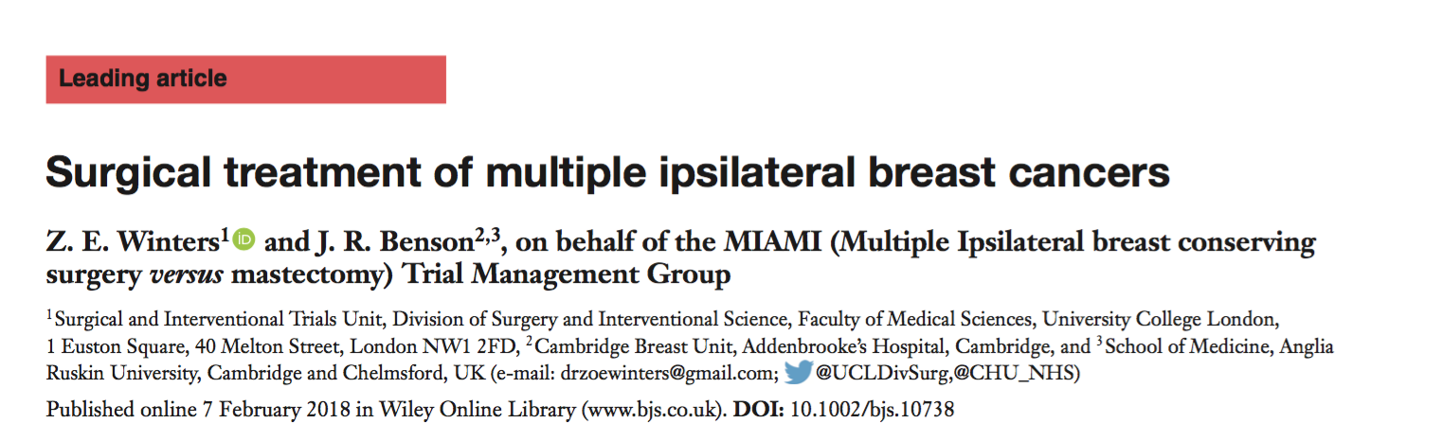
Compare clinical outcomes after BCS vs. Mastectomy for MIBC
Br J Surg Open 26th May 2018 Open Access
Br J Surg 2018; 105: 166
Notes:
Our primary aim was to compare clinical outcomes after BCS versus mastectomy for MF and MC cancers collectively defined as MIBC, and not specifically compare these with unifocal cancers which are fundamentally different in terms of clinical presentation and potentially genomically. Two publications form the basis of a new NIHR funded randomised controlled trial called MIAMI which is a feasibility study.

Slide 3
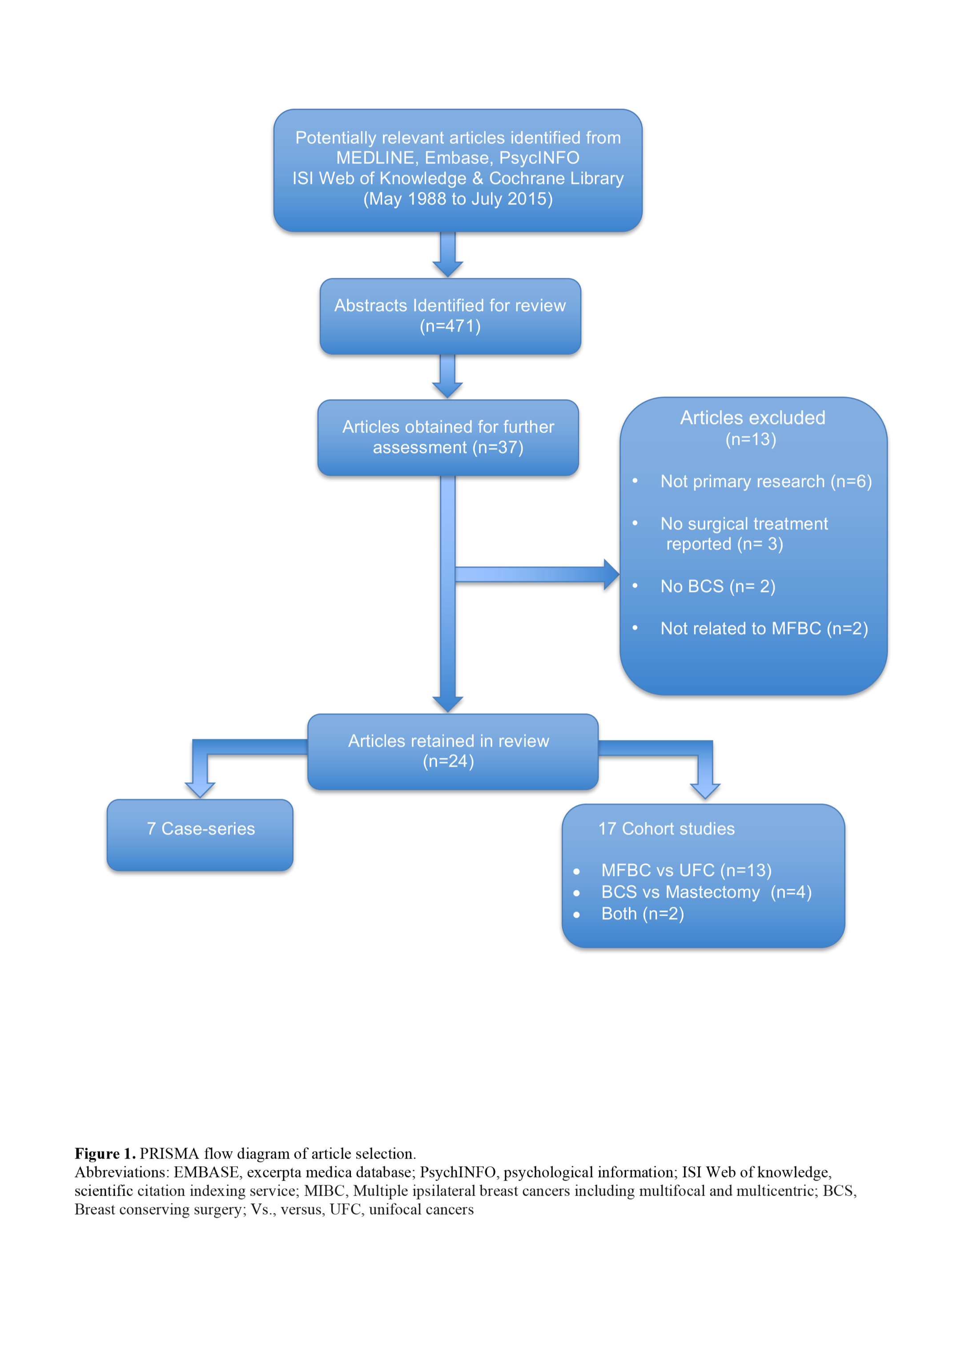
Notes:
A comprehensive literature search covered May 1998 to July 2015 evaluating all study designs resulting in 24 retrospective studies that were critically appraised using the Newcastle Ottowa Scale, 17 cohort studies and 7 case series. This included 3537 women with MIBC undergoing BCS, defined as MF in 2677 and MC in 292 with both in 568. Only six studies evaluated MIBC treated by BCS versus mastectomy.

Slide 4
Key messages
6 moderate quality studies comparing BCS to mastectomy
75.6% Multifocal, 8.3% Multicentric, 16% Both
Inconsistent definitions
No reporting of molecular subtypes
No studies assessed therapeutic mammoplasty
LRR 3-23% median follow up 60 months (56-81)
No patient reported outcomes (PROs)

Slide 5
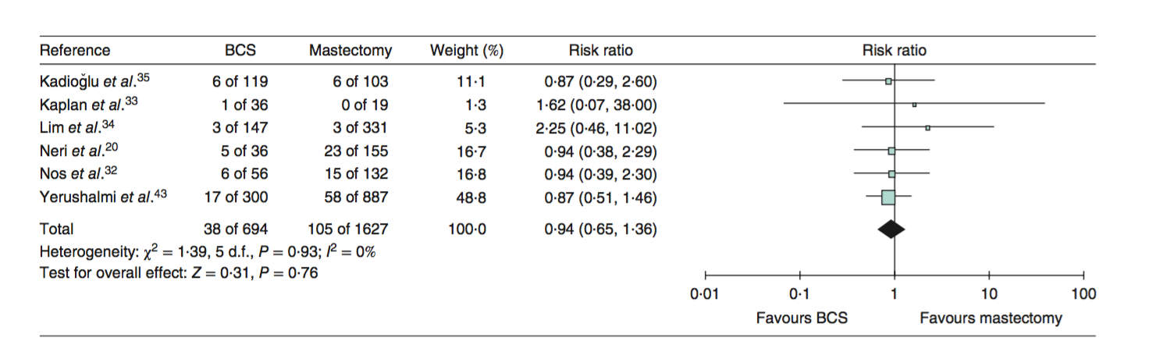
Forrest plot - meta-analysis
Study Quality Newcastle Ottowa 4-6
No heterogeneity - similar case selection biases
Significant intergroup differences in clinical pathology in 4/6 studies
Notes:
6 studies reported LRR rates ranging from 3-23% after BCS with apparently similar rates of LRR compared with mastectomy RR of 0.94. There was no heterogeneity in these studies reflecting similar case selection biases with surgeons choosing BCS for low risk patients and mastectomy for high risk cases. Overall the results are inconclusive and compromised by study quality.

Slide 6
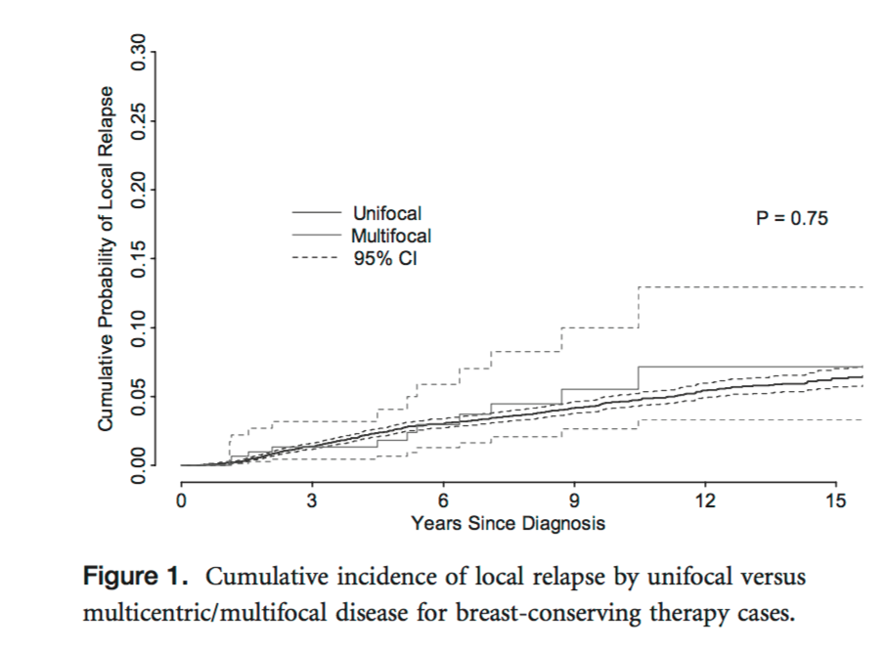
Results
Highest quality study NOS 7
BCS
10 year LRR
BCS 5.5% vs Mastectomy 6.5%
5 yr LRR 2.5%
*Yerushlami R BCRT 2012:117
Notes:
The highest quality study reported the potential clinical equivalence of mastectomy in 887 patients compared with standard BCS in 300 patients with 10 year LRR rates of 6.5% versus 5.5%. Five year LRR rates were 2.5% after BCS.

Slide 7
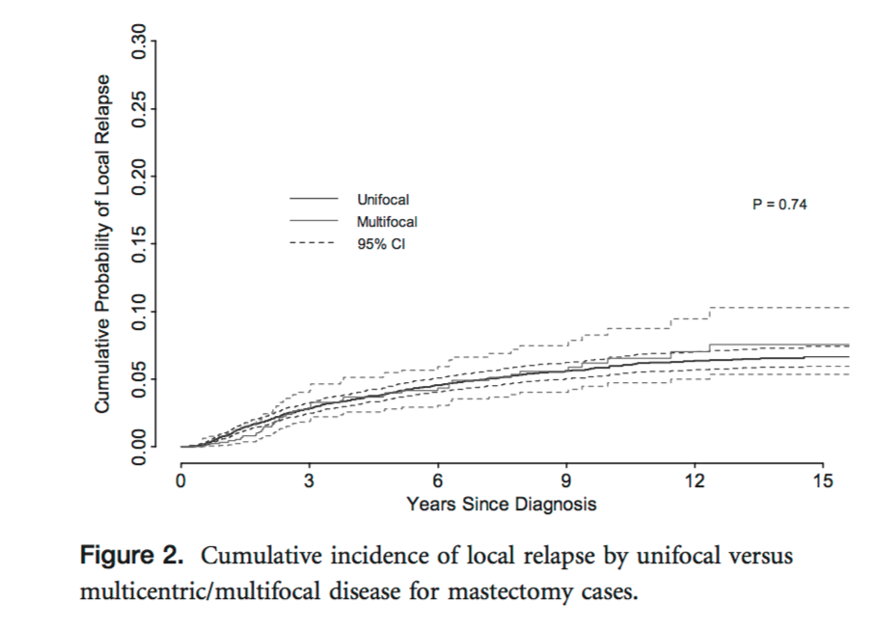
Results
Mastectomy
Biased case - selection
5 yr LRR 4.5%
*Yerushlami R BCRT 2012:117
Notes:
Five year LRR rates were 4.5% after mastectomy versus 2.5% after BCS suggesting biased case selection. These figures have been used on which to base sample size calculations for the MIAMI RCT.

Slide 8
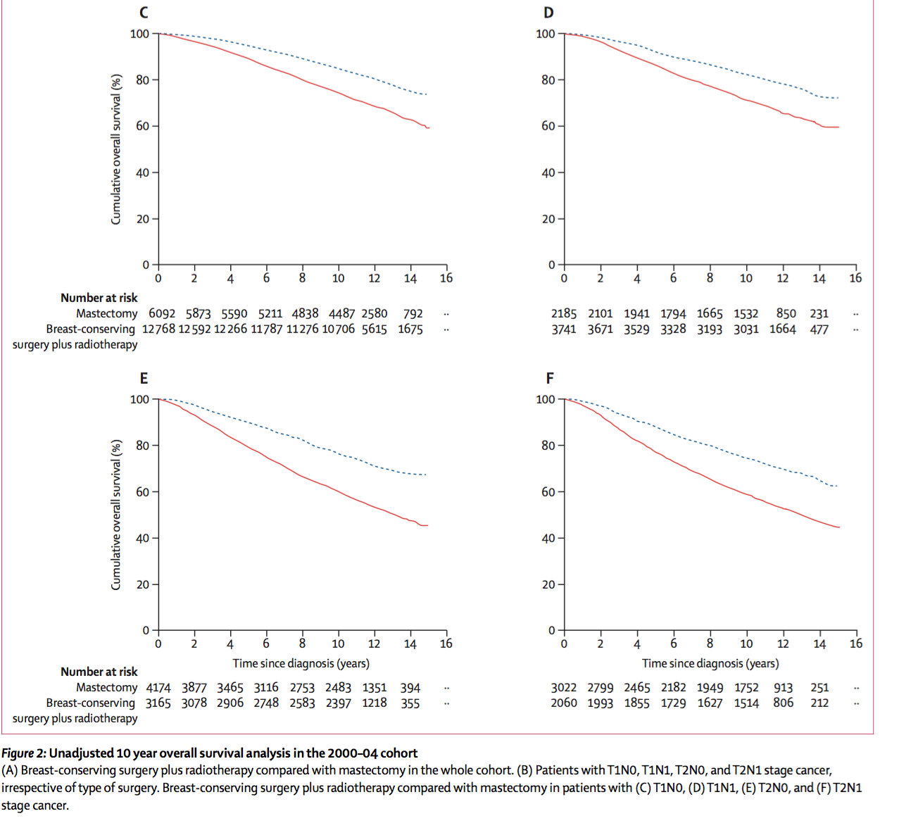
Challenges
No ‘modern big data’ on MIBC
Synergism RT and Systemic
Current TNM underestimate disease
Little knowledge of stromal
epigenetic changes
Evidence for increased
hypermethylation by stage
Van Maaren M Lancet Oncol 2016;17
Teschendorff AE 2015
Notes:
In the Dutch registry of Over 37,000 2000-2004, BCS improved 10 year OS compared to mastectomy which remained significant for all TNM stages. In a sub-cohort evaluating distant DFS, BCS vs mastectomy did not significantly improve DFS except in the T1N0 group
This registry comprised 12 % MIBC where current TN staging is potentially underestimated with MIBC cancers having double the LN involvement compared to unifocal cancers.
Ultimately we need to understand what determines MIBC in relation to the stroma compared to unifocal cancers. Teschendorff analysed DNA methylomes in cancers and surrounding stroma showing increased methylation changes with increasing stage. We also know that genomic heterogeneity exists between MF cancers in up to 25%

Slide 9
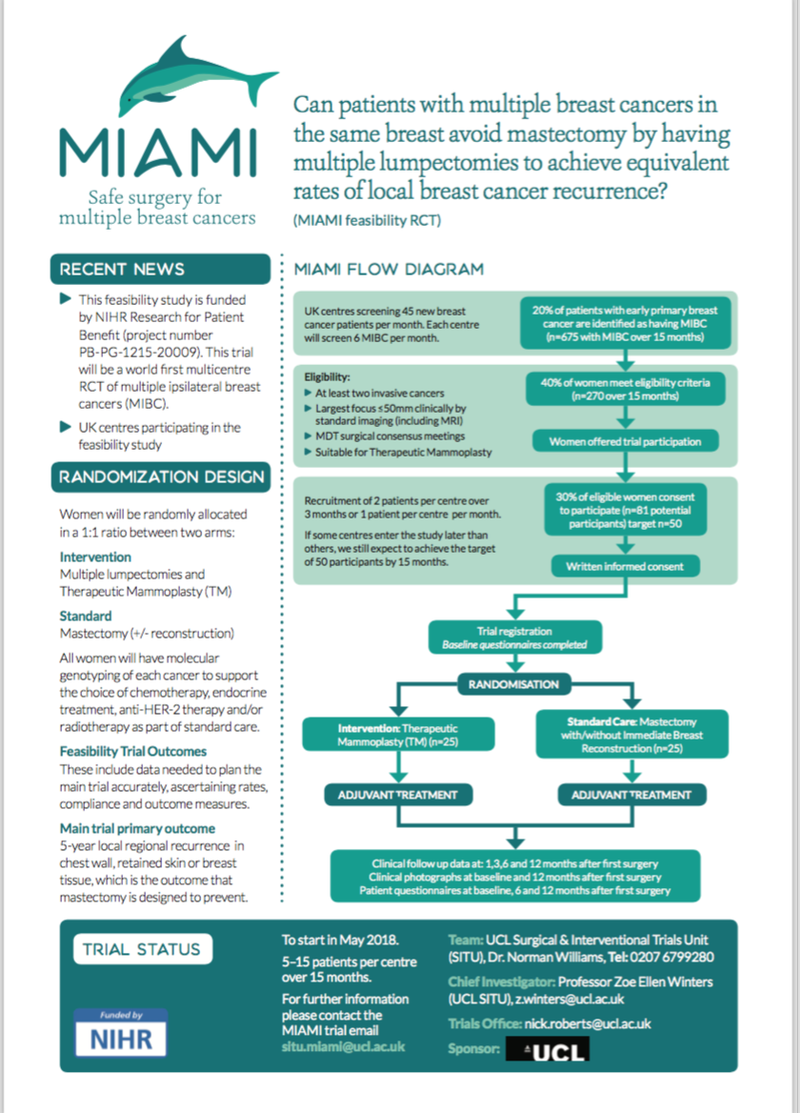

Feasibility randomised study - world first
50 women, 25 per 1:1 randomisation
over 15 months with 1 year follow-up
Alliance 11102, Boughey J, Mayo
Scientific impact award ASBrS 2018
Predicted 5-yr LRR 2.5%*, 2% NI
Small effect size for LRR requires
individual group sizes of 1000
@drzoewinters, z.winters@ucl.ac.uk
nick.roberts@ucl.ac.uk
*Yerushlami R Breast Ca Res and Treat 2012:117
Notes:
Preliminary calculations suggest that treatment groups in the main trial should each comprise at least 1000 patients with a non inferiority of 2%. Hypothetically there may be higher or lower rates of LRR following TM for MIBC where there is minimal biased case selection for treating MIBC cancers by TM in MIAMI.

