Slide 1
Translational failure in preclinical research; how open science can help
Emily S Sena, PhD
Centre for Clinical Brain Sciences, University of Edinburgh
@drEmilySena
@camarades_

Slide 2

Disclosures
BMJ Open Science (Editor-in-Chief)
  I receive an honorarium for this role
I have applied and have received grant funding (& will continue) for this research

Slide 3


My perspective

Slide 4



Structure
Scale of the problem
  How the life cycle of a preclinical research study is not fit for purpose
In an ideal world
  As a consumer of preclinical research what do I want
Potential solutions

Slide 5
What is translational failure?
In vitro and in vivo - 1026
Tested in vivo - 603
Effective in vivo - 374
Tested in clinical trial - 97
Effective in clinical trial - 1
O’Collins et al, 2006

Slide 6
Hypotheses
In the life sciences there are perverse incentives (publication, funding, promotion) to produce positive results with little attention paid to their validity
In the use of animal disease models, pressure to reduce the number of animals (cost, time, ethics, feasibility) results in studies either being underpowered or of unknown power
These factors combine to compromise the utility of animal models and contribute to translational failure

Slide 7
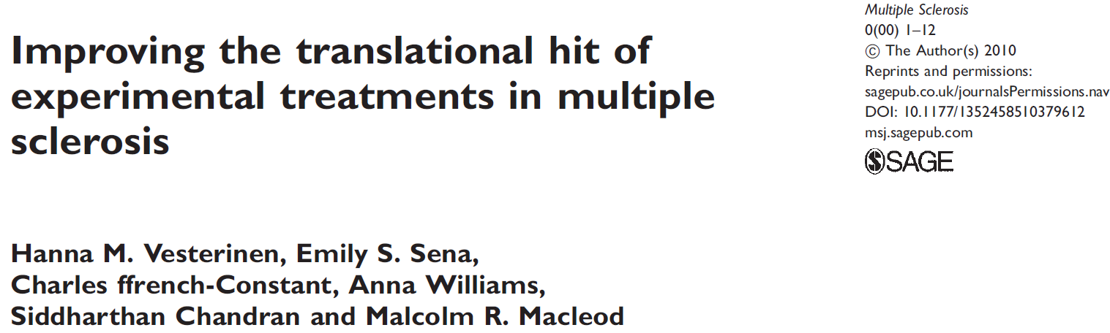
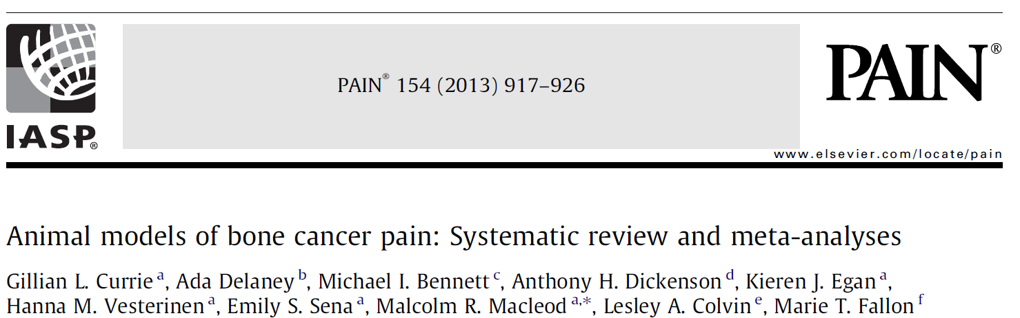
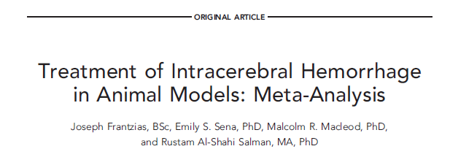
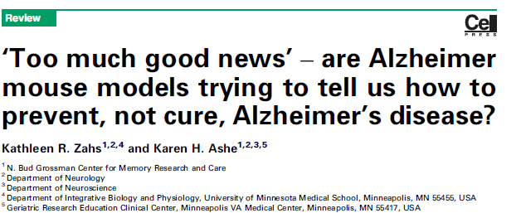
Translational failure

Slide 8
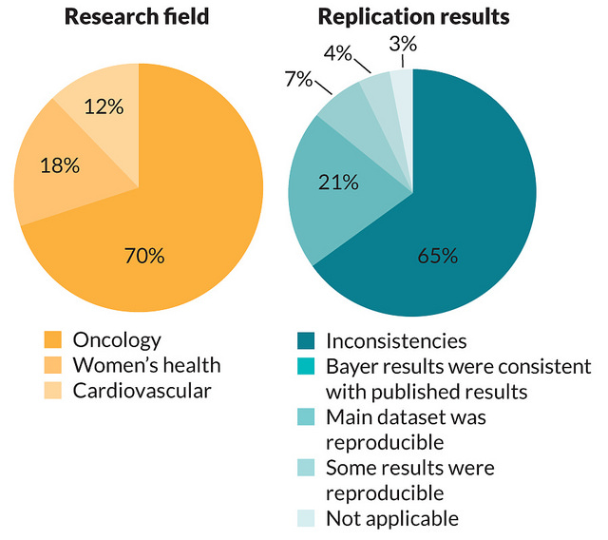
What happens when pharma tries to replicate academic findings?
Bayer, Berlin
67 in-house projects over 4 years
Prinz et al, Nature Reviews Drug Discovery, 2011
Notes:
Even within animal studies with similar experimental designs results cannot be replicated.

Slide 9

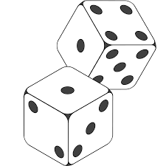
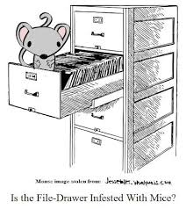
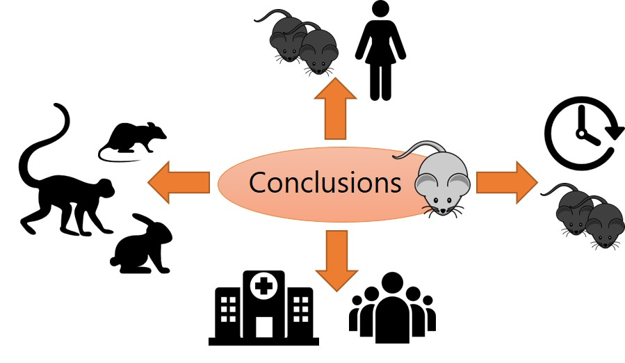
Potential sources of bias in animal studies
Notes:
Are animal experiments falsely positive?
Are clinical trials falsely negative?
Do animal studies not model human disease with sufficient fidelity to be useful?

Slide 10
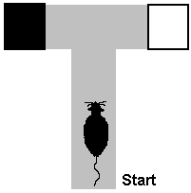
You can usually find what you’re looking for …
12 graduate psychology students
5 day experiment: rats in T maze with dark arm alternating at random, and the dark arm always reinforced
2 groups – “Maze Bright” and “Maze dull”
Group | Day 1 | Day 2 | Day 3 | Day 4 | Day 5
“Maze bright” | 1.33 | 1.60 | 2.60 | 2.83 | 3.26
“Maze dull” | 0.72 | 1.10 | 2.23 | 1.83 | 1.83
Δ | +0.60 | +0.50 | +0.37 | +1.00 | +1.43
Rosenthal and Fode (1963), Behav Sci 8, 183-9

Slide 11
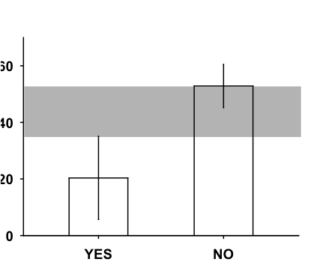
Bias is prevalent and important
 | Randomisation | Blinded Outcome Assessment
Stroke | 36% | 29%
MND | 31% | 20%
AD | 15% | 25%
PD | 12% | 15%
EAE | 8% | 15%
Glioma | 14% | 0%
Efficacy è
Randomisation
Sena et al TiNS 2007

Slide 12
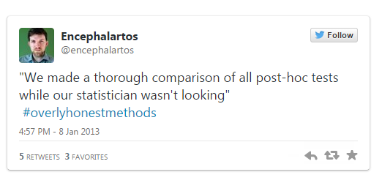
The umbrella of reporting bias
Not all outcomes and a priori analyses are reported
Publication bias
  Neutral and negative studies
  Time lag/remain unpublished
  Less likely to be identified
p-hacking
  Selective analysis
  Selective outcome reporting

Slide 13
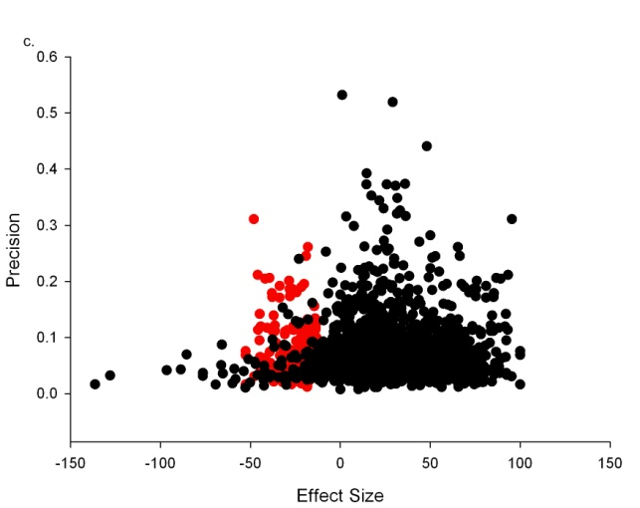
Overall efficacy was reduced from;
  32% (95% CI 30 to 34%) to 26% (95% CI 24 to 28%)
16% of experiments remain unpublished

Slide 14
Ideally…………..
Preclinical research will benefit from open science tools that facilitates:
  Clarity of how studies were performed
  Collaborative studies
  Confirmation that studies report what they set our to do
  Access to data that can be used and compared efficiently

Slide 15
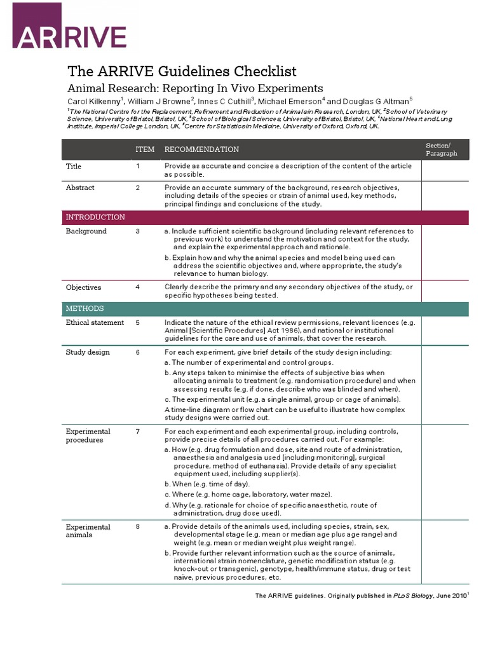
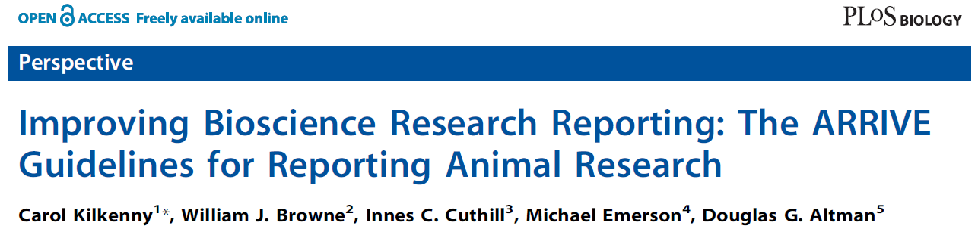
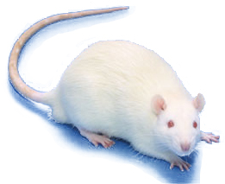

How were the data generated?
Journals
Funders
Universities
Learned societies
Notes:
Endorsed by >1000 journals
Article downloaded 100K times

Slide 16



Open Methods

Slide 17



Study protocol registries

Slide 18

Registered Reports
"Because the study is accepted in advance, the incentives for authors change from producing the most beautiful story to the most accurate one."

Slide 19





Allow others to check your work
Data should be available
Undocumented data dumps
  No quality control
  Often not linked to original study
  How to re-analyse?

Slide 20

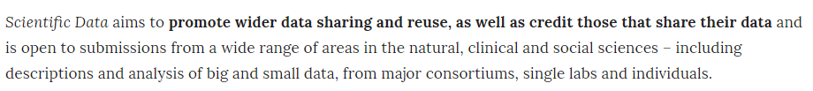

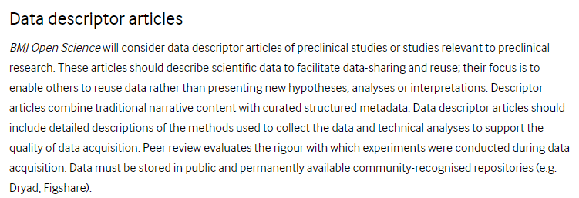
Publish data

Slide 21

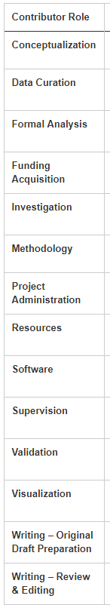

Who did what?

Slide 22
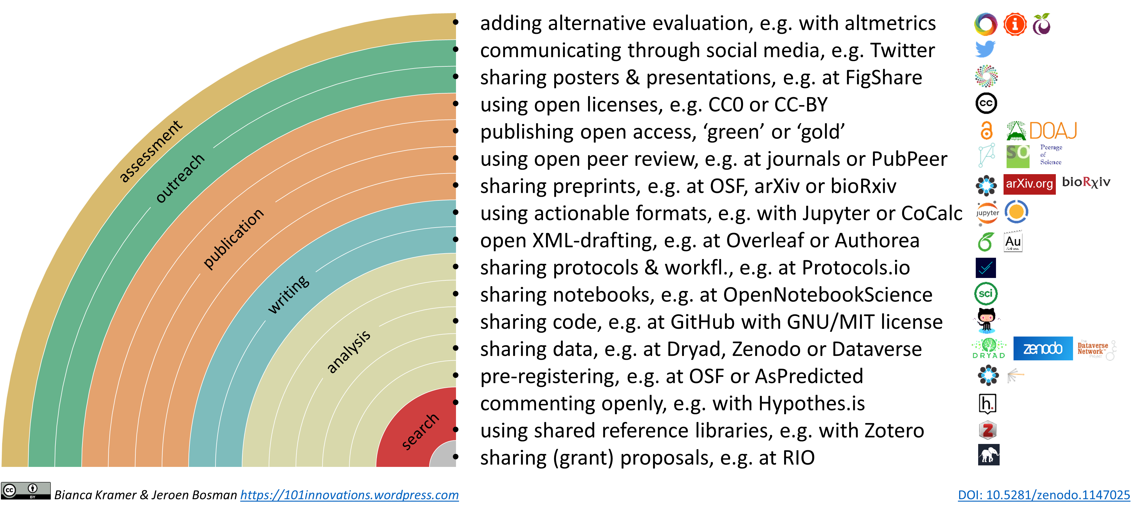
THE open workflow

Slide 23

Obstacles to researchers…..
Emphasising rigour in grant award
Emphasising rigour in appointment panels
CPD opportunities for scientists

Slide 24
Effectiveness of research improvement
Research Improvement Activity: Things done by stakeholders to increase the usefulness of research with which they are associated
Important to assess whether interventions can be effectively delivered
Important to assess whether interventions improve research quality and reduce waste

Slide 25

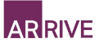
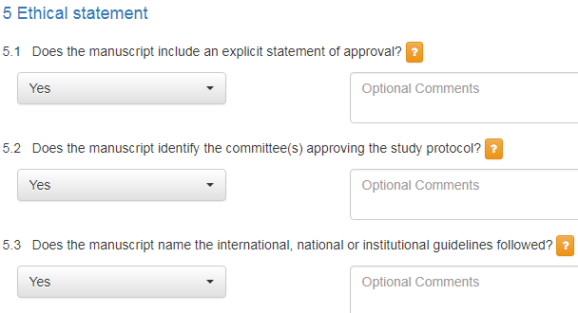

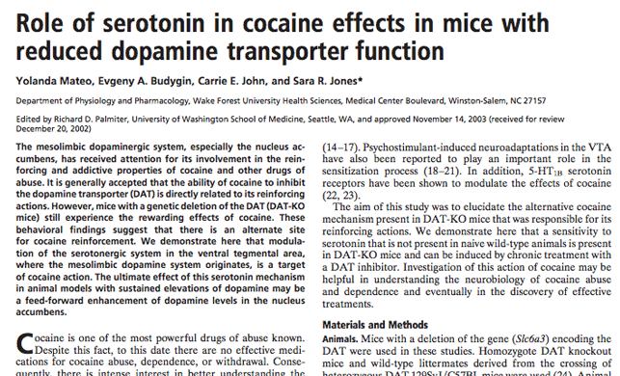


Impact of an Intervention to Improve Compliance With the ARRIVE Guidelines (IICARus)
20
38
101
Web based
Crowd sourced
Assessors trained
Dual ascertainment
Reconciliation by third reviewer
Normal Handling
Protocol: Open Science Framework (February 2017)
Data Analysis Plan: Open Science Framework (September 2017)
Funding: MRC, NC3Rs, BBSRC & Wellcome Trust
Ethics: BMJ Ethics Committee

Slide 26
Manuscripts
Randomised
844 Control
845 Intervention
Peer reviewed
652
647
Accepted
340
332
Checklist
13
301

Slide 27
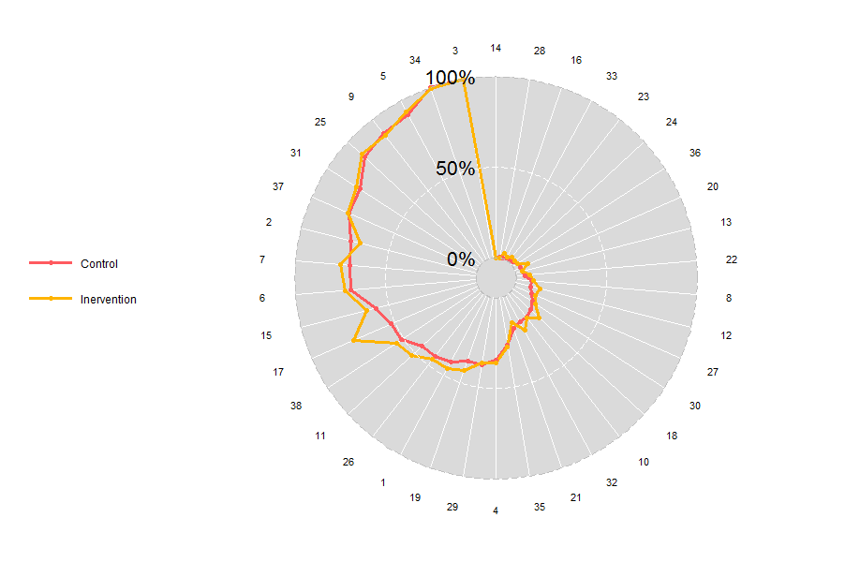
Primary outcome
Control:
  100% compliance n=0 manuscripts
  Median compliance 36.8% (29.7-42.1) of relevant items
Intervention:
  100% Compliance n= 0
  Median compliance 39.5% (31.6-44.7) of relevant items

Slide 28
Key messages
In vivo studies which do not report simple measures to avoid bias give larger estimates of treatment effects
Most in vivo studies do not report simple measures to reduce bias
Publication and selective outcome reporting biases are important and prevalent
You can only find these things out by studying large numbers of studies
Any experimental design can be subverted; what’s important is knowing how to recognise when this has happened

Slide 29
Finally……
Some (useful) tools exists
  I’m confused
Development/implementation needs resource
Research is required to determine their efficacy
Education will help, including training in critical appraisal
Reward/incentives will likely drive change

Slide 30






Thanks to...........

