Slide 1
The study of the Universities under Transformation in Europe (TRUE project).
A posteriori reflections
Giulio Marini, PhD
Research Associate - CGHE IoE UCL
g.marini@ucl.ac.uk
78th CGHE Seminar

Slide 2
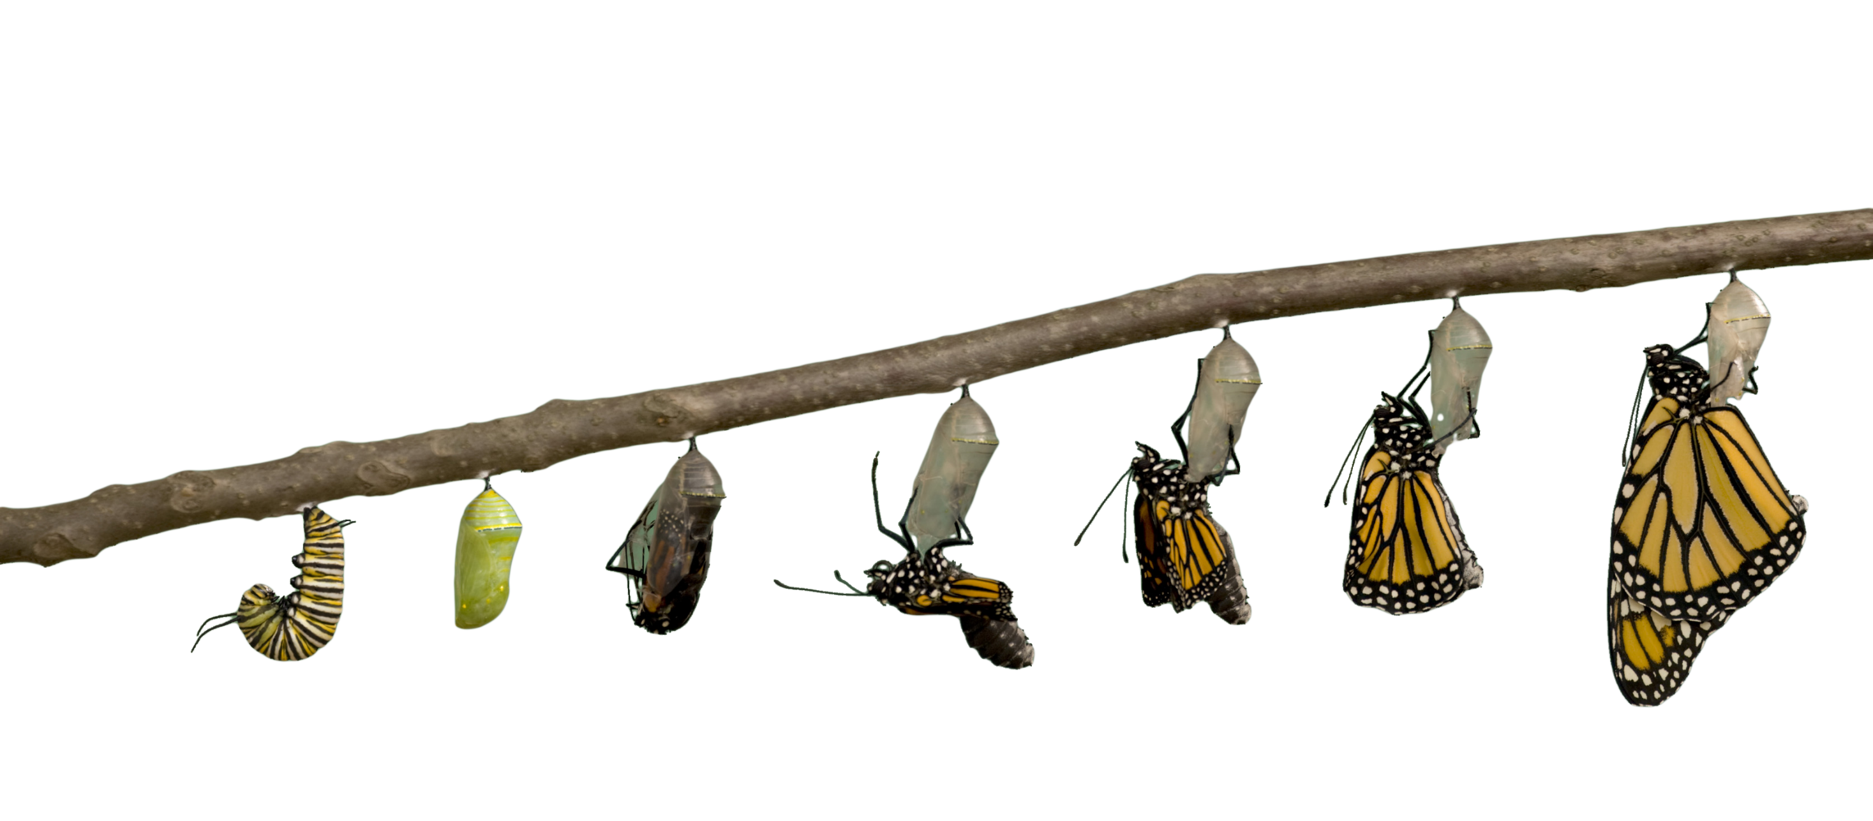
Present (2012)
The days of “positional autonomy” (50s-80s)
Future: HEIs as “complete organisation”

Slide 3

Presentation is about:
Introduction of what TRUE was
Scientific debate and contribution
Methodological reflections
Some empirical findings in the topic of “evaluation as a driver of change” (a chapter of the book “Managing universities” edited by Lepori, Enders, Bleiklie)

Slide 4
What the “TRUE” was
European Science Foundation (around 2010-2013)
8 groups:
  Kassell (Kehm-Krügen)
  Cipes-Porto (Magalhães-Veiga)
  Bergen-NIFU (Bleiklie)
  USI (Lepori)
  Science Po (Musselin)
  CHEPS (Enders)
  CNR (Reale)
  Bath (Huisman)

Slide 5
Primary (and secondary) data
26 institutional reports from open source (stats but especially institutional legal framework, strategy, etc.)
In-house collection of “formal autonomy” description by country
A common survey to all senior managers and middle managers of these 26 HEIs
8 qualitative case studies (one by country): 10-20 in depth interviews to key informants of current managerial practice

Slide 6
The discourse in the literature in Europe
The arose of the institutional autonomy (Aghion et al. 2008; Estermann et al. 2011) as in trade-off with positional autonomy (Neave 2012)
The “Evaluative State” in Europe (Neave & van Vught 1991)
Are HEIs becoming “complete organisations” (Brunsson & Sahlin-Andersson 2000; Brunsson & Olsen 1997)?
The myriad of national “NMP” versions put in place {for national descriptions of reforms in English: https://eacea.ec.europa.eu/national-policies/eurydice/national-description_en }
How does the steer of the national system work? (also how a system is steered from a system without agencies, into one with agencies) (Reale & Seeber 2011; Magalhães et al. 2016)
The quest for monitoring and assessing the “truth” about “governance of HE in the making”: actual implementation, actual post-reform status quo.

Slide 7
Any European common pattern out of all this process of change?
European Countries are not transforming into a unique Country or “one people” (no ex pluribus unum). Europe remains a babel of peoples, in a perennial search for balance of power
European Countries decided to establish a common structure:
  All Countries had to reform themselves according to Bologna process (i.e. Ba+Ma ; ECTS; etc.)
  An easier reform would have been to keep things as they were – adding only a common translation (i.e. international ISCID codes)
Extra common forces commanded reforms:
  Strong Isomorphism in adopting the British model
  Lukewarm Isomorphism in referring to the neoliberal US model
  The strength of global rankings
  Financial difficulties in keeping the post-WWII Welfare States
  New political claims of accountability and value for money

Slide 8
The novelty and the success
Both qualitative and quantitative research design (tentative mixed method design)
Strong emphasis on institutional dimension and its governance
In comparison with other typical international projects, each national team did not deal with the national context, if not for data collection. Each team was “the expert” of some topic, and each was free to use all the data to make comparisons.
  This unleashed a strong potential
  The “common paper” (Seeber et al. 2015) sounds like a publication in physics (26 authors).
  The borders of the participants are not always clear
  Though cross-team co-authorships are still not fully exploited

Slide 9
Some limits

Slide 10

To measure means to compare;
To compare means to compare: vulnera in quaestionibus
TRUE assumed equivalence of governing bodies: the Italian Senate was compared with the Portuguese Senate(no terms of comparisons with Norway, where Senates do not exist).
TRUE assumed that different nominal bodies had not to be mixed. 5 different sets of questions arose with only some questions in common for all (annex)
  Gender was not included
TRUE mission was to trace changes (with the past), without having many information about the past (and no planned sampling in the future)
  It was the first study with this design
  Few questions asked a trend in comparison to 5 or 10 years previously
  The change was supposed to be traceable in the present as stand alone (e.g. new Statutes in Italy pursuant Law 240/2010)
The idea is that NPM, neo-liberal HE etc. is transforming the way HEIs are “managed”, which implies that scholars pass from being self-organised into managed employees…
  but scholars out of governing bodies have not been interviewed (e.g. Full professors have not been asked about if they lost or gained any decision making power)

Slide 11

Novacula Occami
Lex parsimoniae:
Frustra fit per plura quod fieri potest per pauciora.
Around 50 questions for a grand total of around 700 variables are a waste of time for interviewees (and probably a reduction of valid observations)
Some a posteriori evidence:
For instance, Seeber et al. (2015) used a dozen of these variables, including factor analysis which is implicitly a technique to «synthetise» variables; Reale & Marini (2017) used around 20 of them; Marini & Reale (2015) less than 30 and summarised into less item.

Slide 12
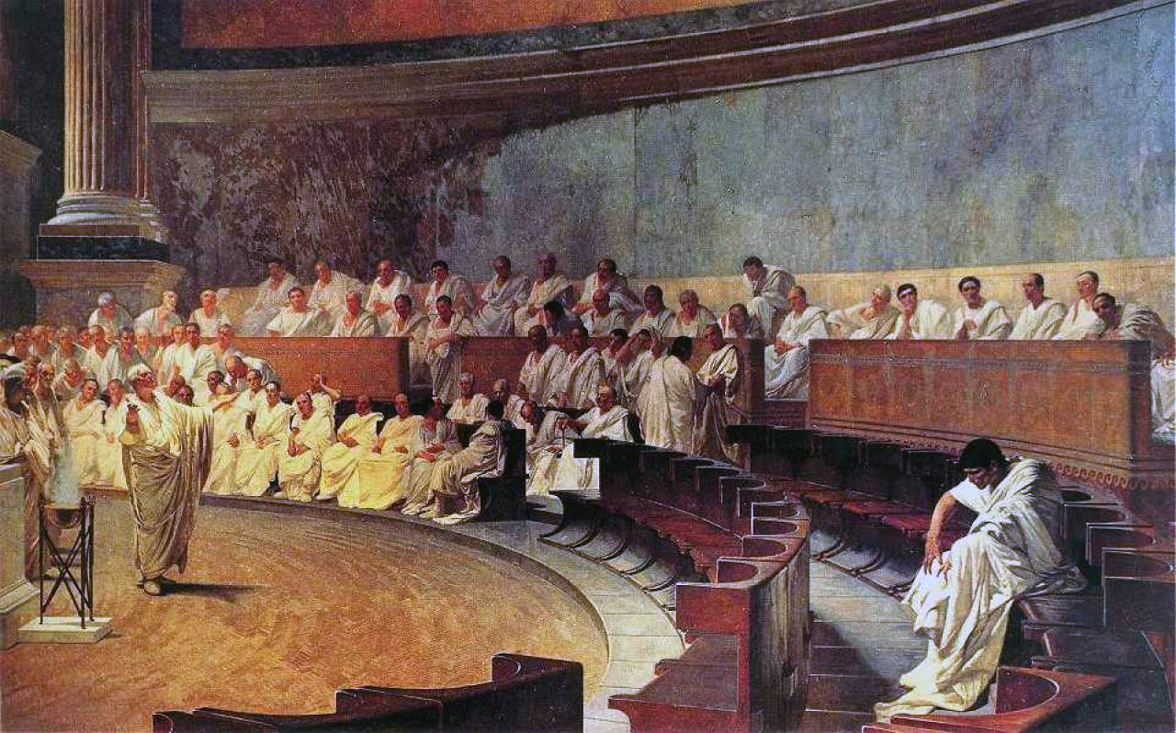
“Mixed method” means mixing something
“Using multiple methods produces more valid results as the strengths of one method can offset the limitations of another method” (Turner et al. 2015)
TRUE replicated the usual dispute between people who are true believers in quantitative stuff and those who are true believers in qualitative stuff
  The quantitative sect won
  By their own admittance (book presentation at CHER 2017), they ended to have the best publication with qualitative data (“Penetrated Heirarchies” in Organization Studies)

Slide 13
Going to findings: A specificity of chapter “The transformative power of evaluation”
We combined the dataset questionnaire with national patterns derived from a parallel questionnaires sent to “experts” about many features of institutional autonomy in the 8 respective countries (“formal autonomy”).
“Formal autonomy” data can weight the answers by governing bodies’ about “real” managing powers and leeway. (link)
Country data are like parameters in international HEIs survey, but they might be just like an ordinary variable in the dataset composed by interviewees as observations
We tested if HEIs are scattered by nation. This was to be considered an evidence of creation/presence of the institutional autonomy
  Bleiklei et al. (2015) would call it “penetration of hierarchies” as a reshuffle of power in academia

Slide 16
So what? Could we answer research questions?
Hp1:
  the more the pressure of external evaluation, the more senior and middle managers report negative effects as organisational outcome 
Hp2:
  if evaluation has a controlling function, the decision making process becomes more distributed across the tiers of the HEI 
Hp3:
  the more there is (institutional) autonomy in a specific domain (i.e. teaching and/or research), the more transformative the respective domain will be at organisation level 

Slide 17
So what? (from the text of the chapter)
The paper tested three propositions, of which the first is not confirmed by the data. This is the particular proposition that the academics active at the central government and middle management levels will perceive greater negative effects, as external evaluation increasingly impacts on decisions regarding the distribution of vital resources. The data instead confirm the second proposition, which is that when evaluation is used for controlling purposes, it has differing transformative effects on the levels of internal government (central, middle managers), distributing the decision-making power so as to mitigate the concentration in the hands of the central bodies. In other words, the data show that regardless the managerial or collegial orientation in the university, both hierarchical levels can have strong decision-making power over evaluation, a finding that is consistent with the literature on universities as ‘non-complete’ organizations.
As to the third proposition, research and teaching evaluation exert different influences between universities, contributing to shape their institutional configurations; the strength of the types of evaluation can be explained by the formal autonomy granted to the universities (at national level) over the types of evaluation themselves.
Formal institutional autonomy emerges as far as external evaluation is reckoned to transform the governance of universities, rather than any features at the institutional level.

Slide 18
Potential for the future
A great potential in panelising the study, repeating the study in the same HEIs, plus new others in other countries: completing the West and having some from Eastern Europe, provided:
  questionnaire is reformulated keeping some of the same exact questions and erasing many others
  at least professorial ranks are included
  a “formal autonomy” desk research is duplicated
  someone will get the money…
  … and someone will deliver the (team of) team leadership

Slide 19
References
Aghion, P., Dewatripont, M., Hoxby C., Mas-Colell, A. & Sapir, A. 2008. Higher aspirations. An agenda for reforming European universities. Bruegel Blueprint Series V.
Neave G (2012) The Evaluative State, Institutional Autonomy and Re-engineering Higher Education in Western Europe. The Prince and His Pleasure. Palgrave
Esterman T., Nokkala T., Steinel M. (2011) University in Europe II. The scorecard. European University Association
Neave, Guy R., & Frans Van Vught. Prometheus bound: The changing relationship between government and higher education in Western Europe. Pergamon, 1991.
Brunsson N., & Sahlin-Andersson K. (2000) Constructing Organizations: The Example of Public Sector Reform. Organization Studies, 21(4), 721-746
Brunsson N., Olsen J. (1993) The Reforming Organization, Routledge
Reale, E., & Seeber, M. (2011). The transformation of steering and governance in higher education: Funding and evaluation as policy instruments. Working Paper CNR-CERIS, Vol. 2, pp. 1-36.
Magalhães, A., Veiga A., & Amaral, A. (2016) The changing role of external stakeholders: from imaginary friends to effective actors or non-interfering friends, Studies in Higher Education, 43:4, 737-753.
Turner, S.F. et al. (2017) Research Design for Mixed Methods: A Triangulation-based Framework and Roadmap. Organizational Research Methods, 20(2), 243-267
Reale E., Marini G. (2017) "The Transformative Power of Evaluation on University Governance", in Managing Universities
Bleiklie I., Enders, J., Lepori, B. (2015) Organizations as Penetrated Hierarchies: Environmental Pressures and Control in Professional Organizations. Organization Studies
Seeber, M. et al. (2014) European Universities as Complete Organizations? Understanding Identity, Hierarchy and Rationality in Public Organizations. Public Management Review
Marini G., Reale E. (2015) How does collegiality survive managerially led universities? Evidence from a European Survey. European Journal of Higher Education

Slide 20
NEW LABEL | B | S | R | CA | MM | Wording
ACTOR_INF | ø | ø | 25 | 29 | 27 | To what extent do the following actors influence university strategies?
B2 | 2 | ø | ø | ø | ø | To what extent do you agree with the following statements about your role as a university board member?
B24 | 24 | ø | ø | ø | ø | With whom do board members engage informally (e.g. consultations, coordination, meeting, etc.) for the listed issues, in order to prepare for regular board meetings?
B25 | 25 | ø | ø | ø | ø | How would you rate the influence of the following actors on the board's decisions?
B27 | 27 | ø | ø | ø | ø | What drives the decisions made by the board? Please indicate the degree of importance of each of the following items.
B3 | 3 | ø | ø | ø | ø | How important are the following actors in your university for your own work as a member of the board?
B4 | 4 | ø | ø | ø | ø | To what extent are you as a board member accountable to the following bodies?
B5 | 5 | ø | ø | ø | ø | To whom is the board as a whole primarily accountable?
B6 | 6 | ø | ø | ø | ø | How long have you been a member of the board?
B7 | 7 | ø | ø | ø | ø | Which of the following reasons led you to become a board member?
… | . | . | . | . | . | …
Count of "ø" | 78 | 86 | 91 | 71 | 74
117 different questions out of 5 questionnaires of circa 50 Qs each over 18000 possible combinations
around 700 variables in the dataset
Less than 50% of the questions of each questionnaire had at least a common question in one of the other 4
3/117 same questions in 5 questionnaires
2/117 same questions in 4 questionnaires
16/117 same questions in 3 questionnaires
18/117 same questions in 2 questionnaires
78/117 (66.7%) unique questions in only one of 5 questionnaires
Back

Slide 21
Formal Autonomy: some variables
Name of variable | Label of the variable | # of values | Dimension
V01 | FREE TO DECIDE ON LEGAL STATUS | 3 | Legal
V02 | FREE TO APPOINT ACADEMIC STAFF | 3 | HR Management
V03 | FREE TO DETERMINE SALARIES | 4 | HR Management
V04 | FREE TO DETERMINE PROCEDURES FOR ASSESSMENT INDIVIDUAL STAFF | 4 | HR Management
V05 | FREE TO DETERMINE PROCEDURES FOR ACADEMIC PROMOTIONS | 4 | HR Management
V06 | FREE TO DETERMINE HOW TO SPEND PUBLIC GRANT | 3 | Financial
V07a | ESTIMATE AVERAGE PROPORTION OPERATIONAL GRANT | Continuous | ---
V07b | ESTIMATE AVERAGE PROPORTION TUITION FEES | Continuous | ---
V07c | ESTIMATE AVERAGE PROPORTION THIRD PARTY FUNDING | Continuous | ---
V07d | CATEGORISED PROPORTION OPERATIONAL GRANT | 4 | ---
V08 | FREE TO BORROW FUNDS ON CAPITAL MARKET | 3 | Financial
V09 | FREE TO BUILD UP RESERVES | 3 | Financial
V10 | FREE TO CHARGE FEES BACHELORS | 4 | Financial
V11 | FREE TO CHARGE FEES MASTERS | 4 | Financial

Slide 22
Dimensions (groups of variables) | No. of variables
External Governance | 2
Financial | 11
Funding | 16
HR Management | 4
Internal Governance | 3
Legal | 2
Policy | 10
Steering Instruments | 20
Total | 68
Back

