Slide 1
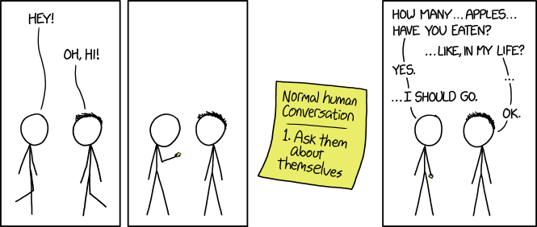
https://imgs.xkcd.com/comics/friendly_questions.png

Slide 2
(Chris Rock video excerpt in original)

Slide 3
Intersectionality, Research-based Education, and Assessment: A Pan-Curricular Threshold Concept
Threshold Concepts Biennial Conference June 2018
Miami University, Ohio
Jason Davies, UCL (University College London)
Notes:
This is the final version of my slides; hopefully rather easier to follow than the draft version posted earlier.

Slide 4
1. Hasty overview, heuristics

Slide 5
1.1 Intersectionality
the recognition that identity and possibility is constituted by dynamic overlapping, interlocking, multiple threads
has a persistent interest in social justice
must be considered in a global and inclusive environment or we are wasting everyone’s time (or worse)
requires far greater self-awareness and suppleness in teaching and learning than has been traditional

Slide 6
1.2 Research-based Education (RBE):
learning through research and enquiry
For instance
Students connect with researchers and with the institution’s research
A throughline of research activity is built into each programme
Students make connections across subjects and out to the world
Students connect academic learning with workplace learning
Students learn to produce outputs – assessments directed at an audience
Students connect with each other across phases and with alumni.
Notes:
these are taken from UCL’s Connected Curriculum strategy but are only intended to be illustrative of an RBE strategy

Slide 7
1.3 Assessment and RBE
RBE implicitly supports assessments that:
  permit a fuller engagement with the outside world than many traditional assessments
  permit more self-defined topics or projects
  permit specifying a particular audience

Slide 8
2.1 Why ‘pan-curricular’/universal as a threshold concept?
General shift in HE towards learner/learning
Less of:
  taking fairly homogenous students
  making them more homogenous graduates for a discipline-framed role that is already understood
  More:
    acknowledging distinctiveness

Slide 9
2.2 ‘Wicked Problems’ and Troublesome Knowledge — what graduates face
1 The problem is not understood until after the formulation of a solution.
2 Wicked problems have no stopping rule
3 Solutions to wicked problems are not right or wrong.
4 Every wicked problem is essentially novel and unique.
5 Every solution to a wicked problem is a ‘one shot operation.’
6 Wicked problems have no given alternative solutions.
Notes:
There are various formulations but they usually share these characteristics

Slide 10
You can’t expect to solve a problem if you have a bunch of people who all went to the same school, think the same way and have been working on the same problem for 15 years
- Dr Jess Wade (via siliconrepublic.com)
Notes:
https://www.siliconrepublic.com/innovation/jess-wade-physics-diversity

Slide 11
3.1 ‘Doing’ intersectionality: why is it so hard to act on?
Homeblindedness: getting far enough away from one’s own unreflected-upon ways of knowing to see them, and remaining critical also of the new perspective (Rortian Irony)
Implications and responses are many
Racism and other prejudices marginalising demarginalisation (eg Tommy Robinson in the UK)

Slide 12
3.2 Group assessment as melting pots
One possibility is to create research-based assessments drawing on teamwork and explicitly making opportunities to draw on each unique perspective and privilege.
  #UCLChemAirPoll
  Engineering ‘scenarios’
  UCL Public International Law Pro Bono Project

Slide 13
3.3 Pitfalls, limitations and possibilities
possible re-enactment of marginalisation in groups
competitiveness can distract
the right space needs to be set up to create opportunities for valuable input to emerge

Slide 14
Activity (time allowing)
If you are comfortable doing so, turn to your neighbour and tell them something that powerfully informs your work and has done for some time
Offer an example of how this gave you a distinctive perspective
  eg being temporarily disabled and what you value now
  growing up poor
  seeing your privilege

Slide 15
Discussion material

Slide 16
Epilogues: the Threshold Concepts ‘checklist’
Transformative
Troublesome
Irreversible
Integrative
Bounded
Discursive
Reconstitutive (shift in learner subjectivity)
Liminal

Slide 17
Epilogues: open-endedness
  You’ll notice that missing from my list is a set of outcomes that we ought to be working towards. This is not because I don’t have an idea of the kinds of changes I want to see in our libraries, but because I think a critical perspective is a matter of heuristics, or developing frames through which we view the work we do. Developing a habit of mind that consistently interrogates what otherwise feels natural means that we can respond nimbly to problems as they emerge in our libraries and in our world. (Drabinski 2018)
Notes:
http://www.emilydrabinski.com/critical-art-librarianship-conference/

Slide 18
Epilogues: Akala and whiteness
a strange thing occurred. I said, “Mum, the white boy… ” and trailed off before I could complete the sentence. A profound realisation hit me. With a hint of terror and accusation, I said, “But you’re white, aren’t you, Mummy?”...From that day, my relationship with my mother was not just that of mother and son, but of a white mother to a black son. Race had intervened and now marked our actions and attitudes, coloured our conversations and heightened the usual conflicts, mapping on to them the loss and suffering of the black world at the hands of “whitey” – and the strange mix of guilt, fear and superiority that a great many white people feel as a result, but rarely talk about.
Notes:
https://www.theguardian.com/lifeandstyle/2018/may/26/akala-grew-up-embarrassed-mother-white

