Slide 1


Learning in nature: primary school children develop through biological experiences which connect the curriculum
Ruth Amos and Prof Michael Reiss
UCL Institute of Education, University College London
ruth.amos@ucl.ac.uk
ERIDOB 2018, University of Zaragoza

Slide 2
Background - Learning in nature
Research into benefits of learning ecology in natural settings typically focused on environmental knowledge, attitudes and behaviours (Stern et al., 2014)
Experience in nature has recently re-focused on impacts on health and well-being (Braun & Dierkes, 2017)
Notes:
Re-focusing on development of the individual - resilience

Slide 3
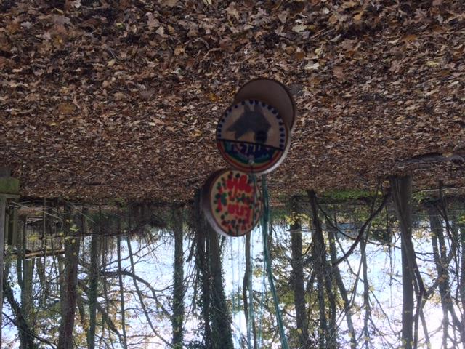
‘There is no Wi-fi in these woods ....
there’s a better connection’

Slide 4
The context: Contemporary pressures in school in England
Primary curriculum: prioritising literacy and numeracy for 4-11 year olds, challenging opportunities for interactive learning in nature
Risk-averse school leaders
Costs

Slide 5
Research project and sample
Qualitative observational visits to 6 Wildlife Trusts UK (TWT) nature events in 2017 (as part of a quantitative-qualitative study)
Field notes and informal interview conversations
172 students (7-11 years old) from 6 primary school
15 teachers, teaching assistants, parents
14 expert field tutors from The Wildlife Trusts
(Some) samples of students’ work back in school
Notes:
There are 47 Wildlife Trusts across the UK, Isle of Man and Alderney looking after 2,300 nature reserves

Slide 6
Research Questions
In designing learning in nature events, what can expert providers in collaboration with teachers, do to support health and well-being alongside core curriculum goals?
2. What do 7-11 year olds do when learning in nature?

Slide 7
The nature events – Type 1 shorter term
Event type | Location | Plant ecology | Animal Ecology | Other impacts
Short – half day | Inner city site – nature reserve reclaimed land London WT | Plant (flower) identification Plants as sources of materials | Invertebrate (mini-beast) hunt | Collaborative partner work and team building
Short – half day | City suburb site – nature reserve reclaimed land Birmingham&BC WT | Forest walk tree identification | Invertebrate (mini-beast) hunt The life of bees Pond dipping and animal identification | Collaborative partner work
Short-medium term – 3 days one day per week | Rural site – forest Suffolk WT | Tree scientists tree study Leaf flags and crowns Seeds and plant life cycles Plant adaptations Uses of plants | Vertebrates Needs in a habitat Identifying animals from bones Food chains Animal tracks Focus on hedgehogs | Den building Wild art Role play Building invertebrate homes – arts and crafts Free play in nature Collaborative partner work

Slide 8
The nature events – Type 2 longer term
Event type | Location | Plant ecology | Animal Ecology | Other impacts
Longer term – 6 week after school club | City suburb site - school playing fields Avon WT | Plant identification Plants as sources of materials | Invertebrate (mini-beast) hunt | Making mini-beast hotels Fire building and cooking outdoors
Longer term – 6 week whole day | Rural site -nature reserve (with public access) Shropshire WT | Plants and rocks as sources of materials and tools |  | Collaborative partner and team building Den building Rock and fossil identification Fire building and cooking outdoors Myth and story telling
Longer term – 6 week Forest School whole day | Rural site – forest nature reserve Herts& Middlesex WT | Tree identification through forest exploration Plants as sources of tools and materials | Invertebrate (mini-beast) hunt Bird identification | Collaborative trust Independence, risk awareness, self confidence Den building Fire building, charcoal making and cooking outdoors, using tools Tree climbing – risk taking with safety Creative and environmental art Poetry writing

Slide 9
Analytical categories
Learning and school work (eg engagement, ecological subject knowledge, other curriculum opportunities, confidence, behaviour, peer/teacher relations)
Subjective well-being whilst in nature (eg excitement, relaxation, peacefulness)
Time spent outdoors, living close to nature, etc
Nature connection (Cheng and Monroe, 2012): personal enjoyment of nature amongst 4th graders

Slide 10
Observing children in natural spaces – what do they do?
instances of learning or applying ecological ideas and skills
instances of affective impacts: engagement; enjoyment; confidence building; fear; worry

Slide 11
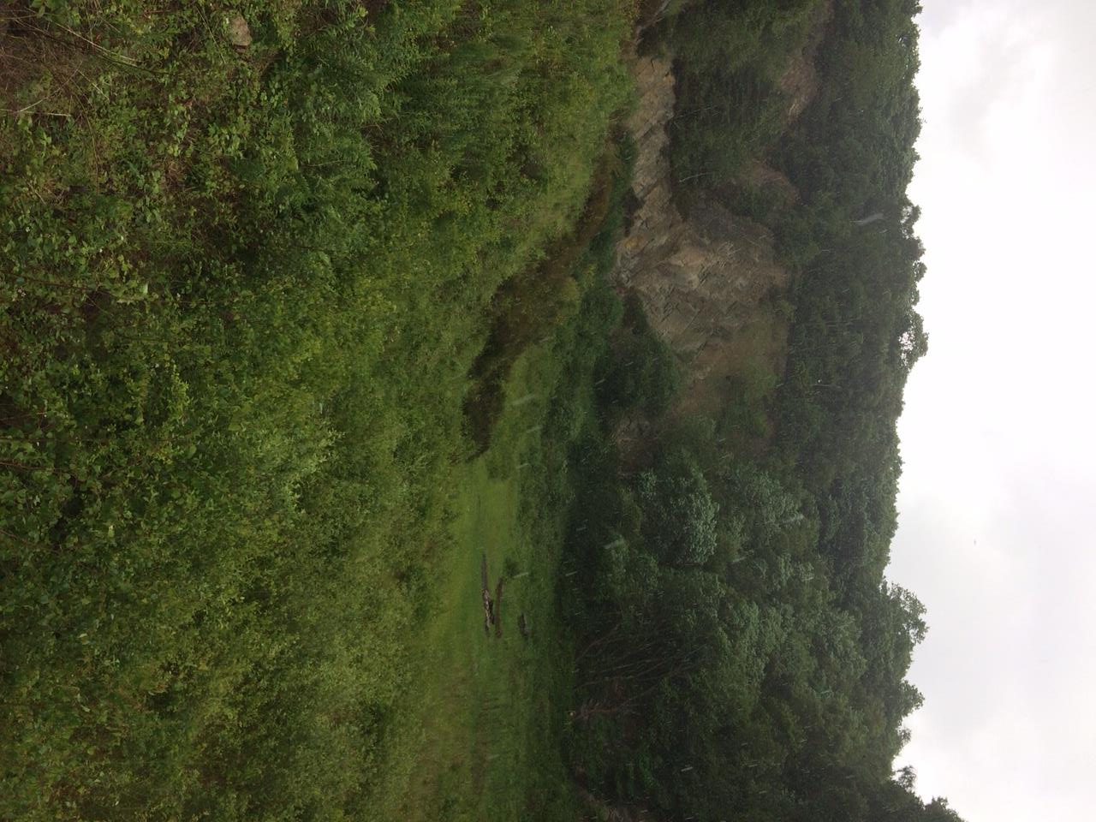
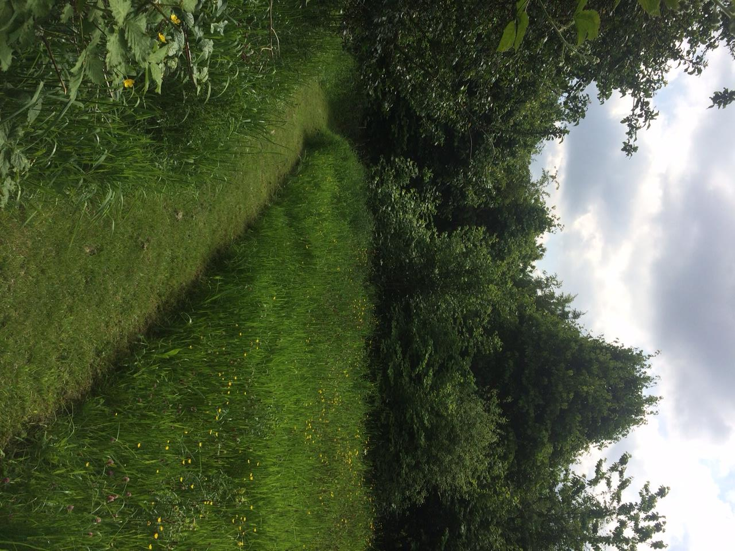

Slide 12
Results and findings (1)
Learning ecology and geology in nature
high frequency of instances of ecology knowledge or application in all field events
high frequency of procedural skills (observation of phenomena) leading into building ideas and application
inquiry and problem-solving challenges promote collaboration and communication

Slide 13
Inquiry learning in nature (Year 5 9-10 year olds)
Tutor challenge: you are hedgehogs in autumn / winter; find food = tokens
Model hedgehog: if you can keep your hedgehog warmer than mine, you will win brown fat tokens and survive the winter!
Collaborative problem-solving
Agree / disagree statements (T/F/NS):
Hedgehogs are mammals
Baby hedgehogs are born with prickles
Bread and milk are good for hedgehogs
Pet dogs can catch hedgehog fleas
One garden is enough space for a hedgehog
Hedgehogs are nocturnal
Hedgehogs run away if disturbed
Engagement and enjoyment visible and audible within different aspects and stages of the inquiry

Slide 14
What do children do / enjoy?
Favourites in Suffolk
we all liked our sticks and stick tag at lunchtime (25)
hedgehog house building (10)
exploring (3)
looking at skulls (1)

Slide 15
Results and findings (2)
Learning biology and connecting the curriculum
- literacy, mapping skills, numeracy, art, technology: ecological contexts support and promote other core skill development

Slide 16
Literacy contextualised through ecology
Tutor: we’re using personification today.
A few of you haven’t done it at school yet.
What does it mean?
L: like a person ...branches, like long
sticky arms - human like
Trees stood straight like a soldier.
Crooked like a witch’s finger- a good one.
Teacher: Or emotions - branches could be
stretched out scarily or as a friendly warning!
Trees don’t have emotions but humans do
so good.
B- look up, it’s waving, dancing ...
B- some look lonely.... stretching like a big hand.
‘I can be big or small
I’m black and white
I have a trunk that looks a bit bobbly brown
What am I?
Answer: a silver birch’
Year 5 (9 year old) student

Slide 17
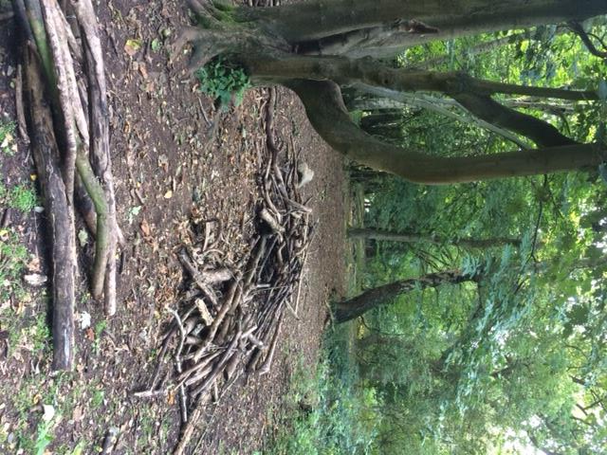
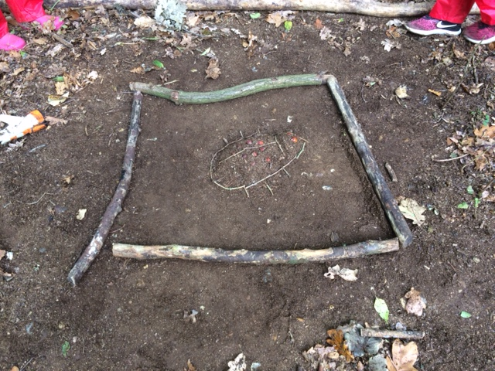
Ecological art and technology

Slide 18
Specific well-being impacts on individuals
My son .. came a couple of years ago ... He’s dyslexic and school isn’t the right place for him. Here he was in his element; the climbing and den building and all the fires ... he loved it. I’m worried about him going to secondary school next year ... the pressures. If he could learn like this he’d be a different child.’ (parent)

Slide 19
Affective: well-being impacts
excitement (→ happiness)
engagement
confidence building
curiosity
free play, roaming, relaxing

Slide 20
Conclusions and implications
Learning in nature happens through expert, well-structured activities which provide opportunities for ‘free’ roaming
More studies looking at measures of attainment, alongside health and well-being (Quibell et al., 2017) ....
.... to provide evidence-based practice supporting teacher beliefs and intentions for cross-curricular learning in nature

Slide 21
References
Braun, T. & Dierkes, P. (2017). Connecting students to nature – how intensity of experience and student age influence the success of outdoor education programs. Environmental Education Research, 23(7), 937-949.
Creswell, J. (2009). Research design: qualitative, quantitative and mixed methods approaches (3rd Ed.). London: SAGE.
Hunt, A., Stewart, D., Burt, J. & Dillon, J. (2016). Monitor of Engagement with the Natural Environment: a pilot to develop an indicator of visits to the natural environment by children - Results from years 1 and 2 (March 2013 to February 2015). Natural England Commissioned Reports, Number NECR208.
O’Brien, E. & Murray, R. (2006). A marvellous opportunity to learn: a participatory evaluation of Forest Schools in England and Wales. Farnham: Forest Research.
Quibell, T., Charlton, J. and Law, J. (2017). Wilderness Schooling: A controlled trial of the impact of an outdoor education programme on attainment in primary school children. British Educational Research Journal, 43(3), 572-587.
Stern, M., Powell, R. & Hill, D. (2014). Environmental education program evaluation in the new millennium: what do we measure and what have we learnt? Environmental Education Research, 20(5), 581-611.

Slide 22
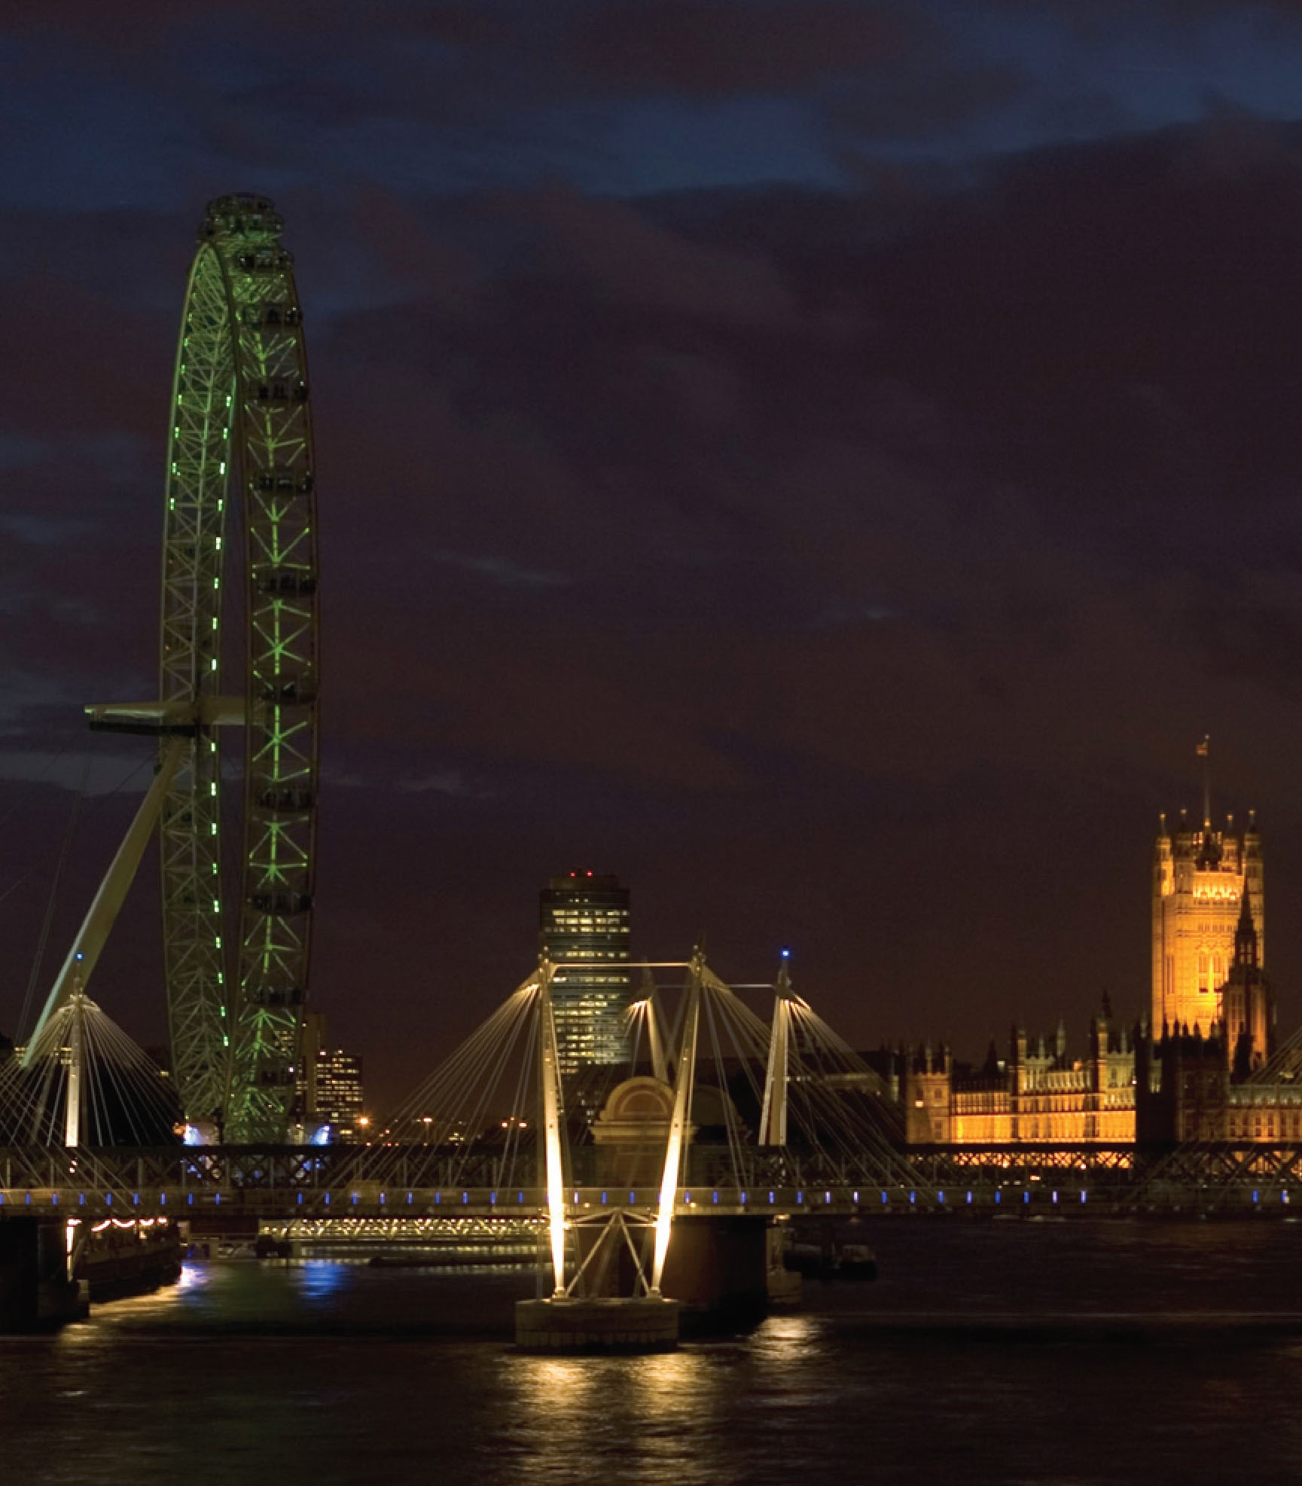
Any questions?
Thank you for
listening
UCL Institute of Education
University College London
20 Bedford Way
London WC1H 0AL
Tel +44 (0)20 7612 6000
Fax +44 (0)20 7612 6126
Email info@ioe.ac.uk
Web www.ucl.ac.uk/ioe

