Slide 1
Polycentric Inspections of Networks of schools.
The English Case Studies (Peer Review Strand)
http://www.schoolinspections.eu/
Dr David Godfrey,
London Centre for Leadership in Learning
UCL Institute of Education

Slide 2
Building blocks of a
self-improving system (Hargreaves, 2012):
Clusters of schools (structure)
The local solutions approach and co-construction (culture)
System leaders (key people)
Notes:
Many of the changes we see today were sparked by four think pieces, written by David Hargreaves for the National College for Teaching and Leadership.
In these think pieces he introduced the notion of a self-improving system which signifies a system of sustainable improvement of schools with a strong focus on bottom-up approaches and locally embedded activities. The conditions of such a system are, according to Hargreaves,
a structure of schools working in clusters and partnerships to promote improvement,
a culture of constructing and implementing local approaches for improvement; addressing topics that are relevant for a specific locality and
Highly qualified people who act as system leaders in creating new knowledge, disseminating knowledge and bringing schools together in partnership work.
Over the last couple of years we have seen many rapid changes to introduce these conditions.

Slide 3
The self-improving system currently:
Formal networks of schools (e.g. Academy Chains, TSAs)
Informal networks of schools (e.g. Challenge Partners, NAHT)
National, local, specialized leaders of education
Notes:
Some of the most prominent building blocks around a self-improving system particularly currently include:
national, local and specialized leaders of education
teaching schools and teaching school alliances, and
academy chains
These new roles and partnerships of schools create a very diverse system education system and many different ways of supporting and structuring school improvement.

Slide 4
Growth in Academies
http://researchbriefings.files.parliament.uk/documents/CBP-7549/CBP-7549.pdf
Notes:
As well as the 5,170 academies open at the start of March a further 413 had been approved
All schools can apply to become academies – independently run state schools
Some 52% of secondary schools and 9% of primary schools are now academies (June 2015). Target for all schools to become academies by 2022*
Primary school Heads resisting/feeling under pressure to Academise
Wanting to collaborate but looking for new insights, new challenges

Slide 5
Multi-Academy Trusts
Notes:
In January 2016 there were 3,490 academies that were part of 936 different MATs. This was 68% of all academies and included just over 2,200 primaries, almost 1,100 secondaries and around 170 non-mainstream schools.10
The MATs with the largest number of member schools are listed in the table opposite. The Academies Enterprise Trust is the largest and includes schools in eight of the nine English regions and 25 different local authorities across the country. It contains more schools than nine English local authorities.
233 schools were formally part of a MAT, but one with only a single ‘member’. In total 748 MATs included fewer than five schools.

Slide 6
https://www.gov.uk/government/uploads/system/uploads/attachment_data/file/544761/Teaching_Schools_Map.pdf
Notes:
In total, there are 765 Teaching Schools (596 alliances) (July 2016)
The Big Six:
school-led initial teacher training,
continuing professional development,
supporting other schools,
identifying and developing leadership potential,
recruiting and managing specialist leaders of education,
research and development

Slide 7
Accountability layers
The Education Funding Agency (EFA – a Department for Education executive agency)
Schools’ inspectorate, Ofsted (focus on single schools)*
Regional Schools Commissioners (DfE appointees who each cover one of eight regions in England)
Multi-Academy Trust internal systems
http://schoolinspections.eu/polycentric/
Notes:
Ensure schools and colleges are given more autonomy but also held to account for the education they provide by:
setting clearer and tougher ‘floor standards’ (minimum requirements) for primary, secondary and further education
New Ofsted inspection framework:
Focus on pupil achievement; quality of teaching; leadership and management; behaviour and safety of pupils; listen to reading
Satisfactory schools – now classified as require improvement
Outstanding schools free of inspection
Significant increase in accessible public information and data on schools
Reforms to performance tables - new measure on average pupil progress at GCSE across 8 subjects (English, Maths, 3 EBacc subjects and 3 others, including vocational subjects) plus measure of percentage of pupils passing GCSE English and Maths to replace existing 5 A*-C GCSE measure
Improve quality of governing bodies by allowing them to recruit governors based on the skills and expertise they can offer

Slide 8

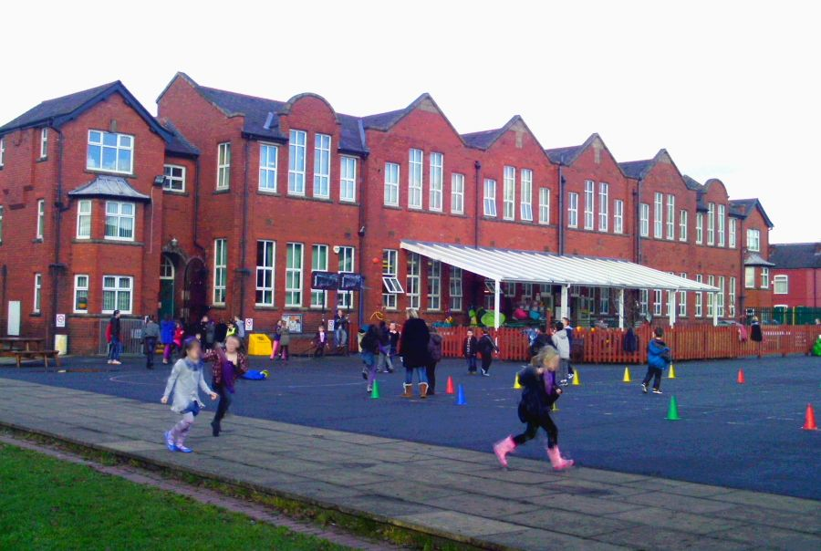



The rise of Peer review

Slide 9
“Our education system has transformed itself from the era when Ofsted was first designed, and the Committee should look at the need for Ofsted to change too. Inspections should not be adversarial; they should be a constructive dialogue between the inspectorate and professionals. 80 per cent on England’s schools are rated good or outstanding, so NAHT believes the time is right to see greater peer-review within the inspection framework. Our own Instead project offers one such model that would help do that; something we hope the Committee will consider in its inquiry”
Russell Hobby, General Secretary NAHT
Education Select Committee, 02/03/2016
“Instead”
Notes:
NAHT is the largest union for senior school leaders. Russell Hobby, the GenSec of NAHT has been vocal about the negative impact of Ofsted:
This arose initially out of the ASPIRE project and Instead (peer review) came later. Dis-satisfaction among Headteachers initially ‘peaked’ in 2012 as OFSTED powers became increasingly high stakes, for example the power to remove leadership if the school achieved 3 consecutive ‘satisfactory’ grades. OFSTED was perceived to be too adversarial and the inspection system was not felt to lead to improvements. Aspire had funding from DfE and this used a model of clustering of schools (emulated in the Instead model but with 3 or 4 schools as opposed to 5-10 in Aspire). Aspire aimed to get schools to ‘good’ within three years.
The peer review model applies particularly well to Primary schools, as inspectors for OFSTED have sometimes been from secondary or FE sectors and this has led to resentment. Also, it was felt that some Headteachers were not always in the best place to self-assess. Thirdly, it was felt that a system of review/inspection that could include school strengths that did not directly impact on attainment was also needed. Therefore there was a period of scoping out alternative models, reading research and discussion with a variety of people, such as Christine Gilbert and Challenge Partners to think of an alternative way to inspect/peer review schools. The resulting discussions with Headteachers has led to a matrix/grid model framework, rather than using or basing the framework on the OFSTED model. Lesley did mention some comments from early pilots of the grid, however, that some Headteachers may want some indication of ‘vulnerability’ to OFSTED inspection, if carried out in this area. This arose from the first pilot in which an experienced OFSTED inspector led a review and pointed out that a ‘good’ outcome on the peer review might be disguising what OFSTED may consider a weakness. Lesley also made the point that the title ‘as well’ might better sum up the intention of their peer review framework but they would stick to ‘instead’.

Slide 10
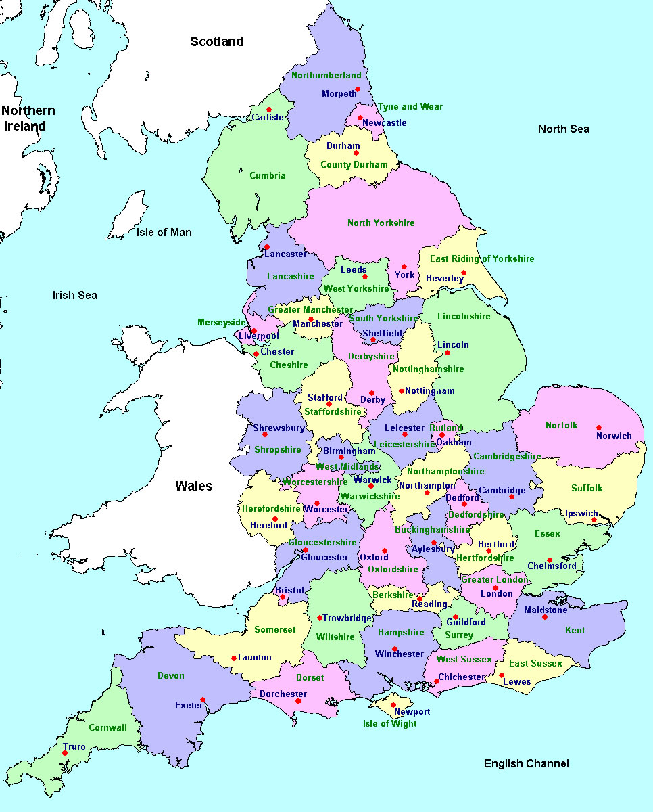
Peer review case study
Headteachers from 3 primary schools
Self-selected cluster
Geographically close (ish) – they have not traditionally worked together
Own framework for self-evaluation (not Ofsted)
Each school is visited and reviewed once (2 days) around agreed focus
Lead Reviewer coordinates and sends out final report (agreed with participants)
Notes:
Schools work In clusters of 3 or 4 and see each other in turn
No grades are given, rather, the framework and report addresses: ‘actions needed and priorities’; what should be prioritised, developed, maximised and sustained?
Lead reviewers join the other members (one from each school in the cluster) for 2 day visits for the review at each school
LRs are taken from outside the cluster and are often involved in their own peer review cluster. There is a pool of 10 LRs. They have been trained by Lesley; there was one recruitment meeting followed by an additional training day of those who decided to take part as LRs. All LRs have some experience of inspection or peer review. The training day frequently leads to direction and discussion on the contrasting aims/processes of this peer review compared to OFSTED inspections
The visits are ‘self-scheduled’
Prior to the visit, the school to be reviewed completes the grid, addressing ‘where they are at’ for each part of the grid, adding evidence and performance data that they send to the LR
The focus of the visit is decided by the recipient school
Most schools come from pre-existing clusters and these range in level of permanency and formality. Some schools were put together into the cluster by Ellie
The school has a right to reply after the reviewers have completed their report and given their findings.
The reviewers can add their evidence in a different colour to the school if their one is in disagreement
Although reviewers do observe lessons, this is to quality assure the observation that a member of the school leadership observes rather than to comment on the lesson directly
Clusters are required send us the review dates and then they are reminded to make a ‘scheduling request’ to Ofsted to avoid their Instead review date.

Slide 11
Informal cluster: Peer Review schools
Peer-reviews cluster schools
Inspections
School’s Internal Evaluation
Network functioning

Slide 12
Key questions:
What was the impact of the peer review network on the participating Headteachers, their schools and on the other local networks that the schools belonged to?
What is the interplay between the peer review, the self-evaluation and school inspections?

Slide 13
Sample: Summary details of schools involved in the peer review cluster case study
School name | Headteacher and date of appointment | Local Authority area | Setting | Number of pupils | Most recent Ofsted grade and date | Date of Instead review visit
Holy Primary | Alice (2008) | Countryshire | Rural | 650 | Good (Oct 2013) | 2nd Feb 2016
Roundtown Primary | Samantha (1999) | Metropol | Urban | 237 | Good (Jan 2014) | 15th March 2016
Greenleigh Primary | Evelyn (2004) | Landshire | Urban | 440 | Good (Jan 2014) | 24th May 2016

Slide 14
Data collection
Variables | Prior to self-evaluation, peer review/inspection | 3-4 months after peer review/ inspection
Current evaluation practices (internal evaluation, peer review, inspections of both single schools and the network) | Interviews with school staff, (internal/peer) reviewers/evaluators (and inspectors). Interview with Lead Reviewer (from outside the cluster) Data and document analyses (e.g. inspection reports, performance data, self-evaluation/peer review reports, school improvement plan, email communications) | Interviews with school staff, (internal/peer) reviewers/evaluators (and inspectors). Interview with Lead Reviewer (from outside the cluster) Data and document analyses (e.g. inspection reports, performance data, self-evaluation/peer review reports, school improvement plan, email communications)
Current improvement practices (school-based, network-oriented)
Relationships and structure of the network
Network-level outcomes (e.g. sharing resources, joint CPD)
Potential dysfunctional effects (transition costs)
Notes:
Research design, timeline, data collection and sample
The research followed a longitudinal case study methodology, looking at peer review practices (see above for research questions); the subject of the case was one peer review cluster consisting of three primary schools and a lead reviewer. We adopted a diachronic approach (Thomas, 2011), looking for longitudinal effects over the period of the 2015/16 school year (September 2015 to July 2016). The effects of the peer review are located within a context of previous Ofsted reports and also historical background given by headteachers and other staff about each of the schools.
Data collection was designed to capture evidence in relation to the wider project variables of:
External context,
Relationships, collaboration, structure of the network, Evaluation practices, Network-level outcomes and Potential dysfunctional effects (see appendix 5).
How these were defined to inform data analysis and report writing in this case study is shown in the section above. In particular, effects at network level were less apparent than in other case studies in the wider project because the Headteachers in our case study wanted to use the review primarily to improve their own individual school rather than to build a sustainable network. Furthermore, the NAHT review clusters were not designed (as a ‘mandatory’ feature) to continue as a network beyond one academic year. Thus, the variable ‘dysfunctional network level effects’ was not evidenced and the ‘network level outcomes’ variable yielded relatively few examples.
Thirteen people were interviewed from the cluster, each one in January of the year before the review visit and then approximately 2 to 3 months after the review. School staff were interviewed in their own school and the lead reviewer was interviewed over the telephone. In the case of Greenleigh Academy, the follow up interviews occurred in November of the following academic year, as their review visit had occurred late in the school year (24/25th May 2016). Of the thirteen interviewees, these included the Head teacher of each of the three primary schools and the lead reviewer for the cluster. We also asked to see other staff significant to each school review, usually other senior leaders or staff with areas that the peer review would particularly focus on. The Head teacher suggested who these should be in each case. The interview schedules are shown in appendices 6-8.
Other data analysed also included the three Instead review reports, records of email communication between members of the cluster and other publically available data such as Ofsted reports and DfE data. We intended to capture evidence about the effect of the peer review in relation to a future inspection but none occurred within the time period of this project.
Interviews would ideally involve the Headteachers, another middle leader and perhaps members of teaching staff. The purpose would be to establish a baseline picture of collaboration within the cluster form the perspective of each interviewee. We’d want to know about the formal networks that each school is a part of; how much and what type and frequency of collaboration already exists between the cluster of schools; changes to school level outcomes, as identified from the review; the relationship of peer review outcomes and Ofsted inspections; changes to ‘network level outcomes’ such as changes to the ways schools work together, sharing of resources.
Data collection to be completed by December 2016/January 2017

Slide 15
Findings: Frequency of occurrence of each node in the thematic analysis
Theme | Sources | Number of References
School context | 20 | 118
External context of network | 15 | 63
Other networks | 16 | 126
Evaluation and inspection practices | 28 | 793
Relationships, collaboration, structure of the network | 25 | 257
Network level outcomes | 20 | 77*
Dysfunctional network level effects | 0 | 0
Notes:
*‘Network level outcomes’ also included anticipated effects of the Instead review on each school’s existing networks.
Analysis: The initial project variables determined the basic themes of analysis (External context, Relationships, collaboration, structure of the network, Evaluation practices, Network-level outcomes and Potential dysfunctional effects). These were used independently by both researchers on the project to code one interview transcript. These were then compared and inconsistencies were addressed to improve reliability of the coding. These variables were then used to code all the data using qualitative data analysis software, NVivo version 11.
In the first stage of coding only the above themes were coded and the researcher made numerous coding notes to inform sub-categories (child nodes). As a result, the theme ‘evaluation and inspection practices’ was further sub-divided into twelve child nodes, some of which had their own child nodes
The analysis followed three steps of describing, comparing and relating, suggested for thematic analysis of qualitative data by Bazeley (2009):
Describing the context, i.e. how people talked about each variable, how many people, and what was not included. Then comparing, i.e. looking for differences and similarities in terms of how the variables were manifested in different people or schools, e.g. about whether the review was seen to be useful or judgemental. Finally relating, i.e., under what conditions a category or theme arose and what circumstances inform it, for instance the extent to which staff other than the Head teacher were involved in review and whether this affected perceptions of how useful the review was.
In order to achieve these three steps, several matrix coding analyses were conducted, for instance comparing the variable ‘evaluation and inspection practices’ by school, by role, by time period (before and after the review). These also aided the write up of the report in terms of separating out the relevant details for each school’s context and motivation for taking part in the review and also outcomes from before, during and after the reviews.
The following variables were examined in this case study, adapted from the wider EU comparative study:
External (network) context
The socio-economic context of the network as a whole, the legislative context and the structure of the national school system and policies that were relevant to the primary schools involved in the case study.
School context
For each school, data were coded for details about the nature and size of the school’s intake, staff turnover, the structure of the leadership team, the socio-economic local context, other specific challenges and the extent of local authority support.
Other networks
Other networks, alliances or partnerships that each school was also involved in, including other peer review arrangements.
Relationships, collaboration, structure of the network
Guided loosely by Provan and Kenis’s (2008), description of characteristics of networks, data were analysed in terms of the structural aspects of the network, i.e. about governance, size and geographical spread; the relational aspects, i.e. levels of trust, formality of relationships and perceptions about hierarchy between the members of the network; and also collaboration, i.e. frequency of communication and types of information sharing. The extent to which these three aspects affected the formation of the network and influenced its functioning were analysed.
Evaluation practices
These were looked at in relation to chronology, i.e. before, during and after the review visits and also sub-divided into classifications about methodology, valuing and judging and user involvement (see below):
Methodology:
The specific practices used in the conduct of the review, before, during and after each school review visit. This included the type of data collected and analysed. Positive and negative aspects of the methodology, such as feelings of enhanced self-esteem or stress of staff were included. This also included aspects of the review visits that were not specifically programmed but became part of the methodology used, such as coaching of host school staff. Specific comparisons to Ofsted inspection practices were noted and categorised here.
Valuing and judging:
This concerned the ways that judgements were arrived at and how these were received and valued by the school personnel. This included the extent to which judgements were made subjectively, in relation to each reviewers’ own value system and experiences of school leadership in their context. Examples of this included the extent to which judgements were arrived at in dialogue between reviewers and host school staff, the extent to which the hosts were learning as well as judging, the extent to which the host school steered the review, inconsistencies in judgements, the extent to which judgements were ‘celebratory’ and the extent to which judgements were made using Ofsted language or experiences of the reviewers or host school.
User involvement:
This looked at which stakeholders were involved in which phase of the evaluation and to what extent. This included the definition of the focus and scope of the review; the involvement of staff in the self-evaluation; the involvement in the review visit itself (such as whether certain staff had been chosen to be interviewed or observed) and the involvement in reaching final judgements and in the final report.
Network-level outcomes
Data were coded for the production of knowledge to solve problems relevant for the entire network and that went beyond the remit of each individual school. Such examples could include: sharing resources, joint CPD, improvement activities, support and joint initial teacher training, although few outcomes were found at the level of the network. Coding for anticipated or actual effects on other existing networks was included.
School-level outcomes
Outcomes at the school level were coded within the ‘relationships, collaboration and structure’ or ‘evaluation practice’ variables, rather than as a specific category. However, these are brought together in this report and include follow-ups to the recommendations of the review and any other outcomes reported before or during the visit or as a result of taking part in the review. These included being better prepared for future inspections, improvements in self-review and leadership preparation.
*Potential dysfunctional effects
Examples of dysfunctional effects at the network level could include: selling improvement packages that are popular and driven by external accountability and easy to offer, shifting dysfunctional teachers across the network, increasing the salary of network managers, making profit and competition between schools. *NB: However, since this network was not an enduring, or local network, no such dysfunctional network effects were found (see table 1, below).

Slide 16
Motivation for taking part in the peer review
concerns about academisation programme;
the withdrawal of support from their local authority;
the desire to be involved in a peer review with a developmental focus (not just for external accountability purposes);
to be ‘Ofsted ready’;
leadership preparation to other staff at the school;
Sharing ideas about coping with policy changes:
  British values; changes to assessment in primary schools; new funding formula for schools

Slide 17
Relationships, collaboration and structure of the network
There was a high level of trust between the heads of the schools and that this had been helped by getting to know each other in the two earlier meetings before the first review.
They shared a similar ‘agenda’ and values.
There was two way discussion and dialogue and recipient schools were able to freely ask advice of the other Heads.
There was no hierarchy, competition or dominance by one single contributor to the review.
There was a lot of mutual respect, particularly recognition for their shared experience. Ross described this as ‘over 50 years’ of shared experience among the Heads.
The review was ultimately driven by the best interests of the children.
Notes:
The validation of each school’s own self-evaluation was seen as a key part of the reason for working together. Heads wanted support, challenge and also some targets for improvement. For Alice at Holy Primary, she was also keen for her peers to help her identify ‘what we are missing’. All wanted a ‘non-judgemental’ process and all valued the fact that they were able to pick their own cluster and their own focus, valuing a shared educational ethos. Although there were some important structural differences between each school; size, rural or urban, ethnicity and funding, they also shared similarities. In terms of having a lot of deprived students and many with EAL, although to varying degrees.
One shared feature between the head teacher’s was that some of their other local networks were seen to lack the qualities they were looking for in peer review relationship.

Slide 18
Evaluation methodology in the reviews
Evaluation practices
Involvement of ‘users’
Valuing and Judging
Comparisons to Ofsted Inspections
Notes:
Below we discuss the evaluation practices during and in the lead up to the reviews themselves. Here, we refer to the conceptual framework and make distinctions between methodology, i.e. the practices used in the reviews and evidence collected, valuing and judging, i.e. the qualitative and subjective heuristics used by reviews and the reactions and perceptions to these judgements and user involvement, i.e. The way that ‘users’ were involved in setting the focus for the review, the timetabling, participation in and ‘ownership’ of the reviews and finally, the production of the report.

Slide 19
Evaluation practices
“Yeah, so there is a very strong pupil voice, but policies?
We hadn’t thought about it before, and we’ve gone back to it and said actually that’s not important for us, we are not going to do it, but at least we thought about it now.”
(Alice, Headteacher, Holy Primary)
Notes:
Methodology for the reviews
Prior to the visit, each Headteacher sent out documents for the team to review, along with their own self-evaluation. These included: current school development plans; the latest Ofsted inspection report; the latest school self-evaluation; RaiseOnline data and Ofsted ‘Dashboard’ data. During the visits the reviewers looked at: Pupils’ work; conducted lesson observations or ‘learning walks’ (briefer walk-throughs to look at a larger number of lessons); interviews with identified school leader, teachers, teaching assistants, other staff, governors, parents, pupils (sometimes the school council) and looked at the school environment (e.g. wall displays) and in one case, attended a school assembly. In this sense, the evidence gathered was very much in line with what might be expected in an external inspection.
The reports were quite short, at around 800-900 words in total (see appendices 1-3 for full reports for each school). The last page then gave short bullet-pointed recommendations to the school in terms of what it should prioritise, develop, maximise and sustain. There was also a section for a school response and negotiations about the content of the report (especially in one case –several emails exchanged.

Slide 20
User involvement
“the real value [of the peer review] was the lead up to it, and the discussion, the analysis, beforehand.”
(Evelyn, Greenleigh Primary).
Notes:
Involvement of ‘users’ in the review
In general, the focus of each visit was strongly influenced by the Headteacher,
At Holy Primary School, Alice asked each of the senior leaders to complete the self-evaluation matrix and then the team came together to try to reach consensus and decide on what the focus of the review should be.
At Greenleigh Primary they conducted the self-review initially among senior leaders, and then in an INSET day, asked departments to conduct and submit their responses anonymously, giving them a sense of where there were discrepancies.
The aspects of the Instead self-evaluation grid led to some thinking on areas that were not previously covered in the schools’ self-evaluations, such as those on ‘whole school community’ and ‘the quality of school vision’. Therefore, the process of discussion was seen as useful in raising awareness as much as it was about deciding the focus of the review,
“the real value [of the Instead review] was the lead up to it, and the discussion, the analysis, beforehand.” (Evelyn, Greenleigh Primary).
In most cases, only SLT were interviewed, however in Greenleigh Primary, parents and the community liaison person and some adult learners were also talked to. Middle leaders (Maths and Literacy coordinators) were also interviewed about their roles. In the case of Roundtown Primary School, Ross felt that Samantha, the Headteacher was less involved than in the other two schools, and that this may have been because she knew she was retiring and therefore felt that the practice of being interviewed about the school was useful preparation for other staff more than for her.
In both Holy Primary and Greenleigh Primary, the final report recorded that many staff were stressed about the visit. In the case of Holy Primary school it was felt that this may have been due to lack of prior sharing of the purpose of the visit.
Ross, the lead reviewer, did caution that there was a danger in this process that the Instead review could be too confined to a ‘discussion between four Heads’ unless these aspects had been properly considered during and prior to the review.

Slide 21
Valuing and Judging
“early years provision looked different to theirs, and we know early years is an area we’ve been working on, but you can’t keep saying oh at my school we’ve got this. You can’t do that, you’ve got to look objectively and not compare it to your own school”.
(Mariana, Assistant Headteacher, Holy Primary)
“it was a very good confirmation that we know our school.”
(Adrian, Holy Primary)
Notes:
Valuing and judging in the review visits
The matrix had a sliding scale of levels (prioritise, develop, maximise, sustain) unlike the discrete categories (grading judgements) that are seen in an Ofsted inspection framework. The fact that an area of the school may not be at the ‘top’ of the scale, did not mean that the school itself would deem this to be an area to prioritise or focus on for the review:
“Yeah, so there is a very strong pupil voice, but policies? No. And we sat and we kept going back to it, didn’t we, and in the end we decided actually it’s gonna [sic] have to stay on the left hand side of the paper because we decided that’s not important for us. But we have considered it. We hadn’t thought about it before, and we’ve gone back to it and said actually that’s not important for us, we are not going to do it, but at least we thought about it now.” (Alice, Headteacher, Holy Primary)
The interviews from the participating schools felt that during the Instead review it was particularly important that reviewers were ‘non-judgemental’, and this was reinforced by the absence of reference to Ofsted-indicators, for instance in judging class observations. Comments from one interviewee also suggested that the reviewers were more focused on observing and gaining evidence about the children than they were about judging the performance of the staff. A further aspect to this was that there was a dialogue between the school senior leaders and the visiting reviewers about the judgements that were reached as they went through the day, in the final meeting on day two, and in the formulation of the final report.
The reviewer’s assessments were seen as a useful audit of where each school was at according to each category of the review. Many of the interviewees commented that the school sought validation of its self-evaluation (both the Instead one and the standard school one) and this included endorsing the good points of the school, enabling these to be ‘celebrated’. In fact, Samantha at Roundtown Primary noted how, the way that each school was able to steer the focus of the review made this possible, and regretted not having done this to the extent that the other two schools had:
“So in the other two schools they asked us to go out in the playground before school, and after schools, and at breaks, whereas I hadn’t asked for that because for us that’s not an issue, it works really well and anybody coming in can see that, but afterwards I thought maybe I should’ve, because again it’s about the process. I haven’t given ours the opportunity to showcase that, I went straight in with what we needed to develop.” (Samantha, Roundtown Primary)
In addition to the validation of the self-evaluation, the reviewers were able to give valued feedback on the school development plans, verifying whether they felt these were sensible in the light of what they had seen over the two days and in the documents that had been previously viewed.
Some of the more subjective and non-judgemental aspects of the peer review were also seen as weaknesses or criticisms. These comments were particularly evident at Holy Primary school, where they had experienced an alternative peer review in their local cluster a few days later, which they felt had more impact. The Instead review was criticised as lacking reference to sufficient detail or in clarity about what the school should do in response to its areas for development:
“Accurate is probably the wrong word, I just felt the whole process to be quite woolly, probably how I’d describe it. It just needed a bit more clarity and more, to be more focussed, that’s how, that’s my feeling after it. I’m not sure what I was left with, I’m not sure what I gained, but I went through a process. I was hoping for more of a this is where you’re at, and these are your development points, these are the areas that you, so that you can actually then build upon that, action plans etc, and if I compare that with the Triad [their local peer review cluster] we’ve just had that’s what I’ve come out with, very clear, structured, development points.” (Charlotte, Holy Primary)
Some of the senior leaders at Holy Primary and the Headteacher at Roundtown Primary criticised the visiting Heads for making references to their own school. These comparisons were not always valued, as they were either seen to ignore differences in the context of the host school or to be based on personal opinion:
Overall, there was a sense that the review ‘merely’ confirmed what the school already knew. While reassuring, and valued to some extent, some of the interviewees felt that they were hoping for some additional insights into aspects they had not already considered.
There was also a sense from some that they had not been sufficiently challenged during interviews by the visiting Heads and that, while the process had been pleasant and informal, this may have hindered its usefulness.

Slide 22
Comparisons to Ofsted Inspections
“You have to be so targeted with Ofsted, make sure that they are seeing what you want them to see.”
(Alice, Headteacher, Holy Primary)
“if I was an Ofsted inspector the school would be at least good with outstanding features, and you are so far from outstanding, and these are the things you would need to do. So they [the reviewers] were talking in those terms.”
(Shaun at Greenleigh Primary)
Notes:
How the review compared to an Ofsted Inspection
The experience of the peer reviews was different to an inspection in several ways. Headteachers and other staff involved in the reviews mentioned the value of gaining feedback from respected and experienced headteachers. They were seen to provide ‘an additional set of eyes’, give a fresh and external perspective on what they saw, to spot inconsistencies in policy implementation and to triangulate the evidence on which the school had made its own self-evaluation.
The ability of the host school to shape the timetable, the questions that reviewers should ask staff at the school and the data they wished the team to collect on the day, was also a significant difference with an externally-led inspection.
Overall, there as an emphasis on ‘improving’ the school rather ‘proving’ (a particular self-evaluated grade) to Ofsted:
“Oh they [Ofsted inspectors] might ask to see it [the Instead report], yeah, but the difference with Ofsted is you know they are going to come in with their key priorities, and that is what you hit them with, you know. If you’re on a really good, and you are pushing for outstanding, then it’s more use then to show oh look at this, look at this, look at this. But when your data still isn’t strong enough to get you an easy good then you’ll be fighting your corner in very specific areas, a very different process. You have to be so targeted with Ofsted, make sure that they are seeing what you want them to see.” (Alice, Headteacher, Holy Primary)
Despite this orientation towards improvement and openness, some of the staff interviewed lamented the level of rigor in the Instead review, compared to what might be expected if using a model more closely in tune with Ofsted methodology.
In the case of Holy Primary, there was a sense that many staff had built themselves up for a process that would put them on their mettle in the way that an Ofsted inspection team would and when this did not prove to be the case, the review had been as an anti-climactic event:
The Instead report generally did not closely reflect the Ofsted reports; with a few exceptions, such as the marking and feedback recommendation for Roundtown Primary and the comments on attendance for Greenleigh Primary. However, the advice of the review team for Roundtown Primary to focus on attendance contradicted the remark in their last Ofsted report that attendance was good at the school. This was a good example of how more recent changes in their intake had created new challenges.
Despite the differences outlined above, the overall ‘feel’ of the review was in many ways remarked as being like that of an inspection, with similar evidence being collected and reviewed and similar practices of review (interviews, observations) being conducted. It was clear that some of the staff had felt under stress on the day of the review (such as at Holy Primary School) and some of those interviewed, such as Robert, the new member of the SLT at Greenleigh, had felt under pressure when interviewed by the reviewers.
Although the Ofsted categories were different to the developmental ‘scale’, mentioned above in the Instead review, this did not stop reviewers from referring to Ofsted language. Shaun at Greenleigh Primary, confirmed that this crept into judgements that the reviewers were making during their visit to the school:
“Yes, because the languages used of if I was an Ofsted inspector the school would be at least good with outstanding features, and you are so far from outstanding, and these are the things you would need to do. So they were talking in those terms.”
The experience and training of the Headteachers with Ofsted methodology also influenced other aspects of the review, for instance, Samantha had read that Ofsted would no longer conduct lengthy lesson observations and therefore wanted the focus of the peer reviewers to be on ‘learning walks’. Neither did she want reviewers to visit the school assemblies, as she felt inspectors would not have time in the new framework to do this.

Slide 23
Impact of the peer review at school level
Excellent leadership preparation for middle and senior leaders as well as Headteachers
Changes to the structure of leadership teams
Further training towards qualifications for senior leaders and mentoring for others
Changes to a marking and assessment systems/policies
Improving monitoring of the impact of strategies for pupil premium students
Improving the use of data systems by all staff
Evidencing how the curriculum differentiates for learners at each end of the achievement scale
Notes:
However, it was difficult to say how much the peer review had motivated these changes, and how much they merely validated the school’s current plans. The peer review appeared to provide additional ‘triangulation’ of the strategy. Other data was likely to be very influential in shaping school improvement plans too. It is unclear how much the peer review was likely to have a longer term impact on the school or whether it would lead to (or contribute to) an improved Ofsted Inspection grade.
In terms of the benefits of the peer review these included the challenge and support it provided to other staff, senior and middle leaders and the governors. A major part of this was that they were likely to be better prepared for a future inspection.
The benefits and learning from the peer review extended also to the Lead Reviewer and his school.

Slide 24
The interplay between peer review, self-evaluation and Ofsted
“if you get four headteachers together I don’t think it’s long before Ofsted gets mentioned.”
(Shaun, Deputy Headteacher, Holy Primary School).
Notes:
The most significant way that Ofsted inspections affected the Instead review, was in the way that the latter was seen as preparatory for the former. Overall, the peer review was hoped to provide reassurance, challenge or validation about the school’s self-evaluation and improvement plans.
As already mentioned above, the review was also seen as valuable leadership preparation. Foremost to this preparation was practice in explaining leaders’ areas of responsibility to an outsider and practice in withstanding such interrogation under pressure. Although such things would not be unique to Ofsted, they were seen as the pinnacle of such a test.
Among the interviewees, some reflected on the way that they viewed Ofsted inspections, and these varied from person to person. Fear of future Ofsted inspections provided a backdrop to the Instead review
Nevertheless, there was an acceptance by most of the participants that Inspections had their (important) place in the education system, and that being prepared for them was a key skill for a school leader.
Indeed, two of the Heads were Ofsted trained, and one went to work for Ofsted full time as an HMI at the end of the academic year, the latter reflecting the inspectorate’s drive since 2014 to recruit more experienced senior leaders with recent practice experience.
Headteachers were uncertain about the timing of the next inspection but it was felt to be a good time to conduct a peer review. Terms such as ‘a dry run’, or ‘middle-man’ were used to describe the relationship of the Instead review to the next Ofsted inspection.
In the longer term, a few staff expressed the hope that future inspection grades might improve as a result of the learning from the Instead review
The process of Instead was also dovetailed with anticipated Ofsted priorities. One example of this was at Holy Primary school, where Alice asked the visiting Heads to interview the governors about the school vision aspect of the NAHT review. She felt that this would serve the purpose of raising their awareness about their accountability responsibilities for their areas in ways that Ofsted could question them.
One view was that the evidence gained and judgements arrived at from the review could be used as potential leverage if an Ofsted inspector wished to question particular aspects of the school covered by the review:
“So I think if they [Ofsted] said we think this is a weakness, I could say hang on a minute, I’ve had three headteachers who didn’t know the school, reviewed us, and took more time over it than you did, and they reckon we are here, so it’s a conversation. I can imagine whipping that out and saying this is other evidence that you’ve not taken into account.” (Shaun, Deputy Headteacher, Holy Primary School).
However, Ross saw the use of the Instead review for the purposes of contradicting or challenging Ofsted as contrary to the aims of their peer review:
“there’d recently been, before we first met, there had been, not issues, but some concerns from NAHT about people publishing quotes on websites etc., and they didn’t feel that was the purpose of it, it wasn’t to sort of either back up or counter an Ofsted judgement, it was for the school very much to see, you know, for use in its own development”. (Ross, Lead Reviewer)
One aspect that remains unclear, is the extent to which the Instead review could influence the conduct of Ofsted inspectors. None of the schools (apart from the Lead reviewer’s school) have subsequently been inspected, so we cannot say if inspectors are interested in the findings of the review reports for instance. What we can say is that the influence of Ofsted on the Instead reviews was significant.

Slide 25

Ofsted
Ofsted
School Improvement?

Slide 26
From Proving | To Improving
Standardised self-evaluation frameworks | Shared themes with own emphasis
Focus on Head teachers | Involving other teachers/middle leaders
Ofsted goals | Own goals
Subjective/anecdotal comparisons | Reference to research evidence
Focus on own school | Joint practice development

Slide 27
Research informed peer review
https://www.ucl.ac.uk/ioe/news-events/news-pub/dll-news/ioe-pilots-new-model-peer-review

Slide 28
Thank you!
David.Godfrey@ucl.ac.uk

