Slide 1
What drives women’s agency with respect to seeking healthcare for themselves and their children? Evidence from India
Neha Batura, Glyn Alcock, Ujwala Bapat, Sushmita Das, David Orsin, Shanti Pantaidya, and Neena Shah More
iHEA World Congress
12-15 July, 2015
Milan

Slide 2
Outline
Motivation for the study
Study objective
Study setting
Data
Methods
Results
Discussion
Concluding remarks

Slide 3
Motivation for the study
India has higher growth rates than neighbours and emerging economies
Economic growth increased from 3.8 to 10.03% between 2000-2010.
Improvement in health outcomes
IMR fell by 28% and MMR by 43% between 2000-2010.
Significantly poorer progress than other emerging economies
Reasons for slow improvement in health outcomes
Health care demand vs supply
Quality of care
Barriers at household and individual levels
Low status of women in South Asia (Ramalingaswami et al, 1996; Smith and Haddad, 2000; Smith et al, 2002; Shroff et al, 2007).
Notes:
Pakistan, Bangladesh and Brazil had lower growth rates but China was also 10%. IMR: Bangladesh, China and Brazil are lower than India, Pakistan marginally higher. MMR: Bangladesh, Brazil, China and Pakistan, lower

Slide 4
Women’s status
Negatively affects maternal physical and mental health
Adverse impact on child survival and morbidity
Less healthy adults
Fewer resources for health outcomes and well-being
Potentially less productive adults
Notes:
We explore health agency specifically because a lot of work has already gone into investigating factors explored with general agency. And to improve MNC indicators, we need to understand how women act as agents of change when it comes to health – this may be different from other areas.

Slide 5
Study objective
Explore the factors associated with women’s status in seeking health care for themselves and their children.
Notes:
Measure women’s status using agency
Primary data collected from a sub sample of women in Mumbai slums in India.

Slide 6
Study setting: Mumbai, India - 1
Population >16 million; over 50% live in urban slums
High rates of neonatal and maternal morbidity and neonatal mortality rates.
Large cRCT targeted at women of child bearing age and children
Population = 283,000; 48 clusters with 1200 households each
Tested effects of a participatory intervention using action research cycles on
Care practices and healthcare seeking behaviour of women;
Neonatal and maternal morbidity; and
Neonatal mortality

Slide 7
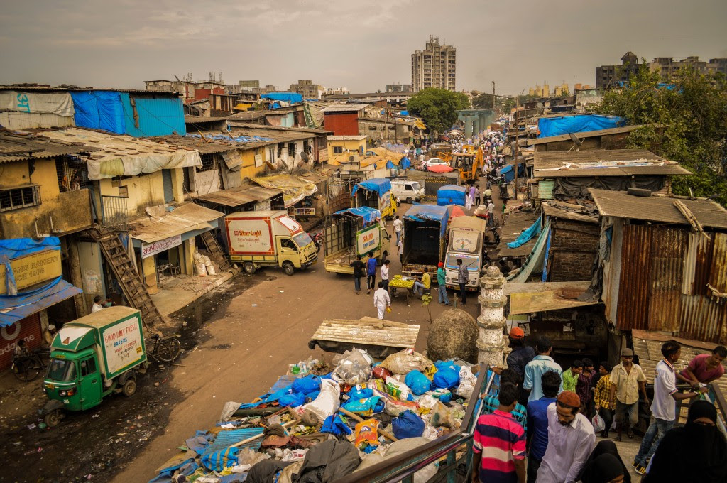
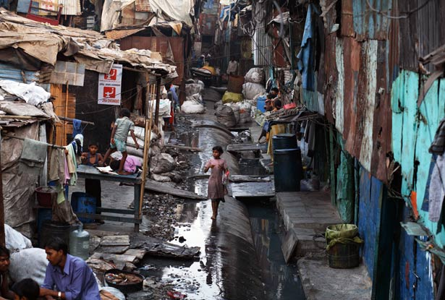
Study setting: Mumbai, India - 2

Slide 8
Study setting: Mumbai, India - 3
Homes of insubstantial materials - 26%
corrugated iron, tarpaulin, plastic sheets
No electricity connection – 28%
No access to piped water – 21%
individual or community
No toilet facilities – 94%
Hazards – 35%
railway lines, garbage dumps, polluted water bodies

Slide 9
Data
Data collected by routine trial surveillance.
Sub sample of women were administered agency survey.
Questions on decision-making (National Family Health Survey)
18 specific questions on decision making with respect to seeking health care
ANC, rest during pregnancy, place of delivery, feeding practices
Complete records for 2064 women

Slide 10
Methods
Two indices using principal component analysis (PCA):
Agency
Agency in seeking health care (health agency)
Descriptive stats
OLS regression model
Dependent variable: health agency PCA index
Independent variables: age, religion, education level, age at marriage, age at first pregnancy, household size, household wealth, employment, group membership, living in intervention clusters
Controlled for overall level of agency
Adjusted for clustering for cluster level unobserved variables

Slide 11
Summary statistics
Variable | Mean | Standard deviation
Age (years) | 24.5 | 4.15
Age at marriage (years) | 19.04 | 3.05
Age at first pregnancy (years) | 20.54 | 3.06
Household size | 6.5 | 4.7
Asset score | 0.15 | 0.97
Variable | Proportion | Standard deviation
No schooling | 20.8% | 0.4
Completed primary ed | 5.27% | 0.22
Completed secondary ed | 63% | 0.48
Completed tertiary ed | 10.92% | 0.31
Hindu | 47.5% | 0.5
Muslim | 46.04% | 0.5
Buddhist | 4.83% | 0.21
Other religion | 1.6% | 0.13
Engaged in paid employment | 13.18% | 0.34
Group membership | 0.29% | 0.05

Slide 12
Women’s agency- overview
Variable | Percentage
Engaged in paid work in the last 12 months | 13.6%
Whether the woman made decisions about (alone or jointly with her husband):
Working outside the home/ type of work | 68.7%
What her money should be spent on | 73.4%
What her husband’s money should be spent on | 66%
Whether she should save and where | 69.4%
Children’s education | 72.7%
Visiting family and relatives | 67.7%
When she goes for ANC | 67.2%
Notes:
Majority of paid work was in the unorganised sector, like domestic work, home made handicrafts etc. This is Dharavai, leather capital.

Slide 13
Women’s health agency – overview
Variable | Percentage
Whether the woman made decisions about (alone or jointly with her husband)
ANC in the first 3 months of pregnancy | 68.9%
More rest during pregnancy than before | 75.8%
Eat more food during pregnancy than before | 79.4%
Place of delivery | 65.6%
Give the baby colostrum | 75.1%
Place of care seeking when she was ill | 70.1%
Place of care seeking when the baby was ill | 70.4%
Feeding baby items other than breast milk | 70.3%
Immunizing the baby | 74.2%

Slide 14
Regression results
Variable | Co-efficient | SE
Age (years) | 0.148*** | 0.015
Age at marriage (years) | -0.018 | 0.028
Age at first pregnancy (years) | 0.077*** | 0.03
Primary education | 0.348 | 0.256
Secondary education | 0.401*** | 0.144
Tertiary education | 0.658*** | 0.216
Muslim | 0.274* | 0.148
Buddhist | -0.157 | 0.29
Other religion | 0.946** | 0.425
Number of household members | -0.051*** | 0.011
Paid work in the last 12 months | 0.590*** | 0.16
Asset index | -0.202*** | 0.067
Group membership | 2.042** | 0.97
Agency (general) | 0.097*** | 0.025
Lives in the intervention area | 2.915*** | 0.759
Notes:
Corr between agency and hagency is positive but very low =0.095

Slide 15
Discussion - 1
Agency positively and significantly associated with:
age
age at first pregnancy
higher levels of education
living in an intervention area
Positively and significantly associated with group membership, paid employment
Contribution to household income associated with higher health agency
Larger social networks, benefit of peer learning and support from non-family members associated with higher health agency
Notes:
Group membership- larger social networks than others. So these women have the benefit of peer learning and support from people other than extended families. This may give them more agency. Fits with theory, even if it doesn’t prove it.

Slide 16
Discussion - 2
Agency negatively and significantly associated with:
Large households
Sharing resource pool amongst several people
Many stakeholders in decision-making
Proxy for religious and cultural norms: stronger inter personal relationships could be limiting.
Household wealth
More established and more traditional: strong interpersonal relationships at play that may limit health agency
Notes:
Conversely, in a nuclear family, women might have more agency because there is no one else to make decisions.
Precarious husbands – oscillating employment status, poor health, alcoholism, women in those households might have more health agency.

Slide 17
Concluding remarks
Several programmes (Grameen Bank and SEWA) aim to improve women’s healthcare seeking behaviour through health education.
Need to understand facilitators and barriers to women’s agency and engagement with these programmes.
Our study fills this gap by identifying age, household size, wealth and employment status and group membership as factors that affect women’s health agency.
Design programmes and interventions that focus on:
Younger women
Target entire families, especially important in large households
Encourage external social networks for support
Notes:
Programmes such as the grameen bank and self employment agency (india)

