Slide 1
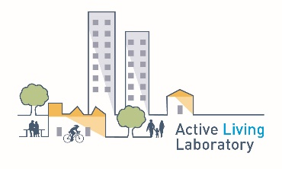






Policy Recommendations for Encouraging Public Bus Use to School in Dunedin, New Zealand
Prof. Jennifer Mindell
j.mindell@ucl.ac.uk @j_mindell
School of Geography
William Evans Fund
We thank our funders:

Slide 2
Co-authors
Logan Copland, MSc student, University of Otago
Christina Ergler, University of Otago
Debbie Hopkins, University of Oxford
Sandra Mandic, University of Otago

Slide 3

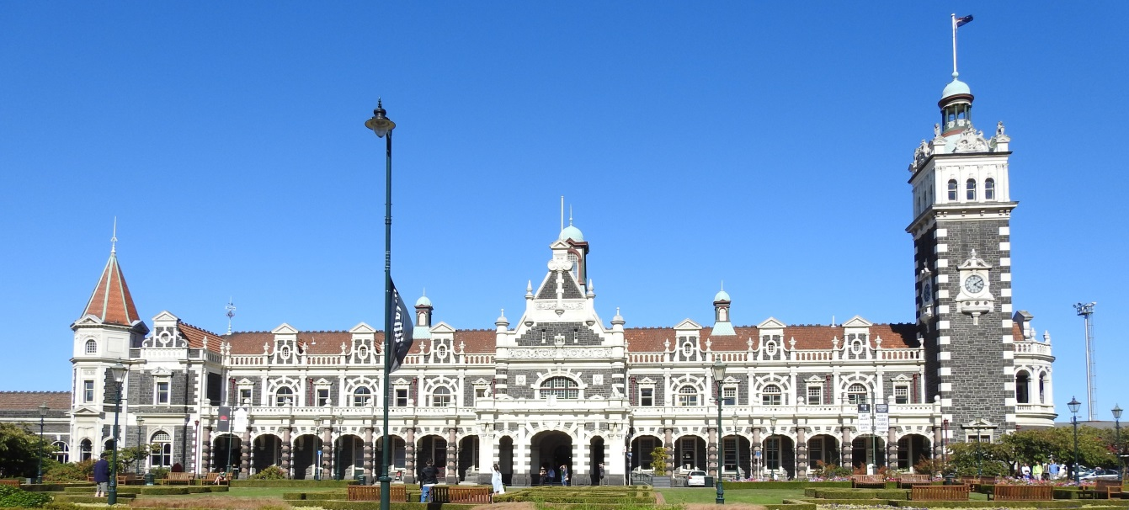
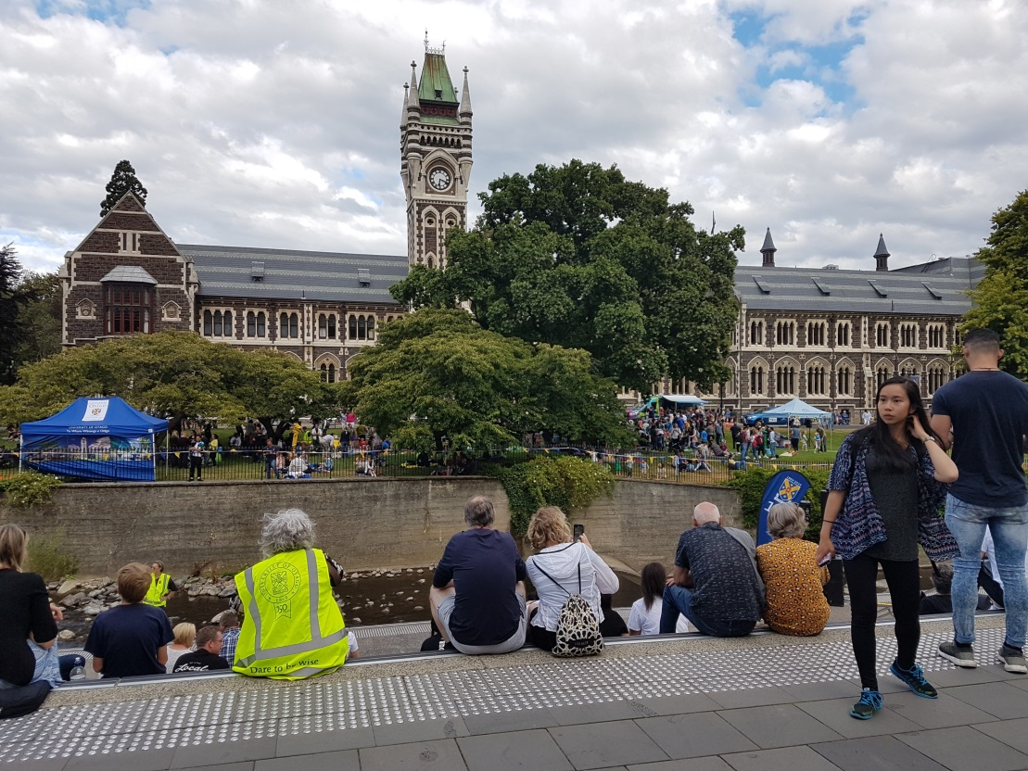
Dunedin

Slide 4
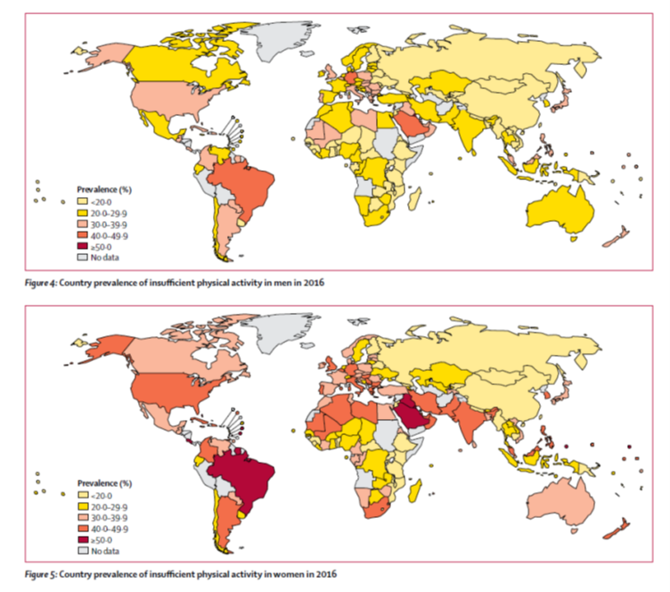
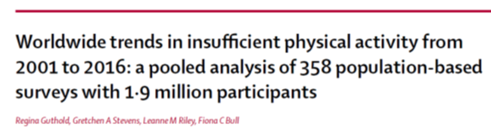
In New Zealand in 2017/18:
14th highest in the world for inactivity

Slide 5
In New Zealand in 2017/18:
14th highest in the world for inactivity
94,000 children aged 2-14y were obese (12%)

Slide 6
Weight Status in Dunedin Adolescents
Source: BEATS Study (2014/2015)
1,300 Dunedin adolescents (measured heights and weights)
Mandic et al. Am J Health Behav. 2017;41(3):266-275

Slide 7
Background
Adolescents’ obesity rates are increasing while physical activity levels are falling in most high income countries.
Transport to school can contribute significantly to adolescents’ physical activity but in New Zealand many adolescents are driven to school.
Public transport journeys usually involve some active transport and could increase adolescents’ physical activity when active transport for the whole journey is not feasible.

Slide 8
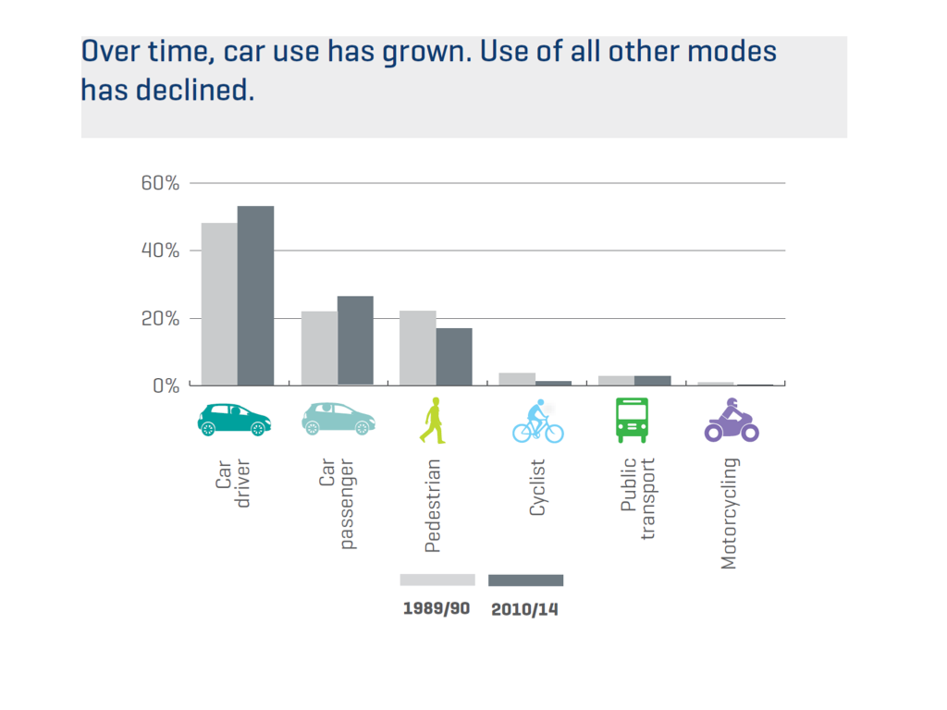
Public transport use is very low

Slide 9
Background
Public transport: 1% of all trips 2012-2014
This study examined environmental, policy and personal factors as well as perceptions of barriers and enablers of public transport to school among Dunedin adolescents.

Slide 10
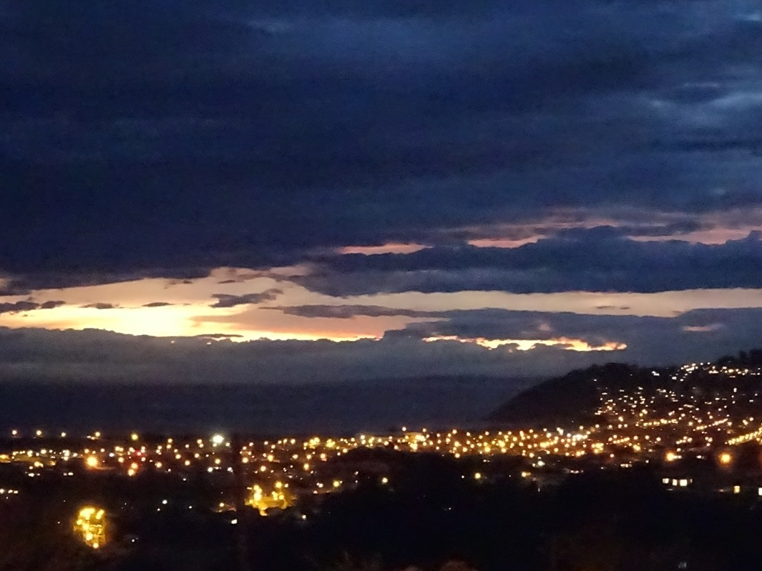
Setting
12 secondary schools in Dunedin, the second largest city in South Island, New Zealand.
Dunedin (population 130,000) is sprawling and hilly.

Slide 11
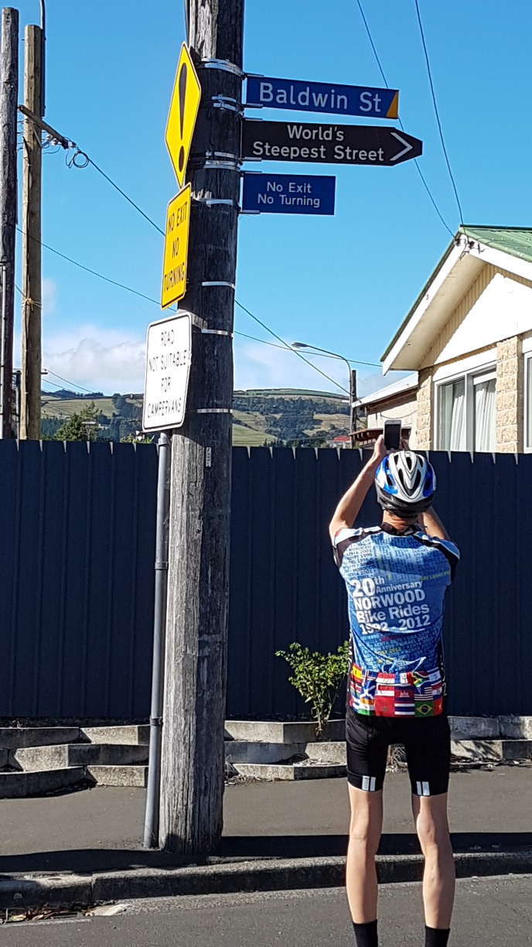
Dunedin: The topography

Slide 12
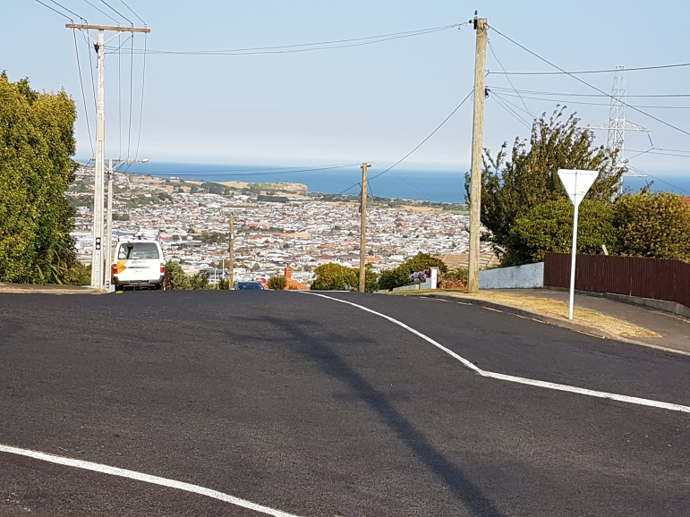
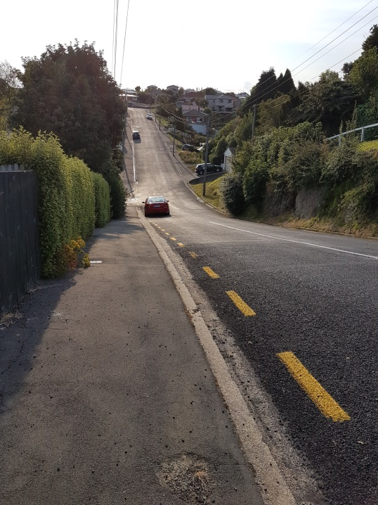
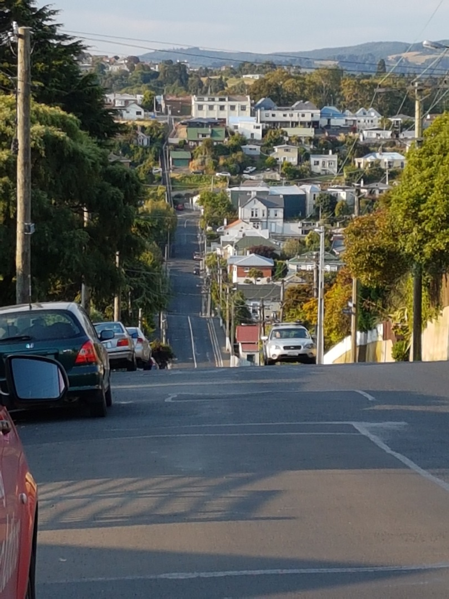
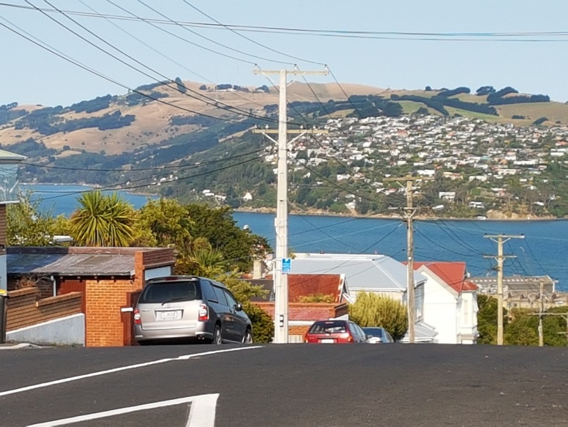
Dunedin is very hilly, except the CBD

Slide 13
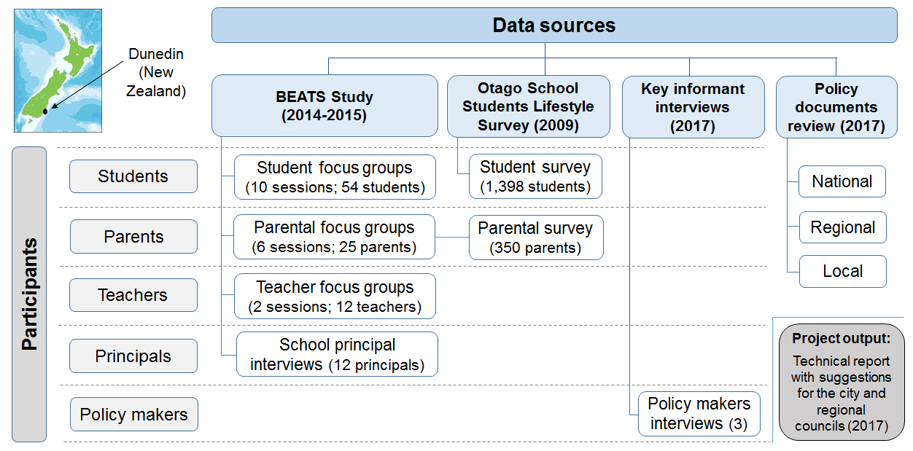
Methods

Slide 14
A mixed-method approach used:
  the 2009 public bus survey from Otago School Students Lifestyle Survey (1398 adolescents);
  Built Environment and Active Transport to School (BEATS) Study in 2014:
    parental survey (350 parents),
    focus groups (54 adolescents, 25 parents, 12 teachers), and
    semi-structured interviews (12 principals);
  a policy analysis of 10 relevant local/regional/national transport plans and strategies in 2017; and
  interviews with three key informants from local/regional/national agencies in 2017 (int schedules informed by policy analysis).

Slide 15
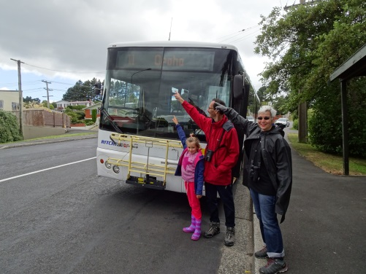
Results
Distance to school, cost, parental trip chaining, built environment features and the weather represent major barriers to Dunedin adolescents using public transport to school.
  Convenience and safety were also major factors.
Current transport planning documents do not favour public health.
Enticing adolescents to use public transport for school travel is challenging in a car-dominated society.

Slide 16
Results
However, stakeholders noted a slow but positive change, with new investment in buses and technology to increase the user-friendliness of public transport and address some of the barriers mentioned by students, parents and school principals. Alternative ways of funding public transport were also explored.

Slide 17
Public bus use (in 2009)
61% of Dunedin secondary school students used public buses
The most common destinations were school (22%); shops in the town/city centre (29%); other shops (16%); and recreational facilities (11%).

Slide 18
Among public bus users:
Use to travel to school:
15% daily,
22% nearly every day,
15% once to twice per week, and
48% never or hardly ever.
<7% of public bus users daily or nearly daily use to all other locations.

Slide 19
Barriers to public bus use in Dunedin reported by parents of secondary school students
 | Parents of :
 | All | Adolescents travelling to school by bus (n=32) | Adolescents not travelling to school by bus (n=318) | p-value
 | Agree (%) | Agree (%) | Agree (%)
My child has other activities before or after school | 65% | 59% | 66% | 0.450
I am already taking the car out, so it is more convenient to drive my child | 59% | 25% | 62% | <0.001
The bus is too expensive | 45% | 50% | 45% | 0.562
The bus trip takes too long | 28% | 19% | 29% | 0.235
The buses do not have bike racks for use free of charge | 26% | 25% | 27% | 0.855
We live too close to school | 19% | 0% | 22% | 0.004
The bus stop is too far from home | 15% | 3% | 17% | 0.043
I am concerned that my child could be bullied on the bus | 7% | 3% | 8% | 0.355
I believe it is unsafe for my child to walk to the bus stop | 8% | 3% | 9% | 0.265
I believe it is unsafe for my child to wait at the bus stop | 6% | 0% | 7% | 0.124
Source: BEATS Parental Survey 2014-2017

Slide 20
Analysis of qualitative data from focus groups, principal interviews and surveys
Theme | Node (no. of references)
Climate and weather | Climate and weather (47)
Mode of transport | Travel habits (72)
Perceptions, knowledge and experiences | Environmental (Planetary health) (2)
 | Built environment (24)
 | Costs (59)
 | Unawareness of bus services and handling of buses (16)
 | Reliability and service offered (88)
 | Negative experiences and perceptions of using the bus (152)
School travel responsibilities | (Dis)advantages of school bus services (16)
 | School transport policies (28)
 | School choice (22)

Slide 21
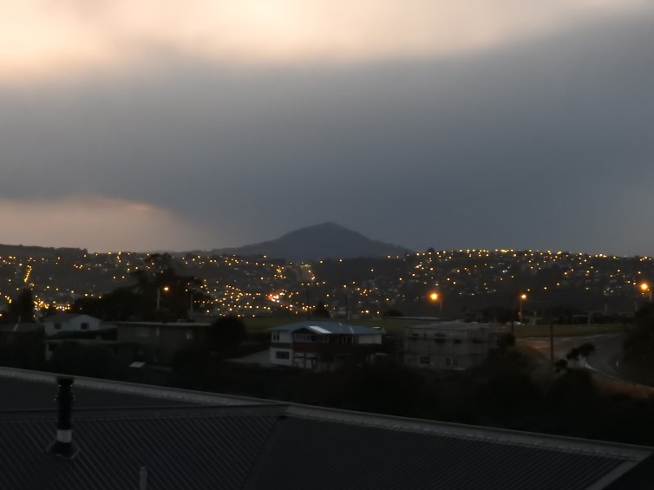
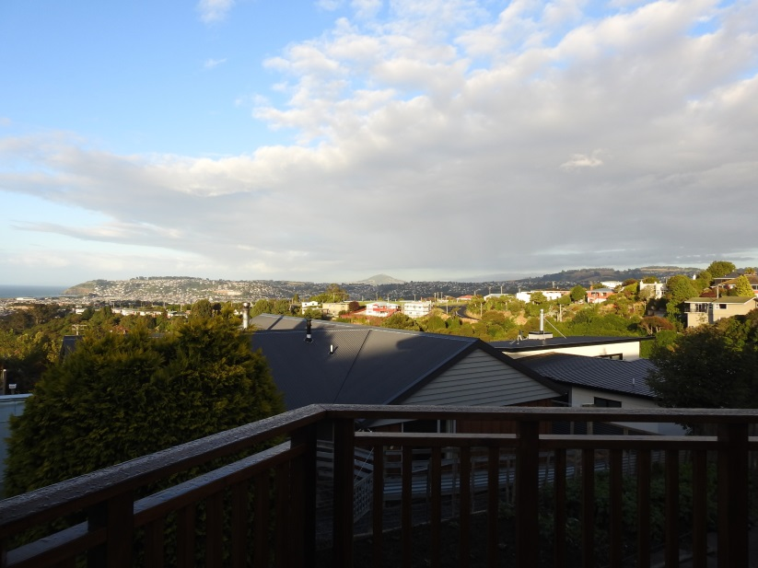
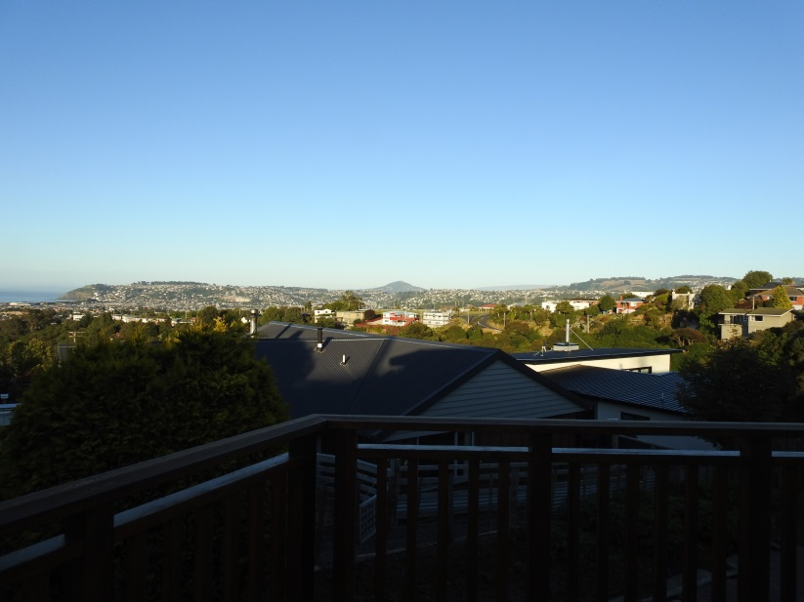
Reported barriers: The weather
“If it’s raining, you’ve got to walk up to the bus, and you’ve got to stand around waiting for the bus to come in the rain, which is not preferable.” [student; focus group 10]
“Because buses are late often and you get really cold waiting for them and then you are late. You don’t know how long it will be until the bus comes” [bus survey]

Slide 22
Qualitative analysis of the interviews with policy makers
Theme | Node (no. of references)
Barriers and enablers to use public transport to school | Cost of bus service (11)
 | Safety (14)
 | Providing for the transport disadvantaged (6)
 | Travel practices (6)
 | Time and convenience (6)
 | Safety (14)
Issues of the current system and for developing an effective transport policy | Collaboration (15)
 | Providing for the transport disadvantaged (6)
 | Planning documents (6)
 | Public bus compared to school bus (8)
Role of policy for increasing public transport use | Transport policies (9)
 | Future planning (11)

Slide 23
Conclusions
Public transport use could be increased by:
  raising parking prices to discourage parents driving and trip-chaining;
  improving bus infrastructure and subsidies; and
  changing perceptions of public buses.
These require collaboration between different government authorities.

Slide 24


Acknowledgment
BEATS Study funding:
Otago School Students Lifestyle Survey funding:
Key Principal Interviews funding:
JM’s sabbatical:
William Evans Fund
Thank you!

Slide 25
The BEATS Study was funded by the Health Research Council of New Zealand
  National Heart Foundation of New Zealand
  Lottery Health Research Grant
  University of Otago Research Grant
  Dunedin City Council
  and internal grants from the School of Physical Education, Sport and Exercise Sciences, University of Otago.
The Otago School Students Lifestyle Survey was funded by Dunedin City Council and Otago Regional Council and was supported by the University of Otago.
Key Principal Interviews were funded by School of Geography, University of Otago
My visit to Dunedin was funded by the University of Otago William Evans Visiting Professor Fellowship.

Slide 26
Policy documents
Jenny, I added this table with a list of policy documents. See if you want this slide or not.
Policy document | Year | Level
The Land Transport Management Act (LTMA) | 2003 | National
Government Policy Statement on Land Transport 2015 | 2015 | National
New Zealand Transport Agency’s 2013 Guidelines for preparing regional public transport plans | 2013 | National
Otago Regional Public Transport Plan 2014 | 2014 | Regional
Otago Southland Regional Land Transport Plans 2015-2021 | 2015-2021 | Regional
Otago Regional Land Transport Strategy | 2011 | Regional
The Dunedin City Integrated Transport Strategy | 2013 | Local
Dunedin towards 2050: Spatial plan for Dunedin | 2012 | Local
Dunedin City Council District Plan | 2006 | Local
Dunedin Second Generation Plan | 2017 | Local

