Slide 1
Promotion patterns in academia: balancing between change and status quo
Presentation for HBS conference, January 2020
Viviana Meschitti (a) & Giulio Marini (b)
(a) Huddersfield Business School, v.meschitti@hud.ac.uk
(b) Centre for Global Higher Education at IoE-UCL, g.marini@ucl.ac.uk

Slide 2
The gender gap in promotion to full prof
Understanding the gender gap in promotion to full professor from the perspective of literature on intergroup dynamics
social identity theory (Tajfel, 1974; Williams & Giles, 1978)
competition theory (Blalock, 1967)
Most literature on the topic is positioned at the individual level

Slide 3
Background literature
Career advancement & gender
Previous literature mainly influenced by critical mass theory (Kanter, 1977)
Factors impacting on promotion:
productivity (Marini & Meschitti, 2018; Weisshaar, 2017)
life domain and caring activities (Ahmad, 2017; Aiston & Jung, 2015)
social capital (van den Brink & Benschop, 2014)
Social capital (networks) and life domain issues might hinder women’s careers

Slide 4
Our aim
Group level of analysis
Is the gender composition of the associate and full professor ranks able to predict the number of promotions available?

Slide 5
The case
Italy, Abilitazione Scientifica Nazionale (ASN)
2-step process:
fit-for-the-role qualification conducted by 14 different disciplinary committees at the national level (productivity criteria)
appointment/promotion if a position becomes available (institutional level)
Our dataset: 2013-2016, census data

Slide 6
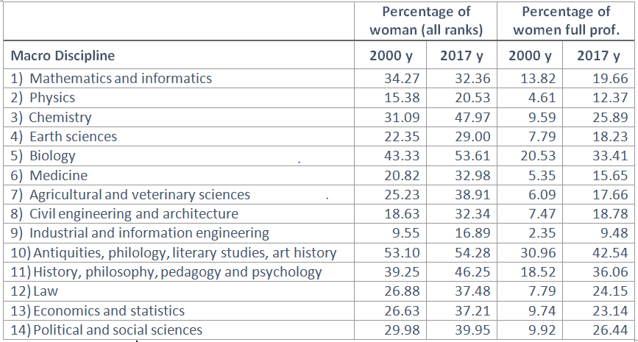
Women accessing full prof rank (2000-2017)

Slide 7
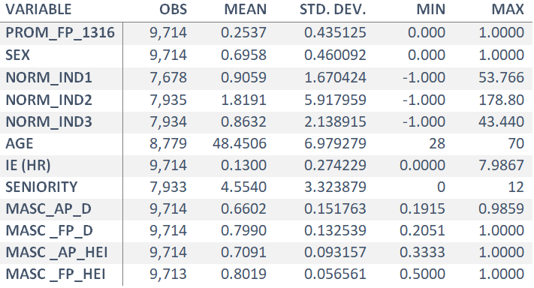
Variables
Masculinity at the level of associate professor,
disciplinary area
1=male
0=female
Notes:
Seniority in position: for how long (years) you have been at AP position?
Institutional endowment IE (HR)

Slide 8
Variables
Masculinity at the level of full professor,
disciplinary area
Notes:
Seniority in position: for how long (years) you have been at AP position?
Institutional endowment IE (HR)

Slide 9
Variables
Masculinity at the level of associate professor,
institution
Notes:
Seniority in position: for how long (years) you have been at AP position?
Institutional endowment IE (HR)

Slide 10
Variables
Masculinity at the level of full professor,
institution
Notes:
Seniority in position: for how long (years) you have been at AP position?
Institutional endowment IE (HR)

Slide 11
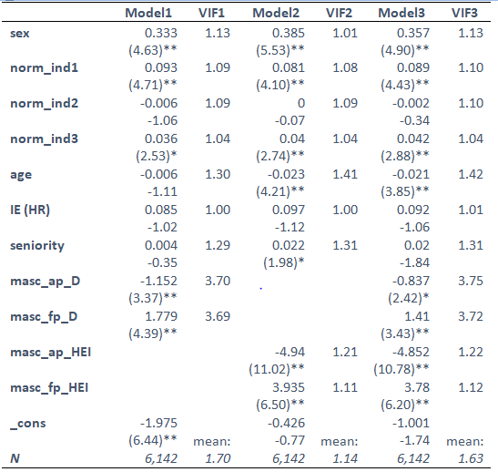
Results
Gender composition at AP and FP ranks as the most important variabls impacting on number of promotions available

Slide 12
Findings
Promotions to full professor are more likely to happen:
In institutions where:
there are more women at associate professor levels;
and more men at full professor level.
When among full professors there are more women,
promotions are less likely to happen (Models 2 and 3)
Gender composition by discipline plays a less prominent role (see Model 1 and first two variables of intergroup dynamics)

Slide 13
Findings - highlights
Promotions are not necessarily given exclusively on the basis of excellence in scientific productivity
There is some gender discrimination at parity of scientific production
But findings show that the most relevant factor in predicting how many promotions to bestow is gender composition at the two level of associate and full professor.

Slide 14
Discussion
The impact of gender in this study is well interpreted through Social Identity Theory :
There is a given pressure for change coming from the minority
majority (men) reacts by creating some more opportunities for change (e.g. promotions)
at the same time these opportunities do not ensure that change will happen (i.e. more women being promoted)
change (in terms of percentage of minority growing at “expected rate”) happens, but at a slower pace
We demonstrate ultimately how the majority enables a way to extend temporarily themselves a dominant role, though such dynamic also allows some change along time.

Slide 15
Any question ?

