Slide 1
The End of Academic Freedom? Mean / End Decoupling in European Western Higher Education Systems
Section: Academic Freedom and Political Legitimation in a Contemporary Globalised World
Panel: Academic Freedom Under Threat
Giulio Marini, phD
g.marini@ucl.ac.uk
Institute of Education UCL – UK
Centre for Global Higher Education (CGHE)
www.researchcghe.org

Slide 2


Slide 3


Slide 4


Slide 5
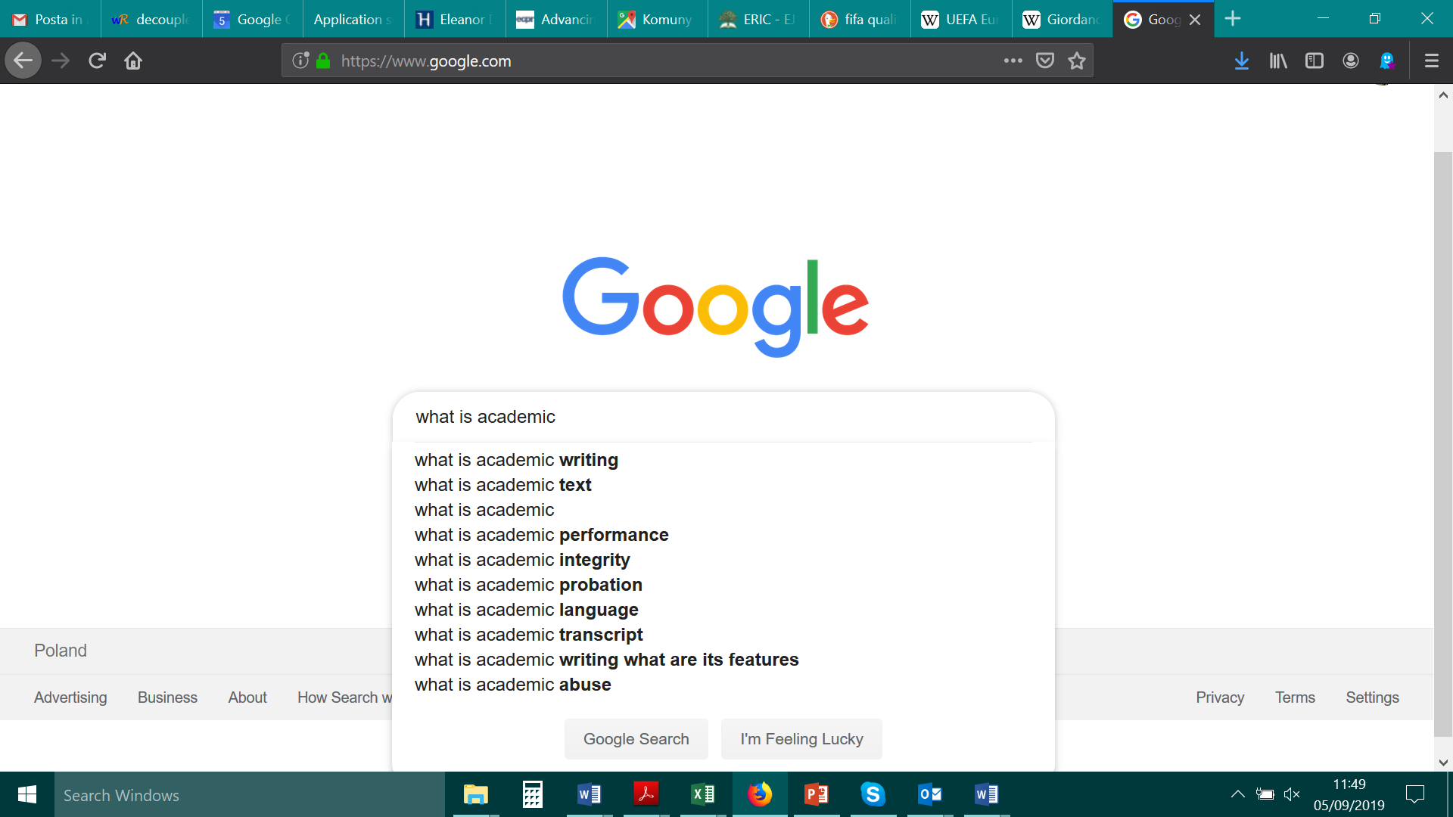

Slide 6
What Academic Freedom is?
Most literature is US-referred and deals with:
  Freedom of speech (by staff or students)
  Codes to define what is legitimate or not
  Tenure of staff as a way to assure safe conditions to pursue research
Academic Freedom as a concept transcend contexts and deals with the essential nature of universities
  Universities require freedom from political-cultural power to just exist (negative liberty) – though with some counter-balance (Hofstadter)
    Also definable as a political system affording protection from punishment, and freedom of carrying on potentially disrupting ideologies to “chartered” bodies (delimited privilegia).
  A.F. not necessarily has to do with individuals (nor institutions), but deals primarily with existence prerequisites of the format (corporatio; guild)
Basically it is protection/privilegia from political power potentially dangerous of status quo allowed in order to pursue a higher order political interest

Slide 7


Slide 8
Not-very-simple cases about academic freedom
A distinguished English universities in its Department of Languages teaches Catalan as a language, and it is funded by Generalitat de Catalunya for doing so
A even more distinguished university have a plenty of Chinese students. May a teacher teach about what “really” happened in 天安门广场 1989年.
Let’s see “hard sciences”. Where’s Academic Freedom when a research, before even being started, has to pass through an ethical review?
Academic Freedom looks to be always with some degree of compromise

Slide 9
Why to study A.F. today in Europe?
Strong isomorphism from US in managerial practices and Human Capital theories (fit for US) derivations go at odds with European traditions
The US parlance about A.F. is inappropriate for European countries (none would be fired in Europe for “having spoken”; tenure/civil servant status is still widespread though decreasing, etc.)
The new superpower, China, does not look like devoted to freedom (at least as we mean it in global West)
Universities often put themselves on the wrong side of history (see during Fascisms or Nazism), and A.F. looks to evaporate easily if conditions are advert
We don’t know where current populisms & crisis of middle classes will transform democracies to and “knowledge society” rhetoric is becoming empty of any particular meaning.
Academic auctoritas is openly challenged (ok, perhaps this is not happening in Europe only)
Disintermediation puts higher education in “off-side”
Europe is and remains heterogeneous, compelling some research that ought to go more in depth in relation to rhetoric parlance about, say, ERA. (ok we got some research in a score card way, but it’s not enough)
Empirically speaking, very different things like Brexit or Mr. Orban’s rule are potentially disruptive to higher education. At the same time, higher education does not seem to have any viable answer for the questions raised by some democratic outcomes.
We grew up believing in the Pax Americana ideology based on education building prosperity and higher education protecting that, but it looks that without proper protection higher education cannot be trusted as a beacon of democracy

Slide 10
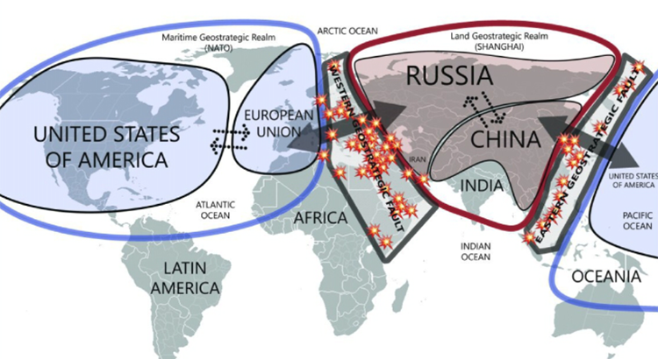
Why geopolitics is relevant to A.F.?

Slide 11
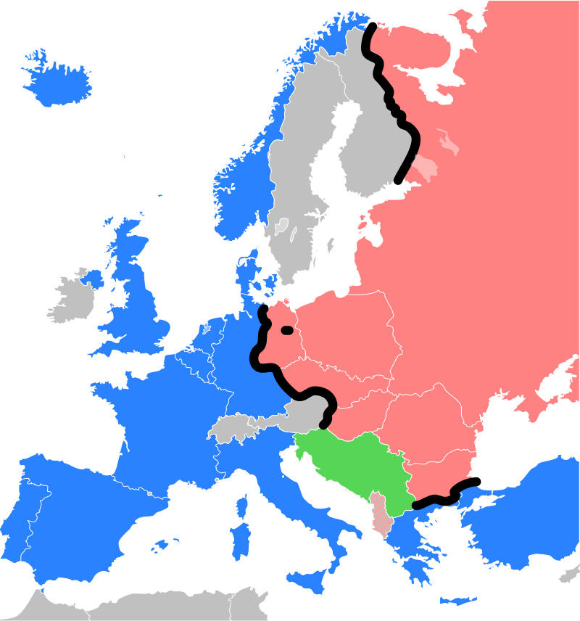
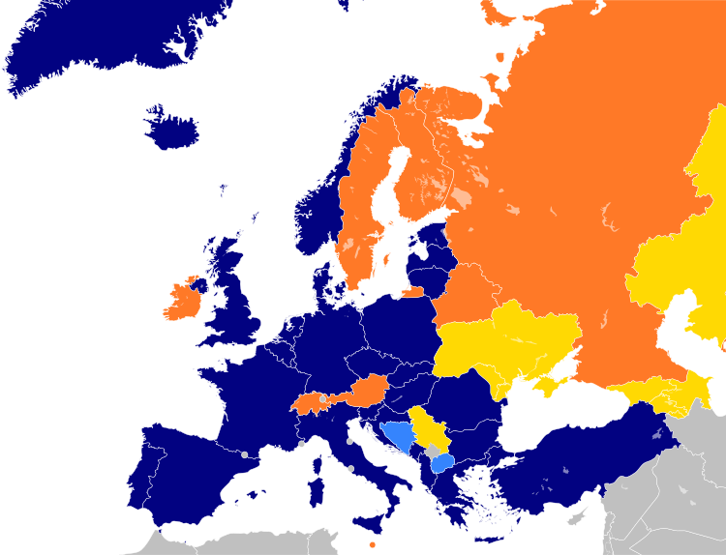

Slide 12
Fault-line contexts – Mittel- & Middle East
As a matter of fact, such countries are not fully fulfilled or long standings democracies – though with notable differences in degrees of such condition.
  There is legacy with pure dictatorship to absorb
  Frustration in realising that freedom does not equal “glory”
Their place in the world in terms of relevance is uncertain and liquid
A.F. is not totally established and, as a result, the ideal-typical “partial liberty” is… partial.
  Arguably students and/or staff would like to have “more academic freedom” just because they don’t live in the closed totalitarian world, nor they have all the conditions to fully join the “excellence”
The consequences of such condition are probable clashed between the aspirations of academia of being “fully western” and the actual condition which is limited.

Slide 13


Slide 14



Slide 15
Not for a relativism all the way. Where’s veritas?
According to Michael Polanyi understanding, Academic Freedom is the way to scientific knowledge (the truth, albeit it may change by time)
  So, I believe in the method a la John Stuart Mill, assuring multiple changing truths
Higher education is expected to legitimise one’s regime instead of doing research also in such “fault-line” societies
All social sciences are not free in both research and teaching…
…although they must adapt some ideology with very delimited leeway of freedom
If you are neglected or suspected, you might struggle to stay in the circles that matter (e.g. co-authorships)

Slide 16
A sum up of premises
The post-WWII Western consensus is based on the idea that education is the way to go for prosperity, but I wonder whether there are intrinsic limits in it.
  Sometimes you just need to belong to the West to have reasonably aim at such goals
The best degree of Academic Freedom is that matching the actual conditions a political system is
  Could Academic Freedom exist in a totalitarian system if we read things in Durkheimian ways?
Universities are particularly under stress just when their respective political systems are in “fault-line” situation (not necessarily geographically, but definitely culturally)
  Such countries really need “real universities”, but only up to a certain point
It s completely unclear the extent to which universities may have “free will” in determine their own “Academic Freedom package”

Slide 18
Non Fault-line contexts – the West
Assuming Western Europe is not a fault-line and that such a fault-line has got farer from (i.e. NATO expanding to East; but what about Chinese penetration then?!), the noble & healthy periphery of Pax Americana is subjected more than ever to isomorphistic pressures
Whilst industry and army -led higher education in US is coherent with the locus of power of such a country (H.E. as essentially not part of welfare state with poor federal level of governance) and such premises justifies managerialism and consumerism (market of credentials), Europe is possibly missing the societal compliance
Neoliberalism may work for ObamaCare-rejecting US, much less for Old Europe (unless it is profoundly tempered and specifically adopted). Are we exaggerating with neoliberalism? Or even shall we have in the future something harsher than that?
Where is the prestige hold by universities in a universal accessed tertiary education?

Slide 19
A premise about neo-institutionalism
neo-institutionalism can be seen as an explanation of why education does not conform to companies rule (education is not a classical market, whatever the efforts by policy makers to make it a market)
Means/end decoupling is useful to understand the compliance link between societal expectations and education.
  In the US (and perhaps other Anglo-Saxon countries)

Slide 20
Mean / End Decoupling in a tentative table
Context | Societal Values related to HighEd {end} | Legitimization (American higher education) {mean}
US | A big companies-driven and established country Individualism; Credentialism (including full market price); High inequalities; opportunity as “chance of a lifetime”; Acceptance of opportunity being sparse; Sport as main machinery of opportunity; Perennial “red scare” Puritanism (e.g. teaching ought to be sensitive-free) … | Strong private HEIs; almost no federal level for HighEd HighEd as a private good to be bought Poor level of subsidies Merit happens (just sometimes) Merit happens when you are an NCAA champ Huge emphasis on codes (positive liberty)
Western Europe (assuming there is any least common denominator) | Individualism but also common good Credentialism, but only some stratification Opportunity as a right Fee to be small and/or means tested HighEd as also a free political experience (both for students, but also for staff) Sport?! We were talking about universities! | Much mimetic isomorphism Efficientism because of aging societies with a huge welfare state burden Global competition based on HEIs is not tailored for most European countries Coded codes are mostly alien to European culture

Slide 22
Where is academic freedom in these vignettes?
A distinguished English universities teaches Catalan as a language, and it is funded by Generalitat de Catalunya for doing so

