Slide 1
Working with traumatic records: how should we train, prepare and support record-keepers?
Dr Anna Sexton
Department of Information Studies
UCL
AERI 2019
Notes:
So before, I start, just a steer on content - I will not be going into any specific detail of instances, but I do make passing reference to distressing or disturbing experiences such as violent acts, harm and abuse including sexual abuse, so you are of course free to leave the room at any moment if you need to.
And also a disclaimer – these are my emergent thoughts, this is actually my first attempt and ordering my thoughts and putting the reading I’ve been doing together in a structured way, so this is very much a work in progress that I am presenting to you today.

Slide 2
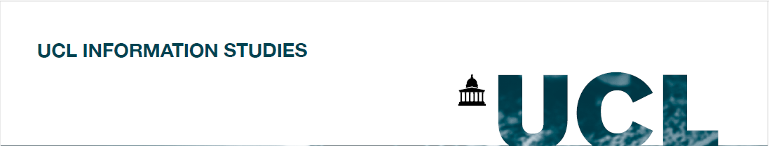
Starting points:
Trauma is the result of a deeply disturbing or distressing experience
Trauma can be:
Singular– a traumatic event
Ongoing – related to repeated and prolonged traumatic experience
Complex – related to exposure to varied and multiple traumatic events, often of an invasive, interpersonal nature
There are instances of records that act as representations of disturbing or distressing experience
Notes:
So I am going to start with a simple statement on what trauma is. And I am going to suggest that trauma is the result of a deeply disturbing or distressing experience.
And then I am going to build on that a little by suggesting that trauma can sometimes be singular….
So there are instances of records that act as representations of distressing or disturbing experience

Slide 3
Starting points:
Documents and other artifacts stored in archives are often considered as potential evidence (or potential sources of evidence) of events that occurred in the past. Such artifacts are known as records in virtue of this potentiality
Furner, J (2004) Conceptual Analysis: A Method for Understanding Information as Evidence, and Evidence as Information, Archival Science, 4 (3-4), pp.233-265.
In a similar vein to Furner’s concept of ‘potentiality’ we might say that records carry ‘traumatic potentiality’
Notes:
In thinking further about how we might define what traumatic records are, I find Jonathan Furner’s concept of ‘record potentiality’ useful here (which I rediscovered recently thanks to an article by Michelle Caswell). He developed it in the context of talking about the relationship between the record and evidence and clarifies that records are not necessarily evidence in and of themselves, but are defined by the potentiality to act as evidence. In a similar vein, records that document traumatic experience also carry what you could call ‘traumatic potentiality’ and that ‘potentiality’ can be heightened or lessened depending on the individual’s relationship to the experience being documented. Trauma, is of course, an embodied experience and so what I am seeking to highlight in this talk is that records in our care have the potential to trigger deep and painful psychological, emotional and physical responses in an encounter with them.
On the surface, it may appear obvious to suggest which types of records may be likely to trigger a traumatic encounter – records that are directly linked to clear cut acts of violence or abuse or harm, for example. But drawing on Sutherland’s scholarship around the concept of the ‘carceral archive’ which describes how institutional and government archives function as instruments of state power, and how violence is perpetuated through process of dehumanization and exclusion which are then codified, reinforced, reinscribed and reified in the documentary record. These types of records also very much carry traumatic potentiality.
Which leads me to suggest that any record which documents power of an individual or a group over another individual or group carries traumatic potential – so I’m not talking about just a niche subset of records. ‘Traumatic potentiality’ exists in many of the records held in institutional archival spaces.

Slide 4
What is trauma?
Psychological trauma is the unique individual experience of an event or of enduring conditions in which the individual’s ability to integrate their emotional experience is overwhelmed
(Pearlman & Saakvitne, 1995, p. 60)
Notes:
So, lets just dwell just for a few moments more on ‘trauma’ as a concept before we move on.
So firstly, this definition by two therapists rooted in a psychoanalytic tradition who give a definition of ‘psychological trauma’ as…………
An inability to stay present, understand what is happening, integrate the feelings, and make sense of the experience
So if we think of a records potential to traumatise, at the extreme end we are talking about when the experience is utterly overwhelming and deeply threatening…
I do think it is important to note that probably many of us have experienced an encounter with a record that has left us shaken by the experience, because it has triggered an emotional response and has left us distressed or angry, and it has taken a while for us to process both the record’s contents, and our experience of the record.

Slide 5
Trauma is:
An external event. No one traumatises themselves.
It is subjective. Only the person can say what haunts her.
It is pervasive, inhabiting every corner of one’s life.
Healing happens. The haunting can end.
Filson, B (2016) The haunting can end: trauma-informed approaches in healing from abuse and adversity in Russo, J and Sweeney, A ‘Searching for a Rose Garden: Challenging psychiatry, fostering mad studies, London: PCCS Books
Notes:
I want to balance that definition of trauma with this one which is generated from a survivor/mad studies perspective which makes two vitally important points. One is that although trauma is subjective and embodied it is the result of external events which are real, brutal and harmful, so that reality and exteriority should not be lost in the discourse of subjective response.
And the other is the janus faced nature of trauma and healing because where we have ‘traumatic potentiality’ at one end of the scale in relation to the record, we have ‘reparative potentiality’ at the other, and an individual’s experience of the record can be both, or may flip between those states or may shift more strongly towards one over time. And so the process of working through the affect of the record, and the nature of its contents, is often a long and complex process.

Slide 6
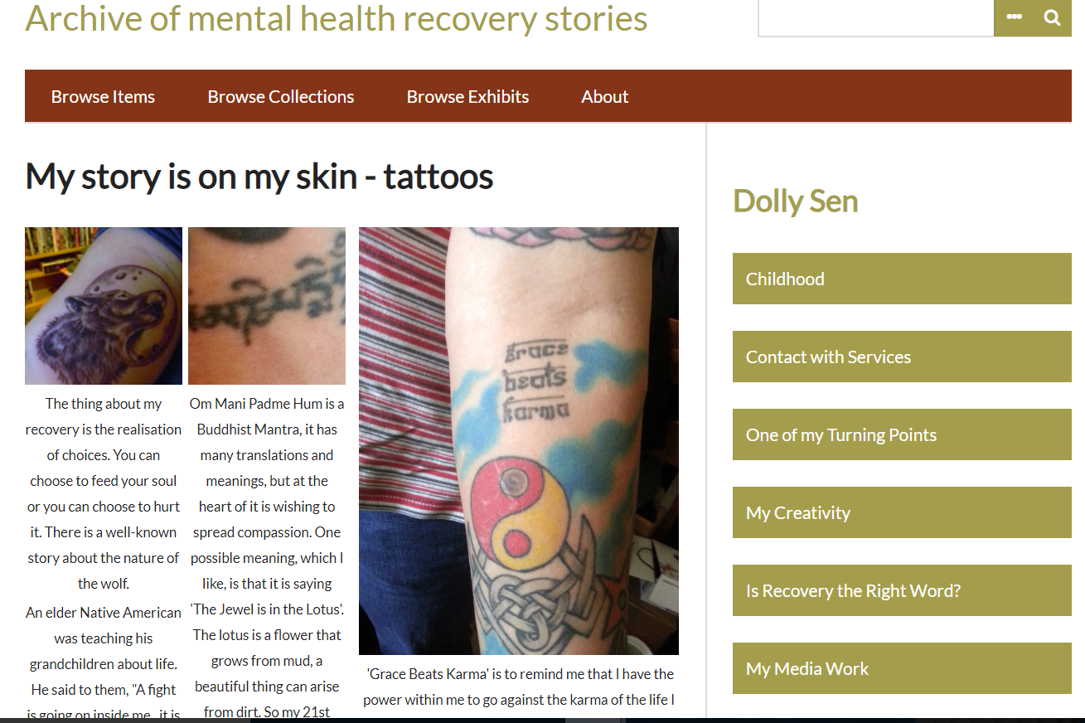
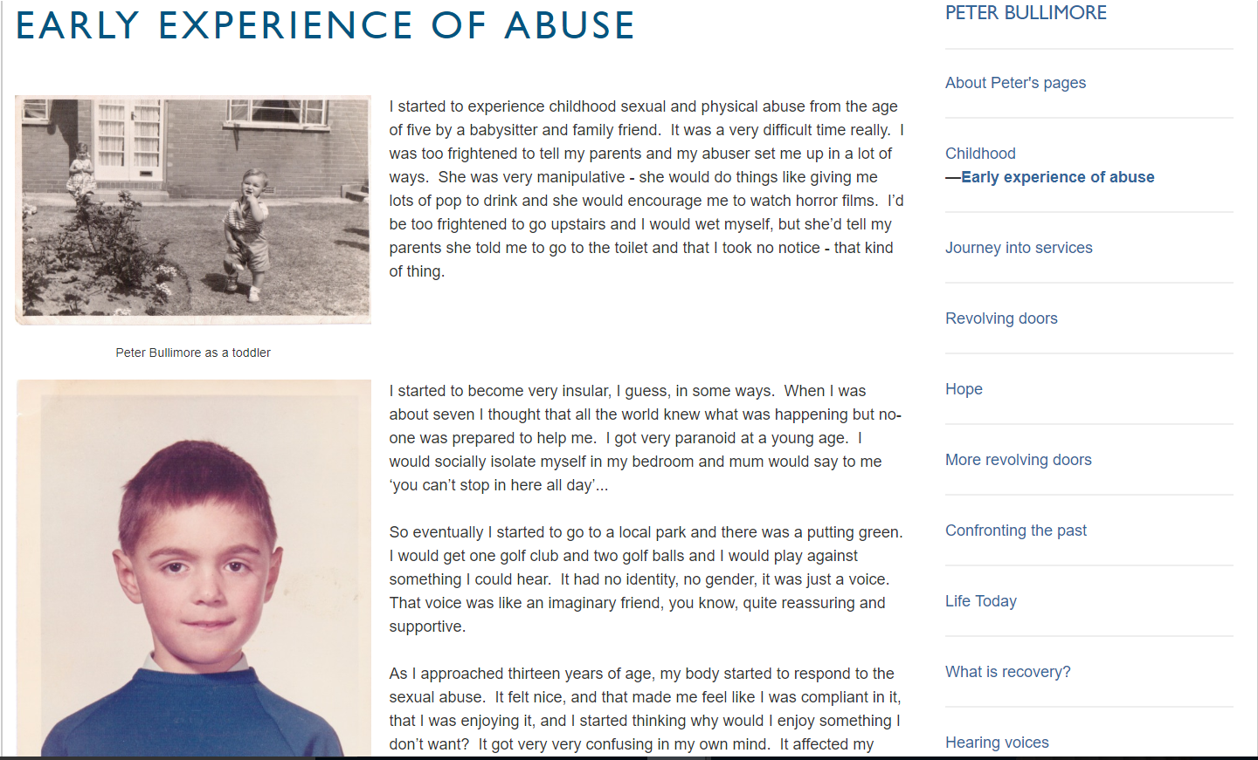
Notes:
I think my own research and practice has rubbed up against documenting trauma and providing access to records with ‘traumatic potentiality’ in many different ways, as a local authority archivist when I was entrusted to care for asylum records, coroner’s records, magistrate court records all of which carry ‘traumatic potentiality’, an issue which I was totally unequipped to think about or deal with through my own professional archival training. Then when I did my PhD, and I worked with a group of co-producer’s who were survivors of the UK mental health system, and we were building an archive to represent their individual experiences and you are looking at two screenshots from the archive we built together, where I had to think very carefully about what it means to work alongside and facilitate a process for an individual to document their experience of neglect, sexual abuse, violence, social isolation, stigma and mental disturbance and where the boundaries around my role lie.

Slide 7
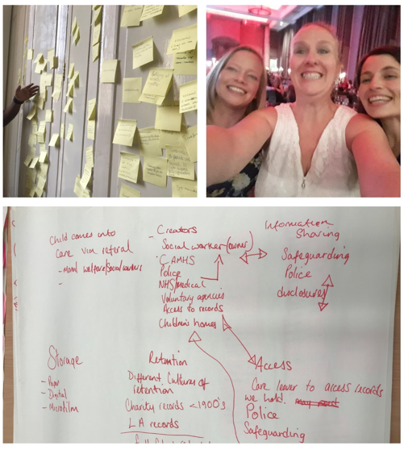
Notes:
And also the research I have done with care leavers, seeking to understand their experiences of seeking access to their social care records has also made me very alive to these issues.
And that research has highlighted for me how there is the trauma inherent in the direct encounter with the record, but that trauma can be reinforced, compounded and added to by having to navigate a legally and instrumentally driven system around the record, rather than a human centred one. This leads me to say that, recordkeeping systems and processes as well as records have ‘traumatic potentiality’.

Slide 8
Layers of traumatic potentiality
Trauma through recordkeeping sytem/processes – e.g. description, access etc
Trauma through representation of experience in the record
Traumatic Experience/Traumatic Memory
Notes:
Layers of traumatic potentiality -
And of course also, when undertaking these roles, there has to be an acknowledgement of the deepness of the emotional labour attached to what we do as record-keepers, and that vicarious trauma which can occur through empathetic engagement both with the record and the individual - is something we need to surface, and that we need to be equipping recordkeeper’s to be able to deal with, which mean finding ways of properly skilling, sustaining and supporting each other.

Slide 9
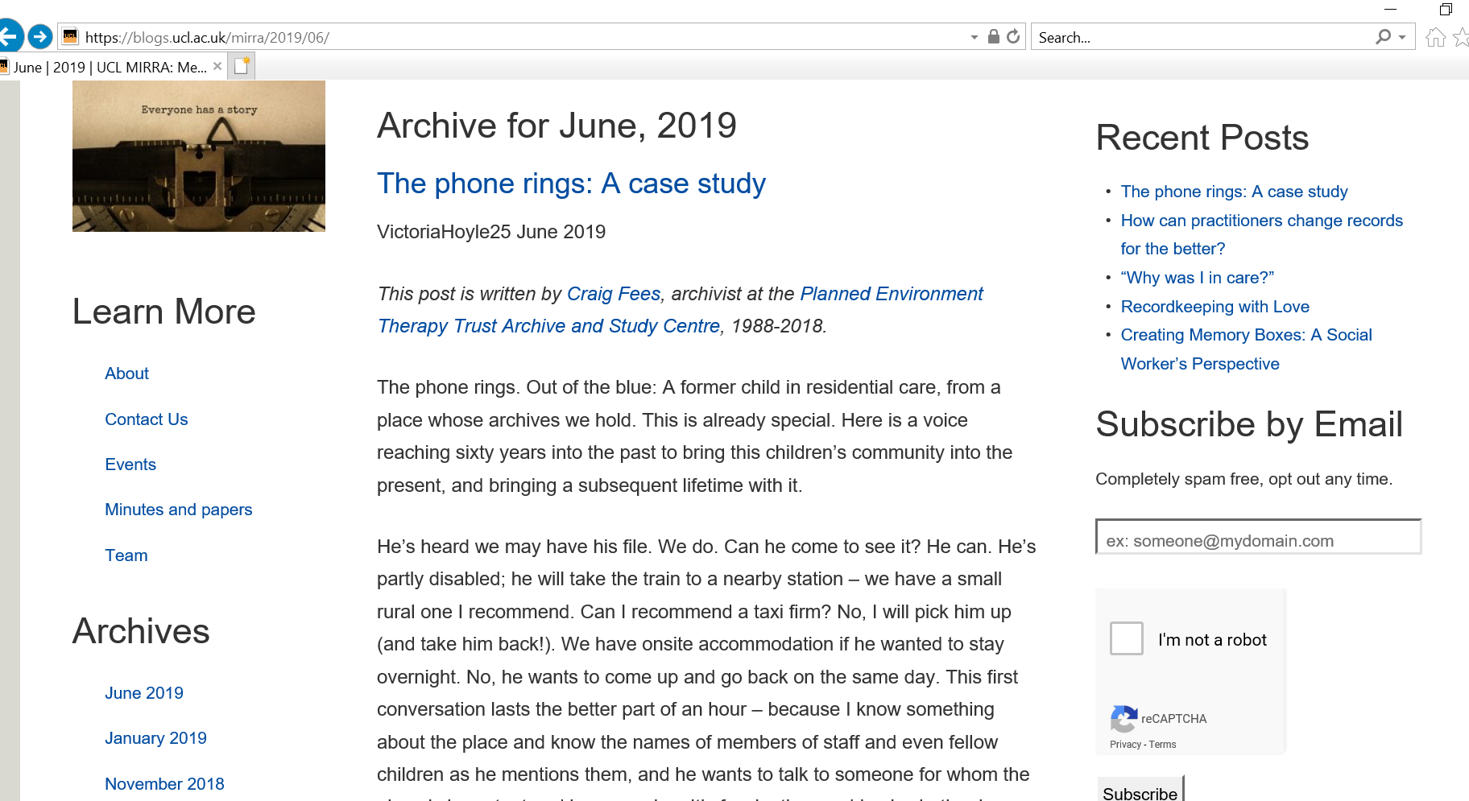
Notes:
So how can our practice be trauma-informed if you like and what principles, mindset, skills, do I need to help my students develop to be responsible record keepers- This post is written by Craig Fees, archivist at the Planned Environment Therapy Trust Archive and Study Centre, 1988-2018.
The Planned Environment Therapy Archive holds substantial collections on the history of adult, prison and children’s therapeutic communities and environments including children’s homes and schools offering alternative education. And so Craig dealt with many requests from individuals wanting access to their case files and had to find ways to sensitively negotiate the ‘traumatic’ and ‘reparative’ potentiality in the records that he was gatekeeping.
Abridged version in the interest of time.
The phone rings. Out of the blue: A former child in residential care, from a place whose archives we hold. He’s heard we may have his file. We do. Can he come to see it? He can. He’s partly disabled; he will take the train to a nearby station – we have a small rural one I recommend. Can I recommend a taxi firm? No, I will pick him up (and take him back!). We have onsite accommodation if he wanted to stay overnight. No, he wants to come up and go back on the same day. This first conversation lasts the better part of an hour. He wants to talk to someone for whom the place is important and has meaning….I want him to know that he and his experience are important.
We talk about what I will do to make the file available to him: I explain the legal parameters guiding redaction and that I will not redact anything unless it is absolutely legally necessary, because the more detailed and complete the record I can put into his hands, the more value it is likely to have for him. I ask him for three things before I start: some proof that he is who he says he is, so that I don’t release information to someone I shouldn’t; any information he can share about who I might encounter in the file, and formal permission to go through his file. Of course he is unlikely to say no to the latter; we both understand that. But it is important to me that he is the one who makes the decision, and gives the permission for this stranger to go into his intimate childhood. It is not just a formality.
I meet him at the station. We readjust the car to meet his physical situation. We talk: it’s beautiful countryside; he’s come from London. He asks about me, about my background and where I’m coming from, so we talk about that. I tell him I have set up my office with his file, and am happy to be in there with him, or to shut the door and let him have it to himself. He won’t be disturbed if he doesn’t want to be. When we arrive I make coffee and biscuits. I explain the very few redactions I’ve made, how he will know when he comes across them, and what they mean.
He elects to be alone with his file. The phone is unplugged, there are no limits on time, and there are no other visitors expected. I will be somewhere around if he needs me. Eventually, he emerges and we talk. He shares his views on his file, and his child’s eye view of its depictions. There are factual inaccuracies in it. Some things have fallen into place for him.
Each request is unique, comes differently, and unfolds in its own particular way. But if done well the underlying philosophy of welcome, of being at the service and disposal of, of adapting to, of making possible, of conveying the meaning and significance of, of learning about and from should be consciously or unconsciously experienced by every person seeking their file, as is a sense of sharing responsibility and of working together. We need to be are of the potential of traumatic experience to spring surprises, including the surprise of having no bearing at all; the knowledge that archivists are not therapists, but people; and with a fundamental understanding that whatever the emotional dynamics of the encounter with their records, that experience is theirs, and not ours. We are guests in their lives, and our role is to provide an environment which is welcoming, informed, and safe.

Slide 10
Threads in Craig’s reflection
Flexibility in relation to access arrangements, individualised approach
Sensitively negotiating a power dynamic between archivist and requester and the broader context of institutional power
Clearly communicating from initial contact onwards
Listening, acknowledging, being present to the extent that is desired, needed, welcomed
Judging when to withdraw
Carefully considering boundaries and the limits of expertise and offer – ‘we are archivists, not therapists or counsellors’
Notes:
Balance between system, structure, process and skills
The rest are person-centred skills, often called soft skills which annoys the hell out of me because they are the hardest skills to acquire.

Slide 11
Questions:
How best to theoretically and conceptually ground the teaching to enable students to develop an appropriate mindset?
What practical skillset do record-keepers need to develop in order to become adept practitioners around records with traumatising content, including the effective management of their personal wellbeing?
What teaching methods should be employed to support student development of an appropriate skillset?
Who should be involved in equipping and teaching our students, and to what extent it is possible to involve survivors of trauma who may be subjects in the records we care for, in recordkeeping education around traumatic records?
What responsibilities do we have as a field to develop broader training and peer networks to ensure that record-keepers working in this area remain equipped, supported and sustained in the long term?

Slide 12
Helpful starting points from inside our field:
Radical empathy and an ethics of care:
“Archivists are seen as caregivers, bound to records creators, subjects, users, and communities through a web of mutual affective responsibility”
Caswell & Cifor (2016) From Human Rights to Feminist Ethics: Radical Empathy in the Archives, Archivaria, vol. 81, 2016, pp. 23-43.

Slide 13
Helpful starting points from outside our field:
Discourses around Trauma Informed Care (emerging from both survivor and therapeutic perspectives)
Five principles:
  Safety…..
  Transparency and Trustworthiness. ...
  Choice. ...
  Collaboration and Mutuality. ...
  Empowerment……
Notes:
These absolutely relate back to the threads in Craig’s description of his approach….

Slide 14
Emerging map for a ‘trauma-informed’ approach to record-keeping teaching:
Issues
Skills
Theories/concepts/models/frameworks
Teaching methods
Individual/Community
Experience of the record
-Trauma or healing?
-Reinforced oppression or
reparation/liberation?
Required interpersonal skills:
-listening
-communicating
-acknowledging
-balancing
-perceiving
-empathising
-cultural competence
-prioritising work-life balance
-ability to understand/ set boundaries around self and other
Within our field:
-Critical Archival Studies
-Social Justice
-Radical Empathy
-Affect of Records
-Ethics of Care
-Liberatory/Carceral Archives
Beyond our field:
-Survivor generated knowledge
-Trauma studies
-Trauma-informed approaches
-Well-being frameworks
-Reflective Practitioner Frameworks
-Valuing experiential knowledge
-Including experts by experience in delivery
-Vicarious trauma
-Emotional labour
-Meaningful practice
Record-keeper
-Role-play
-Case study approach – real world examples
-STEEPLE conditions around the record
-Recordkeeping structures and processes that hinder/enable
The Record

Slide 15
Dr Anna Sexton
Department of Information Studies
Gower Street
London
WC1E 6BT
a.sexton.11@ucl.ac.uk
@annasexton100

