Slide 1
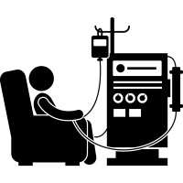
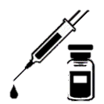
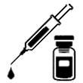
Intravenous iron dosing and infection risk in hemodialysis patients: a pre-specified secondary analysis of the PIVOTAL trial
METHODS
RESULTS
Median follow-up 2.1 years
Proactive high-dose
Reactive low-dose
Incident HD Ferritin <400 µg/L TSAT <30%
HR: 0.98 p=0.80
Any infection (first event)
46.5%
45.5%
N=2141
HR: 0.99 p=0.92
Hospitalization for infection (first event)
IV iron sucrose
29.6%
29.3%
400 mg/mo
Unless ferritin: >700 µg/L or TSAT ≥40%
Median: 264 mg/mo
Only administered (≤400 mg/mo) if: ferritin <200 μg/L or TSAT <20%
Median: 145 mg/mo
HR: 1.04 p=0.84
Death from infection (first event)
4.21%
3.91%
Risk of a first cardiovascular event was strongly associated with an infection-related event in the prior 30 days
HR: 2.83; p<0.0001
HR: 2.74; p=0.0006
During infection (investigator judgment)
CONCLUSION A proactive, higher dosing IV iron protocol did not impact infection incidence in a large HD population.
doi: 10.1681/ASN.

