Slide 1

Are Women Doing it for Themselves? Female Managers and the Gender Wage Gap
Alex Bryson
UCL
John Forth
Cass Business School
Nikos Theodoropoulos
University of Cyprus
Paris School of Economics Labour and Public Economics Seminar
23rd April 2020
Paris France
The authors acknowledge the Department for Business, Energy and Industrial Strategy, the Economic and Social Research Council, the Advisory, Conciliation and Arbitration Service and the National Institute of Economic and Social Research as the originators of the Workplace Employee Relations Survey data, and the Data Archive at the University of Essex as the distributor of the data. None of these organisations bears any responsibility for our analysis or interpretation. Alex Bryson thanks the Economic and Social Research Council for funding (grant number ES/S012583/1)

Slide 2
Motivation
Women outperform men in educational attainment and are closing the gap in experience, but a gender wage gap (GWG) persists
Part due to preferences about where to work / hiring discrimination (‘sorting across workplaces’)
Part reflects different wage outcomes for like workers within the same firm (‘bargaining within workplaces’)
Growth in women’s representation at board level has stimulated interest in the possible ‘trickle down’ effects to women below the board, but evidence of such effects is limited
We focus on the effects of female representation at lower levels of management where the scope to influence outcomes for individual co-workers is arguably greater

Slide 3
Preview
We use nationally-representative data on GB workplaces to examine whether the size of the GWG among all employees and non-managerial employees in a workplace is affected by the share of workplace managers who are female
We find that the GWG decreases with an increasing share of women in managerial positions
We identify one mechanism through which female managers alter the distribution of rewards – performance pay
Offer some evidence that the female manager effect on the GWG is causal
Findings are consistent with a scenario in which female managers reallocate limited resources from men to women
Policy makers should focus more on mechanisms to improve female representation in managerial positions below board-level

Slide 4
British Context
One-third of women and men now have degree-level qualifications (EHRC, 2019)
Women better represented than men in professional occupations (Devine and Foley, 2020)
But men outnumber women by a ratio of almost 2:1 in the top occupations (Managers, directors and senior officials) (Devine and Foley, 2020)
Women have rapidly increased their representation at board level
  In June 2018, women accounted for 29% of directors in UK FTSE 100 companies, up from 15% in 2012 (Vinnicombe et al, 2018)

Slide 5
Theory and Existing Evidence
GWG can arise from two routes:
  Sorting of workers between different firms (due to ‘choices’ on the supply side and hiring discrimination on the demand side)
  Activities within firms that generate different wage outcomes for like workers (e.g. wage setting, work allocation, access to training, promotion)
Evidence suggests that within-firm wage differences are significant
  19ppts of the 22pp% GWG in Jewell et al (2019)
Leadership is plausibly important. Female leaders may:
  Challenge direct gender-based discrimination
  Change gender norms to reduce indirect discrimination
  Or … they may judge women more harshly than men would do (“queen bees”)

Slide 6
Existing Evidence
Wage gains from increased female representation at board level do not extend beyond the C-suite:
  Matsa and Miller, 2011: publicly traded US companies, 1979-2009
  Bertrand et al, 2019: impact of mandated board quotas in Norway, 1986-2014
Studies of broader sets of managerial positions find evidence that female leaders are associated with smaller GWGs lower down the hierarchy:
  Tate and Yang (2015) for US; Cardoso and Winter-Ebmer (2010) for Portugal; Kunze and Miller (2017) for Norway; Hirsch (2013) for Germany; Hensvik (2014) for Sweden; Stojmenovska (2017) for Britain
But few studies can pinpoint the mechanisms through which different wage outcomes might arise

Slide 7
Data

Slide 8
Data
Workplace Employment Relations Survey (2004 and 2011)
Cross-sectional data from around 40,000 employees in 3,200 workplaces (after pooling across years)
Data from each employee on their job (including wage) and personal characteristics (including gender)
Data from HR manager in each workplace on workforce composition (including female share of each occupational group) and other workplace demographics (e.g. size, industry, region)
Panel of around 409 workplaces observed in both years

Slide 9
Distribution of Employees by Overall Female Share in their Workplace,
By Gender of Employee, (Pooled 2004-2011)
Notes:
The average employee works in an establishment where 49% of employees are female, but there is considerable variation around this mean.
There are 14 establishments in the 2011 sample where share female is 0, and there are 42 establishments where share female is 1.

Slide 10
Distribution of Employees by Female Share Among Managers in their Workplace, by Gender of Employee, (Pooled 2004-2011)
Notes:
The mean share of female managers at the workplace is 36%, while the mean share of female non-managers is 50%.
About 28% of employees work in workplaces where the majority (>50%) of managers are women

Slide 11
Results

Slide 12
Raw and Adjusted Gender Wage Gap
 | (1) | (2) | (3) | (4) | (5) | (6)
 | 2004 Raw | 2004 Adjusted | 2011 Raw | 2011 Adjusted | Pooled Raw | Pooled Adjusted
Female | -0.206*** | -0.129*** | -0.182*** | -0.096*** | -0.194*** | -0.113***
 | (0.014) | (0.010) | (0.019) | (0.014) | (0.012) | (0.009)
Constant | 2.291*** | 1.513*** | 2.545*** | 1.597*** | 2.551*** | 1.656***
 | (0.015) | (0.086) | (0.021) | (0.108) | (0.019) | (0.069)
Obs | 20,697 | 20,697 | 19,269 | 19,269 | 39,966 | 39,966
R-squared | 0.030 | 0.442 | 0.019 | 0.426 | 0.066 | 0.452
Adj R² | 0.030 | 0.439 | 0.019 | 0.423 | 0.066 | 0.451

Slide 13
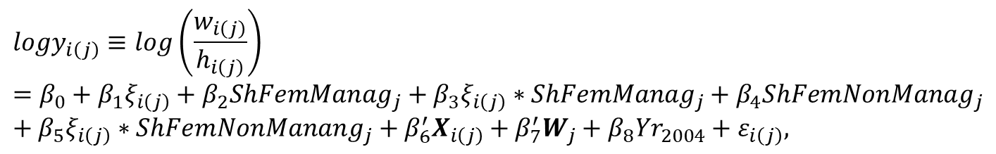
Baseline OLS specification
$${logy}_{i\left(j\right)}≡log\left(\frac{w_{i\left(j\right)}}{h_{i\left(j\right)}}\right)=β_{0}+β_{1}ξ_{i\left(j\right)}+β_{2}{ShFemManag}_{j}+β_{3}ξ_{i\left(j\right)}∗{ShFemManag}_{j}+β_{4}{ShFemNonManag}_{j}+β_{5}ξ_{i\left(j\right)}∗{ShFemNonManang}_{j}+β_{6}^{′}X_{i\left(j\right)}+β_{7}^{′}W_{j}+{β_{8}Yr}_{2004}+ε_{i\left(j\right)},$$
Notes:
The parameter on the gender dummy (β1) indicates the gender wage gap in a male-dominated workplace; the parameter on share of female managers (β2) (or non-managers, β4) shows the impact on male pay of an increasing share of female managers (or non-managers). The parameters of the respective interaction terms (β3 and β5) show the effect on the gender wage gap of an increasing share of female managers (or non-managers).
X_i(j) is a vector of observed individual covariates, W_j is a vector of observed workplace covariates, 〖Yr〗_2004 is a dummy variable taking the value of 1 if the observation comes from the 2004 cross section and ε_i(j) is the disturbance term. We estimate this model using OLS, but for robustness of the functional form we also report some results from an interval regression model.

Slide 14
Log Hourly Earnings – baseline estimates
 | (1) | (2) | (3)
 | OLS | Interval regression | OLS Workplace FE
Female | -0.156*** | -0.153*** | -0.138***
 | (0.021) | (0.021) | (0.023)
Female Share Managers | -0.085*** | -0.092***
 | (0.029) | (0.030)
Female Share Managers*Female | 0.114*** | 0.110*** | 0.137***
 | (0.033) | (0.033) | (0.036)
Female Share Non-Managers | -0.078** | -0.100**
 | (0.039) | (0.039)
Female Share Non-Managers*Female | 0.021 | 0.010 | -0.031
 | (0.040) | (0.039) | (0.043)
Constant | 1.708*** (0.072) | 1.591*** (0.073) | 1.861*** (0.046)
Observations | 39966 | 39966 | 39966
Adjusted R² | 0.452 |  | 0.502
Log pseudolikelihood |  | -359.415
Notes:
A one standard deviation increase in the share of female managers is associated with a 4 percentage point decline in the gender wage gap (0.114*0.355=4.05).
Around one quarter of workplaces in our sample do not contribute to the fixed-effects estimates in column 3 as they have no within-workplace gender variance

Slide 15
Gap in Log Hourly Wages and the Share Female Managers and Non-managers:
Marginal Effects, 95% confidence interval

Slide 16
Share Female Managers and the Declining Gender Wage Gap

Slide 17
Sensitivity Tests
 | (1) | (2) | (3) | (4) | (5) | (6)
 | Without SOC1 (i.e. exclude managers) | Share Female Managers & Share Female Professionals | % Female Supervisors | % Female Supervisors and % Female Managers | Fully Interacted Linear Model | Parsimonious controls
Female | -0.156*** | -0.145*** | -0.162*** | -0.176*** | 0.547*** | -0.145***
 | (0.020) | (0.021) | (0.014) | (0.015) | (0.135) | (0.021)
Female Share Managers | -0.073** |  |  | -0.073** | -0.064** | -0.130***
 | (0.031) |  |  | (0.029) | (0.029) | (0.032)
Female Share Managers*Female | 0.106*** |  |  | 0.079** | 0.081** | 0.161***
 | (0.035) |  |  | (0.032) | (0.032) | (0.036)
Female Share Non-Managers | -0.093** |  |  |  | -0.077* | -0.017
 | (0.041) |  |  |  | (0.042) | (0.042)
Female Share Non-Managers*Female | 0.034 |  |  |  | 0.022 | -0.097**
 | (0.040) |  |  |  | (0.052) | (0.042)
Female Share Managers & Professionals |  | -0.118*** (0.029)
Female Share Managers & Professionals * Female |  | 0.170*** (0.033)
Female Share Non-Managers & Non-Professionals |  | -0.011 (0.036)
Female Share Non-Managers & Non-Professionals*Female |  | -0.053 (0.038)
Female Share Supervisors |  |  | -0.101*** | -0.078***
 |  |  | (0.022) | (0.023)
Female Share Supervisors*Female |  |  | 0.121*** | 0.091***
 |  |  | (0.025) | (0.028)
Constant | 1.741*** (0.080) | 1.694*** (0.070) | 1.693*** (0.069) | 1.694*** (0.070) | 1.345*** (0.099) | 1.085*** (0.070)
Observations | 36381 | 39966 | 39966 | 39966 | 39,966 | 39,966
Adjusted R² | 0.431 | 0.452 | 0.452 | 0.452 | 0.458 | 0.387
Notes:
Col 2: over 2/5 of professionals have supervisory responsibilities
Col 3: In the employee questionnaire employees were asked “Do you supervise any other employees? A supervisor, foreman or manager is responsible for overseeing the work of other employees on a day-to-day basis” Yes/No. We keep employees who answered affirmatively to this question and use those data to compute the share of female supervisors among all supervisors in the workplace

Slide 18
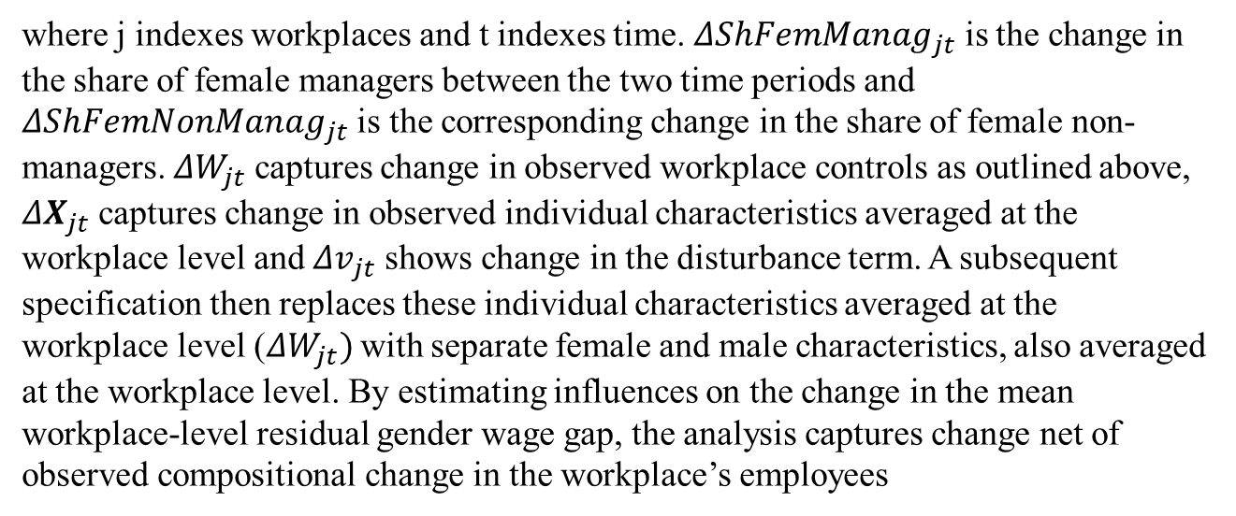
Panel Specification
$$Δ{\left(\overline{W_{M}}−\overline{W_{F}}\right)}_{jt}=δ_{1}{ΔShFemManag}_{jt}+δ_{2}{ΔShFemNonManag}_{jt}+δ_{3}^{′}ΔW_{jt}+δ_{4}^{′}ΔX_{jt}+Δv_{jt},$$
where j indexes workplaces and t indexes time. ${ΔShFemManag}_{jt}$ is the change in the share of female managers between the two time periods and ${ΔShFemNonManag}_{jt}$ is the corresponding change in the share of female non-managers. ${ΔW}_{jt}$ captures change in observed workplace controls as outlined above, $ΔX_{jt}$ captures change in observed individual characteristics averaged at the workplace level and ${Δv}_{jt}$ shows change in the disturbance term. A subsequent specification then replaces these individual characteristics averaged at the workplace level (${ΔW}_{jt})$with separate female and male characteristics, also averaged at the workplace level. By estimating influences on the change in the mean workplace-level residual gender wage gap, the analysis captures change net of observed compositional change in the workplace’s employees
Notes:
The panel analysis is performed in two steps. In the first step we construct the average raw male-female log hourly wage differential from the employee level sample in each workplace. We then merge these raw gender wage gaps to the workplace panel sample using the unique workplace identifier. It is this male-female log hourly wage differential that is the dependent variable for our panel regression

Slide 19
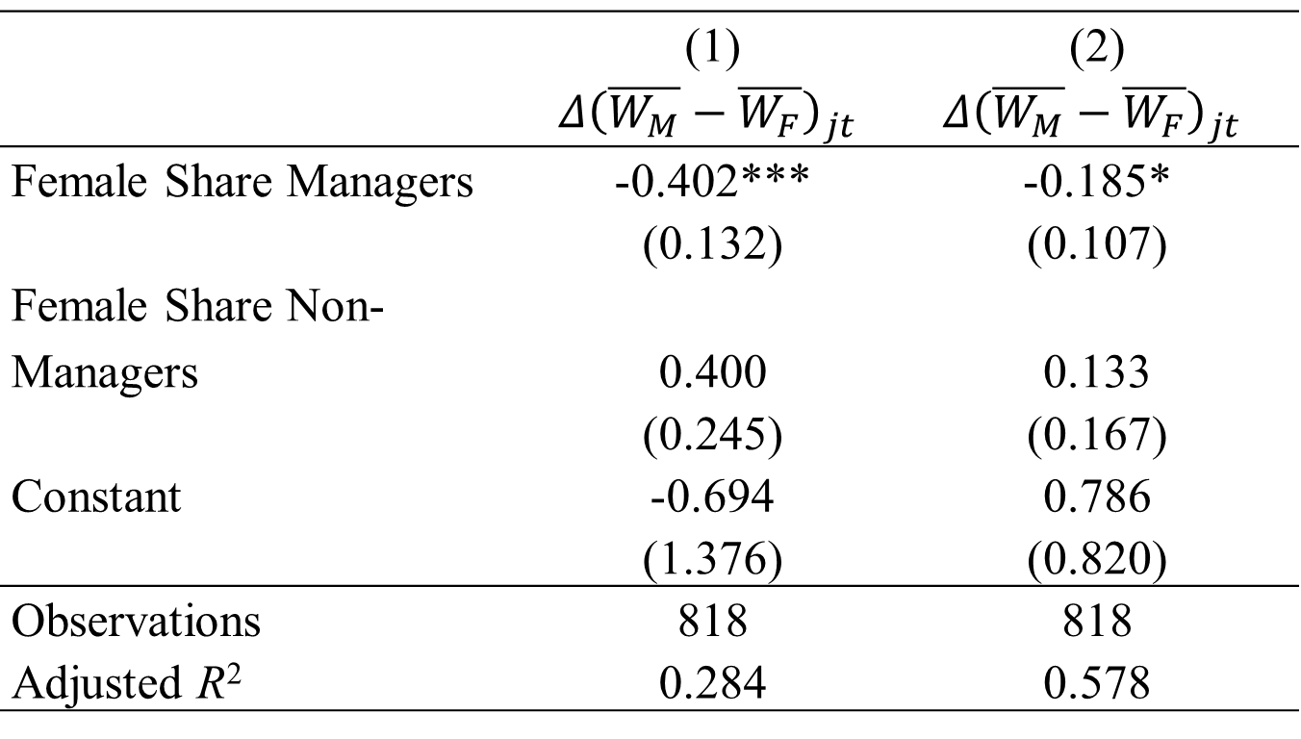
Change in Gender Wage Gap: Workplace Panel (First-Difference) Analysis
 | (1) | (2)
 | $$Δ{\left(\overline{W_{M}}−\overline{W_{F}}\right)}_{jt}$$ | $$Δ{\left(\overline{W_{M}}−\overline{W_{F}}\right)}_{jt}$$
Female Share Managers | -0.402*** | -0.185*
 | (0.132) | (0.107)
Female Share Non-Managers | 0.400 | 0.133
 | (0.245) | (0.167)
Constant | -0.694 | 0.786
 | (1.376) | (0.820)
Observations | 818 | 818
Adjusted R² | 0.284 | 0.578
Notes:
From column 1 a one standard deviation increase in share female managers decreases the log male-female wage differential by 12.3 percentage points.
In column 2 we replace the average employee characteristics with separate female and male averaged workplace characteristics. The share of female managers coefficient decreases in magnitude by around half suggesting that female managers may affect the wage gap through hiring and firing policies which change the composition of the male and female workforce - perhaps recruiting women with higher earnings potential (which is what Hensvik (2014) found for Sweden). However, there remains an effect of female managers on the wage gap after accounting for the compositional changes that we observe in our data: the interaction coefficient in column 2 remains negative and statistically significant, with a one standard deviation shift in the share female managers now decreasing the wage gap by 4.8 percentage points after accounting for compositional changes.

Slide 20
Are Female Shares Endogenous?
Allocation of women in workplaces or in occupations within workplaces is not random
Sorting of women in workplaces and in jobs due to discrimination, worker preferences or unobserved ability
We instrument for share female managers and share female non-managers

Slide 21
Instruments
Household consumption expenditure as share of final demand in the industry sector
  Women’s “people” skills are preferred to men’s “brawn” skills in sectors which are customer-focused (Ngai and Petrongolo, 2017; Lordan and Pischke, 2019)
  concentration of females in those industries from which managers drawn
  Derived for 85 industry sectors from UK Supply and Use Tables (ONS, 2018)
National male-female difference in promotion rates to managerial positions for employees in the workplace’s largest occupation
  Occupational variation in ‘family-friendliness’ resulting in differential promotion rates by gender
  Derive gender-specific promotion probabilities at national level from longitudinal Quarterly Labor Force Survey for the workplace’s core non-managerial occupation
  identify the percentage of employees in each SOC Minor Group (3-digit) in Quarter 1 who have been promoted to SOC Major Group 1 (Managers and senior officials) by Quarter 5 (12 months later)
We use instruments to generate fitted values for the shares of female managers and female non-managers in each workplace, and then use these fitted values (and their interactions with the exogenous female dummy) as instrumental variables in the usual 2SLS approach
Notes:
Share of the industry output that is accounted for by final consumption (consumption by individuals and households) as opposed to intermediate consumption (consumption by other businesses). To give some indication of the variation the share is 3% in SIC(2007) Division 28 (Manufacture of machinery and equipment), 19% in Division 64 (Financial Services), 76% in Group 49.1/49.2 (Rail transport) and 98% in Division 86 (Human health activities). The variable has a small and statistically non-significant standardised beta coefficient when entered directly into our wage equation (beta= -0.027; t= -1.40).
Since many managers are hired via promotion rather than from the external labour market (Lyness and Judiesch, 1999), a workplace whose core non-managerial workforce is drawn from a less egalitarian occupation will have fewer women in managerial positions than one in which the core non-managerial workforce is drawn from a more egalitarian occupation. We thus use gender-differences in promotion probabilities at national level in the workplace’s core non-managerial occupation as an instrument for the share of managers at the workplace that are female. The median three-digit occupation has a value of 0.03, indicating that the share of men promoted to managerial positions annually is three percentage points higher than the equivalent share of women (inter-quartile range: -0.06 to 0.09).

Slide 22
Instrumental Variables: First Stage
 | (1) | (2)
 | Share Female Managers | Share Female Non-Managers
Instrumental variable: Household consumption expenditure as share of final demand in the industry sector | 0.330*** (6.361) | 0.343*** (7.213)
Instrumental variable: National male-female difference in promotion rates to managerial positions for employees in the workplace’s largest occupation | -0.053** (-2.054) | 0.002 (0.089)
Observations | 3,236 | 3,236
Adjusted R² | 0.336 | 0.649
F-test of excluded instruments F(2,3235): | 22.25 | 26.27
Prob>F | <0.01 | <0.01

Slide 23
Instrumental Variables Estimates
 | (1) | (2)
 | All employees | All employees except Managers (SOC1)
Female | -0.125*** | -0.117***
 | (0.022) | (0.022)
Female Share Managers | -0.323* | -0.302
 | (0.167) | (0.185)
Female Share Managers*Female | 0.309*** | 0.366***
 | (0.095) | (0.097)
Female Share Non-Managers | 0.054 | -0.002
 | (0.183) | (0.206)
Female Share Non-Managers*Female | -0.197** | -0.245***
 | (0.084) | (0.086)
Observations | 39966 | 36381
Adjusted R² | 0.452 | 0.431

Slide 24
Performance Pay Mechanism
Reasons why share female managers may affect allocation of performance related pay
  Women may be better-placed than men to judge accurately the work performance of female colleagues and reward them accordingly
  If there is gender-bias in the way performance is rewarded, having a higher share of females in managerial positions may help redress that bias by rewarding employees more equitably
  Non-managerial women may raise effort in knowledge that they will be rewarded fairly
Distinguish workplaces where the majority (60%+) of non-managerial employees are subject to performance-based pay from other workplaces (23% of all workplaces covering 28% employees)
Supplement with identification of individuals subject to individual performance pay within workplaces
  2011 only

Slide 25
GWG, Female Shares and Performance-based Pay
 | OLS | OLS Workplace FE | OLS Workplace FE
Female | -0.132*** | -0.105*** | -0.103***
 | (0.021) | (0.024) | (0.025)
Female Share Managers | -0.054*
 | (0.032)
Female Share Managers * Female | 0.070* | 0.097** | 0.062
 | (0.036) | (0.039) | (0.041)
Performance Pay | 0.104*** |  | 0.127***
 | (0.028) |  | (0.043)
Female * Performance Pay | -0.063 | -0.108** | -0.107
 | (0.046) | (0.054) | (0.074)
Performance Pay * Female Share Managers | -0.103 |  | -0.253**
 | (0.068) |  | (0.122)
Female * Performance Pay * Female Share Managers | 0.178** | 0.165* | 0.319**
 | (0.082) | (0.091) | (0.158)
Female Share Non-Managers | -0.061
 | (0.039)
Female Share Non-Managers*Female | 0.024 | -0.047 | 0.030
 | (0.040) | (0.044) | (0.050)
Performance Pay * Female Share Non-Managers | -0.060 |  | 0.177
 | (0.072) |  | (0.123)
Female * Performance Pay * Female Share Non-Managers | -0.051 | 0.045 | -0.177
 | (0.098) | (0.114) | (0.178)
Constant | 1.684*** | 1.860*** | 2.019***
 | (0.072) | (0.089) | (0.054)
Observations | 39966 | 39966 | 19,269
Adjusted R² | 0.453 | 0.502 | 0.428
Notes:
In column 3, performance pay is a dummy variable taking the value of 1 if the employee is in receipt of performance pay and the workplace human resource manager said that there is either individual performance related pay or merit pay in the establishment, 0 otherwise. Since individual performance pay information is only available in the 2011 employee questionnaire, column 3 is estimated using only the 2011 sample

Slide 26
The Impact of Share Female Managers and of Performance Pay on the Gender Wage Gap
Notes:
GWG disappears under performance pay when 60% managers are women compared to 90% under fixed pay regimes

Slide 27
Summary
Higher share female managers reduces GWG
  In cross-section, panel, and when accounting for potential endogeneity
  Robust to alternative definitions of ‘manager’
Higher share female alters allocation of performance pay across men and women
  One mechanism; there may be others
GWG disappears with a very high share female managers (nine-in-ten) apparent in only a minority of workplaces
  Only need 60% female managers for GWG to disappear under individual performance pay
Female managers seem to reallocate resources to women at the expense of men

Slide 28
Bonus Slide

Slide 29
National Male-Female Difference in Promotion Rates to Managerial Positions for Employees in Each SOC Major Group

