Slide 1
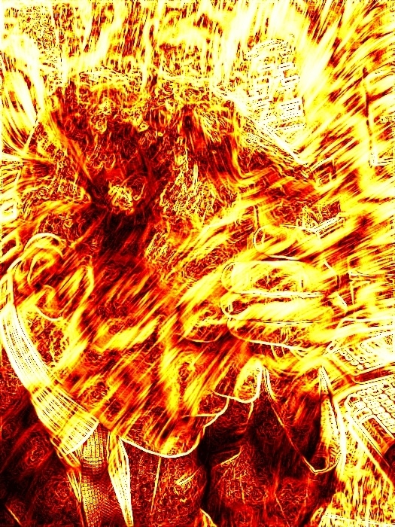
Adult Headache Presenting to the Acute Physician-When and How to Investigate & Treat
Dr Tim Young Consultant Neurologist Headache Department The National Hospital for Neurology and Neurosurgery,
Queen Square, London
March 2013

Slide 2
Evidence and Guidance
SIGN Headache Guidelines Nov 2008(Scottish Intercollegiate Guidelines Network) http://www.sign.ac.uk/pdf/sign107.pdf
International Headache Society Criteria http://ihs-classification.org/_downloads/mixed/ICHD-IIR1final.pdf
NICE Sept 2012 Guidelines http://www.nice.org.uk/nicemedia/live/13901/60853/60853.pdf

Slide 3
What Headaches present to A&E?

Slide 4
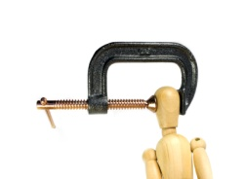


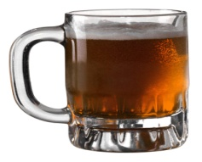
What do I ask them?..
Maybe more than 1 headache type so ask for both!
TIME Onset (?thunderclap),
Duration (without analgesic),
How many times in a day, what time of day
PAIN Where, Nature (throb vs stab), Intensity (/10); Do
lights/sound/motion/posture/Straining/touching/eating worsen it?
WHAT DO THEY DO WITH HEADACHE?
What do they do during attack?-Lie still or pace/rock
ASSOCIATED FEATURES: Nausea, aura, ONE SIDED autonomic features (ptosis, runny eye/nose, sweating, puffy eye)
HEADACHE/ANALGESIA DAYS IN LAST MONTH?
Allergies, Depression, Glaucoma, smoker, OCP/Pregnant
MIGRAINE ‘RISK’ FACTORS:
Easy hangovers, travel sickness, Family History of headache

Slide 5
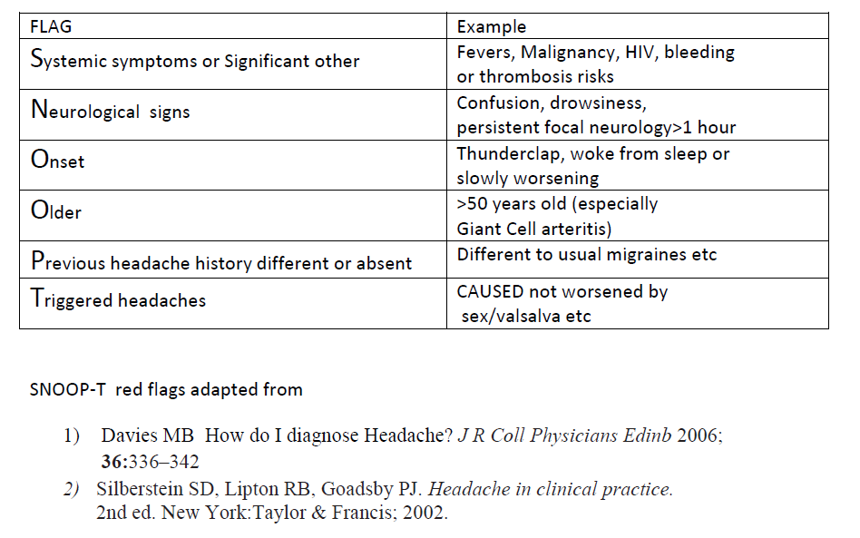
Red Flags-SNOOP-T
NICE also suggest headache with change in cognition/personality or if triggered by exercise

Slide 6
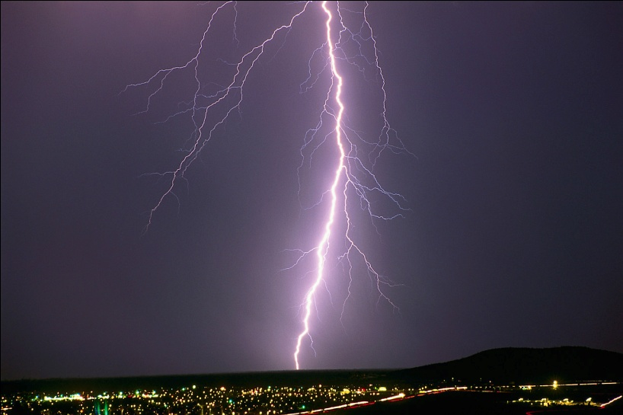

Thunderclap Headache
Headache reaching maximum intensity in under 1 minute (NICE suggest <5minutes) and typically lasting 1 hour-10 days.
Subarachnoid haemorrhage is the major concern though only the case in about 10-15% of thunderclap headaches (about 1% of all Headache patients seen in A&E-Vermeulen et al 1990). There is a growing list of secondary causes of thunderclap headache to be considered before the term ‘idiopathic’ is used.

Slide 7
Subarachnoid Haemorrhage
CT head (plain) (If done within 6 hours with modern CT& senior radiologist says normal, recent Canadian study suggested LP of limited value¹)
If CT negative & no contraindication
LP (opening pressure, glu/prot/micro, PCR)
CSF 4th bottle for cells and
Xanthochromia (bilirubin spectrophotometry)
Xanthochromia +ve for SAH 12hr-2 weeks
¹ [BMJ 2011;343]

Slide 8
Other causes of thunderclap headache not excluded by CT LP
Cervical/Vertebral artery dissection-usually other features from history or exam (Horner’s/lower cranial nerve lesions). Probably only 1-2% of all dissections present only with pain-in such cases it is not known if treatment-even with aspirin really helps
Cluster headache-recurrent attacks even in 1 day-unilateral autonomic features-Pacing around or rocking in attack and usually longer History
Pituitary Apoplexy-Rare & often associated visual field loss, diplopia or reduced GCS-may show on CT if large
Cerebral Venous Thrombosis-usually slower build and O/P may well be raised on LP
Acute Narrow angle glaucoma-mid dilated pupil and halos/scotoma painful red eye
Giant Cell arteritis-especially if jaw claudication and tender/enlarged/non-pulsatile Superficial temporal artery.

Slide 9
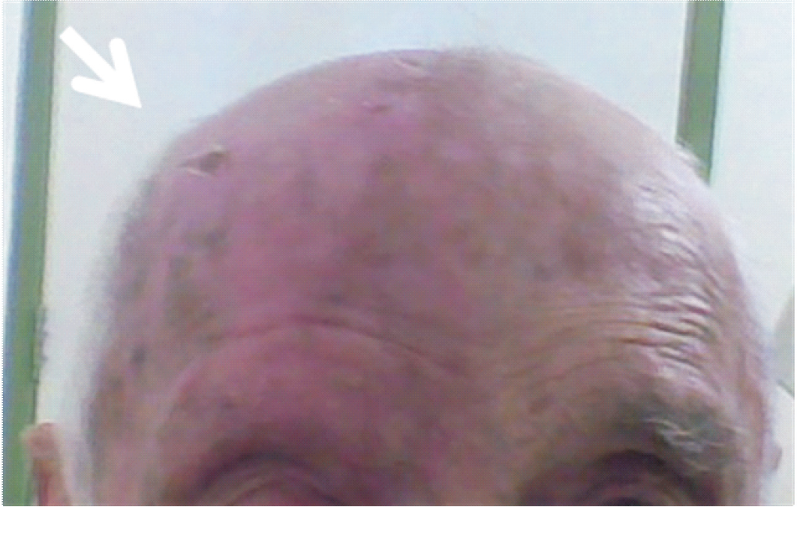
Cluster Headaches (CH)
Martins HA et al Headache Medicine, v.2, n.2, p.70-72, apr./may/jun. 2011
CH diagnosis often delayed by years but consistently rated as most painful experience by patients. It is not known as ‘suicide headache’ for nothing but is usually characteristic-short (15-180 minutes) with severe unilateral V1 pain with pacing and tearing/ptosis on that side. Usually several in a day often same times. 100% O2 and Subcutaneous Sumatriptan can really help in the acute situation then refer to Neurology

Slide 10
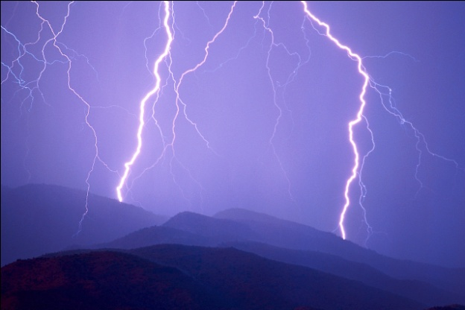
When Lightning strikes twice...
Reversible Cerebral Vasoconstriction syndrome (RCVS)-recurrent thunderclap headaches often within days-to weeks
This term embraces Posterior Reversible Encephalopathy Syndrome
Unclear if caused by other conditions (migraine, dissection, aetiologies).
No clear treatment EXCEPT exclude precipitant (SSRIs, cocaine, sympathomimetics).
Nimodipine may help headache but main concern are bleeds/infarcts
Key point: If more than one thunderclap think of RCVCS and
MRI/A/V Brain-’strings & beads’ appearance on MRA .
Exclude reversible causes: drugs/eclampsia
Remember Cluster Headache too!

Slide 11
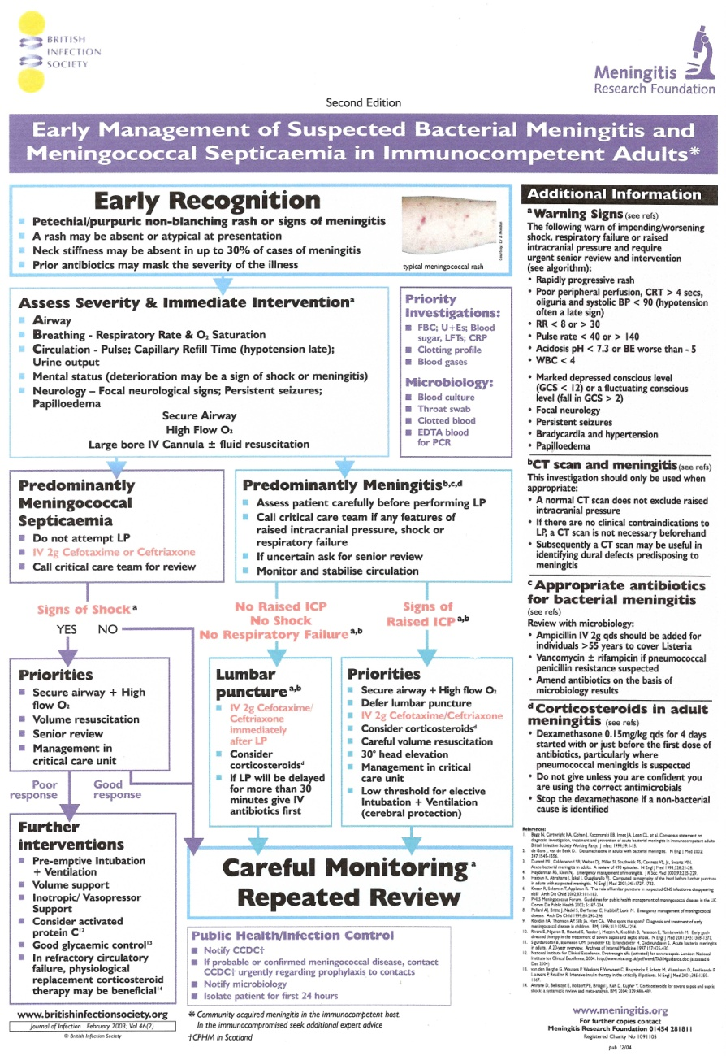
Bacterial Meningitis Guideline
http://www.britishinfection.org/drupal/sites/default/files/MeningitisAlgorithm03.pdf

Slide 12
The Slow Cooker- weeks ago but worsening
Duration key-ask for last headache FREE day
Medication Overuse often key BUT check Ethnicity (TB Meningitis)
Ask about postural/straining factors or recent weight gain
Intracranial Hypertension either idiopathic or secondary possible
Examine Visual Acuity both eyes, visual fields and blind spot, ?papilloedema or VI palsy looking for signs raised CSF pressure
If concerns about any of above have low threshold for CT and, if safe to do so, then LP IMPORTANTLY MEASURING OPENING PRESSURE LYING ON SIDE –IF RAISED DROP TO ABOUT 20 cm H2O.

Slide 13
Worse version of the patient’s usual headache –its only migraine isn’t it?
1) Chronic Headaches (15 or more days/month)
MOH
Probable Chronic Migraine (CM) with
CM
Chronic Migraine
HC
Hemicrania Continua
TTH
Tension-Type Headache-is it really migraine?
Probable Medication Overuse
Stop analgesics or max Days 8/month
Topiramate, Propranolol, Gabapentin,
Acupuncture
BoTox
Amitriptyline, Topiramate
RARE
One sided/Autonomic
INDOMETHACIN

Slide 14
Worse version of the patient’s usual headache –its only migraine isn’t it?
2) Episodic Migraine (14 or less days/month)
NSAIDS
If no contraindication
TRIPTANS
NOT Opiates
Caffeine, Codeine
Antiemetic
ANTIEMETICS:
Can add Triptans
Or Aspirin 900mg
Ibuprofen 200-800mg:
NICE says cheapest first
BUT if not tolerated
Or not working
ANTIEMETIC +/-
Non-oral triptan (Melts,
metoclopramide or prochlorperazine
Triptans common causes of MOH (2% of population!)
sprays, S/C)
Often need High doses of NSAID

Slide 15
Who to scan?
If exacerbation of normal migrainous headache without thunderclap, focal signs or red flags no need to scan
CTA routinely picks up the 3-6% of the normal population with aneurysms which are likely to be incidental but cause concern
Incidental findings in MRI imaging of the brains of healthy young men J of the Neurological Sciences 240 2006 81-84 showed at least 10% with abnormalities
Amazingly there were 10% incidental abnormalities on even CT heads in a study of patients referred for headaches by their GP
Br J of GP 2010; 60(575):426-430
non-contrast CT head should be used if:
The patient also had abnormal neurological exam, altered mental state or cognitive function, Thunderclap headache; also if HIV+ve or patients over 50 presented with a NEW type of headache

Slide 16
Thank you are there any questions?
I have participated in advisory panels for both Allergan and GlaxoSmithkline & received support to attend the 2009 International Headache Society Conference from Allergan

Slide 17
To LP or not to LP after –ve CT?
BMJ Canadian study [BMJ 2011;343] suggested modern 3rd generation CT¹ with experienced radiologist within 6 hours of headache maybe sufficient to exclude SAH. This was a prospective study over a number of years.
3132 worst ever headache patients BUT allowed reaching max intensity in an hour or less, LP only done at local discretion (known that 50% of cases of acute ‘worst headache of life’ did not have LP, both in the1990’s –Morgenstern et al 1998 Ann Emergency Medicine and in the BMJ paper itself) and then when LP was done, white paper not spectrophotometry was used. Non-LP patients chased at 1 and 6 months if no reply coroner contacted [In Ontario all sudden deaths must be reported]
They said 100% sensitivity for the 953 patients who had CT in 6 hours.
If CT later then 17 of 119 SAH cases missed on CT alone. 6 of the 17 needed surgery. Were there another 17 cases (if only 50% Lped) of missed SAH when CT done over 6 hours? Might expect it-and a higher SAH % of thunderclap than the 7.7% in this study-typically 10-13%. Also nearly half SAH have normal exam on admission but 25-50% can die within 6/12 if untreated. Surprisingly low rate (almost no rate) of significant other causes found but again these may have been missed without LP. Hb below 10 can also lead to missed blood.
On balance it does seem likely that if modern CT scan done within 6 hours and reported as negative by experienced radiologist then SAH highly unlikely. LP would be likely to add to the certainty however as well as helping exclude rarer differentials.
¹ x ray emitter and detector rigidly linked and operating in rotate/rotate geometry; multiple rows of detectors in z axis).

Slide 18
2013 J of Neurology update on CT/LP debate
J Neurol. 2013 Jan 29. [Epub ahead of print]
Differential diagnostic yield of lumbar puncture in investigation of suspected subarachnoid haemorrhage: a retrospective study.
Brunell A, Ridefelt P, Zelano J.
Source
Department of Neuroscience, Uppsala University and Uppsala University Hospital, 75124, Uppsala, Sweden.
Abstract
The diagnostic algorithm of computerized tomography (CT) and lumbar puncture (LP) for suspected subarachnoid haemorrhage (SAH) has lately been challenged by the advancement of radiological techniques, such as higher resolution offered by newer generation CT-scanners and increased availability of CT-angiography. A purely radiological workup of suspected SAH offers great advantages for both patients and the health care system, but the risks of abandoning LP in this setting are not well investigated. We have characterized the differential diagnostic yield of LP in the investigation of suspected SAH by a retrospective study. From the hospital laboratory database, we analyzed the medical records of all patients who had undergone CSF-analysis in search of subarachnoid bleeding during 2009-2011. A total of 453 patients were included. In 14 patients (3 %) the LP resulted in an alternative diagnosis, the most common being aseptic meningitis. Two patients (0.5 %) received treatment for herpes meningitis. Five patients (1 %) with subarachnoid haemorrhages were identified. Among these, the four patients presenting with thunderclap headache had non-aneurysmal bleedings and did not require surgical intervention. We conclude that the differential diagnostic yield of LP in investigation of suspected SAH is low, which indicates that alternative diagnoses is not a reason to keep LP in the workup when a purely radiological strategy has been validated. However, algorithms should be developed to increase the recognition of aseptic meningitis. One hundred and fifty-three patients (34 %) were admitted to undergo LP, which estimates the number of hospital beds that might be made available by a radiological diagnostic algorithm.

Slide 19
Overview of talk
1) What headaches are seen on acute takes
2) Secondary or Primary headaches-Red flags
3) the Secondary headaches: a) THUNDERCLAP (mention menigitis
b) Postural headaches (low high Chiari AND Post LP headaches)
C) Progressively worsening over days to weeks
D) Progressively worsening over months
E) Pregnant with headaches
F) Others-include NOCTURNAL headaches: Giant Cell, glaucoma, REBOUND Rx/caffeine
4) Its OK its only a Primary Headache-right?
A) Acute Migraine (include status)
B) AURA with or without headache (not if atypical put in SECONDARY group unless proven otherwise)
C) Probable Chronic Migraine with Probable Medication overuse (secondary or blocking effect). Impact and psychiatric co morbidity-WHY NOW? If No MOH check D correct-could be post-traumatic
D) Cluster headache episodic chronic GET the Skull picture
E) Short Stabs-PH, SUNCT, TN, Idiopathic stabbing
F) Others-rare headache talk, sex, cough, hypnic
G) TTH-do you see it in A&E? probably migraine or other factors though recent paper suggested could be higher (was it undiagnosed migraine though) A total of 204 patients agreed to participate in the study and were randomized to the oxygen (102 patients) and placebo (102 patients) groups. Patient headache types included tension (47%), migraine (27%), undifferentiated (25%), and cluster (1%). The American Journal of Emergency MedicineVolume 30, Issue 9, November 2012, Pages 1760–1764 Efficacy of high-flow oxygen therapy in all types of headache: a prospective, randomized, placebo-controlled trial.
Ozkurt B, Cinar O, Cevik E, Acar AY, Arslan D, Eyi EY, Jay L, Yamanel L, Madsen T.
E) Overview on Investigating and managing headaches-when to scan, how to scan, LPs ESRs, specialist input
F) summary

Slide 20
Who to scan?
If exacerbation of normal migrainous headache without thunderclap, focal signs or red flags no need to scan.
Whilst in theory some expanding but not yet bleeding aneurysms might be associated with thunderclap headaches, performing CTA routinely picks up the 3-6% of the normal population with aneurysms which are likely to be incidental but cause concern
Incidental findings in MRI imaging of the brains of healthy young men J of the Neurological Sciences 240 2006 81-84 showed at least 10% with abnormalities which can potentially cause concern but were not causing harm.
Amazingly there were 10% incidental abnormalities on even CT heads in a study of patients referred for headaches by their GP [Thomas R, Cook A, Main G, Taylor T, Galizia CE, Swingler R. Primary care access to computed tomography for chronic headache. British Journal of General Practice. 2010; 60(575):426-430.]
In total; published studies which NICE reviewed in their recent guidelines only 0.93% of scans for headaches revealed a serious abnormality but the quality of data was very low
In Essence NICE agree: If a primary headache disorder (CH, TTH, migraine) Do not scan to reassure
Clinical Policy paper (Edlow et al Annals of Emergency Medicine 2008 52(4) 407-436) recommended that for non-traumatic headache in ER non-contrast CT head should be used if the patient also had abnormal neurological exam, altered mental state or cognitive function, Thunderclap headache; also if HIV+ve or patients over 50 presented with a NEW type of headache to CT

