Slide 1
Welcoming New Undergraduates to UCL Chemistry A Moodle-Based Welcome Page
DEPARTMENT OF CHEMISTRY
Stephen E. Potts and Mirabel A. Brow
 s.potts@ucl.ac.uk
@StephenEPotts

Slide 2
Rationale
The literature presents many challenges that students face when moving from high school to university (Coertjens et al., 2017).
“The more individuals used social networking sites to gather information and connect with friends, the lower they reported their academic adjustment to be.” Raacke & Bonds-Raacke, 2015
“[We recommend the prioritisation of] open-weeks to ensure that [freshers] are knowledgeable of the degree programmes they are enrolling for.” Methebula, 2015
“Pre-university effort and pre-university academic self-efficacy both positively [correlate] with academic success.” van Herpen et al., 2017
L. Coertjens et al. (2017). “Students’ Transition into Higher Education from an International Perspective”, High. Educ., 73, 357–369.
N. Mathebula (2015). “Surviving First Year of University as a Student: Is it a Jungle?”, Int. J. Educ. Sci., 9, 47–54.
J. Raacke and J. Bonds-Raacke (2015). “Are students really connected? Predicting college adjustment from social network usage”, Educ. Psychol., 35, 819–834.
S. G. A. van Herpen et al. (2017). “Early predictors of first-year academic success at university: pre-university effort, pre-university self-efficacy, and pre-university reasons for attending university”, Educ. Res. Eval., 23, 52–72.
Notes:
L. Coertjens et al. (2017). “Students’ Transition into Higher Education from an International Perspective”, High. Educ., 73, 357–369.
N. Mathebula (2015). “Surviving First Year of University as a Student: Is it a Jungle?”, Int. J. Educ. Sci., 9, 47–54.
J. Raacke and J. Bonds-Raacke (2015). “Are students really connected? Predicting college adjustment from social network usage”, Educ. Psychol., 35, 819–834.
S. G. A. van Herpen et al. (2017). “Early predictors of first-year academic success at university: pre-university effort, pre-university self-efficacy, and pre-university reasons for attending university”, Educ. Res. Eval., 23, 52–72.
H. Jones et al. (2015). “Indications of Knowledge Retention in the Transition to Higher Education”, J. Biol. Educ., 49, 261–273.
H. Jones et al. (2017). “Unexpected benefits of pre-university skills training for A-level students”, Educ. Stud., 43, 67–70.

Slide 3
The Moodle Page
The page was designed to be in line with the UCL’s Moodle Baseline+.

Slide 4
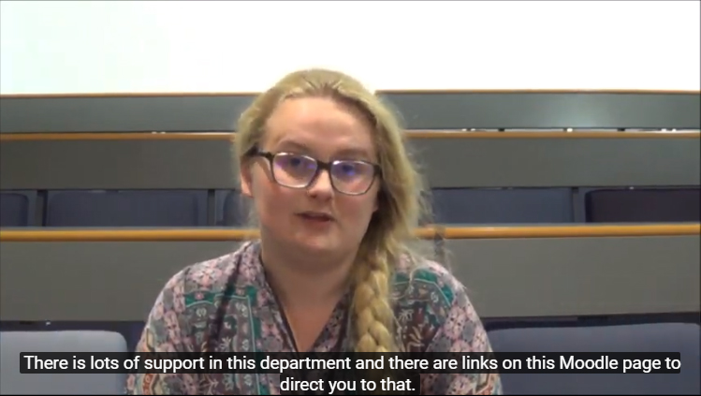
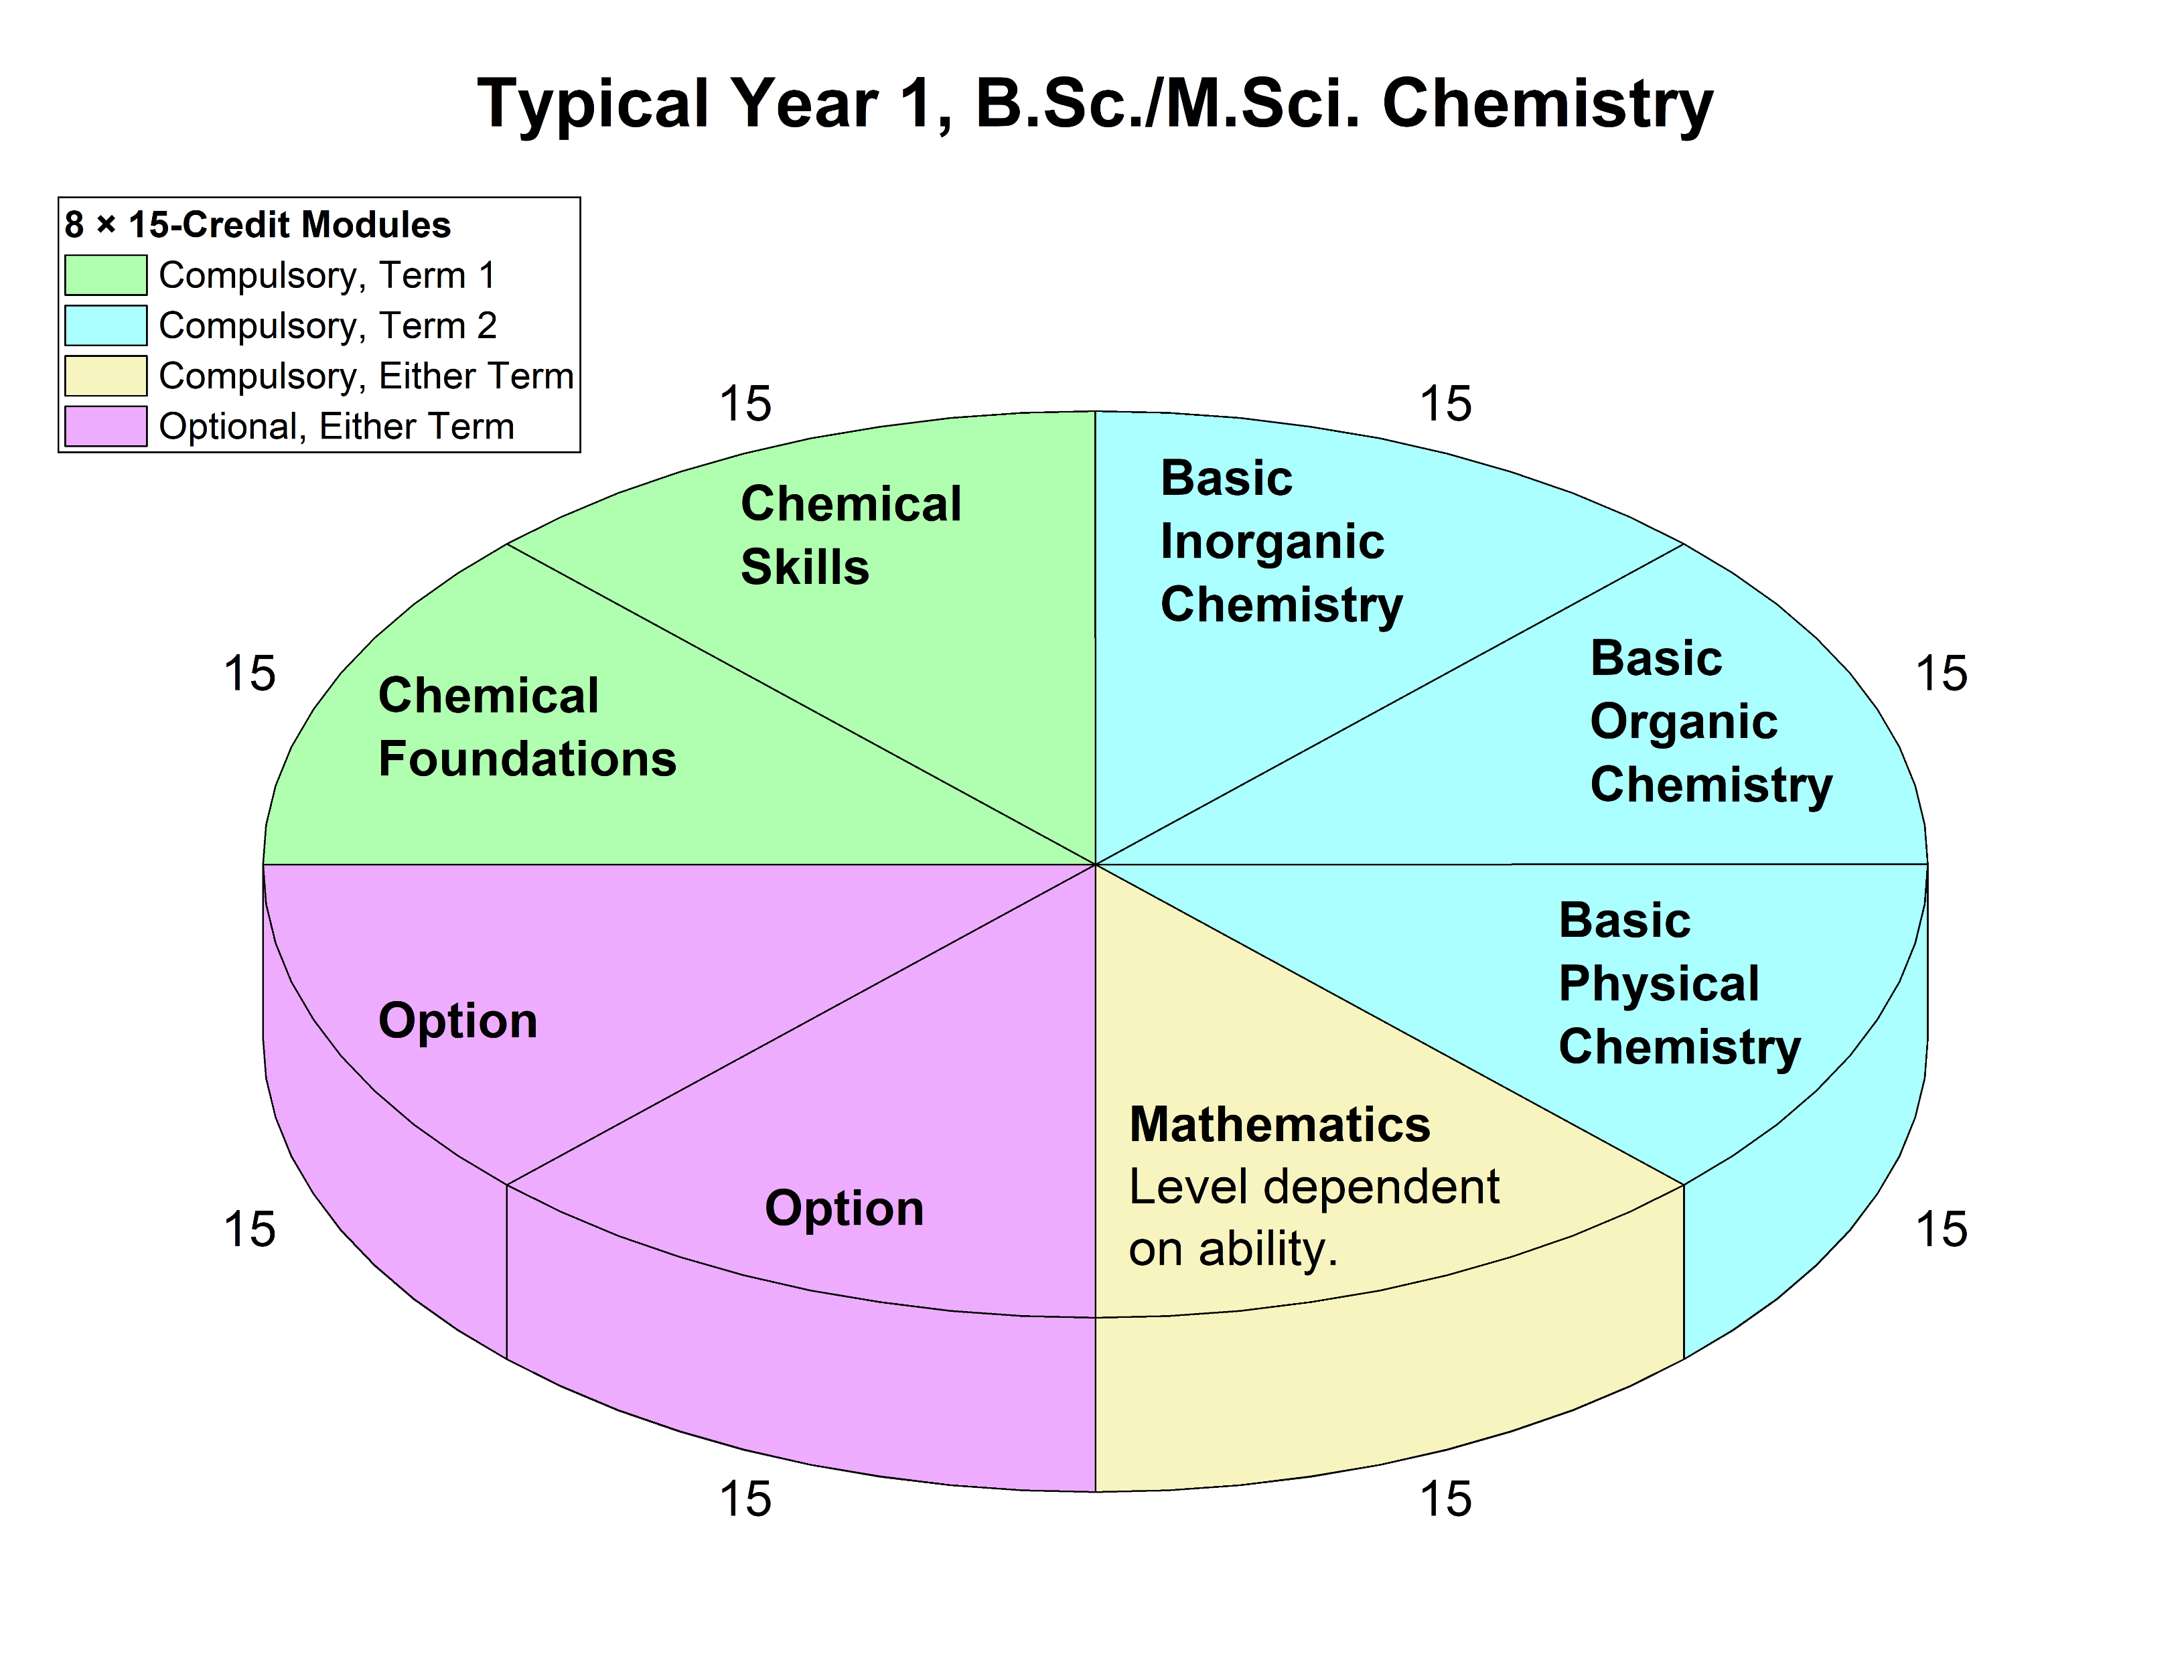
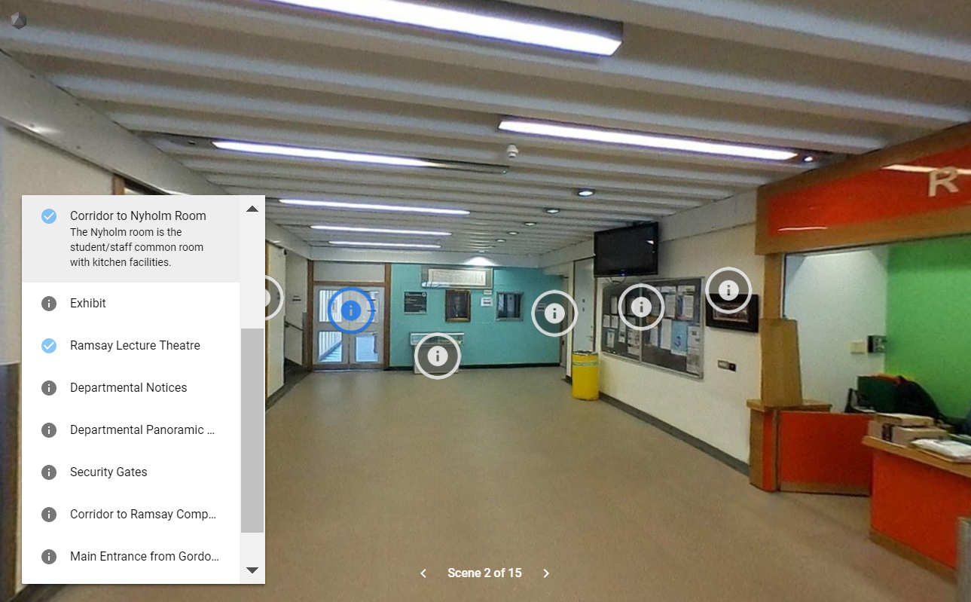
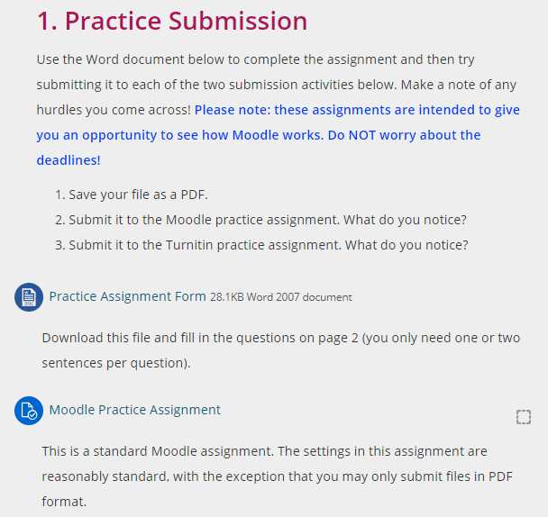
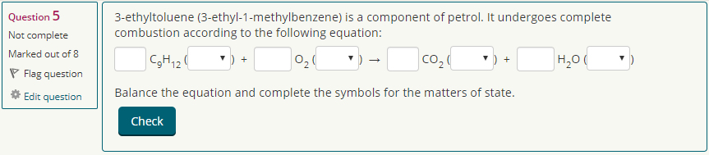
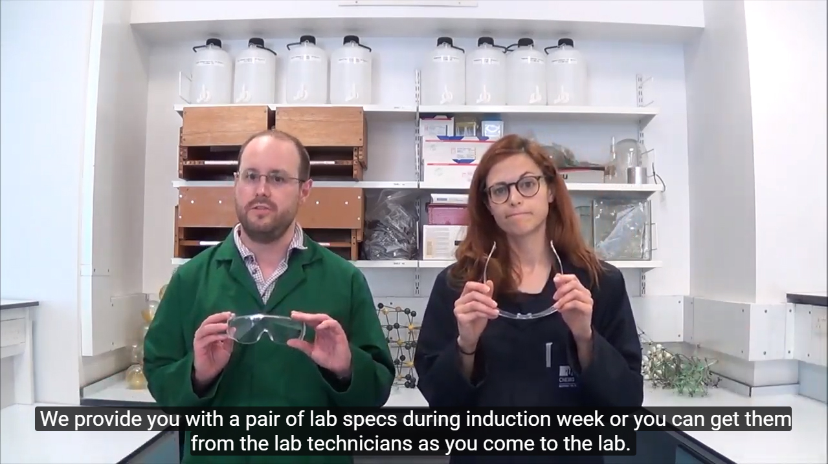
Page Sections
Welcome video
Y1 info
Revision quizzes
Lab videos
3D virtual tour
Pre-reading

Slide 5
Changes in confidence and anxiety?
Responses to a questionnaire before using the page (n = 113) were compared to those from a questionnaire after using the page (n = 60) at the beginning of term using a Mann-Whitney U test.
“I feel confident with coping with the workload at university.”
p = 0.472
“I am anxious about my time at university.”
p = 0.473

Slide 6
Students’ Expectations of Feedback at University
“How soon do you expect feedback after submission?”
(Choose one.)
“How do you expect to receive feedback?”
(Choose all that apply.)
Chemistry standard
UCL standard

Slide 7
“I found the following activities useful.”

Slide 8
Pre-University Qualifications (n = 60) (1/2)
Independent-Samples Median Tests
“I am anxious about my time at university.” p = 0.030
Students with A-levels and IBs were spread.
Those with Advanced Placements and other qualifications were more anxious.

Slide 9
Pre-University Qualifications (n = 60) (2/2)
Independent-Samples Kruskal-Wallis Test
“I have enough information to start my modules in the Department of Chemistry.” p = 0.032
Students with A-levels and IBs felt well-informed.
Students with Advanced Placements were less sure.
Others (e.g. Matura) were very sure.
“I feel confident about coping with the workload at university.” p = 0.020
IBs and other the most positive.
A-levels were mixed.
Advanced placement were negative (sample of 2).

Slide 10
Gender (n = 60)
Independent-Samples Kruskal-Wallis Test
“I feel confident about coping with the workload at university.” p = 0.029
Male students all (strongly) agreed or were neutral.
Female students were more spread.
The mode for both groups was 4 (“agree”).
“I am anxious about my time at university.” p = 0.001
Females skewed to (strongly) agree.
Males largely neutral or disagreeing.

Slide 11
Outlook
 s.potts@ucl.ac.uk
@StephenEPotts
A welcome page needs to encourage students to engage with the page and invest time in it before coming to university.
More course-like structure to help students follow through and/or more gamification.
Careful thought needs to be put into how we can help international students understand how university works in the UK.
Especially those who don’t have A-levels or IBs.
Introduction of new activates to get students used to online learning (e.g. MS Teams, Blackboard Collaborate etc.).

