Slide 1
Easing the Transition from Further to Higher Education Use of Moodle to Welcome New Chemistry Students – A Pilot Study
DEPARTMENT OF CHEMISTRY
Stephen E. Potts and Mirabel A. Brow
 s.potts@ucl.ac.uk
@StephenEPotts

Slide 2
Rationale
The literature presents many challenges that students face when moving from high school to university (Coertjens et al., 2017).
“The more individuals used social networking sites to gather information and connect with friends, the lower they reported their academic adjustment to be.” Raacke & Bonds-Raacke, 2015
“[We recommend the prioritisation of] open-weeks to ensure that [freshers] are knowledgeable of the degree programmes they are enrolling for.” Methebula, 2015
“Pre-university effort and pre-university academic self-efficacy both positively [correlate] with academic success.” van Herpen et al., 2017
L. Coertjens et al. (2017). “Students’ Transition into Higher Education from an International Perspective”, High. Educ., 73, 357–369.
N. Mathebula (2015). “Surviving First Year of University as a Student: Is it a Jungle?”, Int. J. Educ. Sci., 9, 47–54.
J. Raacke and J. Bonds-Raacke (2015). “Are students really connected? Predicting college adjustment from social network usage”, Educ. Psychol., 35, 819–834.
S. G. A. van Herpen et al. (2017). “Early predictors of first-year academic success at university: pre-university effort, pre-university self-efficacy, and pre-university reasons for attending university”, Educ. Res. Eval., 23, 52–72.
Notes:
L. Coertjens et al. (2017). “Students’ Transition into Higher Education from an International Perspective”, High. Educ., 73, 357–369.
N. Mathebula (2015). “Surviving First Year of University as a Student: Is it a Jungle?”, Int. J. Educ. Sci., 9, 47–54.
J. Raacke and J. Bonds-Raacke (2015). “Are students really connected? Predicting college adjustment from social network usage”, Educ. Psychol., 35, 819–834.
S. G. A. van Herpen et al. (2017). “Early predictors of first-year academic success at university: pre-university effort, pre-university self-efficacy, and pre-university reasons for attending university”, Educ. Res. Eval., 23, 52–72.
H. Jones et al. (2015). “Indications of Knowledge Retention in the Transition to Higher Education”, J. Biol. Educ., 49, 261–273.
H. Jones et al. (2017). “Unexpected benefits of pre-university skills training for A-level students”, Educ. Stud., 43, 67–70.

Slide 3
Research Questions
Can we use a pre-university Moodle page to…
manage incoming students’ expectations?
reduce their anxiety about university?
help international students understand how UK institutions work?

Slide 4
Survey of Staff
Revision/refresher questions
Mole calculations, relative molecular mass calculations, empirical and molecular formulae, maths revision
Videos
How things are done, virtual walk-around the department, lab introduction, lab safety, how to submit a Moodle assignment
FAQs
Examples a typical timetable
An example of departmental structure
Information on how to take notes
Information on how to keep a lab notebook
Management of students’ expectations was key.

Slide 5
Survey of Current Chemistry Students Suggestions
“Wish I knew how much lab work there was. Wish there was a clear breakdown of the weightings of each assignment/coursework/lab report.”
“1) revision list of things I am supposed to know, 2) how to draw arrows in organic chemistry, 3) I think staff suggestions are quite eloquent; maybe a map of CIB/relevant buildings.”
“Include revision for unit conversion. NMR and IR spectrum? I was not taught about this during my A levels (international student), which stressed me out when we needed to do analysis for our labs […]. Maybe include a molecule simulator for them to play with.”

Slide 6
Survey of Current Chemistry Students Advice to Incoming Freshers
“Join more societies and engage in more social events. Getting out of [your] comfort zone more often will help.”
“Be prepared for a very intense and stressful year ahead. First year of uni is not easy or a breeze, contrary to popular opinion. Read ahead. Just do it. Start assignments/coursework as soon as they’ve been assigned. Select optional modules wisely.”
“Read about hybridisation of orbitals (specifically sp) as this was not covered in my A level course at all however it was covered in other exam boards. Improve maths skills (did not do maths AS or A level), even though there is a first year course in maths, when not having done maths in a while, it was a lot of work to catch up.”

Slide 7
The Moodle Page
The page was designed to be in line with the UCL’s Moodle Baseline+.

Slide 8
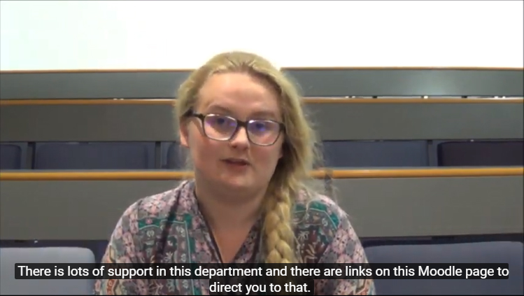
Page Sections
Welcome!
Welcome video featuring key staff members and students.
Diagnostic quiz – how does your level of chemistry match what we expect?
Key Information (Links To…)
Departmental information and procedures page
Departmental safety page
Moodle Induction
Student wellbeing

Slide 9
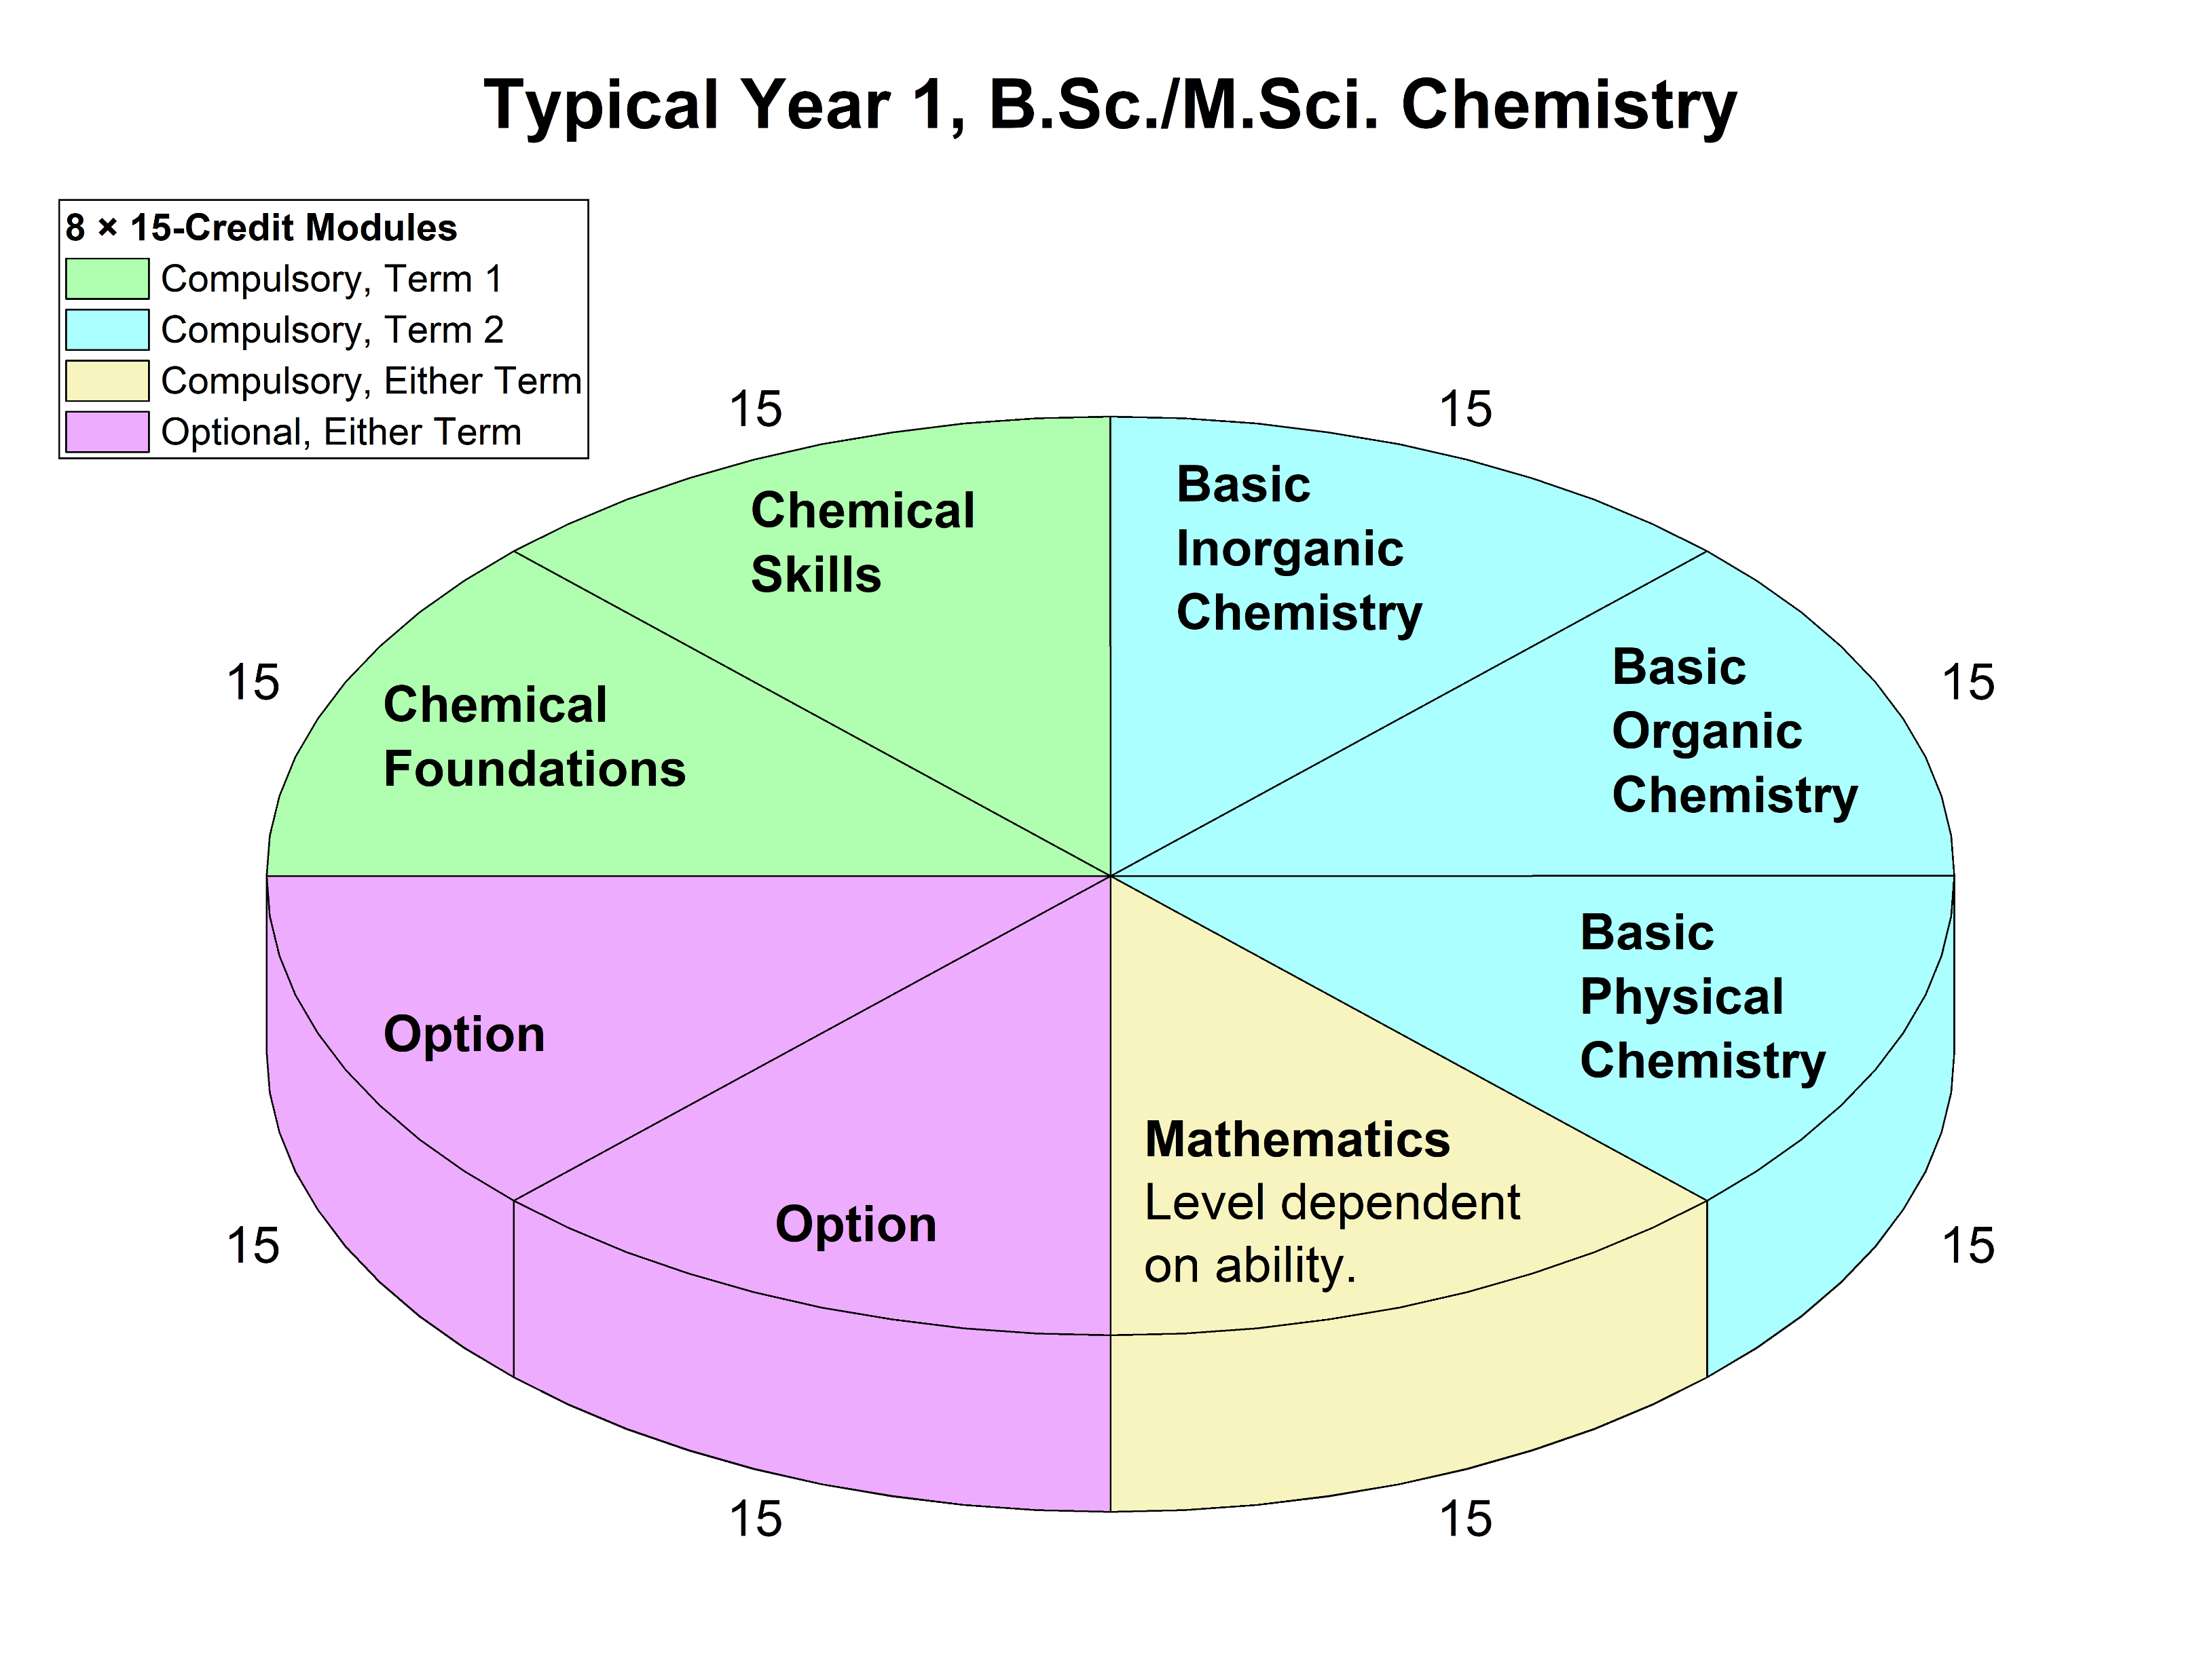
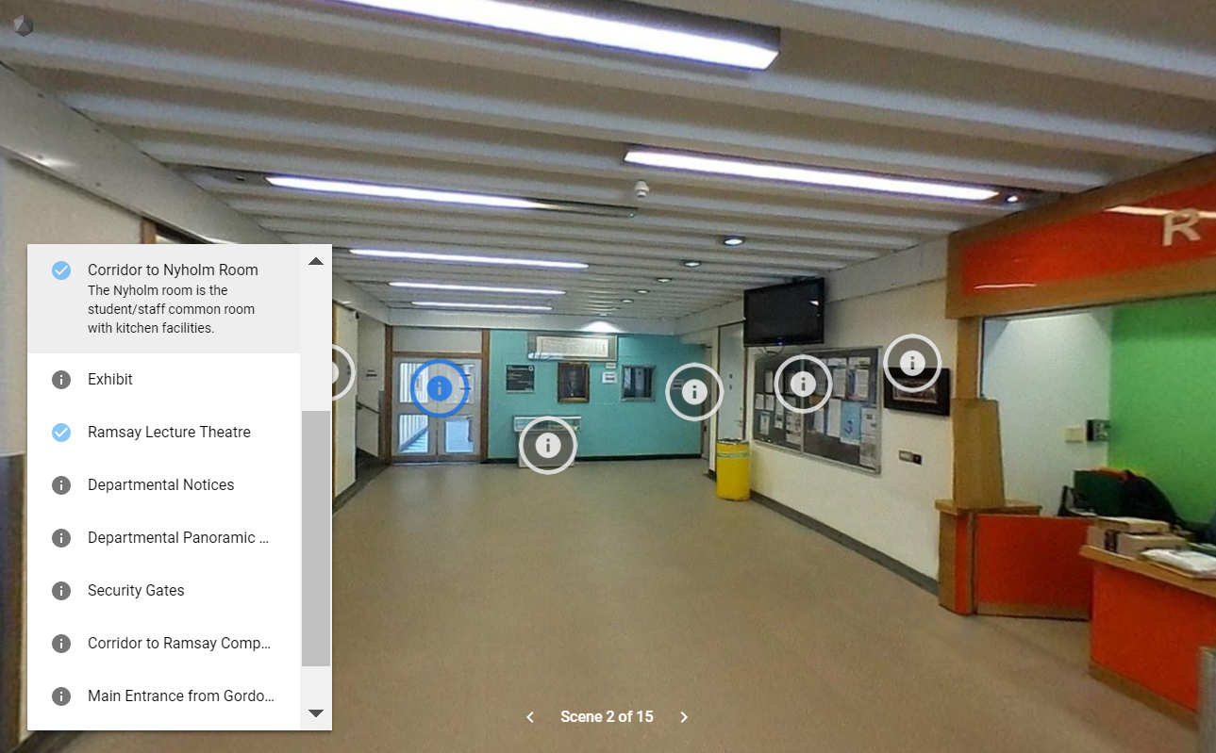
Page Sections
Your First Year
Information about term dates.
Typical options
Example timetables of a typical first year chemist
Frequently-Asked Questions
Have Your Say (Forum)
Virtual Tour
A 3D tour of the department, made using Google Poly.

Slide 10
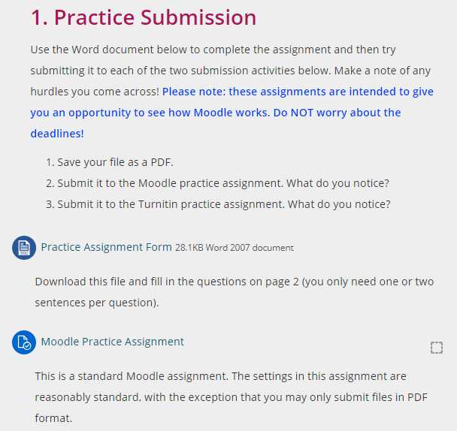
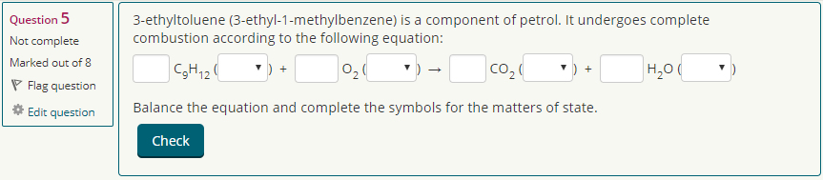
Page Sections
Pre-Reading
Provision of e-texts covering key revision topics required prior to starting the course (Bibliotech).
Practice Assignments
Provision of e-texts covering key revision topics required prior to starting the course.
Revision Resources
Quizzes that participants can retake as much as they like.
Plenty of feedback provided.

Slide 11
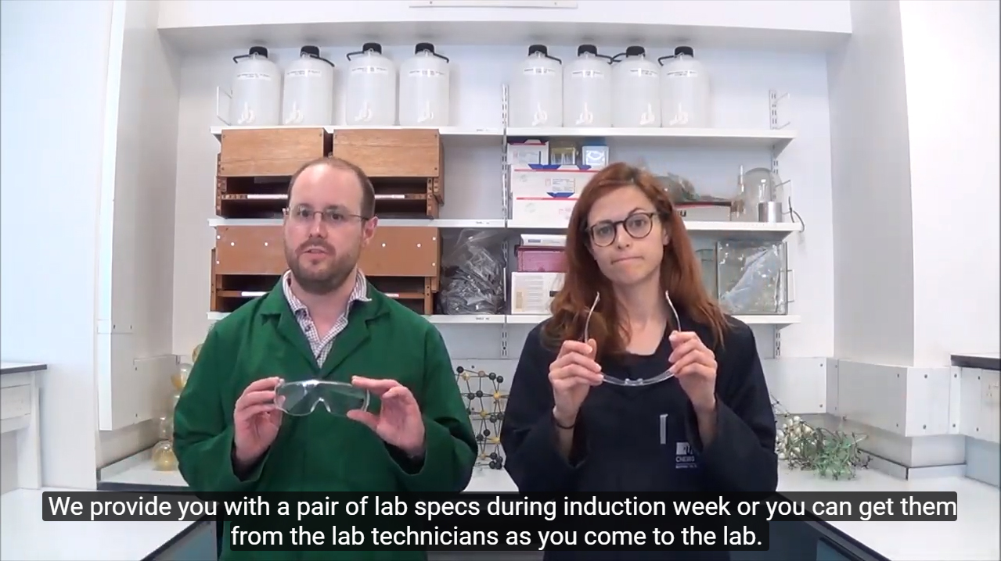
Page Sections
Laboratory Introduction
Videos on how we run our labs and what it’s like doing a practical.
Lab technique simulations for practice (Learning Science).
Beyond Exams
Information about extra-curricular activities (both general and chemistry-related).
Link to Royal Society of Chemistry.
Link to the department’s Chemical & Physical Society.
Just For Fun!
Information about extra-curricular activities
general
chemistry-related

Slide 12
Participants (n = 60)
Pre-University Qualifications
Area of Study at University

Slide 13
Participants (n = 60)
Gender
Age
Nationality

Slide 14
“I found the following activities useful.”

Slide 15
Changes in confidence and anxiety?
Responses to a questionnaire before term 1 (n = 60) were compared to those from a questionnaire at the end of term 1 (n = 34) using a Mann-Whitney U test.
“I am confident with coping with the workload at university.”
p = 0.760
“I am anxious about my time at university.”
p = 0.825

Slide 16
Summary
Students need clarity on what to expect at university.
A welcome page needs to encourage students to engage with the page and invest time in it before coming to university.
More course-like structure to help students follow through and/or more gamification.
Careful thought needs to be put into how we can help international students understand how university works in the UK.
 s.potts@ucl.ac.uk
@StephenEPotts

Slide 17
Students’ Expectations of Feedback at University
How soon do you expect feedback after submission?
(Choose one.)
How do you expect to receive feedback?
(Choose all that apply.)

