Slide 1
Constructing Memory in Contemporary Cambodia: “Cautious resistance and calculated conformity”
Will Brehm
April 15, 2019

Slide 2
“Small and vulnerable, Cambodia has been colonized, overwhelmed by foreign ideologies, torn apart by international conflict, and occupied by other countries. Faced with these incursions, Cambodians have attempted to define an uncontaminated national identity.”
– Evan Gottesman (2003, p. 12)

Slide 3
１．Historical Memory: A Social Process
Family Memory
Religious Memory
Official Memory

Slide 4
2. Official Memory
The sanctioned version of a nation’s history – so called “present assertions of past facts” deemed appropriate by the state (von Leyden, 1984, p. 55).
Based on myth, not necessarily an accurate representation of history (Ricoeur, 2004).
Contested depending on who is in power, what myths are emphasized, and how.

Slide 5
3. Official Memory in Cambodia (1)
Cambodia “is best thought of as an ‘unfinished imagined community’” because questions remain over who should be considered a member of the nation (Norén-Nilsson, 2016, p. 2).
Elite interests have since 1979 coalesced around the ruling party and its long-serving Prime Minister, Hun Sen (Strangio, 2014).
In the post-1979 version of official memory, Hun Sen is a national hero for ousting the Khmer Rouge and saving the Khmer nation.

Slide 6
3. Official Memory in Cambodia (2)
Official vs. Family Memory of Vietnam: Helped CPP come to power but symbolized a hidden power controlling the government. (Converges with other memories)
Political challenges: Consolidation of opposition parties created first real challenge to Hun Sen’s power.
Global summitry: UNESCO Bangkok’s projects impacted historical memory of many government officials.

Slide 7
4. Not only an elite process
Contestation over official memory happens at ‘mid’ or ‘lower’ levels.
James C. Scott (1985; 2018) uses the phrase: “cautious resistance and calculated conformity.”
School curriculum is an excellent entry point: made by bureaucrats who resist or conform to elite versions of official memory.
Eisner’s (2002) framework is a useful tool to analyze the political nature of curriculum

Slide 8
5. Methods
Details the development and content of the 2018 detailed history curriculum framework for upper secondary school (grades 10-12).
Over the course of 2018, interviews were conducted with members of the government committee tasked with designing the history curriculum. The final framework analyzed.
How did bureaucrats balance (national and international) elite interests?

Slide 9
Curriculum Framework Committee
20 person committee comprised government officials in the Ministry of Education Youth and Sport (MoEYS), public school history teachers, professors of history, and curriculum technical experts.
Over 2 years, group designed the general outline of content that should be included in the history subject for grades 10, 11 and 12.
Guide the development of history textbooks and teacher guidebooks.

Slide 10
6. Findings: Managing the State
Conformity: Self-censorship (e.g., the K5 Plan) and Consent (e.g., Color Revolution)
Adding sensitive topics to the null curriculum while assuming they would be discussed in other settings became a convenient way for the designers to reach agreement internally.
Resistance: selective placement; minimize content; allow alternative versions of history
Different text in framework, textbook, and teachers books.
Use oral history to challenge written text.

Slide 11
7. Findings: Managing UNESCO
Conformity: Adopt international language that does not challenge Official Memory
uncontroversial topics (e.g., Rice and spices); reduced work-load (25 ‘free’ lessons).
Resistance: Reinforce an ethno-centric version of nationalism
Identity based on exclusion (e.g., “way of living of Khmer people”) and repackage nationalism with international language (e.g., ‘global values of Khmer kings’)

Slide 12
Conclusions
Bureaucrats’ efforts at curriculum reform, despite instances of resistance, further entrenched state official memory.
How will official memory manifest in the final textbooks?
International versions of historical memory re-interpreted in ways to further the ruling party’s interests.
Has UNESCO Bangkok legitimized the CPP?
Is it an unfinished community or an exclusive community based on delusion?

Slide 13
Research funding provided by:
Project number: 17H07187

Slide 14
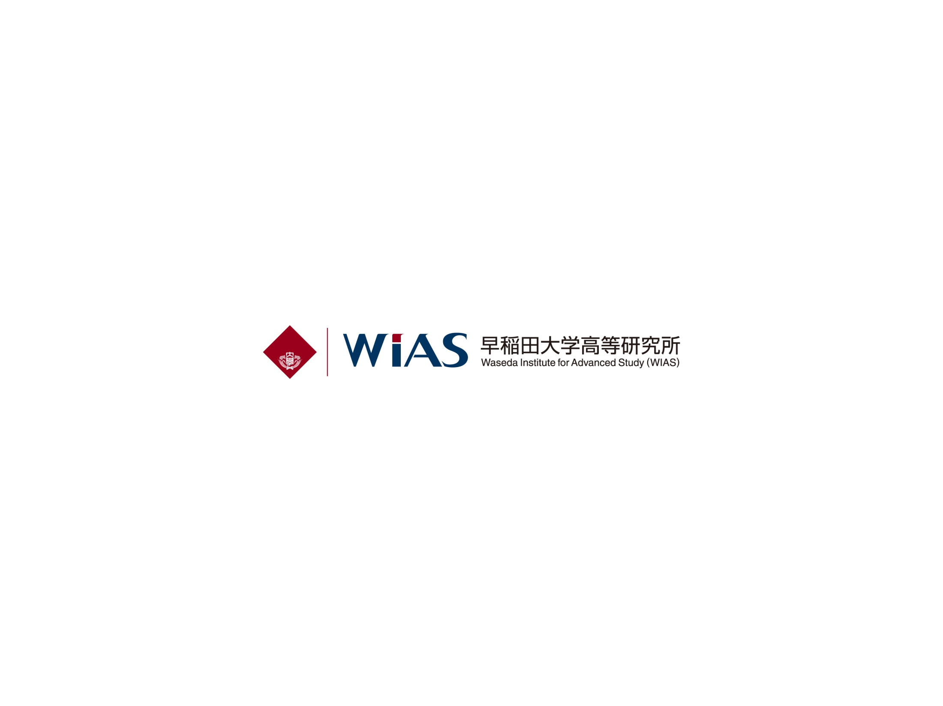
Email: willbrehm@aoni.waseda.jp
Twitter: @wbrehm
13
Notes:
13

