Slide 1
History from Below, Censorship from Above
Memory, Identity, and Schooling across the Mekong
Will Brehm
February 16, 2018
ASEBH Conference
Hobart, Australia

Slide 2
１．On Collective Memory
“Memory only seeks to rescue the past in order to serve the present and the future.”
- Jacques Le Goff
”[Collective Memories] mold social groups, generations and nations and constitute identity.”
- Horst Möller
Notes:
And the differences are usually bloody: Hutu and Tutsi, Shi‘a and Sunni, Hindu and Muslim, Catholic and protestant.
This is Balibar’s notion that racism is at the heart of the state project.
Thonchai’s notion of “negative identification”

Slide 3
１．On Collective Memory
“The various groups that compose society are capable at every moment of reconstructing their past…[and as] they reconstruct it, they deform it.”
- Maurice Halbwachs
“Collective historical remembrance far more closely resemble myth on one side and political propaganda on the other than they do history.”
- David Rieff
Notes:
Mention schooling is a big part of the myth making and propaganda of the state. Site Anderson and Apple
But also remembrance that is done in families and communities. The Nanjing Massacre is a good example.
We know that memory is socially constructed and not entirely tied to accurate history.
But we don’t know exactly how changes occur.

Slide 4
Why, how, and to what effect do changes in collective memory occur in a society?
Notes:
Note that changes and resistance movement happen without being completely organized. James Scott
“The most submissive peasantry is not only capable of 'working the system' to its advantage— or rather to its minimum disadvantage—but also of resisting and where appropriate, of counterattack.” E.J. Hobsbawm, 1973, P. 13)

Slide 5
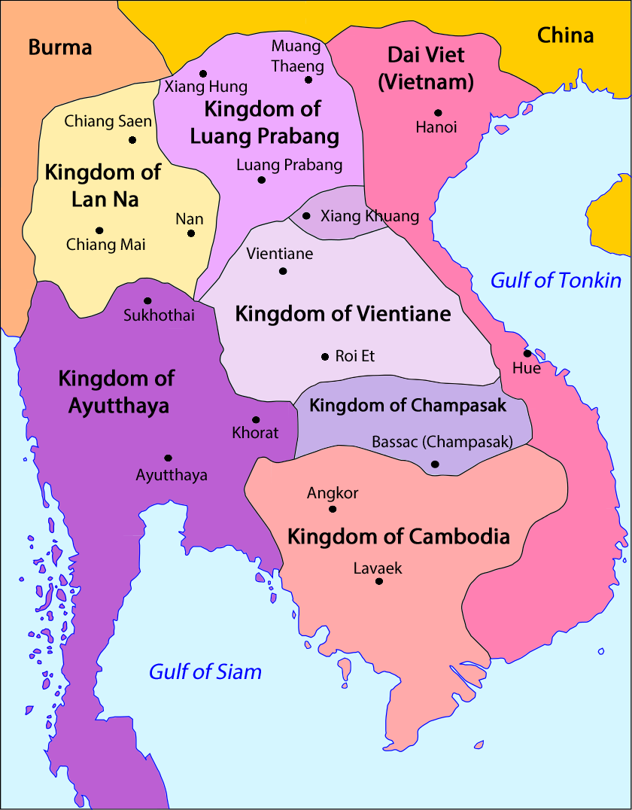
2. Collective Memory in the Mekong
Notes:
Socio-cultural community by 2020
The project is looking at textbooks in Cambodia, Laos, Myanmar, Thailand, and Vietnam. It is also conducting interviews with policy makers and then understanding public opinion surveys of students and teachers.

Slide 6
3. The case of Thailand
Nationalist
Revisionist
Origin: descendants from Tai who lived in South China 1000s of years ago. Thai = Tai.
Unification and independence: Many powerful kingdoms overtime, all matching the Thai borders today.
Hero Kings: Monarchy has defended Thai sovereignty.
Origin: No pure Thai race. History of inter-ethnic mixing among Tai, Lao, Khmer, Mon, Chinese, etc.
Unification and independence: Cultures other than Tai/Thai have influenced Siam, Ayutthaya, etc. History of contestation among city-states.
Hero Kings: Monarchy has written history for own legitimacy.

Slide 7
3. The case of Thailand
Learning standard S.4.3: “Students understand the origin of the Thai nation, Thai culture and Thai wisdom. Students love, take pride in and seek to conserve Thainess”.
“The Thai เชื้อชาติ [nation/race] has over 2,000 years of successive civilization. It was able to build up a unified and strong nation.”

Slide 8
4. The case of Thailand
“Theories of Origin of Thai Chon Chat
…Research of scholars and experts in various disciplines has produced a range of arguments about the origin of the Thai Chon Chat. Some arguments have been accepted; some haven’t. The summary of these arguments are as follows…” (p. 63)
Notes:
Present the competing theories of the origin of thai race, language ethnic group

Slide 9
4. The case of Thailand
“the idea that the origin of Thai Chon Chat situated as far as the Altai mountains is no longer accepted by contemporary historians”
the Central China theory is no longer held by modern-day historians due to the unclear and meagre evidence”
“This theory has not been agreed by historians, because the evidence of language and blood-type is still inadequate”
Notes:
We are left with a nationalist discourse despite incorporating revisionist history

Slide 10
4. The case of Thailand
From Below: Revisionist historians spend years articulating alternative versions of Thai history.
From Above: The State incorporates these other versions of history in textbooks, but ensure students still see the nationalist version as correct.
Outcome: Critical history may loose its criticalness and manufacture consent that leaves the hegemonic ideology in place.

Slide 11
5. The Case of Cambodia
Original Text | Revised Text | Justification
“Since the collapse of the Angkor Empire, Cambodia’s people have witnessed wars of invasion and internal power struggles among its leaders ....” | “From the collapse of the Angkor Empire to 7 January 1979, Cambodian people who survived the execution of the Democratic Kampuchea regime were born again. On 23 October 1991, Cambodia reached a Peace Treaty in Paris. After that, the United Nations organized a national election held on 25-27 May 1993. Cambodia then organized elections by itself on 26 July 1998 and on 27 July 2003.” | Therefore, the text at this point must clearly indicate that the Cambodian People’s Party, under the glorious leadership of Samdech, had never struggled for power with anyone. Namely, the power that the Cambodian People’s Party, which has held effectively up to the present day, comes from the active and strong support of the people.
Notes:
More about the null curriculum – what is not there.

Slide 12
5. The Case of Cambodia
New history curriculum currently being written by a group of ministry officials.
From chronological to thematic in hopes of creating critical thinking.
Calculated Conformity: excluding known absences
  K5 continues to be absent in text

Slide 13
5. The Case of Cambodia
Cautious resistance: creating room to remember
  Changing the names in Khmer based on historical evidence as a way to reclaim collective memory.
  Writing curriculum standards in vague language.
  Hoping students bring in their own sources to challenge textbook.

Slide 14
5. The Case of Cambodia
From Below: Bureaucrats are designing new curriculum through “cautious resistance and calculated conformity”
From Above: The Prime Minister and his team will continue to line-edit texts, but may not realize the power of what’s not said.
Outcome: Could be similar to case of Thailand but may make room for new versions of collective memory.

Slide 15
6. Conclusion: What of collective memory?
Why change?
  Mounting pressure from new sources
  Un-organized resistance
How change?
  The state itself changes memory in a controlled fashion
  Low-level bureaucrats make calculated changes.
To what effect?
  Fortifying old collective memories?
  Allusion of critical thinking?
Notes:
“cautious resistance and calculated conformity” (James C Scott)

Slide 16

Funding provided by Kakenhi
Project number: 17H07187
Contact:
willbrehm@aoni.waseda.jp
15
Notes:
15

