Slide 1
Remembering to Forget Kor Pram: Politics and National Identity in Post-Khmer Rouge Cambodia
Will Brehm
Graduate School of Education
University of Tokyo
December 17, 2016, Kyushu University

Slide 2
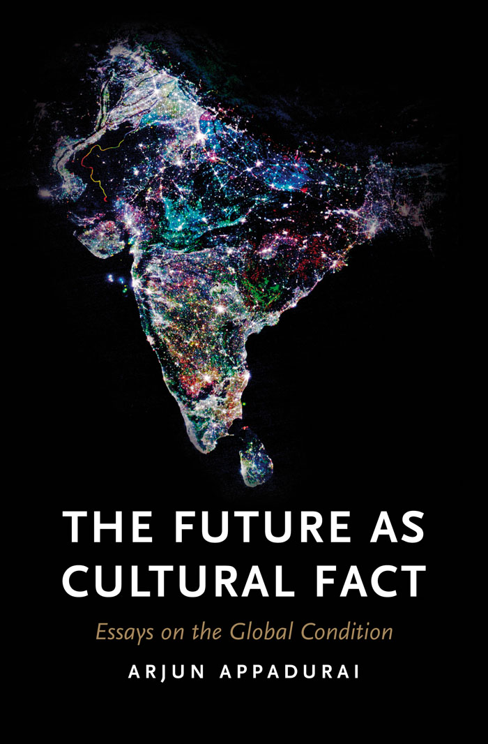
“Histories make geographies.”

Slide 3
“Memories make histories; histories make geographies.”

Slide 5
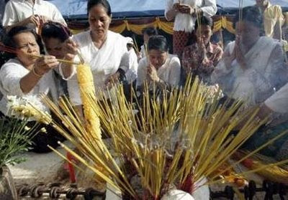
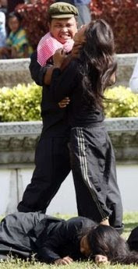
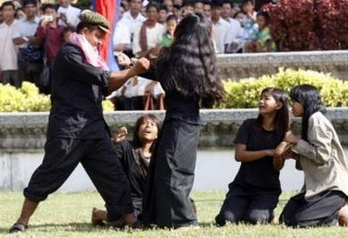
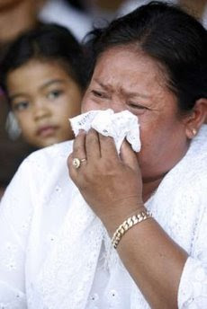
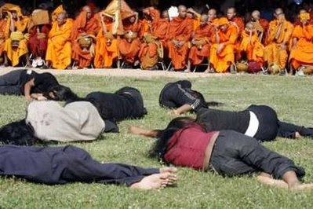
National Day of Hatred, commemorated present-day

Slide 6
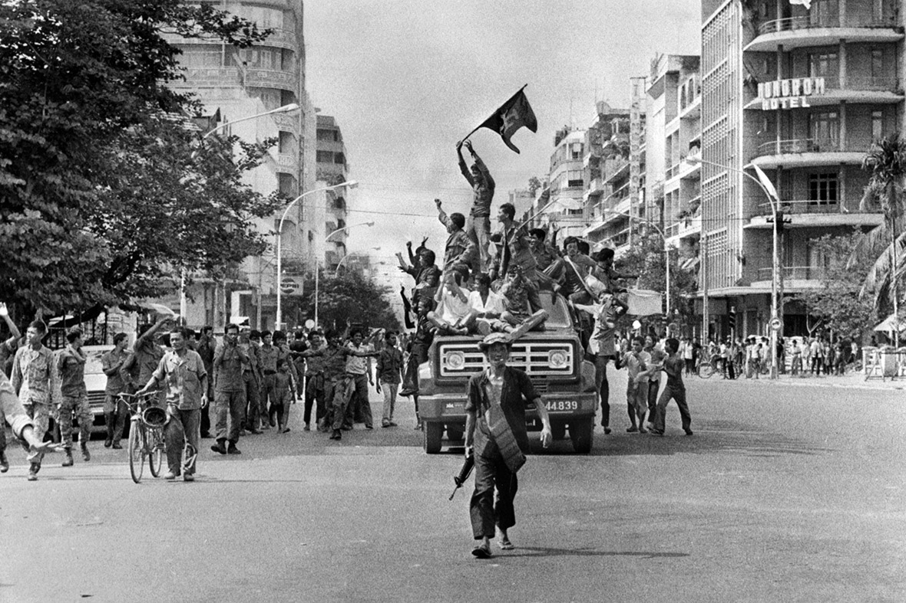
Khmer Rouge soldiers enter Phnom Penh, April 17, 1975

Slide 7
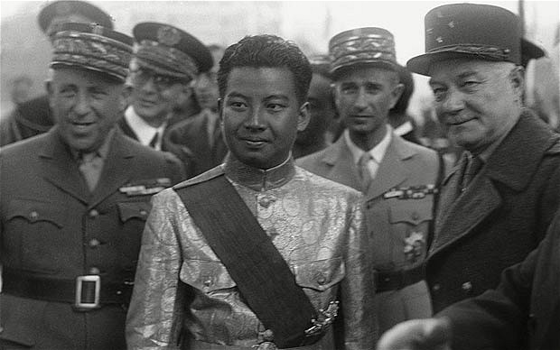
Sihanouk with French generals in Paris,1946

Slide 8
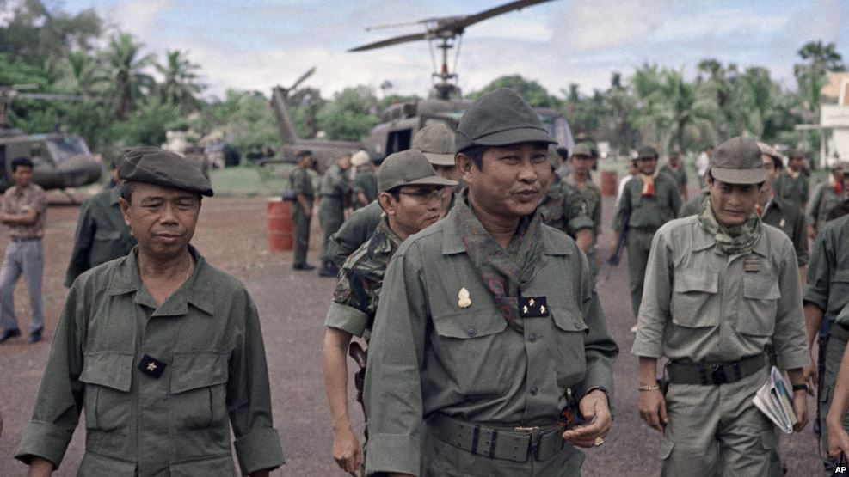
3-Star General Lon Nol, circa 1970

Slide 9
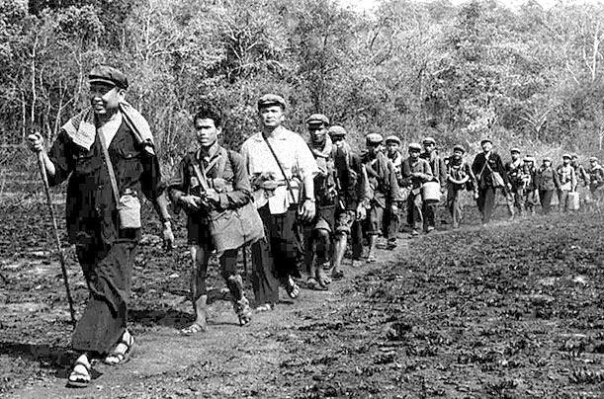
Pol Pot leads soldiers north, circa 1978

Slide 10
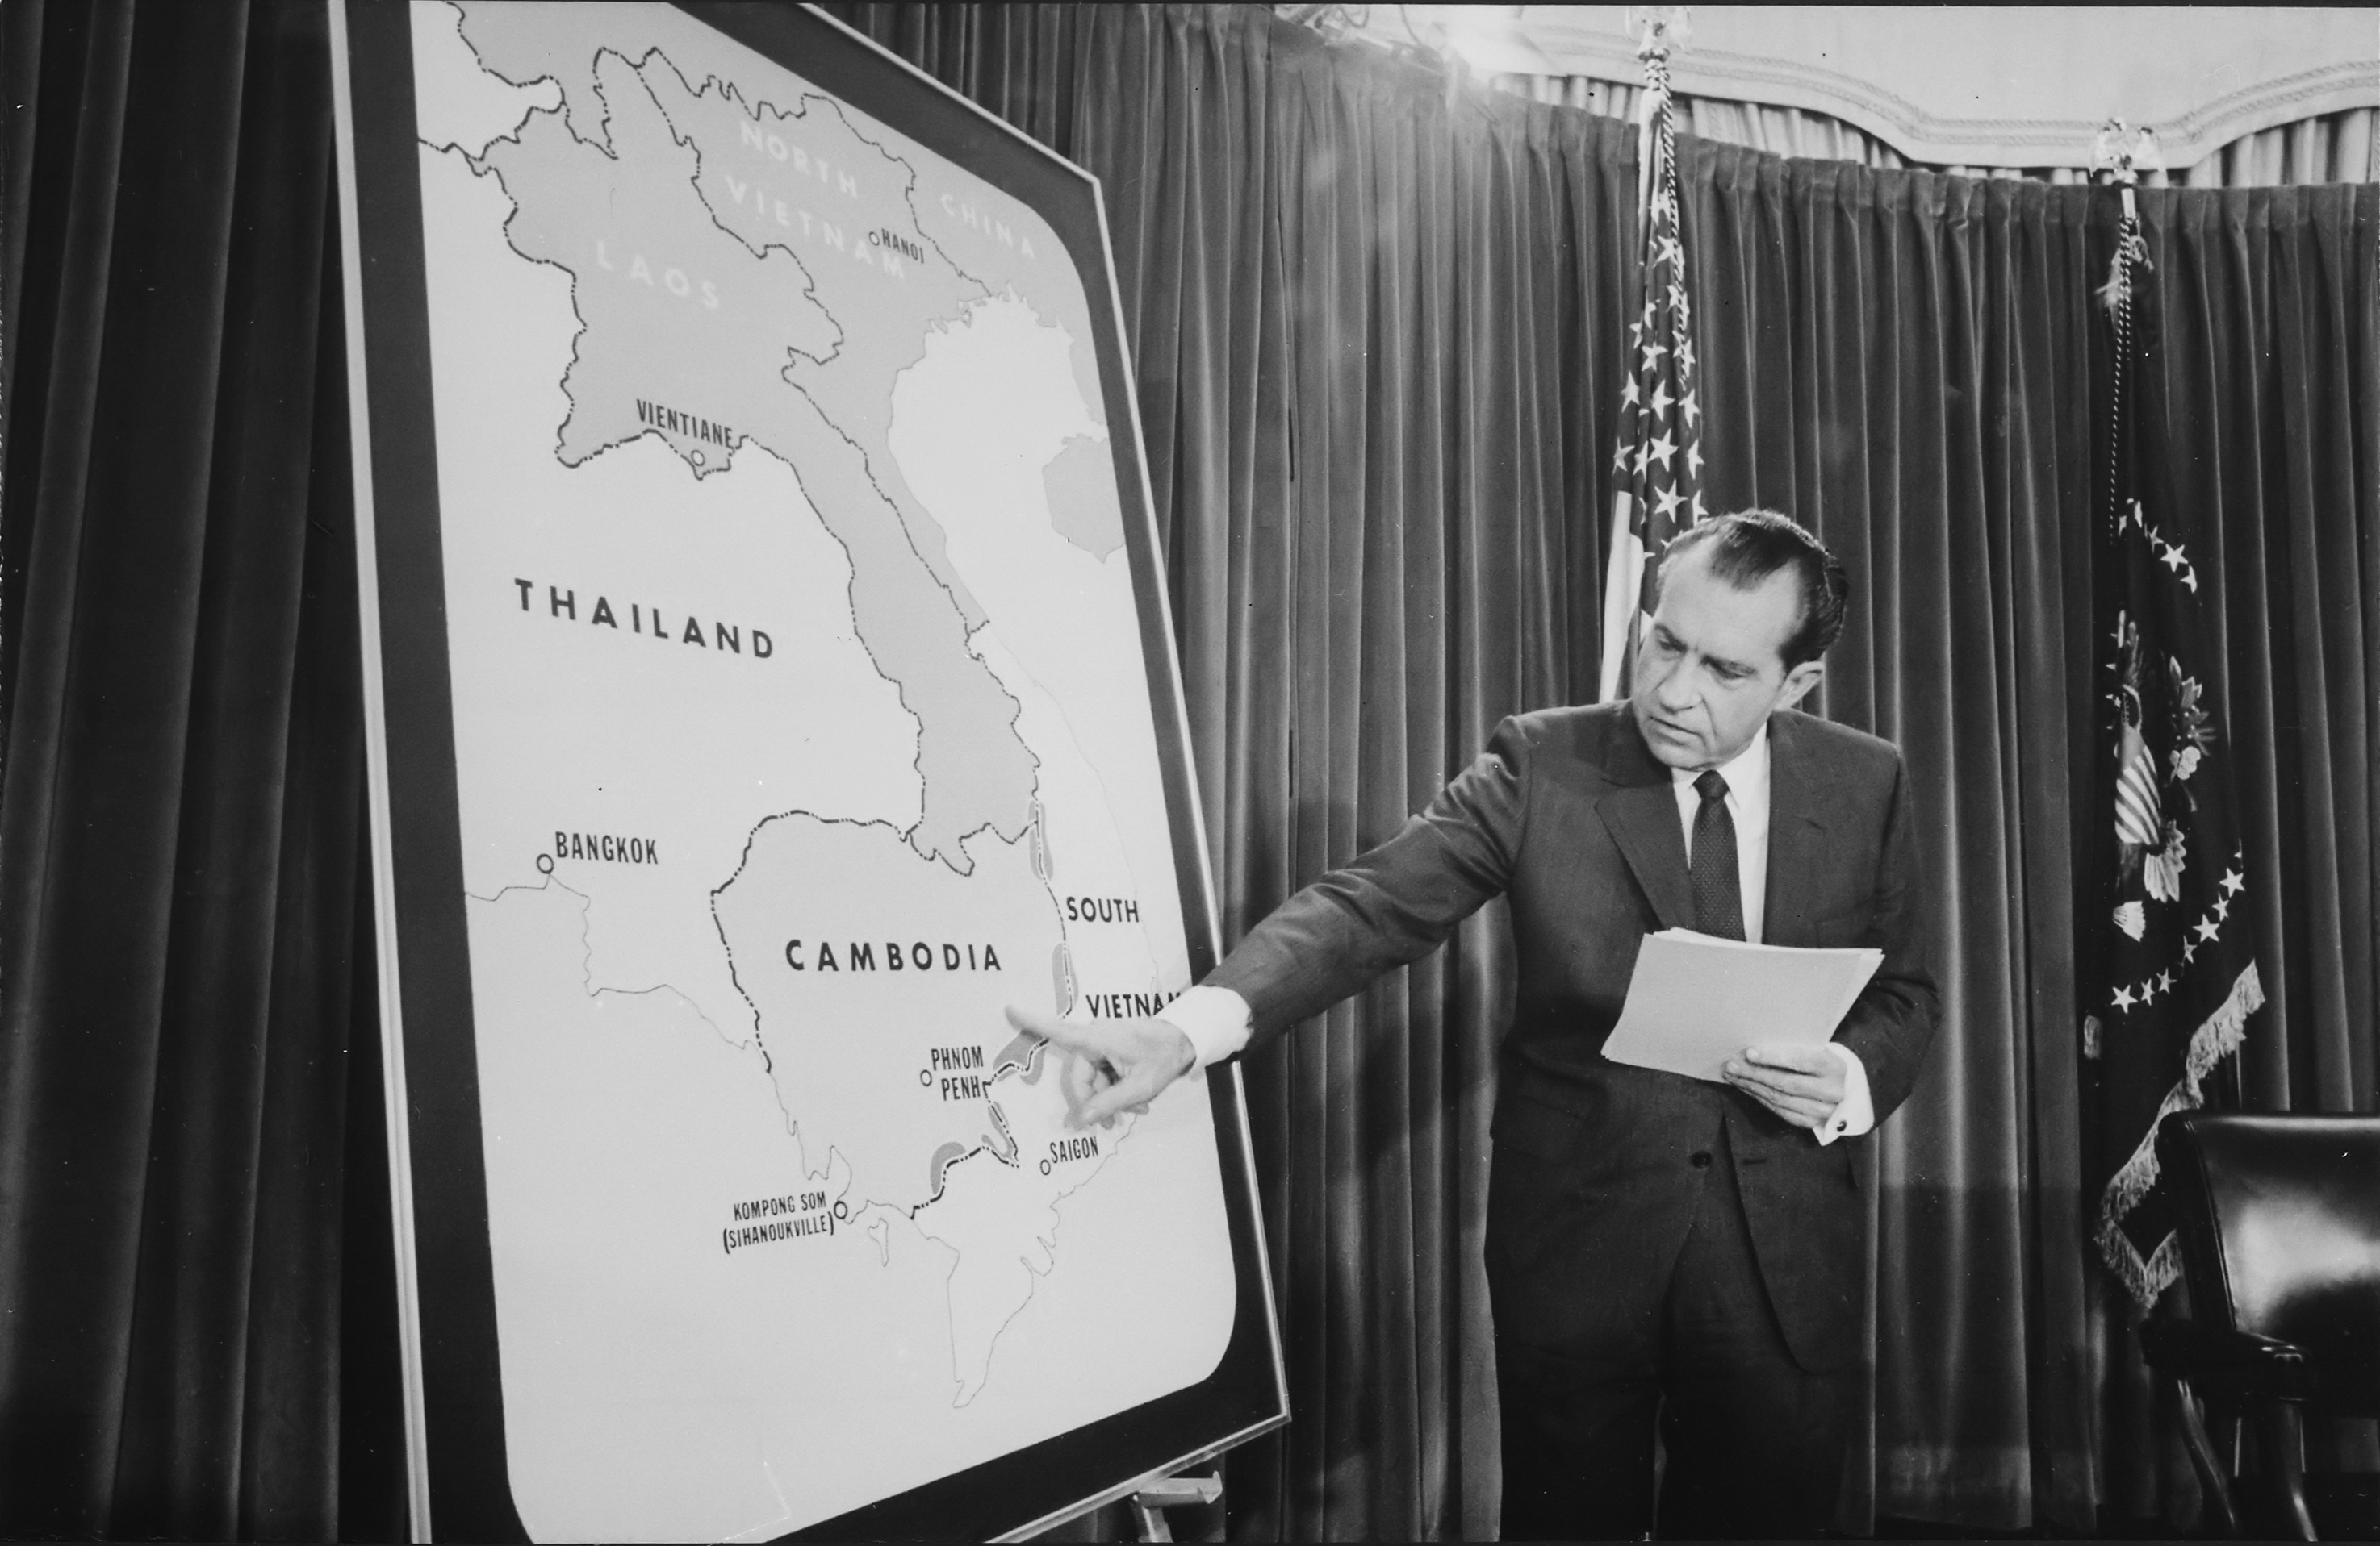
Nixon announces bombing of Cambodia, April 30, 1970

Slide 11
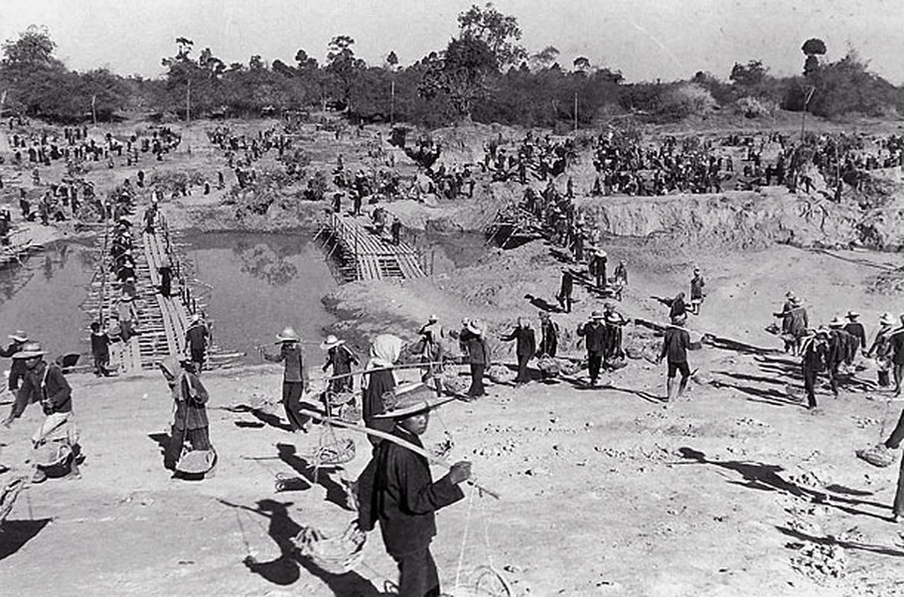
Khmer Rouge forced labor camp, circa 1976

Slide 12
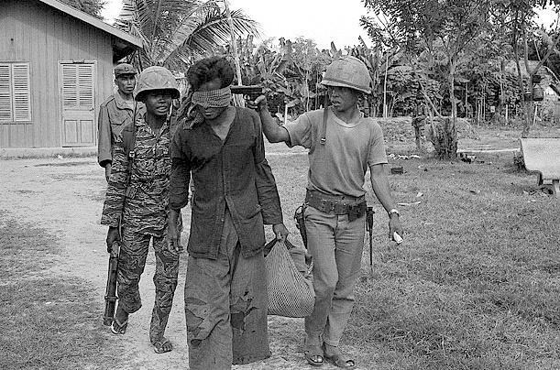
Mistrust among Khmer Rouge, circa 1978

Slide 13
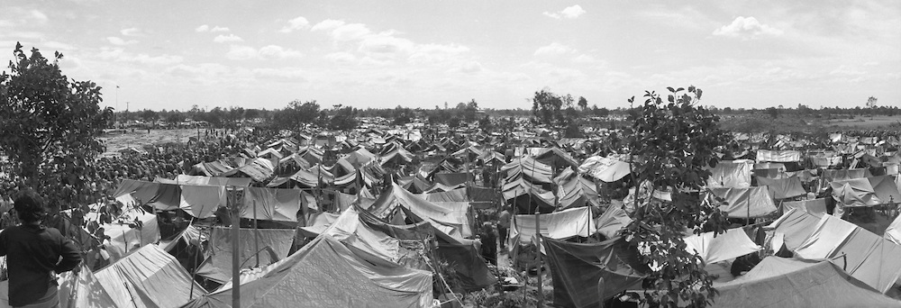
UN refugee camp in Thailand, circa 1979

Slide 14
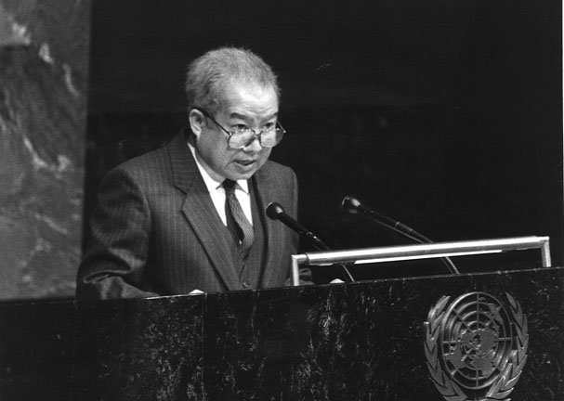
Sihanouk, President of the Coalition Government of Democratic Kampuchea, addressing the General Assembly of the United Nations, circa 1983

Slide 15
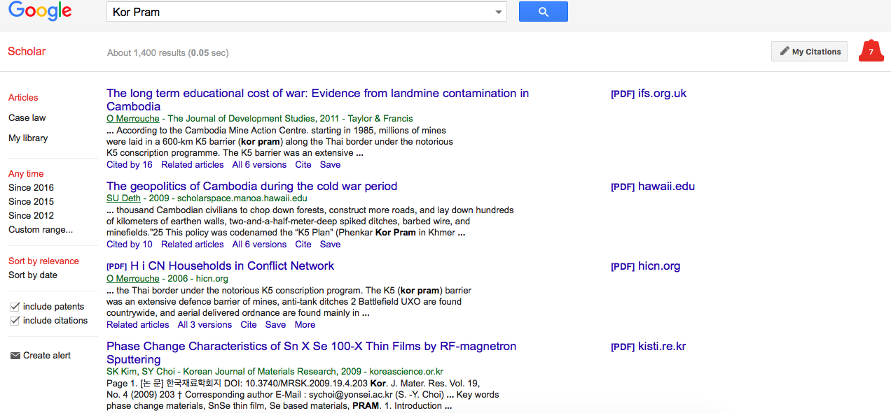
Few mentions of Kor Pram in Google Scholar.

Slide 16
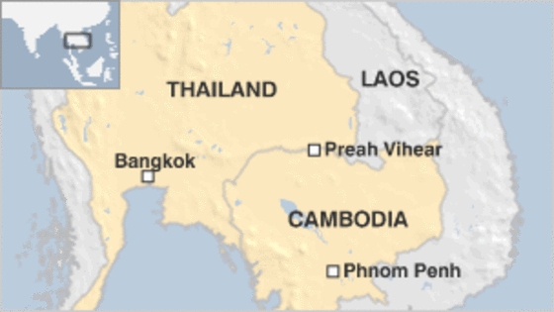
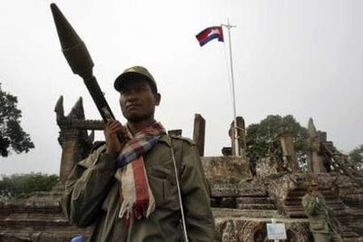
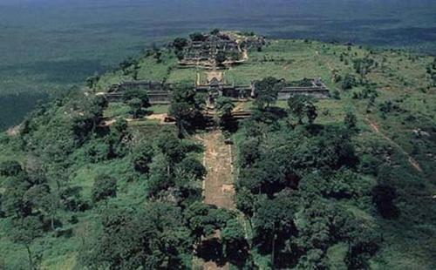
Disputed Preah Vihear temple complex on Cambodian-Thai border, circa 2008

Slide 17
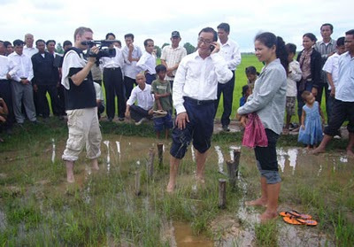
Sam Rainsy moves border post along Cambodian-Vietnam border, October 25, 2010.

