Slide 1
The Structures and Agents Enabling Educational Corruption in Cambodia: Shadow Education and the Business of Examinations
William C. Brehm
The University of Hong Kong

Slide 2
Kitamura, Y., Edwards Jr., D.B., Chhinn, S. & Williams, J. (Eds.) (2015). The political economy of schooling in Cambodia: Issues of equity and quality. New York: Palgrave MacMillan.

Slide 3
Cambodia and Corruption
“Because we are too poor to pay for extra lessons, we did not do well [on the examination.]”- Student (Grade 12)
“Teachers will always help their students [pass the examination] because if lots of students fail the exam, it’s the teacher’s fault. But the teachers don’t usually tell everything that’s on the exam; they just tell some points for students to learn.” - Teacher (grade 7-9)

Slide 4
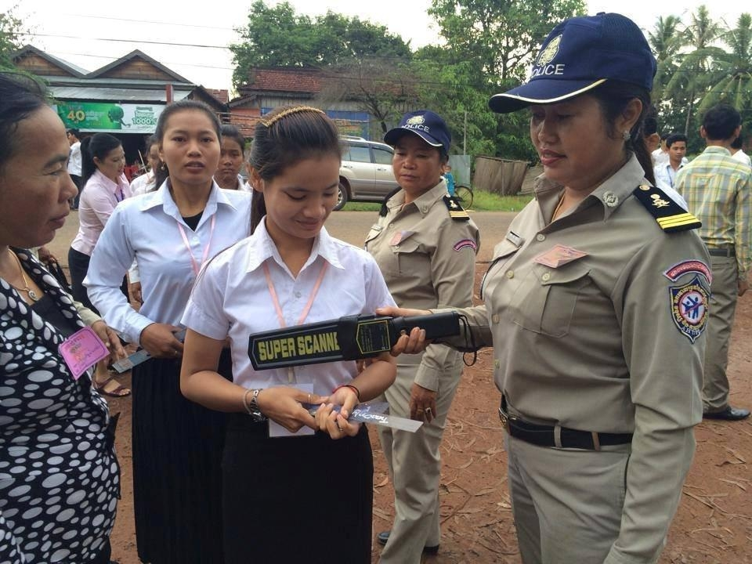

Slide 5
Blame the teacher!
Teachers “are the monopoly suppliers of their services to the students, they have the full discretion in what they supply, and they are hardly held accountable for their actions. This gives rise to a situation where the teachers try to extract students’ consumer surplus by shirking at school and supplying tutoring outside for a fee” (Biswal, 1999, 223).
Teachers (and/or others) deteriorated the quality of education “because individual rent-seeking behavior by agents increased” (Heyneman, et al. 2008, 2).
From this perspective, teachers may “slow down their pace of delivery in order to ensure that they have a market for the after-school supplementary classes” (Bray, 1999, 55).
These individual actions are possible partly because there are no systems of accountability to prevent corrupt behavior.

Slide 6
Upward conflation
The main problem with conceptualizing corruption as an individual behavior is that casual efficacy is only granted to individual agency. The structures of society, in this perspective, are constructed through the aggregation of individual behavior.
This is methodological individualism, conflating individual agency with social structures.
This is called “upward conflation” (Archer, 1995) because it explains social structures through the aggregation of individual behavior. As such, corruption is perceived to result from “individual decision-makers, who are not only regarded as their own ‘sovereign artificers’ but are also credited, along with others like them, with making their society too—through the aggregate effects of their decisions” (Archer & Tritter, 2000, 7).
Upward conflation leads to individualized policy solutions to the perceived “problem” of educational corruption: if all individuals behaved ethically, educational corruption would disappear.

Slide 7
It’s the system!
Alternatively, blame can be placed on the context and the system, not the individual. Johnson (2011) captures this by saying, “blame the context, not the culprits” (p. 254).
This perspective derived from Johnson’s (2008) study in Kyrgzstan where he found “most [students surveyed and interviewed] believe that the reason for teacher corruption is systemic (the government, economy, or society), not the failings of an individual” (p. 190).
Brehm et al. (2012, 14) and Dawson (2009, 71) continued this line of reasoning in the Cambodian context by pointing to low teacher salary, over crowded classrooms, and double shift schooling as the factors causing corruption.
This account is similar to Rose-Ackerman’s (1999), who referred to corruption as “a survival strategy” (p. 72).

Slide 8
Downward conflation
The causal explanation of education corruption derives from some sort of systemic failure.
Educational corruption as socially determined views causal efficacy as granted to social structures.
In other words, agency is denied to teachers who are simply robotic actors preforming habitual, routinized actions without subjectivity.
This approach is downward conflation because “agency is explained in terms of structure” (Sibeon, 2004, 97).

Slide 9
Sometimes it’s both…
Corruption increases in systems of education that have broken down: when “the central authority in education broke down and the various agents (ministry officials, rectors, faculty, and staff) no longer acted in concert” (Heyneman, et al., 2008, 1-2).
Biswal (1999) suggested the main reasons for teacher-supplied tutoring are related to (1) low salaries from governmental schools and (2) weak accountability and monitoring systems. In other words, individuals react to their circumstances.
Dawson (2009) writes of the “tricks of the teacher” who force students into tutoring, thus locating corruption at the individual level.

Slide 10
Corruption = Monopoly Power + Discretion – Accountability.
Notes:
This is economists Robert Klitgaard’s formulaic approach to corruption that is very popular. If we could only tweak the different variables in this equation, corruption could be eliminated. The whole point for these scholars is to balance between individual casual explanations (monopoly power and discretion) with the context (accountability) but always claim corruption can be eradicated liked small pox.

Slide 11
In search of alternatives…
An alternative view starts with the assumption that individuals and society “do not constitute two moments of the same process. Rather they refer to radically different things” (Bhaskar, 1989, 33).
As such, “agents and structures are ontologically different, but they are intertwined and together they account for the state of social affairs at any time and place” (Archer, 2014, 26-27).
In this view, educational corruption is enduring in all systems of education and not fleeting. In some specific cases, individual teachers can engage in (or “activate” in critical realist terminology) educational corruption, while in other instances it can be left dormant. Likewise, systems of education can be structured in ways that are more likely to result in the activation of educational corruption than others.

Slide 12
In search of alternatives…
As such, humans agents make the structures creating systems of education where corruption is possible, but agents are also made by those very structures that predate action.
From this perspective, structures constrain, enable, and/or motivate agents.
Structures produce specific vested interests, opportunity costs, and situational logics of action. These change across time and context.
In addition, agents sustain and transform structures by their actions and interactions. As such, “there was no time when individuals were solely the cause of (or solely responsible for) their own social situations” (Archer, 2014, 29).

Slide 13
Re-turning to Cambodia
In the Cambodian education system, which is marked in part by its high stake testing regime and underpaid teachers, there is an emergent property of educational corruption that is typically (but not always) activated through private tutoring by a student’s own teacher.
Either by students’ demand or teachers’ supply, a teacher-cum-tutor may emerge as an empirical reality.
When this happens, educational corruption is possible because the power relationship between teachers and students takes on features—such as providing money in exchange for answers—within historically structured educational institutions that set the boundaries of action.
Notes:
Corruption without ‘corruptionist’ like racism without racists. Some of this history includes UNTAC that brought in an externally imposed logic of liberal interventionism into Cambodia, the Khmer Rouge that destroyed social services and led to community financing of most institutions post Khmer Rouge, but also cultural elements
The structural elements include double shift schooling, long curriculum, not enough hours to teach, large class sizes.

Slide 14
Corruption through social relations
This alternative view sees corruption as an emergent phenomenon out of the social relations between actors (e.g., teachers and students) in an education system.
The emergent phenomenon has a history that structured the social relationship but also structures future outcomes. In addition, agents can always act otherwise, and therefore find some teachers selectively charge students.
What makes this relationship possible?
What are the outcome of the emergent phenomenon?

