Slide 1
The post conflict social contract in Cambodia: the effects of private tutoring in public education
William C. Brehm
This Life Cambodia
January 4, 2012

Slide 2




Notes:
This research is in partnership with Lehigh University and funded by OSI.

Slide 3
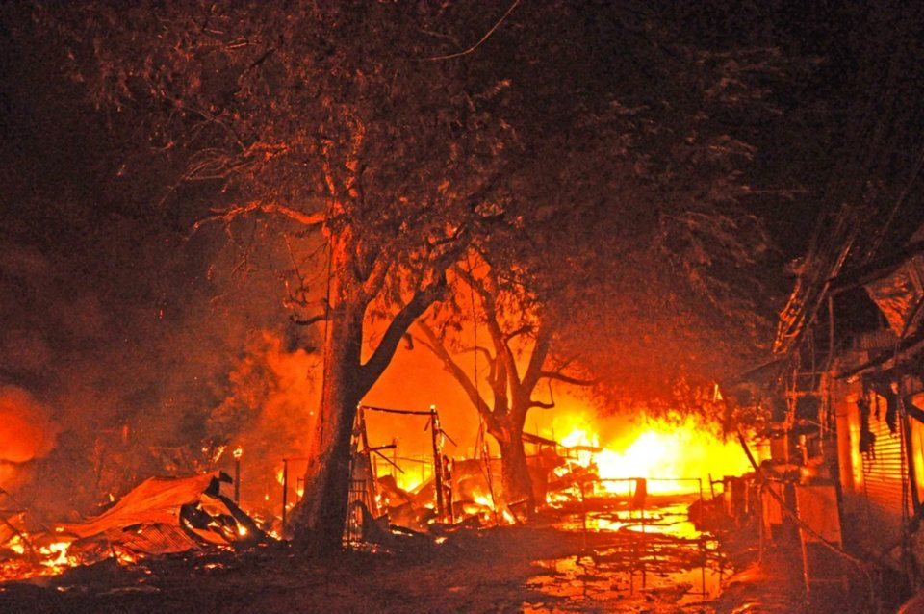
November 9, 2011

Slide 4

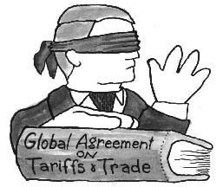
The Social contract
Natural Rights (negative rights)
Positive Rights (the welfare state)
End of the Cold War, “the end of history”

Slide 5
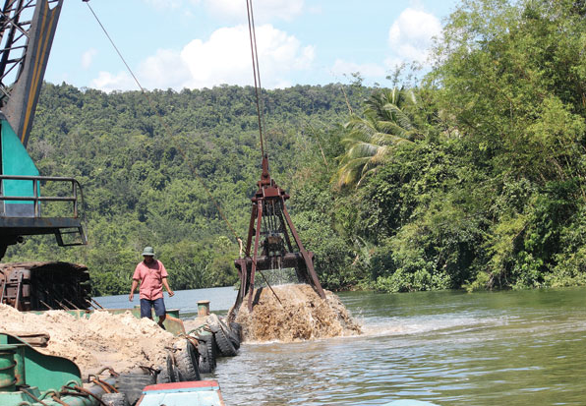

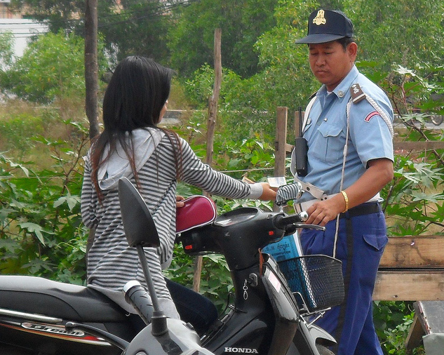
Engineering the state
UNTAC
Liberal internationalism
Neoliberal economics
Cambodian historical legacies
The post-conflict social contract

Slide 6
The Education landscape
School day too short
Too few buildings
Too few teachers
Too many students
Too little education recurrent expenditures
Too many informal fees
An a la cart menu of educational services
An uneven landscape: all education for some?

Slide 7

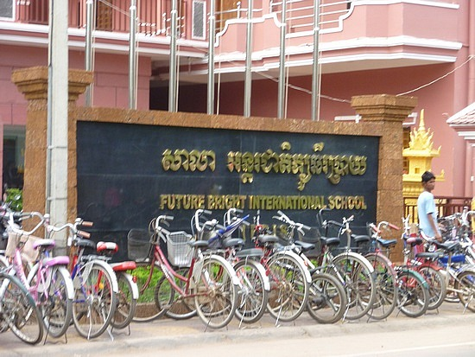
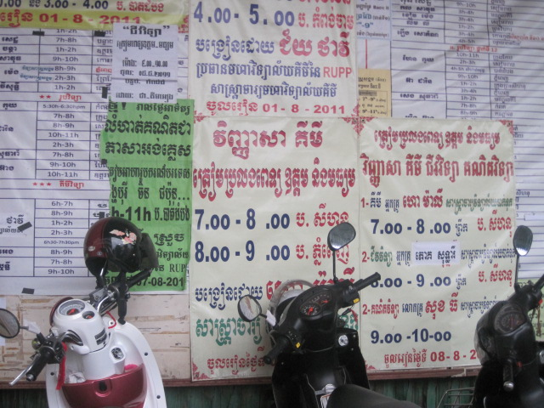
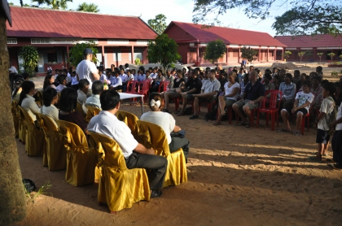
The willful private sector
Elite private schools
NGO schools
Elective private tutoring

Slide 8
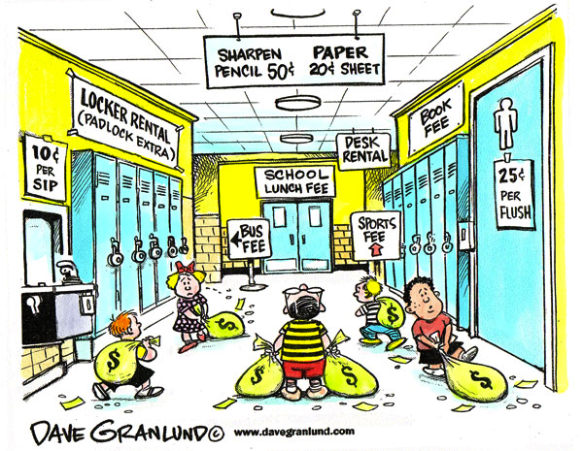
The Forced private sector
The “tricks of the teacher”

Slide 9
The reluctant private sector
Pay for education because no other choice.
Private tutoring is “necessary” for full national curriculum.
Demand side issue
If public school was adequate?

Slide 10
Conclusion
UNTAC placed a price tag on the sale of all social services and natural resources under the veil of democracy.
The poor are disproportionally disadvantaged when social goods are sold.
Education as commodity or emancipation?
Alternatives to the post-conflict social contract?

