Slide 1



A Conversation Analytic (CA) study of CALM therapy sessions
Dr. Chloe Shaw on behalf of the CA CALM Study Team
University College London

Slide 2
Overview
Aims
Data and rational
Methodology
Some preliminary analysis

Slide 3
Research Aims
MAIN AIM: To explicate the conversational practices that underpin the therapeutic programme of CALM and which concern relational and attachment theory in particular.
RESEARCH QUESTION: To what extent are meaning and values around mortality addressed?

Slide 4
To what extent are meaning and values around mortality addressed?
How is this talk initiated and who raises it?
How is talk around death pursed by the therapist?
What practices enable talk to become emotionally heightened?
What practices close down this talk?
In which conversational contexts do we see these alternative strategies being used?

Slide 5
Data and Rational
Audio recordings of therapy sessions
– Naturalistic data
Introductory CALM sessions
- Exploration of how an alliance is established
- Common thread allowing exploration of common interactional issues
20 sessions approximately 1 hour long each
- Range and volume of practices and across a range of therapists

Slide 6
Analytic Method: Conversation Analysis
Qualitative method in the Social Sciences
Study of talk and social action (see Sacks; Schegloff; Sidnell)
Importance of sequence and context
Aim to explicate social order (see Garfinkel)
Importance of participant orientations
Naturalistic data (see Heritage and Atkinson)
Notes:
Fundamental principle – talk is always doing something e.g. greeting, request, information giving, advice, formulating, interpreting.
– it doesn’t just float but is part of an action exchange with another person or people – in ordinary conversations, if I say something, I make relevant a response from you
Members methods for creating and maintaining social order so that we can understand one another.
Participant orientations – talk about rigour
Avoids problem of recall (Heritage and Atkinson, 1984)
‘Black box’ of real life encounters
Social constructionist perspective –Ontological perspective – nature of reality: social constructionist approach
Epistemological perspective - how we can study the world: aim to understand participant orientations and constructions of the world vs. a positivist of “truth seeking”

Slide 7
Transcription
To capture: how, when and where something is said
Jefferson Transcription System (Jefferson; Hepburn and Bolden)
Captures: pauses/ pitch/ volume/ emphasis/ speed of delivery/ elongated sounds
Notes:
apriori/ can’t disregard any detail as irrelevant/ context – back to Garfinkel

Slide 8
Transcription – Quick Guide
Symbol | Meaning | Symbol | Meaning
[ ] [ ] | Brackets: Align overlapping talk | <need> | Left then right carats: Talk slowed down
(0.3) | Numbers in parenthesis: Silence to the nearest tenth of a second | >need< | Right then left carats: Speeded up talk
need | Underlining: Emphasis | nee- | Hyphen: Cut off
nee::d | Colons: Elongation of prior sound | .hh hh .snff | Full stop + ‘h’s: Inbreath Standalone ‘h’s: Outbreath Wet sniff (upset)
. , ? ¿ | Punctuation markers: For normal intonation shifts | huh /heh | Combinations of ‘h’s + vowels: Laughter
↑ or ↓ | Up and down arrows: Marked intonation shift | £ | Pound sign: Smiley voice
NEED | Capitals: Louder talk | (need) | Words in single brackets: Unsure hearing
°need° | Degree signs: Quieter talk | (( )) | Words in double brackets: Transcriber comments

Slide 9
CA and Healthcare
Large body of work spanning 30 years (see Gill and Roberts)
Range of settings e.g. Adult primary care, HIV counselling, oncology, antenatal screening, and neurology
Small changes in talk can have profound impacts (e.g. Heritage and colleagues)
Notes:
Heritage and colleagues found that when visiting GP surgeries, significantly more patients listed further reasons for their visit when their doctor asked if they had “some” rather than “any” more concerns.

Slide 10
CA and Psychotherapy
Relatively new area with particular interest over the last decade (See Peräkylä for review).
Range of therapies including – cognitive therapies (e.g. Antaki, Barnes and Leudar) and psychoanalysis (e.g. Peräkylä).
Main areas of research: formulations, interpretations, questions, and relational aspects of practice including resistance, affiliation and emotion.

Slide 11
CA and Theory in Psychotherapy
Explicating identified practices (e.g. Antaki et al. on formulations)
Identifying new practices and dimensions (e.g. Rae)
Exploring how therapeutic goals are established within (see Voutilainen et al.) and across (see Bercelli et al.) therapy sessions.
Differences between practices used in different types of psychotherapy (e.g. Weiste and Peräkylä).
Addressing how issues are raised that are specific to a given approach and context
See Peräkylä and Vehvilainen

Slide 12
Focus on talk around death
Lutfey & Maynard (1998) Bad news in oncology encounters using conversation analysis.
How doctors deliver bad news about death and dying without using those words.
Degree of explicitness interactionally constructed – related to patient responses.
Notes:
How doctors skilfully deliver bad news around end-of life in a way that is tailored to the patients responses.

Slide 13
Extent of talk around death and dying in the data
What counts – explicit and vague references
10 conversations – 5 male, 5 female
57 instances of death talk – approx. 6/conversation
51 sequences – death talk raised by the client
43 of sequences closed down by therapist
Notes:
End of life, death, dying and vague might be fearing the future, being scared or in trouble etc.
Initial gloss and doesn’t quite capture the gradual way in which death talk might be introduced by the therapist and gradually closed down by therapist/client either…and this is what out study hopes to explore further.

Slide 14
Explicit reference to death

Slide 15
Case 1118 – Clinical Details
Demographics: Female, Age 57
Type of cancer: High grade serous and endometrioid ovarian cancer with metastases to lung and retroperitoneal nodes

Slide 16
Explicit reference - Extract 1: 1118 (1)
66 Cl: He (0.2) #u-# (0.2) famously (0.2) over, (0.4) our
67 thirty years (0.3)
68 Th: Ye[s ]
69 Cl: [or] more together has said (0.7) ‘just (.) >you
70 know< (0.2) give me a g↑u(h)n >.hh hh< >or<
71 [take me out] an shoot me’ >an I said<
72 Th: [ mm: ]
73 Cl: ‘°#I nee:d#° [need] a gun it’s ↑too messy:’
74 Th: [ hm ]
75 Th: mm#::# (.) m[m: ]
76 Cl: [So,] (1.4)
77 Th: °tch Oh ok[ay.°]
78 Cl: [ Ur] (.) he understands .HH I: remember
79 saying to him one day (0.2)
Notes:
These un-annotated files will have sound files and be played

Slide 17
Explicit reference - Extract 1: 1118 (2)
80 Th: m[hm, ]
81 Cl: [↑‘I’ve] ↑go:t it (0.9) carbon mon↑oxide poisoning
82 Th: m[hm ]
83 Cl: [You] just go to sleep↑’=an ‘e said (0.6) ‘°that’d°
be good’ an then a few minutes later he said (1.1)
‘w↑ait a minute (.)
86 Th: >mhm<
87 Cl: (.) they’ll think ↑I did it.’
88 Th: mm[:#::# ]=
89 Cl: [eh huh .hh]
90 Th: =m(h)m hmm [hmm ]
91 Cl: [heh] huh .hslhh
92 Cl: So< (.) yeah
93 Th: Yeah
94 (0.2)
95 Cl: °He knows how I feel.°
Notes:
These un-annotated files will have sound files and be played

Slide 18
Explicit reference - Extract 1: 1118 (1)
66 Cl: He (0.2) #u-# (0.2) famously (0.2) over, (0.4) our
67 thirty years (0.3)
68 Th: Ye[s ]
69 Cl: [or] more together has said (0.7) ‘just (.) >you
70 know< (0.2) give me a g↑u(h)n >.hh hh< >or<
71 [take me out] an shoot me’ >an I said<
72 Th: [ mm: ]
73 Cl: ‘°#I nee:d#° [need] a gun it’s ↑too messy:’
74 Th: [ hm ]
75 Th: mm#::# (.) m[m: ]
76 Cl: [So,] (1.4)
77 Th: °tch Oh ok[ay.°]
78 Cl: [ Ur] (.) he understands .HH I: remember
79 saying to him one day (0.2)
Notes:
Explicit reference to death here via ‘control my end’ (line 1). The therapist has enquired as to how her partner feels about this.
Exaggerated, playful extreme talk about death which is potentially problematic – raises issue of suicide. Laughter and high intonation modulates uptake as something serious to be attended to by the therapist.
Off the record alignment through intonation. Avoids problematic alignment with content. The therapist is put in a problematic position here of being invited to align with a suicidal notion. The therapist manages this potentially problematic position by aligning with the client in an off the record manner. She uses acknowledgment tokens but in an animated fashion that embodies some symmetry with the animated story production. This is achieved through elongated production and accompanied by croaky voice (line 74). In responding in this way, the therapist aligns with the emotional stance of the story telling without aligning with the content of the story or explicitly inviting further exploration of this. The therapist then responds with a quiet news receipt token ‘oh’ and acknowledgment ‘okay.’

Slide 19
Explicit reference - Extract 1: 1118 (2)
80 Th: m[hm, ]
81 Cl: [↑‘I’ve] ↑go:t it (0.9) carbon mon↑oxide poisoning
82 Th: m[hm ]
83 Cl: [You] just go to sleep↑’=an ‘e said (0.6) ‘°that’d°
84 be good’ an then a few minutes later he said (1.1)
85 ‘w↑ait a minute (.)
86 Th: >mhm<
87 Cl: (.) they’ll think ↑I did it.’
88 Th: mm[:#::# ]=
89 Cl: [eh huh .hh]
90 Th: =m(h)m hmm [hmm ]
91 Cl: [heh] huh .hslhh
92 Cl: So< (.) yeah
93 Th: Yeah
94 (0.2)
95 Cl: °He knows how I feel.°
Notes:
The client continues to pursue a problematic, extreme case/ light hearted notion of death.
At first we see minimal receipts from the client as she delivers her story.
Once the story is complete and where an appreciation of the story is due, the therapist again delivers more acknowledgement tokens.
The therapist is put in a problematic position here of being invited to align with a suicidal notion. The therapist manages this potentially problematic position by aligning with the client in an off the record manner. She uses acknowledgment tokens but in an animated fashion that embodies some symmetry with the animated story production. This is achieved through elongated production and accompanied by a croaky voice (line 87) and with interpolated laughter, or a very minimal ‘off the record’ laughter (line 88). An alternative and more strongly symmetrical laughter here might be considered inappropriate, or taking this issue too lightly. In responding in this way, the therapist aligns with the emotional stance of the story telling without aligning with the content of the story or explicitly inviting further exploration of this.

Slide 20
Extract 1 key points
Importance of capturing how and when talk is produced
Management of the interactional issue of maintaining alignment without strongly inviting continued problematic talk.
Resource in responding to particularly intensified notions of talk around death and dying.
Notes:
Sum – importance of capturing how and when talk is produced – resource in responding to particularly intensified notions of talk around death and dying. Management of the interactional issue of maintaining alignment without strongly inviting continued problematic talk.

Slide 21
Implicit reference to death

Slide 22
Case 1064 – Clinical Details
Demographics: Female, Age 69
Type of cancer: Stage IV cholangiocarcinoma with liver metastases

Slide 23
Implicit reference - Extract 2: 1064 (1)
75 Cl: I th↑ink I’m s:lightly more on the, hh I wouldn’t
76 say positive but optim↓istic [side. ]
77 Th: [>Okay.<]
78 (.)
79 Th: ↑Okay.
80 (.)
81 Cl: Than hh negative. [hh ]
82 Th: [>W’ll you] sound like a realist.<
83 (0.2)
84 Cl: °eh.° Yeah I think I ↓am.
85 Th: Okay.
86 Cl: >Yeah<
87 Th: °Okay.° .HH A::nd that’s the >sort of< (0.2) ba::d 88 days >sort of< low days and high days an
89 mediocre?=s’that’s: really great to have (0.2) that
90 ra:nge?

Slide 24
Implicit reference - Extract 2: 1064 (2)
91 Cl: Yes.
92 Th: ‘cause you do ↑need- I mean it ↑is °frightening:
93 [So::° ]
94 Cl: [It is scary.]
95 Th: °↑It [is↑ (.) sca]ry?°
96 Cl: [Yes. ]
97 (.)
98 Cl: It’s the- (.) d- total unknown.=
99 Th: =mm::.
100 (.)
101 Cl: Yes.
102 Th: °Yeah.°
103 (0.3)
104 Th: °Yeah°=something’s happening to you that (0.4)
105 Cl: You have no control.
106 Th: °No.°
107 (0.7)

Slide 25
Implicit reference - Extract 2: 1064 (3)
108 Cl: You’re on this car an, (0.8) you’re not the driver.
109 Th: °I know.°
110 Cl: mhm
111 (0.4)
112 Th: .tHH But it’s great that you have other days of
113 feeling ‘↑well (0.2) things look good
114 Cl: .HH Yes an I [have ] friends who: urm: .hh you
115 Th: [(? ) ]
116 Cl: know urm: hh (1.1) are very keen for me to- (.) to
be social and .hhhh >you know< get out and that sort
of thing.=[An I can’t always] meet their
119 Th: [( )]
120 Cl: expecta[tions.]
121 [ Yeah.]

Slide 26
Implicit reference - Extract 2: 1064 (4)
122 Cl: .sff
123 (0.2)
124 Th: >An are you okay with that?<
125 (0.2)
126 Cl: Yes an they understand.=[I just]say to them
127 Th: [°Yeah.°]
128 Cl: ‘today’s a bad day an, (0.2)’
129 Th: °Ye:ah,°
130 Cl: You know
131 (1.0)
132 Th: Okay.<So tell me about your: your: social world…

Slide 27
Implicit reference - Extract 2: 1064 (1)
75 Cl: I th↑ink I’m s:lightly more on the, hh I wouldn’t
76 say positive but optim↓istic [side. ]
77 Th: [>Okay.<]
78 (.)
79 Th: ↑Okay.
80 (.)
81 Cl: Than hh negative. [hh ]
82 Th: [>W’ll you] sound like a realist.<
83 (0.2)
84 Cl: °eh.° Yeah I think I ↓am.
85 Th: Okay.
86 Cl: >Yeah<
87 Th: °Okay.° .HH A::nd that’s the >sort of< (0.2) ba::d 88 days >sort of< low days and high days an:
mediocre?=s’that’s: really great to have (0.2)that
ra:nge?
Notes:
More oblique reference to death here ‘knew myself I was in trouble’, ‘scared to ask about some stuff’, ‘frightened of what’s gonna happen.’
Although the client has mentioned some negative emotions, she goes on to project a more positive stance – that she is optimistic.
Description which interprets – via epistemic marker ‘sounds like’ and edited version of ‘realist.’ Interpretations, in contrast to formulations are where the talk is presented as from the therapists’ perspective, and as such, seek extended agreements or disagreements (see Peräkylä, 2004).
Elicits an extended agreement, rather than a simple ‘yes’ type confirmation.
The therapist then validates having negative emotions and uses this as a basis for exploring them thereafter.

Slide 28
Implicit reference - Extract 2: 1064 (2)
91 Cl: Yes.
92 Th: ‘cause you do ↑need- I mean it ↑is °frightening:
93 [So::° ]
94 Cl: [It is scary.]
95 Th: °↑It [is↑ (.) sca]ry?°
96 Cl: [Yes. ]
97 (.)
98 Cl: It’s the- (.) d- total unknown.=
99 Th: =mm::.
100 (.)
101 Cl: Yes.
102 Th: °Yeah.°
103 (0.3)
104 Th:°Yeah°=something’s happening to you that (0.4)
105 Cl:You have no control.
106 Th:°No.°
107 (0.7)
Notes:
The therapist continues to pursue troubles talk using a strong negative assessment which invites a second assessment and then an enquiry specifically into whether the client finds it scary. This elicits a response which strongly confirms that it is indeed scary, by going beyond the characterization of ‘scary’.
After minimal expansion from the client on this however, the therapist then constructs a turn with a pause and projectable 2nd part to that turn, this provides an opportunity for the client to come in and build on this negative aspect. This is what has been identified in by Lerner in the literature as a collaborative completion. Indeed, the client collaboratively completes the therapists turn in line 102.

Slide 29
Implicit reference - Extract 2: 1064 (3)
108 Cl: You’re on this car an, (0.8) you’re not the driver.
109 Th: °I know.°
110 Cl: mhm
111 (0.4)
112 Th: .tHH But it’s great that you have other days of
113 Feeling ‘↑well (0.2) things look good
114 Cl: .HH Yes an I [have ] friends who: urm: .hh you
115 Th: [(? ) ]
116 Cl: know urm: hh (1.1) are very keen for me to- (.) to
117 Be social and .hhhh >you know< get out and that sort
118 of thing. =[An I can’t always] meet their
119 Th: [( )]
120 Cl: expecta[tions.]
121 [ Yeah.]
Notes:
The client goes on to expand on this using the metaphor or being in a car. In doing so, she strongly aligns with the perspective.
Optimistic projection to close down.
Although continued pursuit of negative aspect from the client – issue of managing people’s expectations.

Slide 30
Implicit reference - Extract 2: 1064
122 Cl: .sff
123 (0.2)
124 Th: >An are you okay with that?<
125 (0.2)
126 Cl: Yes an they understand.=[I just]say to them
127 Th: [°Yeah.°]
128 Cl: ‘today’s a bad day an, (0.2)’
129 Th: °Ye:ah,°
130 Cl: You know
131 (1.0)
132 Th: Okay.<So tell me about your: your: social world…

Slide 31
Extract 2 key points
References to death – ‘knew myself I was in trouble’, ‘scared to ask about some stuff’, ‘frightened of what’s gonna happen.’
Practices for pursuing emotionally heightened talk - Interpretation and collaborative turn construction
A practice for closing it down - bright side projection.

Slide 32
Summary
Value in capturing the details of how and when talk is produced.
How these actions work within sequences
Endogenous impact
Collections

Slide 33
Analytic questions
Are these regular practices in the data?
Are there ordered/patterned ways in which we see these practices being produced?
Is there a social preference for optimistic sequences to be left with optimistic projections?
Future research questions – how does the unfolding sequence compare to those in later therapy sessions?

Slide 34
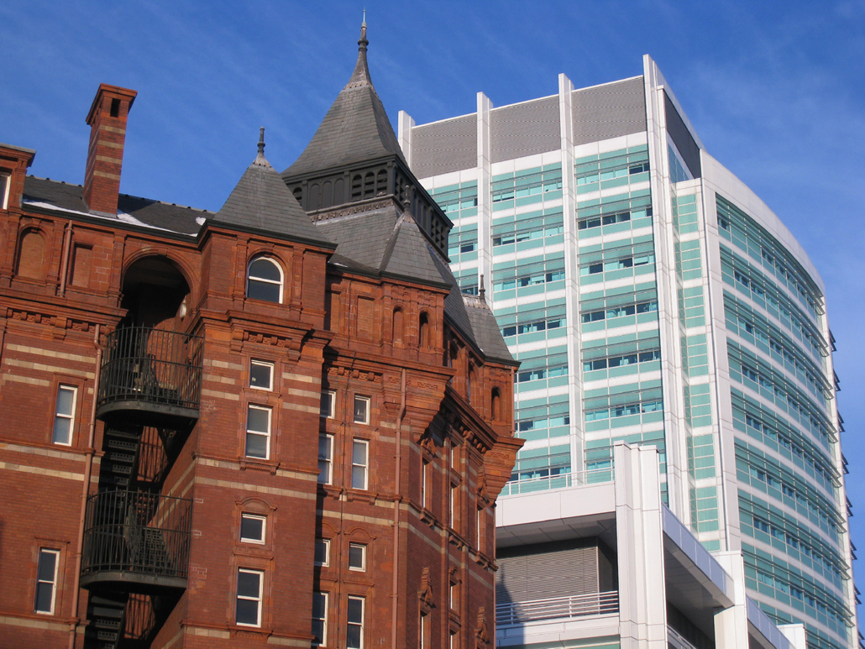
CA Study Team, UCL
Dr. Anne Lanceley (PI)
Dr. Sue Gessler
Dr. Chloe Shaw
Dr. Vasiliki Chrysikou

Slide 35
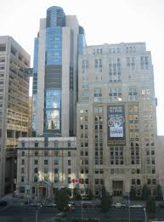
CALM Study Team, Toronto
Prof. Gary Rodin (PI)
Dr. Sarah Hales
Dr. Judy Young (special thanks for all
her work on the data contract & transfer)
Dr. Anne Rydall
Dr. Chris Lo

