Slide 1
Systematic Visuo-Textual Analysis: A framework for analysing visual and textual data
Dr Nicole Brown
UCL Institute of Education
@ncjbrown
Dr Jo Collins
University of Kent
@PGDevAdvisor
Notes:
NB

Slide 2
Background
Developments in qualitative research
sensory, visual, embodied, reflexive
Analytical frameworks missing
"output or creation is not used" (Brown, 2019a:1)
Search term | Number of results for the period from 2000 to 2010 | Number of results for the period from 2010 to July 2020
art-based | 100 | 317
photo voice | 4,399 | 8,177
creative data collection | 7,423 | 17,492
Notes:
NB

Slide 3
Existing analytical frameworks
Framework | Process | Revisit other images to see if proto-theme is recognisable anywhere else, pull in more evidence: can this be elevated to a theme? | Continue to identify themes until no more themes (relevant to your questions emerge. Consider the extent to which your themes are distinct. Do the themes cluster together in a way that suggests a higher order theme? Define higher order themes.
Gleeson (2011) | Look at images repeatedly and group into proto-themes (noting features). Build notes through additional evidence and write descriptions of proto themes | Revisit other images to see if proto-theme is recognisable anywhere else, pull in more evidence: can this be elevated to a theme? | Continue to identify themes until no more themes (relevant to your questions emerge. Consider the extent to which your themes are distinct. Do the themes cluster together in a way that suggests a higher order theme? Define higher order themes.
Saldaña (2016) | First cycle (initial coding which might be grammatical, elemental, affective, literary and language-based, exploratory, procedural and/or theming. | Eclectic coding: "using a select and compatible combination of two or more first cycle coding methods" (213) to plan for… | Second cycle methods – "require such analytical skills as classifying, prioritising, abstracting, conceptualising and theory building" (68).
Collier and Collier (1986) | "Open" and "unstructured viewing" and immersion in images/film (181) | Structured analysis, when you ask specific questions of the material | Microanalysis "repeated, careful examination" to perceive patterns (182)
Braun and Clarke (2006) | Familiarization Generating initial codes Searching for themes | Reviewing themes (across whole data set) | Defining and naming themes
Chapman et al. (2017) | Data organization Code creation | Coding photographs Finding relationships | Interpretation
Notes:
JC

Slide 4
Critique of existing frameworks
Connecting of visual and textual elements is implicit
Art/artefact not considered as language
"Translation" of images into words
Systematic Visuo-Textual Analysis
Notes:
JC

Slide 5
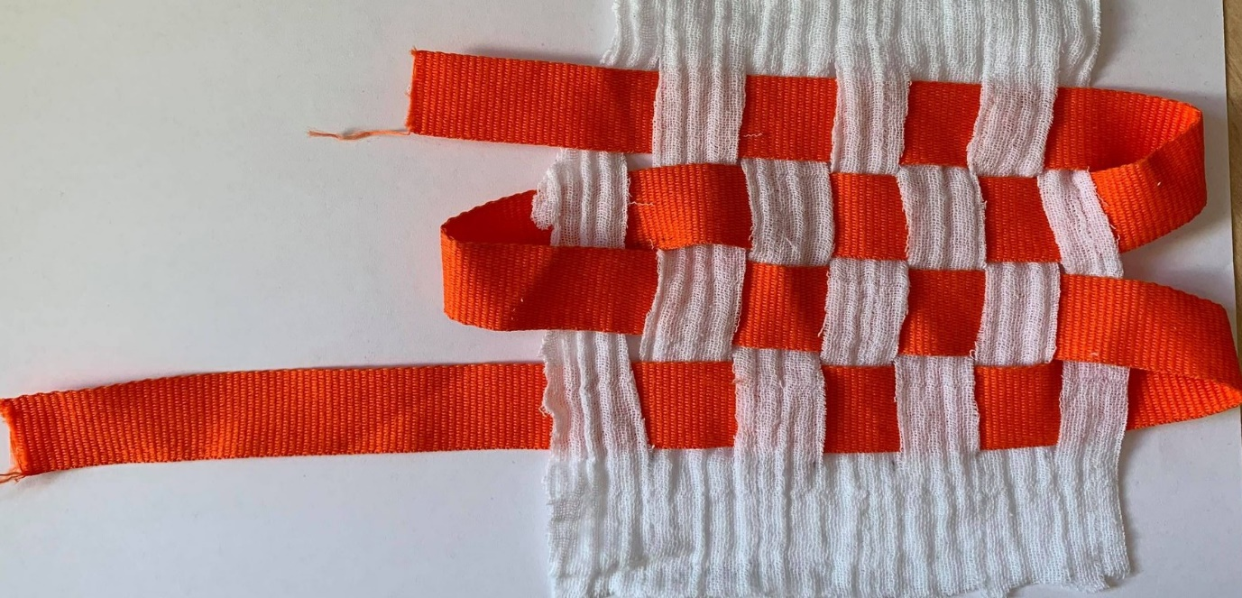
Systematic Visuo-Textual Analysis in Practice
 | Element 1 visual only | Element 2 textual only | Element 3 visuo-textual combined
Level 1 noticing and describing | artistic in visuals (use of colour, space, composition) | linguistic in textual work (use of words, phrases, structures) | connect the visual and the textual (structure, meanings, expressions)
Level 2 conceptualising | essential elements that unite artefacts | words/phrases that capture patterns/themes | connections between artefacts and themes
Notes:
NB

Slide 6
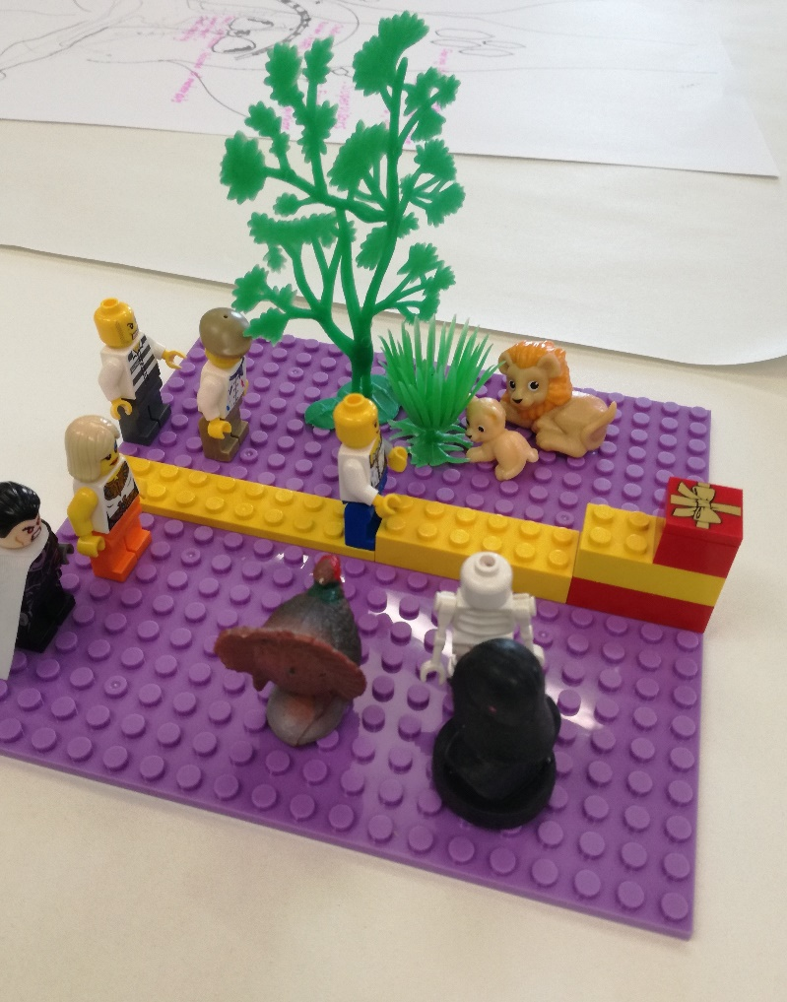
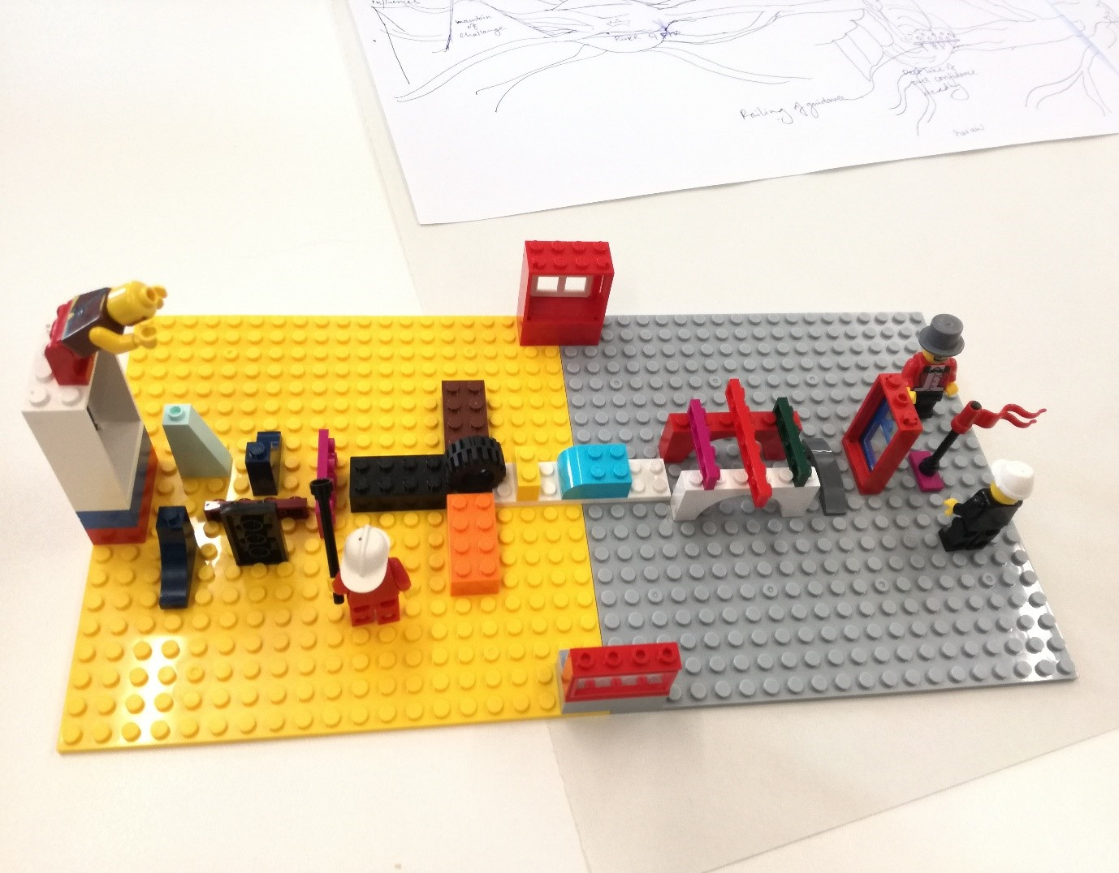
An example of LEGO® models
Notes:
JC

Slide 7
Principles of the Systematic Visuo-Textual Analysis
A framework, not a philosophical or theoretical approach
Bounded in phenomenological, metaphorical, embodied understanding of human communication (Brown, 2019b)
Researcher's "interpretative control" (Riessman, 2008)
Iterative, cyclical/spiral, dynamic process linking the specific to the general, the idiographic to the nomothetic and the one mode of communication to the other
Critical-reflexive openness (Dahlberg et al., 2011)
Notes:
NB

Slide 8
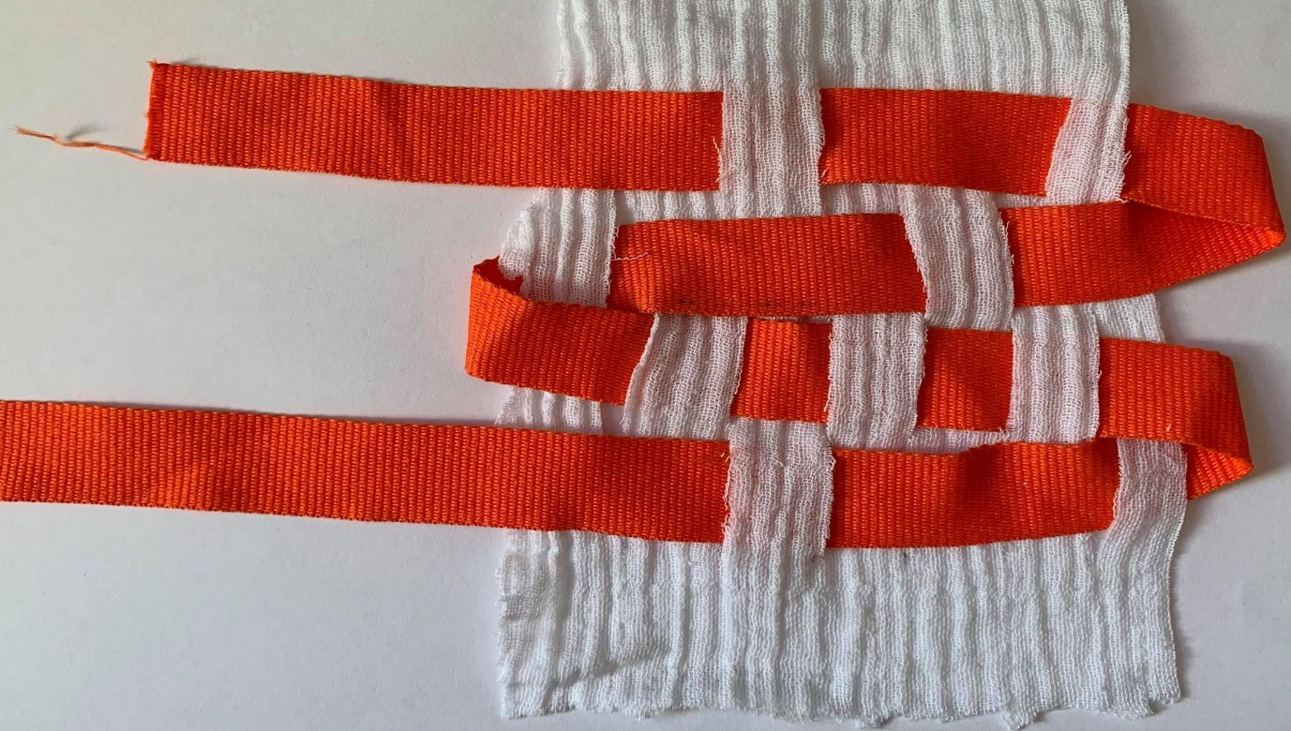
Concluding reflections
Role of subjectivity and skills in analysis
Attention to embodied nature of research
Connection between visual and textual
intertextuality and intervisuality
Rigour of levels and elements
Notes:
NB

Slide 9
References
Braun, V. & Clarke, V. (2006). Using Thematic Analysis in Psychology. Qualitative Research in Psychology, 3, 77-101.
Brown, N. (2019a). Emerging researcher perspectives: Finding your people: My challenge of developing a creative research methods network. International Journal of Qualitative Methods, 18, 1-3.
Brown, N. (2019b). Identity boxes: using materials and metaphors to elicit experiences. International Journal of Social Research Methodology, 22(5), 487-501. DOI: 10.1080/13645579.2019.1590894.
Chapman, M. V., Wu, S., & Zhu, M. (2017). What is a picture worth? A primer for coding and interpreting photographic data. Qualitative Social Work, 16(6), 810-824.
Collier, J. and Collier, M. (1986). Visual Anthropology: Photography as a Research Method. Albuquerque: University of New Mexico Press.
Dahlberg, K., Dahlberg, H. , & Nyström, M. (2011). Reflective Lifeworld Research. (2nd ed.). Studentlitteratur, Lund.
Gleeson, K. (2011). Polytextual Thematic Analysis for visual data. In: Reavey, P. (Ed.). Visual Methods in Psychology: Using and Interpreting Images in Qualitative Research. London: Taylor Francis. 314-329.
Riessman, C. K. (2008). Narrative Methods for the Human Sciences. London: Sage.
Saldaña, J. (2016). The Coding Manual for Qualitative Researchers. London; Los Angeles: Sage.

Slide 10
Systematic Visuo-Textual Analysis: A framework for analysing visual and textual data
Dr Nicole Brown
UCL Institute of Education
@ncjbrown
Dr Jo Collins
University of Kent
@PGDevAdvisor
Notes:
Overview What is analysis?
How can visual/sensory/embodied data be analysed?
Analysing data from linear texts vs. data from visual/sensory/embodied sources (LEGO models, song lists, photographs, videos)

