Slide 1
Applying psychology to preparedness for climate change: lessons for construction
Niamh Murtagh University College London
Birgitta Gatersleben University of Surrey
Chris Fife-Schaw University of Surrey
Notes:
I hope you are all sitting comfortably at a pleasant ambient temperature. The topic of my talk is overheating.

Slide 2
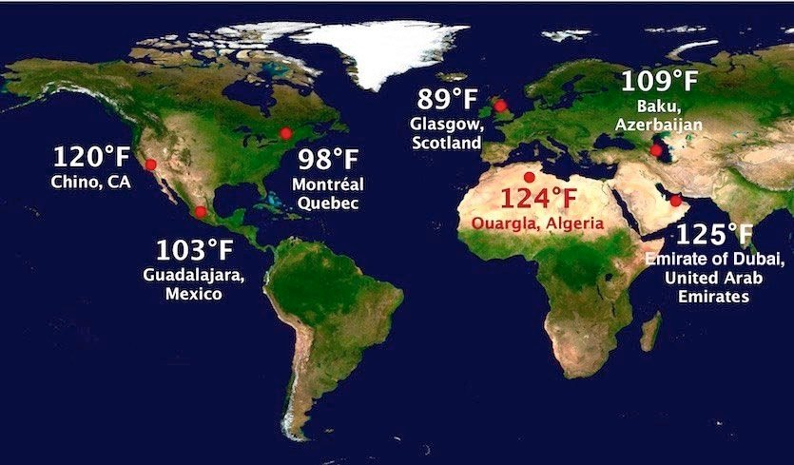
(Some of the) Record-breaking Temperatures Globally 2018

Slide 3
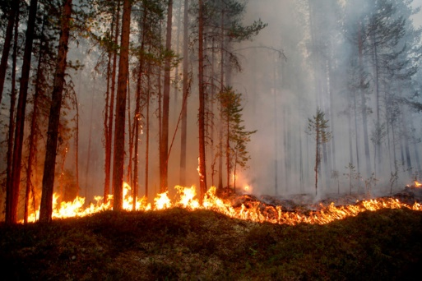

Slide 4
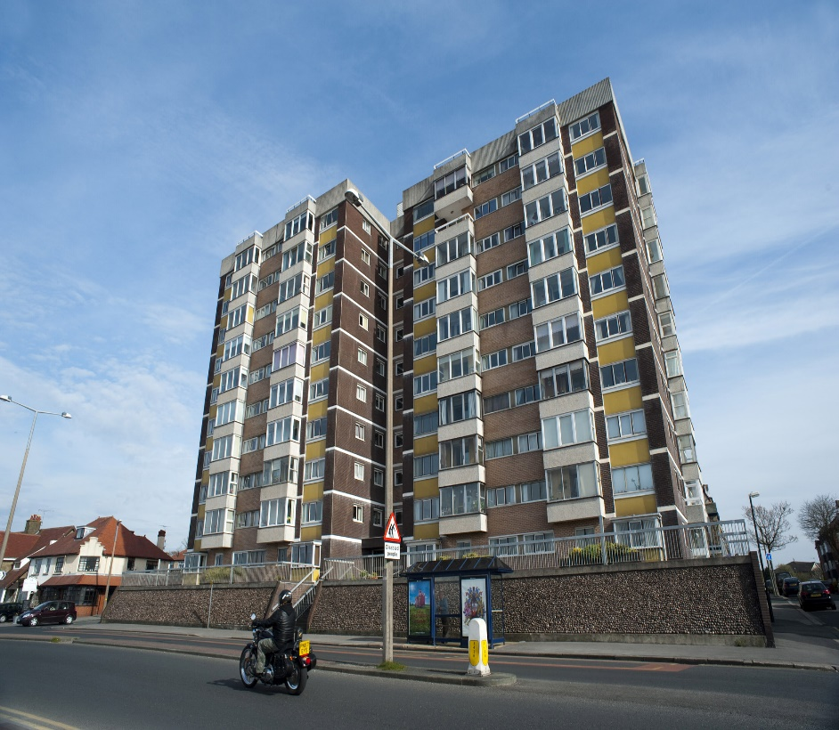
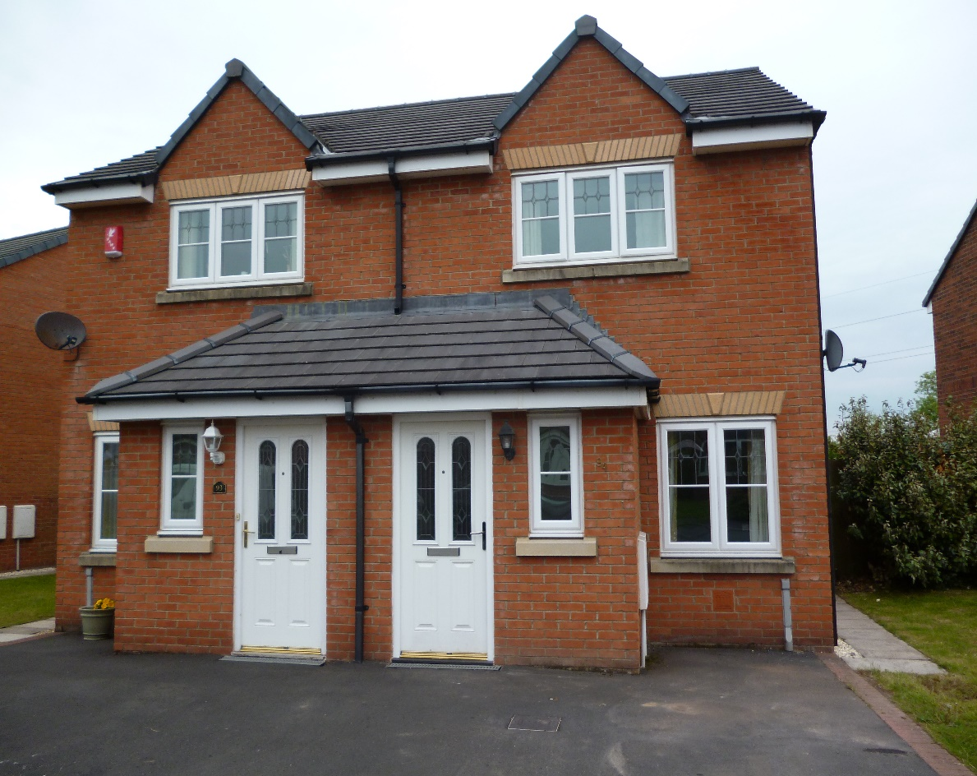
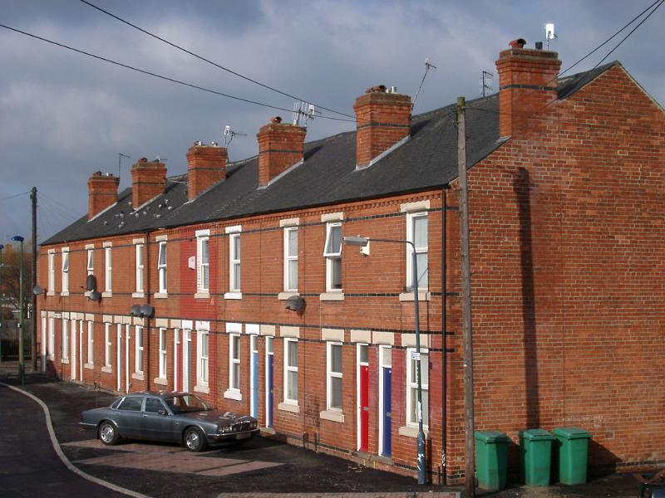
Flats
Terraced
Semi-detached
87% of housing in 2050 already built (Boardman 2007)
Two-thirds privately owned
Flats & terraced courtesy of www.photoeverywhere.co.uk

Slide 5
Research Question
Resilience to overheating in homes
The role of the householder
What are the determinants of intention to take precautionary action against overheating?

Slide 6
Protection Motivation Theory (simplified)
Threat appraisal
- Probability
- Severity
Protection motivation (Intention)
Coping appraisal
- Self-efficacy
- Response-efficacy
- Cost/time/effort

Slide 7
Protection Motivation Theory (simplified)
Threat appraisal
- Probability
- Severity
Protection motivation (Intention)
Coping appraisal
- Self-efficacy
- Response-efficacy
- Cost/time/effort
e.g.
Insulation to walls/roof
Ventilation
Shutters/awnings
Pale exterior façade
Planting near walls

Slide 8
Protection Motivation Theory (simplified)
Threat appraisal
- Probability
- Severity
Protection motivation (Intention)
Coping appraisal
- Self-efficacy
- Response-efficacy
- Cost/time/effort
Property Characteristics
Flat v house
Owner v tenant
Occupier Socio-demographics
Age
Income
Education
Overheating experience

Slide 9
n = 1,007
Variable | Category
Gender | Female Male | 50.8% 49.2%
Participant age | Mean Range | 50.58 18 - 85
Income (personal monthly net) | Less than £1,000 £1,001 - £2,000 £2,001 - £3,000 £3,001 - £4,000 Over £4,001 Not given | 23.2% 35.2% 17.4% 8.0% 6.2% 10.0%
Home ownership | Owner Tenant Other | 66.0% 31.8% 2.2%
Property type | Flat Mid-terrace Semi-detached Detached Other | 24.9% 26.8% 27.9% 18.9% 1.5%

Slide 10
Findings
n = 1,007
Variable | Mean (scaled to 0 to 6 scale)
Threat Appraisal | 2.71
Coping Appraisal | 3.51
Intention to Take Action | 0.55

Slide 11
Findings
Threat appraisal and coping appraisal positively related to protection motivation
Coping appraisal the stronger factor
For flat dwellers (versus house dwellers)
Threat appraisal greater
Coping appraisal lower
Threat appraisal became non-significant
Coping appraisal lower for tenants than for homeowners
All at statistically significant levels

Slide 12
Conclusions
Threat and coping appraisals stronger than sociodemographics
Coping appraisal important, especially for flat dwellers

Slide 13
Recommendations
Focus on developing coping appraisal
Self-efficacy – how to take mitigating actions
Response-efficacy – effectiveness of mitigating actions
Target by dwelling type

Slide 14
Thank you n.murtagh@ucl.ac.uk

