Slide 1
China’s Young Talents Programs.
How do returnees perform?
Giulio Marini, Lili Yang
CGHE Webinar No. 213, 3rd June 2021

Slide 2
Published works from this topic
L. Yang, & G. Marini (2019) Research productivity of Chinese young thousand talents. International Higher Education, 17-18. https://doi.org/10.6017/ihe.2019.97.10944
G. Marini, & L. Yang (2021) The research productivity of Chinese academic returnees from the Global West: An evaluation of Young 1000 Talents recipients’ productivity. DoQSS Working Papers. https://econpapers.repec.org/paper/qssdqsswp/2102.htm
G. Marini, & L. Yang (2021) Globally-bred Chinese Talents returning home: An analysis of a reverse brain-drain flagship policy. Science and Public Policy, https://doi.org/10.1093/scipol/scab021

Slide 3
The context
Mobility of PhD holders is key to trace leaders of the global competition in higher education and research (Lepori et al. 2015).
Chinese universities may only be attractive to some of its diaspora who have not been hitherto particularly productive (Wang et al. 2015).
The overall number and quality of international PhD students are still misbalanced between China and the Global West (Shen et al. 2016).
Cheung and Xu (2015) demonstrated that China’s ability to narrow the gap between its research capacity and the global excellence largely depends on dedicated policies of talents attraction.
Notes:
Studies found that talents who get their PhDs from leading overseas universities usually performed well even before receiving doctoral degrees (e.g., Veugelers & Van Bouwel, 2015).

Slide 4
The context
Institutions, and their prestige in particular, play an important role in attracting returnees and supporting their career development (Li et al. 2015).
Chinese returnees may face problems in terms of readapting to their home country (Ma and Pan 2015).
Chinese scholars and social capitals: domestically-educated ones use social capital in the closure mode; and those with more international experience turn on their structural holes to maximize opportunities (Lu & McInerney 2016).
Publications largely depend on available financial resources, especially for STEM disciplines (Zhang et al. 2016).

Slide 5
Young Thousand Talents Program (Y1000T)
Introduced in 2011
Aimed at attracting relatively young talents (primarily in STEM areas) who have potential to become leading figures
Below the age of 40, and normally with at least three-year overseas working experience
Successful recipients shall have “engaged in scientific research, with formal teaching and research positions in overseas prestigious universities, institutions or enterprises”
Generous support (research, infrastructure, salary …)

Slide 6
Table 1 - Possible options in devising a comparison surrounding the Y1000T recipients
Possible comparisons / evaluation of policies
Y1000T vs. Chinese-bred recipients Do returnees have better research performance than domestically bred researchers?
Y1000T vs. Other Chinese academics of similar career stage To what extent this policy is effective in boosting the research performance?
Y1000T vs. Other non-Y1000T returnees of similar career stage To what extent returnees with the support from the Y1000T outperform those without?
Y1000T vs. Other Talents policies recipients based in Mainland China When recruiting talents, at what career stage can a system maximize the return of investing?
Y1000T vs. Other non-Chinese Y1000T-like recipients (e.g., European Research Council recipients) Which policy is better devised overall? Which national system is best to host a recipient?
Y1000T vs. Other globally-bred Chinese PhD holders who continue to work abroad Is working under this generous scheme in the Chinese system a better choice than remaining abroad?

Slide 7

Research question:
Are Chinese early- and mid-career researchers who received their PhDs from world-leading higher education institutions, and are recruited back to China under the scheme (Y1000T) better performing in terms of research quantity and quality in comparison to those who have similar education and research experience, but continue to be affiliated in the US research-intensive universities?

Slide 8
Data
A combination of individual curriculum vitae (CV) information plus respective Scopus publications.
The ‘treatment’ group: first two waves of this policy (2011 and 2012 years).
The list of researchers who were recruited under the Y1000T policy was of public domain at the time of data collection (no longer available; data cleaned after collection).
The ‘control group’:
Manually extracted from official websites of some US research-intensive universities.
Sampling of universities is proportionate to their places in rankings.
By name, we individually collected people who belonged apparently to the same generation of the first two waves of Y1000T (this is possible as information about the “treated” researchers’ birth year and the year of PhD attainment is available).

Slide 9
Data
There are 183 researchers in the treatment group and 369 researchers in the control group.
Discipline: material science and engineering, life science, chemistry, information science, mathematics and physics, environment and earth science, medicine.
Researchers in both groups are similar by age, career stage, doctoral background and publication record.
The dataset comprises single scientific output as observations (around 37,000 in total) which can be referred to univocal authors, who in turns belong to either the treatment group or the control group.

Slide 10
Variables
Biographical information
Age, year of PhD attainment, gender, current scientific affiliation, and PhD awarding institution (the latter two also indicate respective countries) are the information grabbed from CV or institutional official websites.
Dependent variables
The number of citations (ln_tcit; time scaled citations)

Slide 11
Independent variables
Type of publication: open access (OA, binary), language of publication (lingua, binary), typical output (Type_p, article/non-article)
Social capital: number of co-authors by each output (no_aut), degree of internationality (int_coll), heterogeneity of co-authorships by country (heter), institutional mobility (mob), kept relationship (KR; did Chinese in the US co-authored with Chinese-based scholars? Y/N)
Standings of universities: The list of institutional qualifiers: average of Categorical Normalized Citations Indicator (CNCI), average of Journal Normalized Citation Index (JNCI), average of percentile of articles (av_percentile), percentage of top 10 percentile articles (perTOP10), percentage of 1 percentile articles (perTOP_1), percentage of cited documents (%documents cited)

Slide 12
Treat and period simple interaction
Figure 3. Distribution of dependent variable (ln_tcit) by group and period

Slide 13
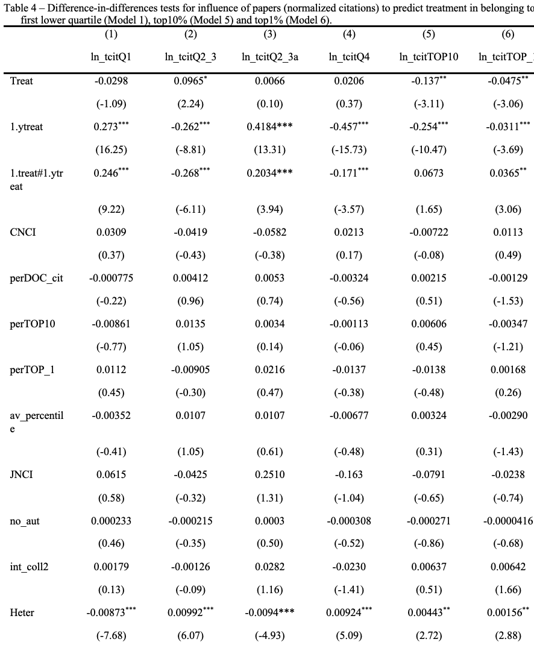
Main results (Logistic regressions - 6 Models)

Slide 14
Findings and discussion
Y1000Ts are more likely to produce papers with citations within the first quartile
Y1000Ts are less likely to fall in the middle league of the distribution.
Y1000Ts are more likely to result no better than non-returnees.
Y1000Ts are more likely to produce top-1 percentile papers in comparison to control group researchers, although there is no traceable effect of Y1000T policy for falling in the top-10 percentile of papers in terms of citations.
There is no simple yes or no answer to the research question – the answer is more nuanced. Specifically, the Y1000T “treatment” is more likely to predict publications within the bottom or the top-1 percentile. In other words, Y1000T returnees either publish less successful outputs or publish in the very top quartile – a minority of outputs though. These mixed findings may pave the way to multiple interpretations.

Slide 15
Findings and discussion
The evaluation mechanism in Chinese universities/research institutions.
Some returning researchers might have tended to publish more rather than better (Yang & Marini 2021) – provided the threshold of quality is kept above decency, not necessarily this factor is visible in the short term, if any, in terms of citations.
While generous financial support is conducive to researchers’ scientific performance, the soft environment including academic culture also makes a difference, echoing findings of Scaffidi and Berman (2011).
Y1000T policy strongly attracted those who were already in contact with scholars in Mainland China (KR variable), being this a factor deserving more attention in future analyses.

Slide 16

Limitations
The reasons of curvilinear outcomes are not probably all observed.
Social capital might be measured in a more fine-grained way, considering not only country level, but also institutional and individual ones.

Slide 17
Thank you!
Q&A

Slide 18
Annex 1 – List of US universities scanned to build up the control group (alphabetic sorting)
California Institute of Technology, Columbia University, Cornell University, Duke University, Emory University, George Washington University, Georgia Tech, Harvard University, Iowa State University, John Hopkins University, Louisiana State University, Massachusetts Institute of Technology, Michigan State University, New Mexico State University, New York University, Oregon State University, Princeton University, Purdue, Rochester, Stanford University, Temple University, University of Arizona, University of California at Berkeley, University of California at Los Angeles, University of California at San Francisco, University of California at Santa Barbara, University of Chicago, University of Cincinnati, University of Colorado, University of Connecticut, University of Florida, University of Iowa, University of Kentucky, University of Minnesota, University of Oklahoma, University of Oregon, University of Pennsylvania, University of Tennessee, University of Wyoming, Virginia Commonwealth University, Washington State University, West Virginia University, Yale University, Yeshiva University.

Slide 19
Annex 2 - Determination of ‘period’
Fig. 1 Distribution of publications according to years elapsed from person’s PhD attainment by treatment (treat = 1) and control group (treat = 0).
Fig. 2 Distribution of publications according to years elapsed from person’s PhD attainment by period (ytreat) of treatment groups: “0” equals before treatment; “1” equals after treatment (both treated and control group).

Slide 20
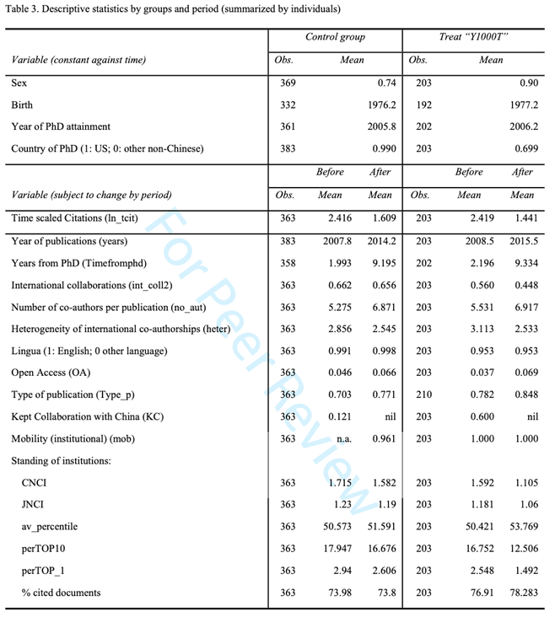
Annex 3 – Descriptive statistics

Slide 21
References
Cheung, A. C. K. and Xu, L. (2015) ‘To Return or Not to Return: Examining the Return Intentions of Mainland Chinese Students studying at Elite Universities in the United States’, Studies in Higher Education, 40/9: 1605–24.
Lepori, B., Seeber, M., and Bonaccorsi, A. (2015) ‘Competition for Talent. Country and Organizational-Level Effects in the Internationalization of European Higher Education Institutions’, Research Policy, 44/3: 789–802.
Li, F., Miao, Y., and Yang, C. (2015) ‘How do Alumni Faculty Behave in Research Collaboration? An Analysis of Chang Jiang Scholars in China’, Research Policy, 44/2: 438–50.
Lu, X. and McInerney, P.-B. (2016) ‘Is It Better to “Stand on Two Boats” or “Sit on the Chinese Lap”?: Examining the Cultural Contingency of Network Structures in the Contemporary Chinese Academic Labor Market’, Research Policy, 45/10: 2125–37.
Ma, Y. and Pan, S.-Y. (2015) ‘Chinese Returnees from Overseas Study: An Understanding of Brain Gain and Brain Circulation in the Age of Globalization’, Frontiers of Education in China, 10/2: 306–29.
Shen, W., Wang, C., and Jin, W. (2016) ‘International Mobility of PhD Students Since the 1990s and Its Effect on China: A Cross-National Analysis’, Journal of Higher Education Policy and Management, 38/3: 333–53.
Wang, Q., Tang, L., and Li, H. (2015) ‘Return Migration of the Highly Skilled in Higher Education Institutions: A Chinese University Case’, Population, Space and Place, 21/8: 771–87.
Zhang, L., Bao, W., and Sun, L. (2016) ‘Resources and Research Production in Higher Education: A Longitudinal Analysis of Chinese Universities, 2000–2010’, Research in Higher Education, 57/7: 869–91.

