Slide 1

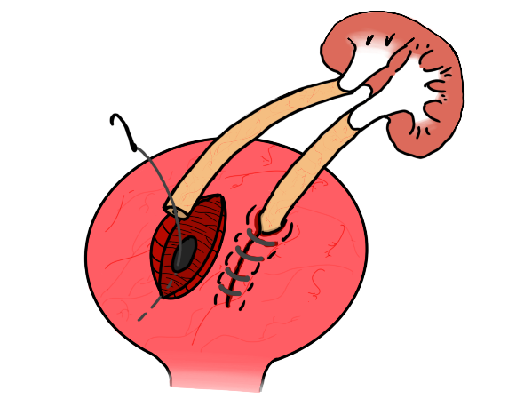
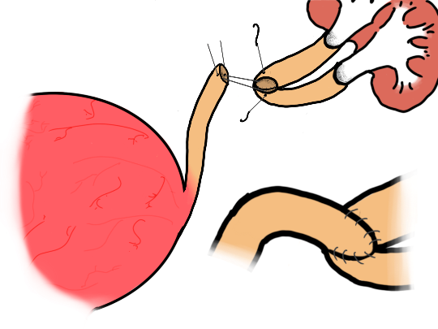
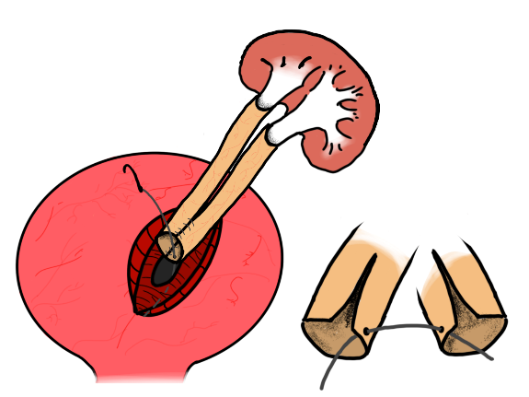

Duplex ureters: what are the long-term implications after transplantation?
Charles Hill¹, Fernando Yuen Chang², Reza Motallebzadeh², Ammar Al Midani², Colin Forman², Neal Banga², Bimbi Fernando², Fiona McCaig², Mohammad Hossain²
Introduction
Kidneys with duplex ureters are one of the most common congenital genitourinary anomalies, with an incidence of 0.6-0.8% (1-3).
Duplications may be discovered in childhood or less often in later life.
Patients are still at a higher risk of recurrent UTI, reflux and stone formation (4).
Many healthy patients are asymptomatic and the duplication is often not discovered until the donor’s kidney is prepared for implantation (or in autopsy).
Discussion
Our case series highlight that there is no difference in clinical outcomes between single and duplex ureter and should not be a factor for organ decline. This aligns with previous studies (Table 3)
However, it is still important to recognise that duplex ureters do pose technical challenges and must be taken into account preoperatively
Transplant factors should be closely considered with recipient factors
Figure 3. Formation of the ureteroureterostomy using the native ureter and the donor ureters
Figure 1, Lich-Gregoir technique, applied twice
Figure 2, Common ostium formation and implantation using Lich-Gregoir technique
Technique | No. of ops.
Double Lich-Gregoir (fig.1) | 7
Common ostium (fig. 2) | 2
Ureteroureterostomy (fig. 3) | 1
Incomplete duplication (single Lich-Gregoir) | 1
Methods
Eleven patients who had received a duplex ureter kidney were identified from April 2009 to November 2020.
We evaluated the length of stay, ureteric post-operative complications and readmissions, and graft function with eGFR up to one year.
The control group was matched for recipient factors, date of operation (month) and the operator.
Surgical techniques are outlined in Table 1
Results
Length of stay, eGFR and reoperations are shown in Table 2
There was no significant difference in eGFR or urologic complications between the case and control group
One patient with multiple pelvic comorbidities experienced 2 re-operations and 1 procedure
One stayed for 32 days due to unrelated post-operative complications.
In the control group, one stayed for 190 days due to unrelated vascular complications.
Author | No. of patients | Outcome
Ghazanfar et al. (3) | 76 | No significant difference
Alberts et al. (5) | 71 | No significant difference
Haferkamp et al. (6) | 19 | Significant difference (10.5% in duplex, 1.8% in single)
Table 1, 11 patients were operated on, the surgical technique chosen was at the discretion of the surgeon
POPULATION | Donor |  | LOS (days) | LOS (mode) | REOPS | PROCEDURES | eGFR
 | LIVE | DECEASED |  |  |  |  | 1 MONTH | 3 MONTHS | 12 months
Duplex (n=11) | 2 | 9 | 9.64 | 5 | 0.18 | 0.09 | 45.9 | 49.1 | 50.3
Control (n=11) | 3 | 8 | 24.27 | 5 | 0.00 | 0.00 | 47.0 | 50.6 | 47.2
Table 3, A summary of three significant studies on outcomes in duplex kidney transplantation. Alberts et al. reviewed 13 papers covering 71 operations.
Sources
1. Malek RS, “Observations on ureteral ectopy in children”. J Urol; 1972
2. Campbell MF, “Anomalies of the ureter”. 3rd ed. Saunders; 1970.
3. Alberts VP, “Duplicated ureters and renal transplantation: a case-control study and review of the literature”. Transplant Proc; 2013
4. Fernbach SK, “Ureteral duplication and its complications”. Radiographics; 1997
5. Ghazanfar A, “Outcome of kidney transplant with double ureter: a multicenter study”. Exp Clin Transplant; 2015
6. Haferkamp A, “Ureteral complications in renal transplantation with more than one donor ureter”. Nephrology Dialysis Transplantation; 1999
Table 2, the large variance in length of stay is due to non-urologic complications in both groups. Otherwise, there was no significant difference in number of reoperations or procedures required, nor was there a difference in eGFR up to 12 months
¹From University College London Medical School, London, UK; ²the Department of Urology and Renal Transplant Surgery, Royal Free London NHS Foundation Trust, London, UK
Acknowledgements: The authors have no conflicts of interest to declare. No funding was received for this study
Corresponding author: Mr Charles Hill, 5th Year Medical Student, Royal Free London NHS Foundation Trust, London, NW3 2QG
Email: Charles.hill1@nhs.net
Copyright © 2020 Charles Hill, charles.hill1@nhs.net

