Slide 1
The compressibility of the Jovian magnetosphere
Department of physics and astronomy
Dimitrios Millas (UCL)
N. Achilleos (UCL), P. Guio (UCL / Arctic University of Norway), C. S. Arridge (Lancaster University)
15th HELAS Conference, 5-8/07/2021

Slide 2
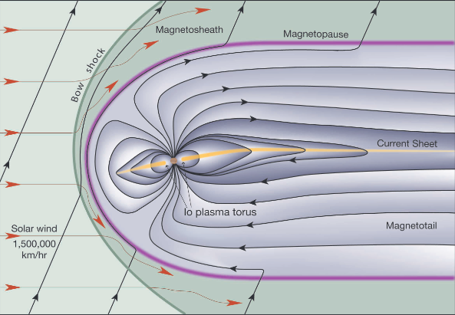
Constructing the magnetosphere
Magnetic dipole
Works well for Earth
Not appropriate for giant planets
Additional plasma sources (e.g. Io)
A more realistic picture
Observations: significant deviation from the dipole case
Strong J_{φ} leading to stretched lines radially outward
Magnetodisc structure
Model proposed by Caudal (1986)
Implementation & application (Achilleos et al. 2010)
Bartlett & Bagenal, 2004

Slide 3
Global magnetosphere: Caudal’s scheme
Assume an axisymmetric, 2D case (planet to magnetopause, spin axis)
Force balance: $\vec{J}×\vec{B}$, $∇P$, centrifugal force
Express the magnetic field using Euler potentials $α,β:$
$\vec{B}$=$∇α x ∇β$
Include hot plasma population (E_{th} > E_{kin,rot})
Constraints from observations (e.g. ρ, Τ, composition…)
Angular velocity (ω) profile via Hill’s method / Apply updating algorithm using the disc

Slide 4
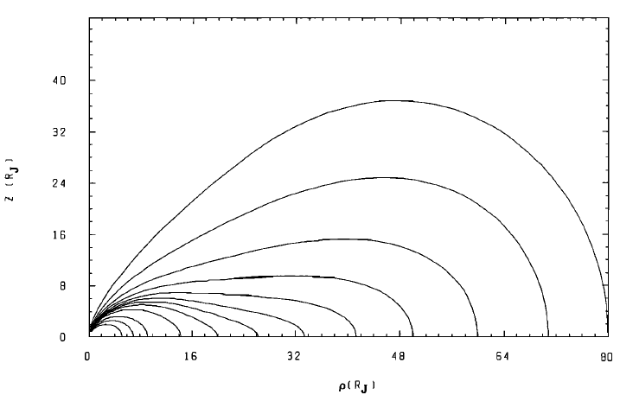
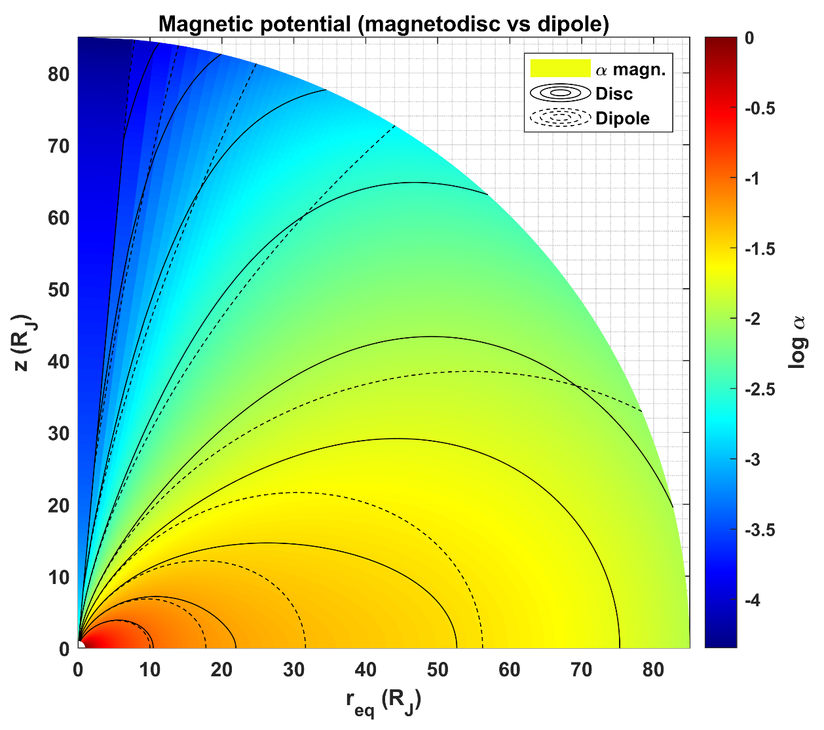
Iterative process
Initialize the magnetic field as a dipole
Expansion of the potential α using Jacobi polynomials
Exploit axisymmetry for β
Iterate until the relative error satisfies a condition (<10⁻²)
Meridional projection of fieldlines
(left: Caudal 1986 / right: sample solution)

Slide 5
Compressibility of the magnetosphere
The magnetosphere responds to changes in external or internal influences
Compressibility index γ: “Measure” of the response
External : Solar Wind (SW), Interplanetary magnetic field (IMF)
Internal variations also important (e.g. hot plasma pressure, Sorba et. al 2017).
Measure the magnetopause distance as a function of the dynamic solar wind pressure
Use ensemble of models as “magnetopause crossings”

Slide 6
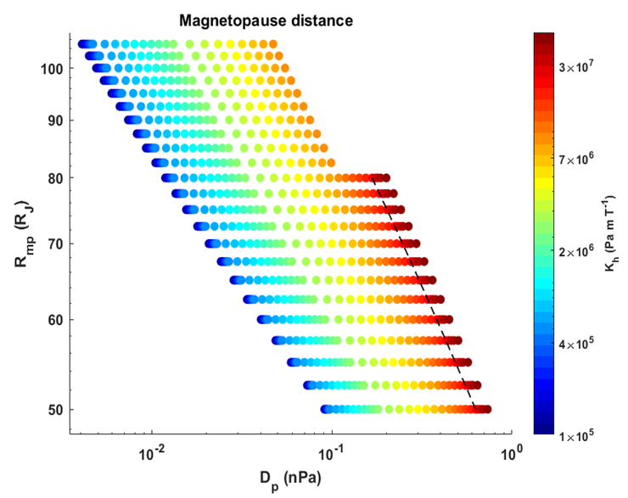
Cases ( > 700) with different R_{mp} and hot plasma population
R_{mp} : 50 – 105 R_{J}
K_{h}: 10⁵ – 4.5·10⁷ Pa m T⁻¹
Calculate the dynamic pressure of the SW from the boundary values
D_{p} ~ P_{m} + P_{th} (R=R_{mp})
Account for “deflection”
Assume first a constant compressibility
log-log plot ~ linear behaviour ?
Examine the effects of system size

Slide 7
Contributions to the total pressure for different K_{h} cases

Slide 8
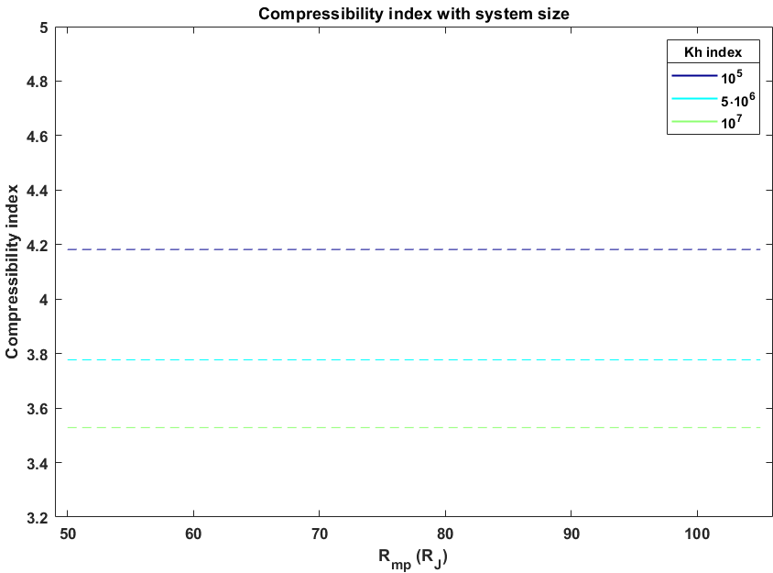
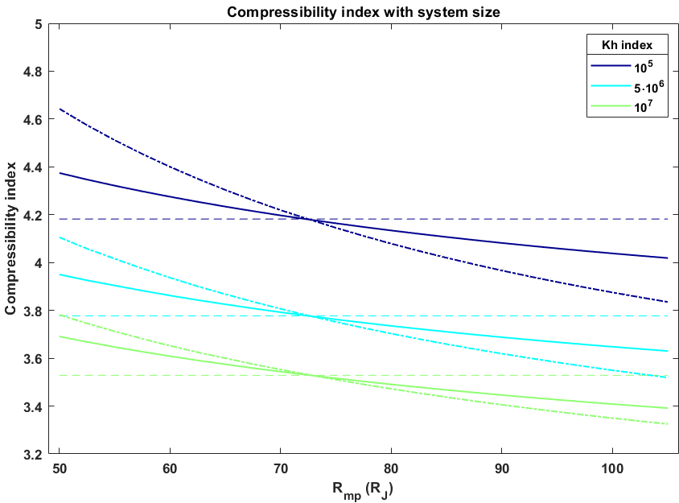
Relation between R_{mp} – D_{p}
R_{mp} = λ $D_{p}^{{−1}/γ}$
Dipole in vacuum: γ = 6
Fit: logR_{mp} = $−\frac{1}{γ}$ logD_{p} + c
Constant compressibility index γ
System size effect via λ
In general, not a constant (effects of ring current)
Higher order analysis
logR_{mp} = - f (logD_{p})
γ = $\frac{1}{f′\left(\text{log}\text{D}\text{p}\right)}$
Examined via a 2nd order and “generalized” fitting functions f (Hardy et al., 2020)

Slide 9
Consider scaling according to “local” plasma-β
Calculate an averaged β_{eff}
Use P_{SW,eff} instead of D_{P}
Clustering of models for small K_{h} values (< 10⁷)
Linear behaviour breaks down for larger values

Slide 10
Jupiter & Saturn
Jovian magnetosphere
(this study)
Kronian magnetosphere
Sorba et al. 2017

Slide 11
Conclusions
Studying the compressibility of the Jovian magnetosphere
Ensemble of models with different R_{mp}, K_{h}
Compressibility index values typical for the system (γ ~ 4)
Linear analysis sufficient for “moderate” states
Effects of system size important, higher order analysis necessary
Scaling with “effective values”
Expanded magnetosphere → more “easily” compressed (γ decreases)
Dependence on K_{h}
“Similar” with studies of the Kronian magnetosphere

Slide 12
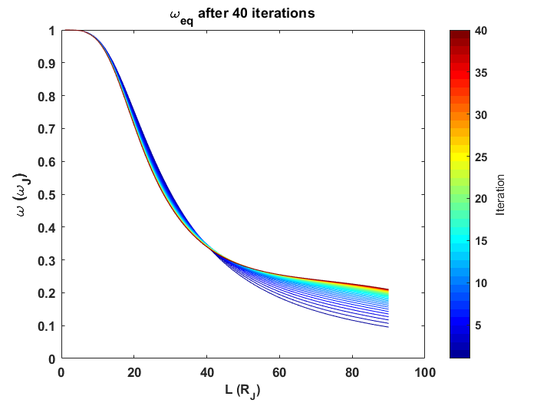
Updating the angular velocity ω(L)
Hill’s equation only applicable to a dipolar field
The Pontius’ (modified Hill) equation for the corotation lag f = 1 – ω/ω_{J} :
Include “deviation” from dipole in μ_{Β}
cosθ(r): mapping function (field line from equator to ionosphere)
corotation
“Relaxed”
“Dipole”

Slide 13
corotation
“Relaxed”
“Dipole”

