Slide 1
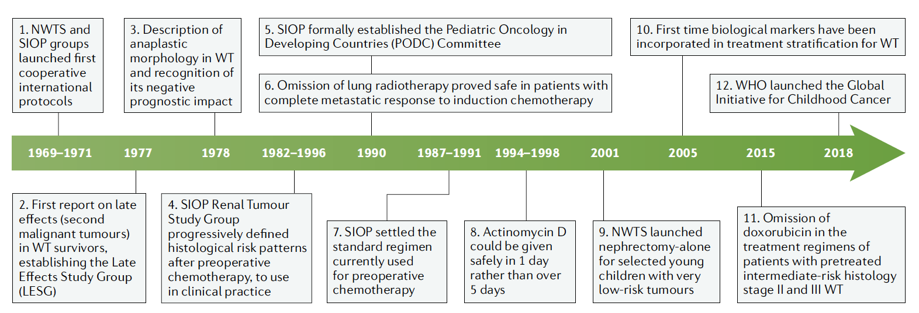
Figure.1: Timeline of key clinical advances that established the modern clinical management of children with Wilms tumour
1. National Wilms Tumour Study group (NWTS), which was supplanted by the Children’s
Oncology Group (COG) in 2002, and the International Society of Paediatric Oncology (SIOP)
11. In 2018, WHO launched the Global Initiative for Childhood Cancer, with the goal of improving outcome in children with cancer around the world, initially focusing on six common cancers including WT.

Slide 2
Fig 2: Estimated age-standardized mortality rates in 2020, kidney, in children aged 0-14 yrs (source GLOBOCAN 2020)

Slide 3
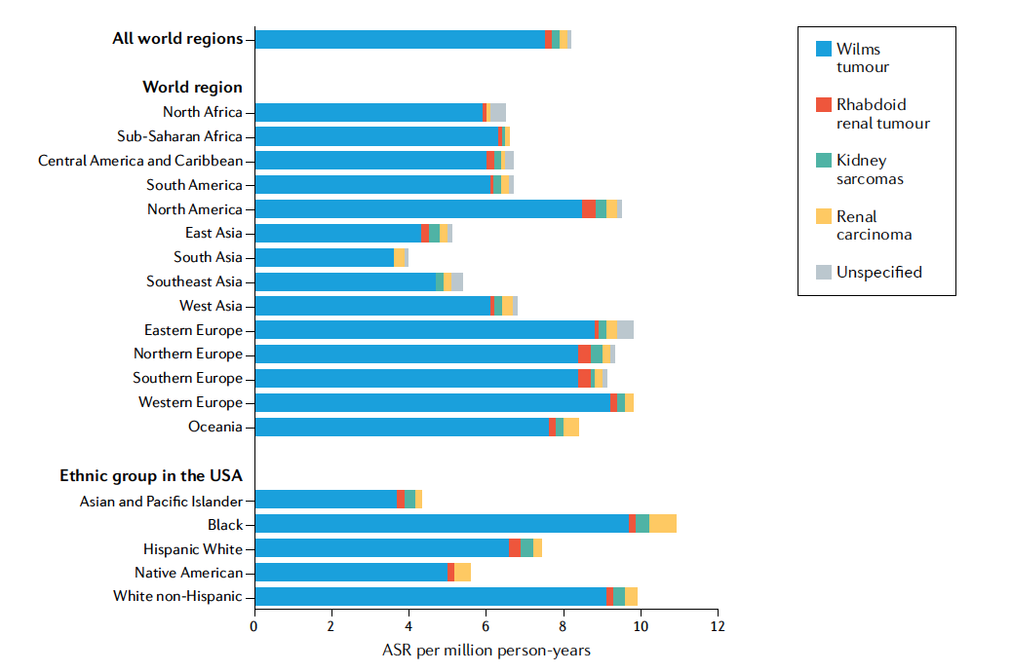
Fig 3: The incidence of Wilms tumour according to geographical area and ethnicity. Age- standardized incidence
rates (ASRs) of renal tumours in children 0–14 years of age by world region and ethnicity, 2001–2010 (N = 15,320).
Unspecified, unspecified malignant renal tumours. Adapted from ref.2, CC BY 4.0.

Slide 4
Fig 4. Age-specific incidence of Wilms tumour according to gender, laterality and geographical area.
a | Age- specific incidence of Wilms tumour (WT) in children 0–14 years of age, all world regions combined, by sex (N = 13,838) and laterality (N = 6,396), 2001–2010. Only the registries providing information on the laterality for at least 95% of patients with WT are included.
b | Age- specific incidence of WT in children 0–14 years of age by world region, 2001–2010 (N = 13,838). Adapted from ref.2, CC BY 4.0.

Slide 5
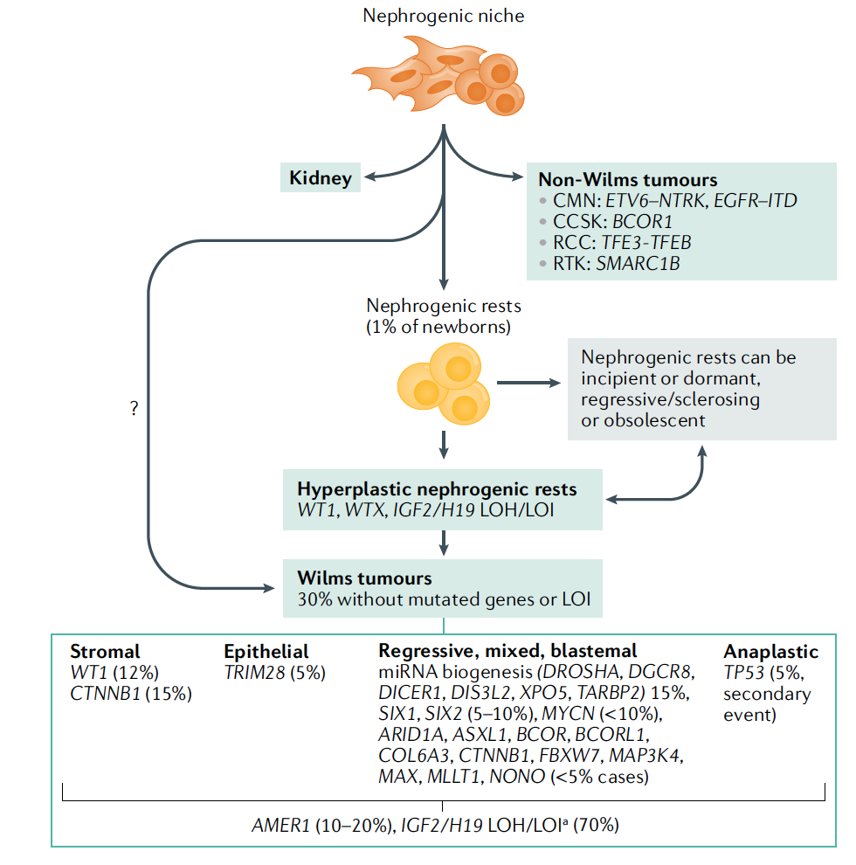
Fig. 5 Biology of paediatric renal tumours

Slide 6
Figure 6: Different histological patterns of Wilms tumour.

