Slide 1
Figure 1: Study flowchart of cohort 2011-2012
Isolated TAVI = 8942
Isolated SAVR = 9068
Exclude Frail, repeat, porcelain aorta or malignancy
TAVI = 4785
Exclude repeat SAVR = 2
Isolated TAVI = 4157
Isolated SAVR = 9066
Failed to Match TAVI = 2337
Failed to Match SAVR = 7246
Matched TAVI = 1820
Propensity Score Matched
Matched SAVR= 1820

Slide 2
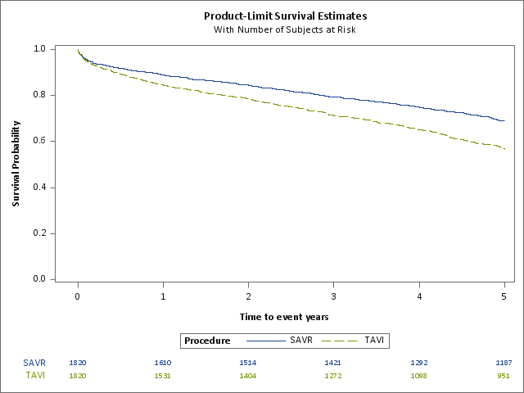
Figure 2: Survival probability by treatment for 2011-2012 matched cohort.
HR 1.51 (95% CI 1.35 to 1.68; p<.0001)

Slide 3
Figure 3: Mortality risk by year of procedure for 2011 and 2012 cohort (Hazard ratio, 95% CI, and test for interaction).

Slide 4
Figure 4: Mortality risk of patients with TAVI prostheses compared with matched sAVR patients in 2011-2012 cohort (Hazard ratio and 95% CI). Subjects who underwent TAVI are compared with their respective propensity score-matched SAVR subjects.
Sapien
1.54 (1.26,
1.88;
p<.0001; n=966, deaths = 389)
1.52 (1.19, 1.95; p=0.0009;
n=796, deaths=257
Sapien XT
)
CoreValve
1.46 (1.23, 1.73; p
<.0001; n=1528, deaths=545
)
ACURATE TA
3.00 (1.42, 6.31; p=0.004; n=98, deaths=33)
JenaValve
1.48 (0.60, 3.69; p=0.40;
n=48, deaths=19
)
Other
1.28 (0.75, 2.18; p=0.37; n=154, deaths=54)
0.5
1
2
5
10
Favours TAVI
Hazard Ratio (95% confidence interval)
Favours SAVR

