Slide 1
Department of Science, Technology, Engineering and Public Policy
Data for Policy 2019
Bridging the sociotechnical divide from a policy perspective:
Knowledge sharing in cybersecurity & data management in digital technologies
From UCL STEaPP:
Dr Irina Brass, Lecturer in Regulation, Innovation, & Public Policy (Chair)
Dr Kruakae Pothong, Research Fellow
Dr Feja Lesniewska, Research Fellow
Dr Uchenna Ani, Research Fellow
Dr Alex Chung, Research Fellow

Slide 2





Department of Science, Technology, Engineering and Public Policy
Data for Policy 2019
Cyber capacity building and knowledge sharing:
The UK policy community’s perception of the National Cyber Security Centre (NCSC)
Dr Madeline Carr, Associate Professor, UCL STEaPP (PI)
Professor Siraj Shaikh, Coventry University (Co-I)
Dr Alex Chung, Research Fellow, UCL STEaPP
Atif Hussain, Research Associate, Coventry University

Slide 3
Department of Science, Technology, Engineering and Public Policy
Introduction
Cybersecurity as a ‘wicked’ policy problem
Skills gap
Recruiting & retaining talent
Legacy IT systems
Cybersecurity culture
Keep pace with change
Investment in new tech
Reactive IoT futureproofing
Behavioural changes
Cyber hygiene
Cyber ecosystem resilience
Fragmented infrastructure
Crisis response coordination
Cyber growth for SMEs
Board level valuation of risks
Overzealous tech adoption
Long term planning
Measuring and managing threats
Evidence base
Human factor
Conflicting information
Complex landscape
Prevent to complement Protect
Victim support
Customer support
Clarity on cyber paradigm
Politics & geopolitics of advice
Trust on the Internet
Brexit implications
Corporate monopoly on contracts
Attribution difficulties
Export challenges
Information overload
Partial coverage
Cybercrime awareness
Confidence in policing

Slide 4
Department of Science, Technology, Engineering and Public Policy
Introduction
Policy advice in cyber capacity and resilience building
UK National Cyber Security Centre (NCSC) since 2016
  ‘Making the UK the safest place to live & work online’
  Coordinates information sharing and major incident response
How does UK policy community perceive NCSC provisions and interactions?

Slide 5
Department of Science, Technology, Engineering and Public Policy
Evaluating Cyber Security Evidence
for Policy Advice (ECSEPA)
ECSEPA Main Project - Evidence
ECSEPA Mapping Exercise - Governance
15 Interviews, November 2017 to February 2018
69 Online survey responses, June 2018 to July 2018
NVivo and Excel for data analysis

Slide 6
Department of Science, Technology, Engineering and Public Policy
ECSEPA
UK Government policy specialists: Respondent stats
Gender
Female | 26.5%
Male | 73.5%
Age
20-29 | 11.6%
30-39 | 27.5%
40-49 | 26.1%
50-59 | 29%
60-69 | 4.3%
70-79 | 1.4%
HMG
Yes | 44.1%
No | 55.9%
Work Focus
All 3 | 42%
-2 & +2 | 18.8%
Incident & -2 | 18.8%
Other focus | 20.4%

Slide 7
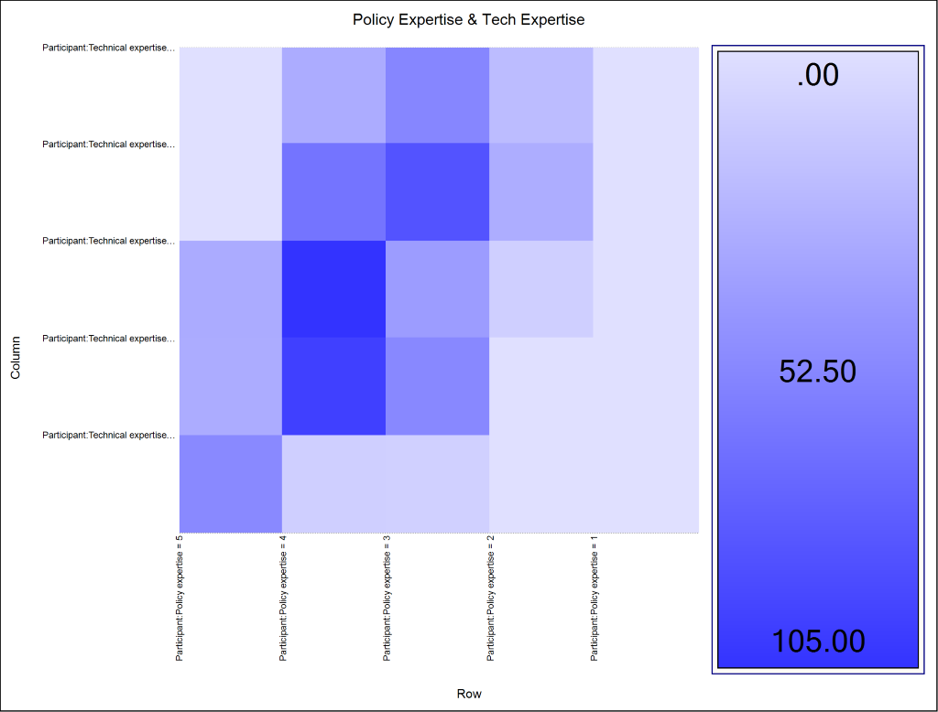
Department of Science, Technology, Engineering and Public Policy
ECSEPA
Self-rating of policy & technical expertise:
A good balance (pol-tech)
Most common: 4-3 & 4-4
Absent: 2-5, 2-4, 5-2, 5-1

Slide 8
Department of Science, Technology, Engineering and Public Policy
ECSEPA
Where do you go for technical advice?
1 | Within dept | 49/69 or 71%
2 | NCSC | 48/69 or 69.6%
3 | Outside gov’t | 45/69 or 65.2%
4 | Outside dept within gov’t | 39/69 or 56.5%
5 | CS websites/blogs | 38/69 or 55.1%
6 | Law enforcement | 27/69 or 39.1%
7 | Other | 14/69 or 23.3%

Slide 9
Department of Science, Technology, Engineering and Public Policy
ECSEPA
Types of sources relevant to work ranked by aggregate ratings
 | Source Category | % of total
1 | NCSC* | 70%
2 | Ind’ O* | 66%
3 | NGO/Pro | 62%
4 | Academic | 60%
5 | Int’* | 59%
6 | Classified* | 54%
7 | Online | 53%
8 | Ind’ R | 51%
9 | Judicial | 37%

Slide 10
Department of Science, Technology, Engineering and Public Policy
ECSEPA
Important sources named, grouped and ranked by frequency
 | Source Category | % of total (n=266)
1 | NCSC | 54 (20.3%)
2 | Other UK Gov | 41 (15.4%)
3 | Industry | 37 (13.9%)
4 | Blog/news | 28 (10.5%)
5 | Generic/unknown | 24 (9%)
6 | Int'l org | 20 (7.5%)
7 | US Gov | 19 (7.1%)
8 | Acadmic | 19 (7.1%)
9 | NGO/pro org | 11 (4.1%)
10 | LEA (incl int'l) | 9 (3.4%)
11 | AUS Gov | 4 (1.5%)
Notes:
f

Slide 11
Department of Science, Technology, Engineering and Public Policy
ECSEPA
NCSC Engagement
NCSC Products & Services
HMG | Non-HMG
HMG | Non-HMG
Satisfied
Un-/dis-satisfied
Mixed
71.4% | 66.7%
9.5% | 10%
19% | 23.3%
50% | 54.5%
18.2% | 12.1%
31.8% | 33.3%

Slide 12
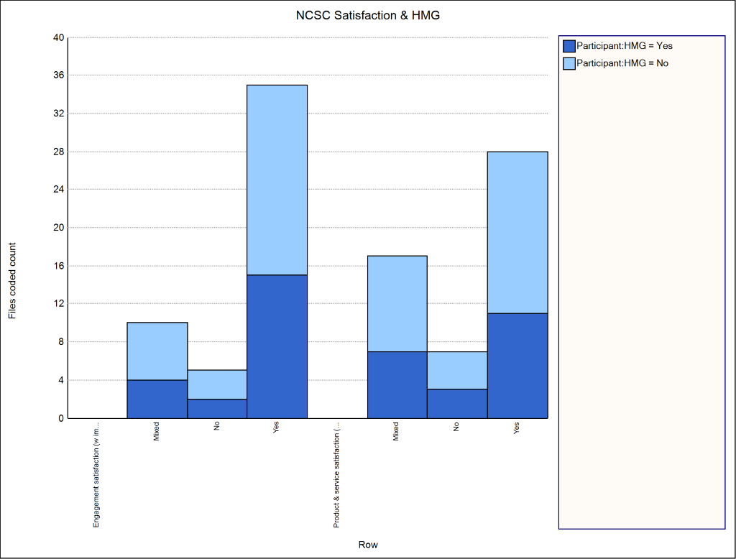
Department of Science, Technology, Engineering and Public Policy
ECSEPA
Satisfaction with NCSC:
Over 1/2 satisfied with P&S
Over 2/3 satisfied with Engagement
Approx. 1/3 expressed mixed views about P&S

Slide 13
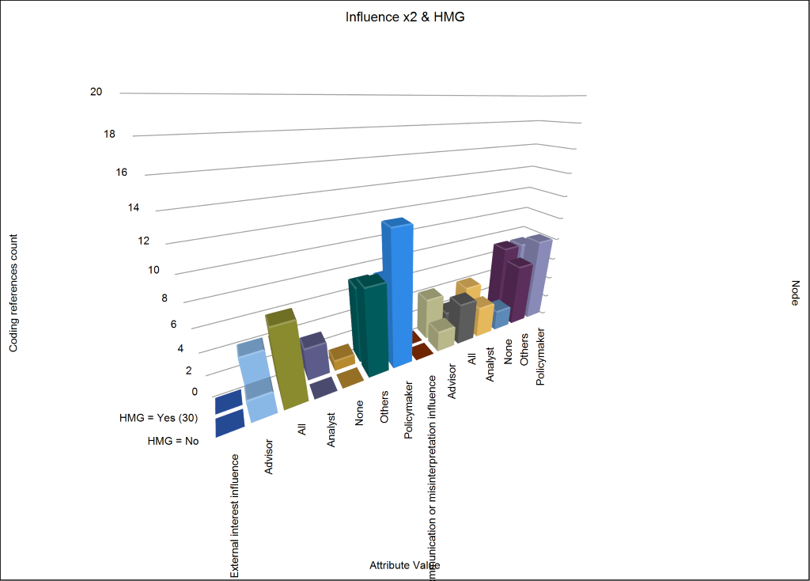
Department of Science, Technology, Engineering and Public Policy
ECSEPA
Influences in the policy processes by type and actor
Policymakers prone to external interests: Non-HMG (63.2%), HMG (32.8%)
Relatively even spread for misinterpretation and miscommunication
'Other' actors also involved

Slide 14
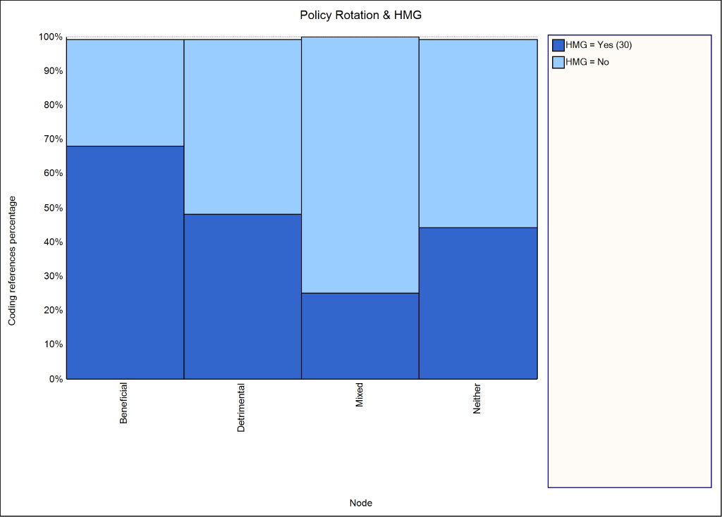
Department of Science, Technology, Engineering and Public Policy
ECSEPA
Rotation of policy posts
HMG see benefits (68.2%) vs non-HMG (31.8%)
75% mixed views in non-HMG vs 25% in HMG

Slide 15
Department of Science, Technology, Engineering and Public Policy
Conclusions
Consensus: NCSC regarded as central technical authority
NCSC provisions and interactions perceived largely positively; still room for improvement with recommendations
Better information sharing mechanisms are suggested; transparency is needed for evidence produced

Slide 16
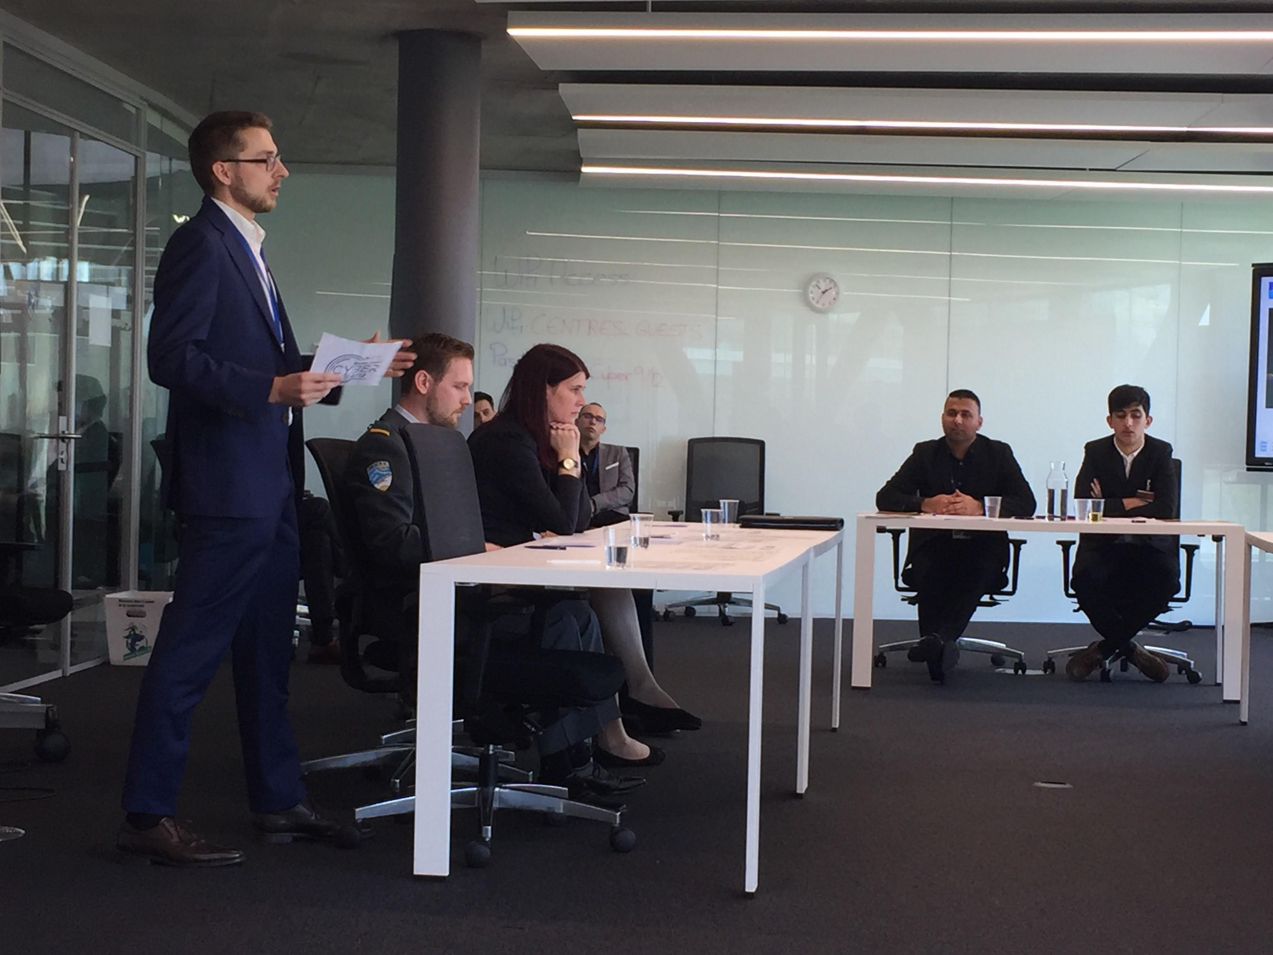
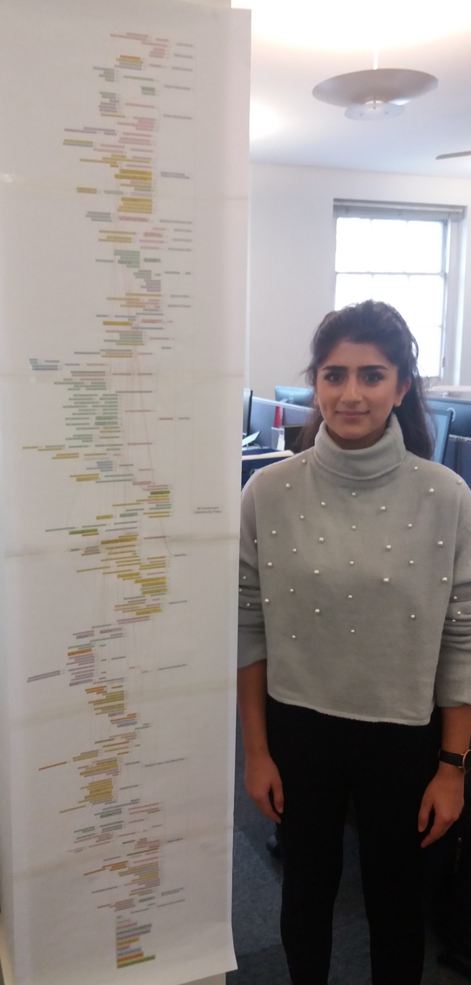
Department of Science, Technology, Engineering and Public Policy
Further Information
ECSEPA Project Website
  http://ecsepa.coventry.ac.uk/
ECSEPA Map, Research & Policy Briefs
  https://www.riscs.org.uk
ECSEPA Policy Crisis Games Report
  https://tinyurl.com/y25hbpz3
ECSEPA Newsletter Mailing List
  alex.chung@ucl.ac.uk

