Slide 1
Strategy, Partnerships and Discipline Differences
Dr Paul Ayris
Director of UCL Library Services and UCL Copyright Officer
Chief Executive, UCL Press
President of LIBER (Association of European Research Libraries)
Chair of the LERU community of Chief Information Officers
e-mail: p.ayris@ucl.ac.uk

Slide 2
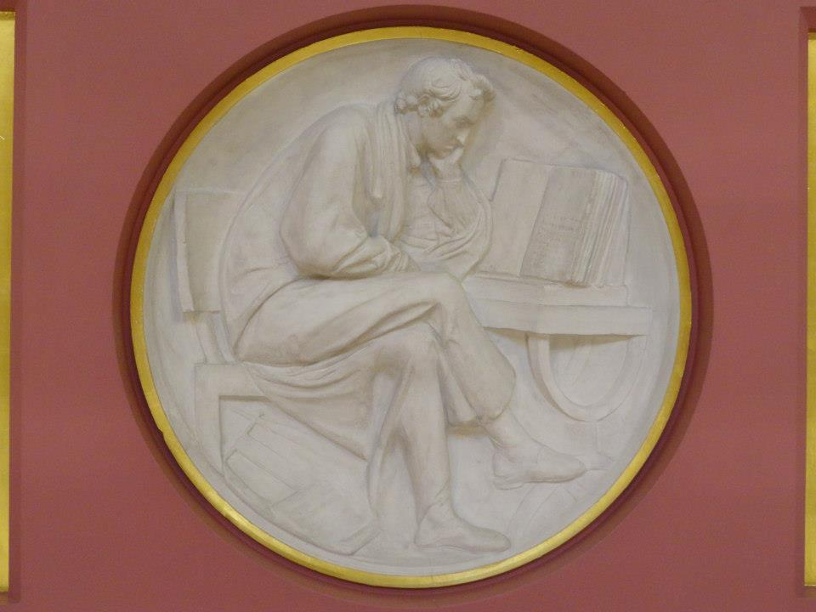
Contents
Strategy
Partnerships
Disciplinary differences
Conclusions?
Plaster Relief by John Flaxman, Flaxman Gallery, UCL

Slide 3
Contents
Strategy
Partnerships
Disciplinary differences
Conclusions?
Plaster Relief by John Flaxman, Flaxman Gallery, UCL

Slide 4
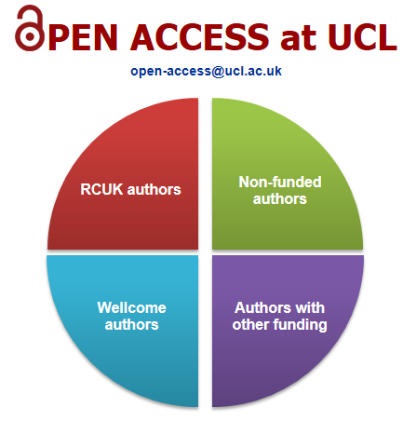
Strategy
UCL OA strategy at http://www.ucl.ac.uk/library/open-access/
Cost of APCs should not be a barrier to OA publication
Monies from
UCL Research budget
RCUK, Wellcome, ERC
UCL has OA mandate at http://www.ucl.ac.uk/library/publications-policy.shtml

Slide 5
UCL Discovery
Downloads from UCL Discovery
Year | Q1 | Q2 | Q3 | Q4 | Total
2013 | 334,159 | 343,262 | 320,162 | 227,753 | 1,225,336
2012 | 213,402 | 245,836 | 229,864 | 349,688 | 1,038,790
2011 | 146,748 | 155,152 | 107,601 | 175,464 | 584,965
2010 | 117,514 | 133,024 | 128,924 | 146,690 | 526,114
OA Type | No. of records in UCL Discovery
External links | 6,433
Local Full Text | 13,851
Total UCL OA | 20,284
Counting UCL OA availability

Slide 6
Contents
Strategy
Partnerships
Disciplinary differences
Conclusions?
Plaster Relief by John Flaxman, Flaxman Gallery, UCL

Slide 7
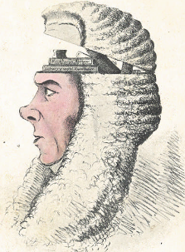
LERU OA Legal Portal
LERU has 21 research intensive universities as members in Europe – see http://www.leru.org
Portal would be built by TEL (The European Library)
All LERU OA legal publications brought together into one interface
Value-Added Services, such as Text and Data Mining, also possible
A Box of Useful Knowledge
(Brougham Papers, UCL Library Services)

Slide 8
Benefits of Partnership working
Portal builds on shared values - collegiality, research and knowledge creation as a shared endeavour, expressed in LERU Roadmap Towards Open Access
Costs shared amongst members
Creation of a value-added product amongst a subject community with strong ties
http://www.leru.org/files/publications/
LERU_AP8_Open_Access.pdf
Gratian, 12th century: Decretum cum summario
Joannis de Deo Hispani.
Nuremberg: Anton Koberger, 28 February 1483

Slide 9
Contents
Strategy
Partnerships
Disciplinary differences
Conclusions?
Plaster Relief by John Flaxman, Flaxman Gallery, UCL

Slide 10
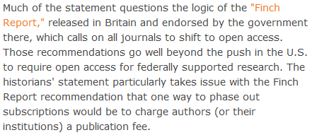
The view from Arts and Humanities?
http://blog.historians.org/2012/09/aha-statement-on-scholarly-journal-publishing /

Slide 11
Monograph Publishing
Is Open Access a solution to broken Business Model?
University Press takes on role as monograph publisher
Long form monographs, peer reviewed
Short monographs in AHSS – new publishing format?
UCL Special Collections, 15th century Book of Hours, with 19th century additions. MS. Lat. 25

Slide 12
Shared European infrastructure for monographs?
19 European partners, led by UCL
European universities can become publishers themselves
Shared publishing infrastructure with Open Access business models
Research monographs in the Arts, Humanities and Social Sciences
OAPEN to provide much of the technical infrastructure
To be launched at UCL in December 2013
UCL Special Collections. Pentateuch, 1666.
STRONG ROOM MOCATTA Q B 12 TAR

Slide 13
What could be achieved?
OUTPUTS
Shared publishing infrastructure Shared by 19 partners Scaleable to all European Universities
Advocacy for new solutions to solve monograph crisis
Marketing frameworks
Business Modelling activities
At least 180 OA monographs in 35 series

Slide 14
Indicative series in European collaboration
35 series titles proposed in total | Subject area
Media History and Film Theory | Media studies, Film theory
Spirituality Studies in Theology | Theology
World Oral Literature Series | Literary Studies
Iranian Studies | Middle Eastern Studies
Law, Governance and Development Research | Law, International Studies
Interdisciplinary Issues - Art, City, Society | Urban Studies
New Ideas in Human Interaction | Linguistics

Slide 15
And finally…
Thanks for listening
Happy to answer any questions

