Slide 1
Open Access publishing tools and services
Dr Paul Ayris
Director of UCL Library Services and UCL Copyright Officer
President of LIBER (Association of European Research Libraries)
Chair, LERU (League of European Research Universities) Chief Information Officer community
e-mail: p.ayris@ucl.ac.uk

Slide 2
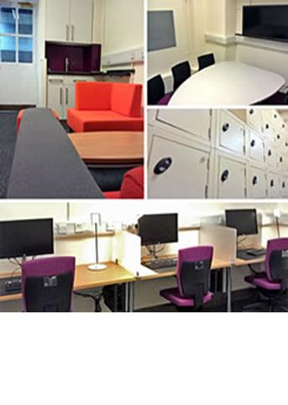
Contents
OA Advocacy
Metadata issues
Description
Aggregation
APC payments
Altmetrics
Publications and research data
Digital Preservation
Conclusions?

Slide 3
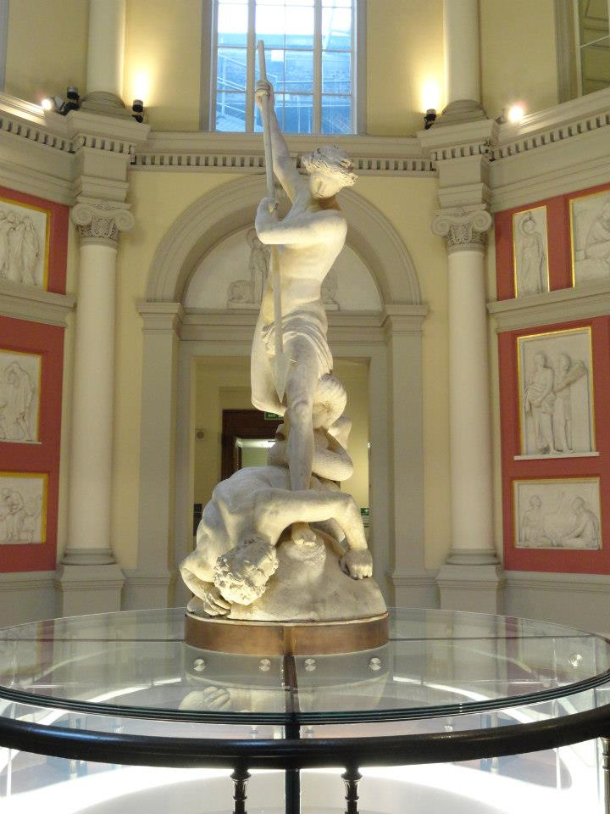
OA advocacy
Arts, Humanities and Social Science communities slow to embrace OA
HEFCE REF consultation has omitted monographs from scope of OA mandate
OA monograph publishing far from being accepted in these communities – see Debating Open Access at http://www.britac.ac.uk/openaccess/
St Michael, by John Flaxman, UCL

Slide 4
Contents
OA Advocacy
Metadata issues
Description
Aggregation
APC payments
Altmetrics
Publications and research data
Digital Preservation
Conclusions?

Slide 5
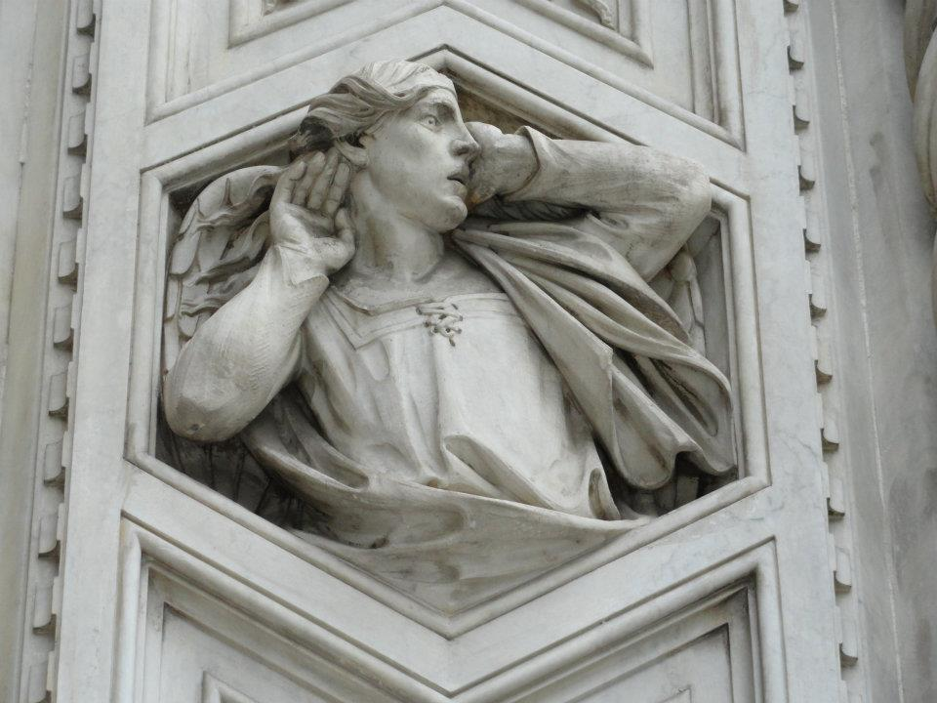
Metadata issues Description
No accepted standards for identifying OA materials
Particularly true for Gold OA outputs, which is an issue for UK
Community needs to agree how to identify such outputs
West end, Duomo, Florence

Slide 6
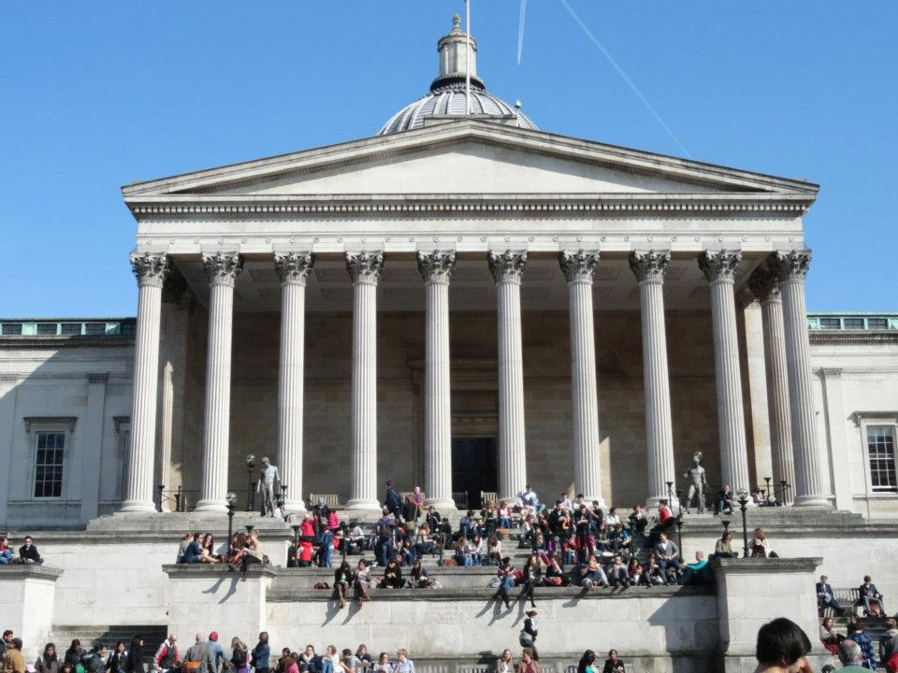
Metadata issues Aggregation
UCL harvests metadata, with permission, from several global databases
Impossible to gather all UCL OA outputs
Role for commercial Knowledge Bases to supply a service?

Slide 7
Contents
OA Advocacy
Metadata issues
Description
Aggregation
APC payments
Altmetrics
Publications and research data
Digital Preservation
Conclusions?

Slide 8
APC payments
JISC Collections trialling a shared service to UK universities
OAK will manage OA funds held in universities
And payments for APCs for Gold OA publishing

Slide 9
Contents
OA Advocacy
Metadata issues
Description
Aggregation
APC payments
Altmetrics
Publications and research data
Digital Preservation
Conclusions?

Slide 10
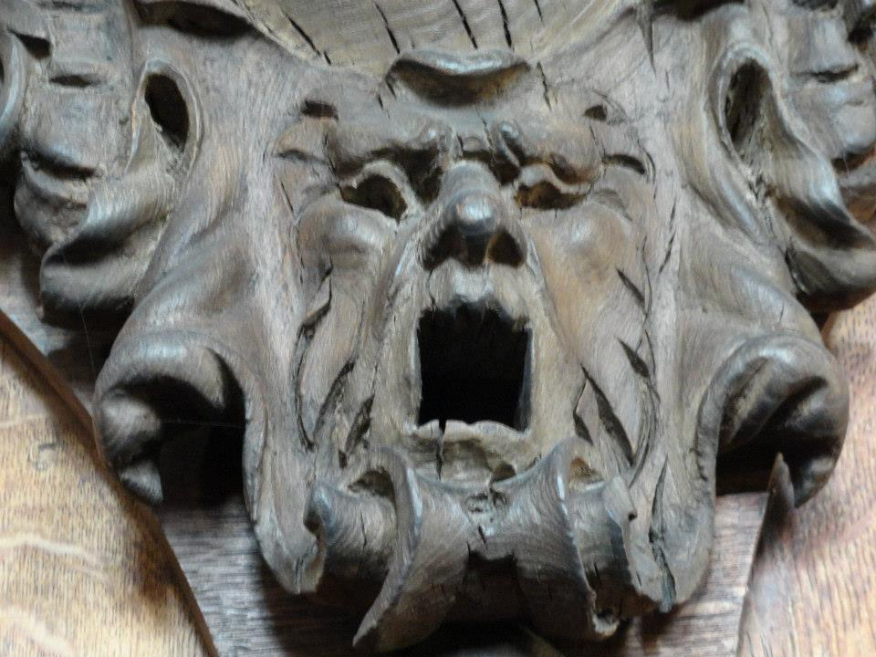
Altmetrics
Journal Impact Factor no longer seen as suitable metric
REF (Research Excellence Framework does not take IF into account)
Article-level, chapter-level measurements required
What is the right measure?
Citation?
Download?
Occurrence in social media or newspapers?
Pembroke College, Cambridge

Slide 11
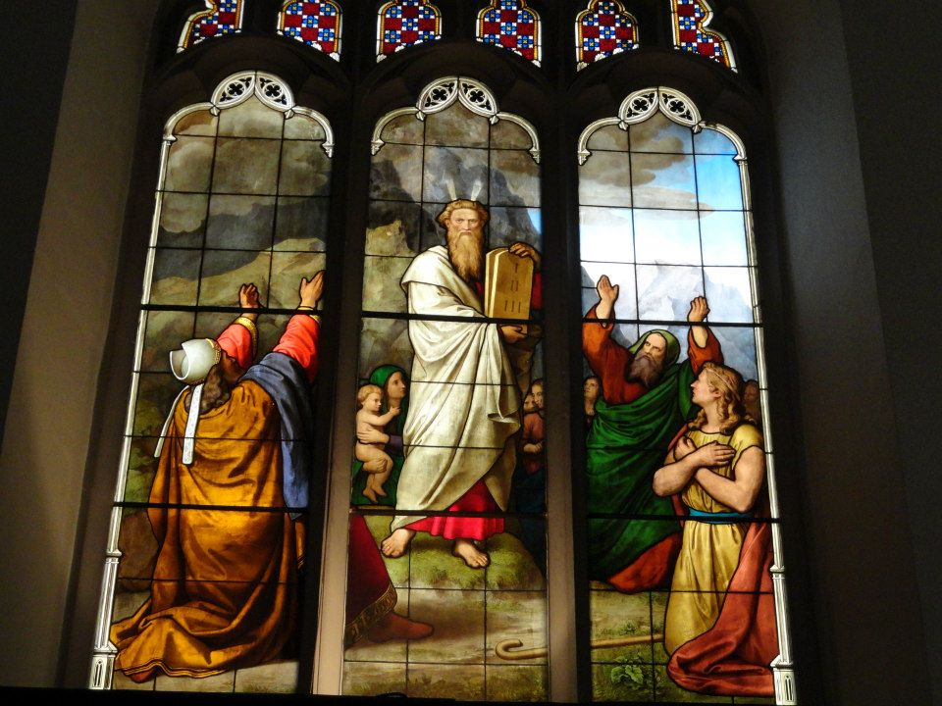
Altmetrics
Aggregation of metric measurements required to give global picture of usage from whatever platform is used:
Publisher
Institutional repository
Subject repository
Shared workspace
Social Network site
Is this a space for a commercial provider service?
Moses and the 10 Commandments,
Peterhouse, Cambridge

Slide 12
Contents
OA Advocacy
Metadata issues
Description
Aggregation
APC payments
Altmetrics
Publications and research data
Digital Preservation
Conclusions?

Slide 13
Research Data
Open inquiry is at the heart of the scientific enterprise. Publication of scientific theories - and of the experimental and observational data on which they are based - permits others to identify errors, to support, reject or refine theories and to reuse data for further understanding and knowledge. Science’s powerful capacity for self-correction comes from this openness to scrutiny and challenge.
Science as an Open Enterprise
Royal Society Report at http://royalsociety.org/policy/projects/science-public-enterprise/report/

Slide 14
Research Data
Data (raw, processed) underpins publications
Who is responsible for curating this data?
In UCL:
UCL Research Data Service for Big Data
UCL Library Services for outputs of Small Science
Research Data Policy @ http://www.ucl.ac.uk/isd/staff/research_services/research-data/researchdata/uclresearchdatapolicy
Double Helix DNA

Slide 15
Contents
OA Advocacy
Metadata issues
Description
Aggregation
APC payments
Altmetrics
Publications and research data
Digital Preservation
Conclusions?

Slide 16
Digital Preservation
Mission of a University Library as publisher is to:
Produce Knowledge
Curate and preserve that Knowledge and make it available
Main principle behind the UCL Research Data Policy
Publications and research data need stable platforms
Are these:
Institutional?
Subject-based?
Collaborative?
http://www.ucl.ac.uk/isd/staff/research_services/research-data/researchdata/uclresearchdatapolicy

Slide 17
UCL curation and preservation activities
UCL Research Data Service
Aimed at funded project outputs (mainly Big Science)
Fee-based service aimed at partial cost recovery
Digital curation performed in-house
Long-term digital preservation may be outsourced to third party provider
UCL Library Services
Focus on AHSS
Will also cover 20+ UCL digitisation projects
Surveyed in Sustaining our Digital Future at http://sca.jiscinvolve.org/wp/files/2013/01/Sustaining-our-digital-future-FINAL-31.pdf
Long-term preservation platform to be considered

Slide 18
Contents
OA Advocacy
Metadata issues
Description
Aggregation
APC payments
Altmetrics
Publications and research data
Digital Preservation
Conclusions?

Slide 19
Conclusions?
Open Access publishing delivers a new role to Libraries
New tools and services are needed
Some can be delivered in-house
Opportunities for collaborations and outsourced services

