Slide 1
Open Access and Open Data in Europe
Open Access and Open Data
DART Europe Workshop, UCL, London, 6 September 2013
Alma Swan
Director of Advocacy, SPARC Europe
Convenor, Enabling Open Scholarship
Director, Key Perspectives Ltd

Slide 2
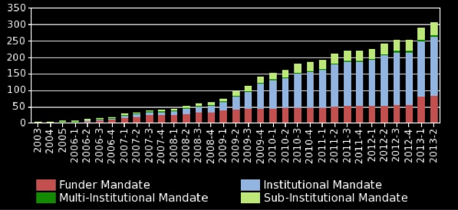
Mandatory policies

Slide 3
The effect of a mandatory policy

Slide 4
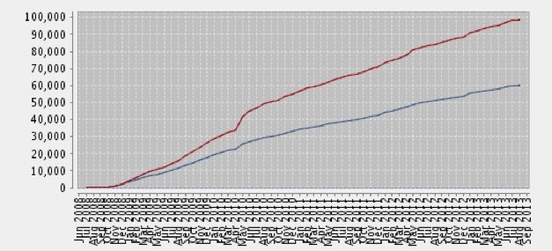
University of Liege repository: authors deposit

Slide 5
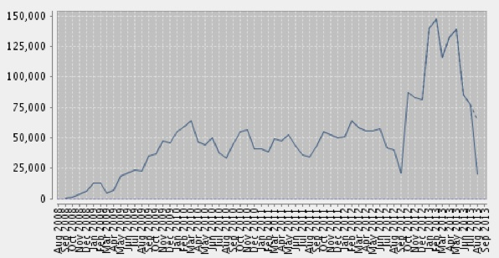
And the material gets used

Slide 6
New OA policies in Europe
Institutional mandates:
  Belgium 1
  Portugal: 3
  Spain: 1
  UK: 1
  Ukraine 1
Funder mandates:
  Denmark (joint policy from 5 national funders)
  Ireland (joint policy from 17 organisations, including RPOs and funders)
  EU: European Research Council: Updated guidelines (2012)
        6 months embargo
        including primary data
  UK: RCUK: revised policy
  EU: European Commission: Horizon 2020
  Global reach: UNESCO (May 2013)

Slide 7
Others
Science Europe position statement (April 2013)
Global Research Council action plan (May 2013)
Australian Research Council policy (January 2013)
White House Office of Science & Technology Policy policy (February 2013)
HEFCE proposal (February 2013)

Slide 8
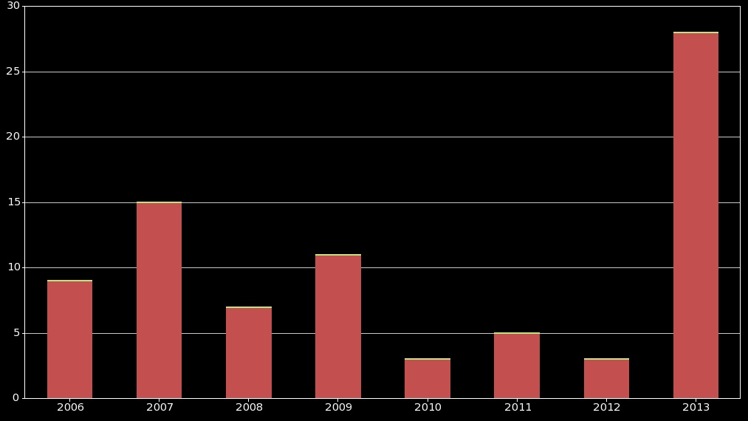
Funder policies

Slide 9
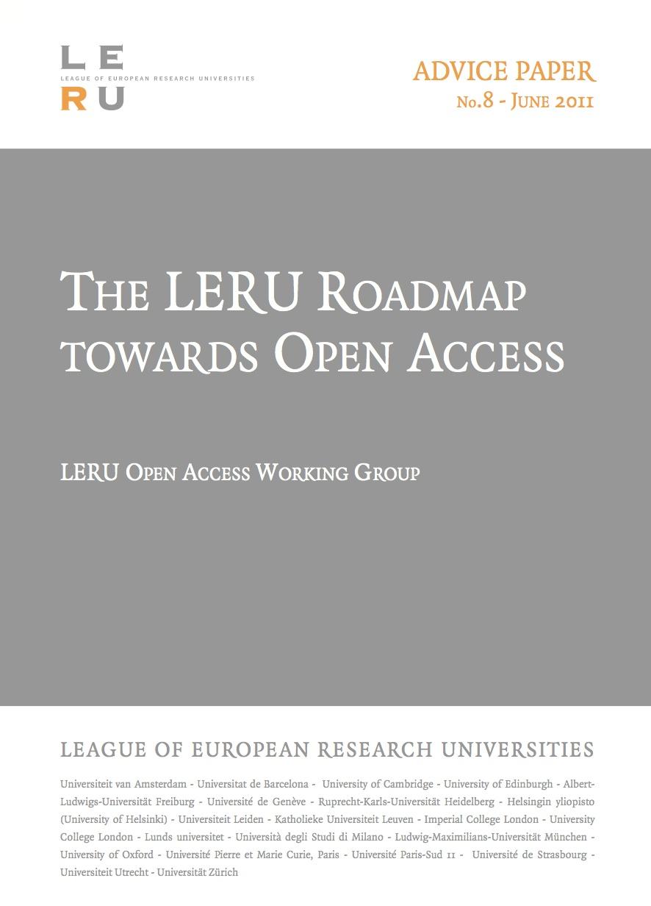

Slide 10
LERU Roadmap Towards
Open Access
Laid out the background and case for OA
Described the two routes (‘Green’ and ‘Gold’)
Explained how universities can achieve OA through either (or both) of these routes

Slide 11
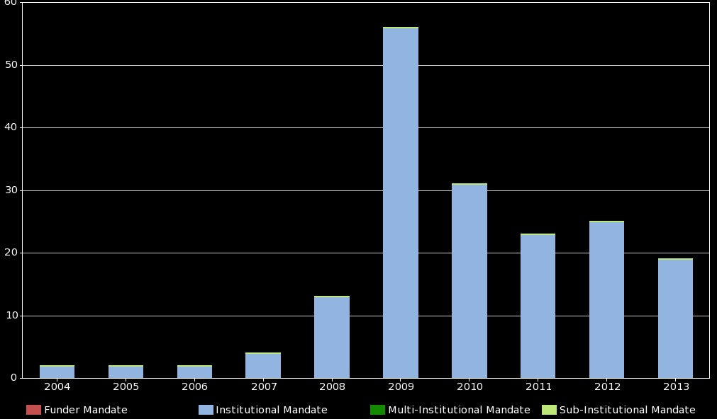
Institutional policies

Slide 12
Policies covering theses
Total mandatory policies for theses: 105
In Europe: 39

Slide 13
H2020 and Open Access
Mandatory (non-policed mandate on 20% FP7 research)
‘Green’ OA mandate:
  Authors deposit into local repositories
  ‘Harvested’ by OpenAIRE (Commission-funded European repository)
  Shop window for European research
Permits payments from grants for ‘Gold’ OA

Slide 14
After the legislation...?
Coordination across the Union
27 Member States (some of which already have policies of their own)
Some have centres of expertise
Many do not
Even amongst those that are fairly OA-aware there is a high level of misconception and lack of understanding
Coordination is key

Slide 15
Policy alignment
Irons out dissonances for researchers working in interdisciplinary areas or on international teams
Supports EU harmonisation agenda for ERA (research conditions, researcher mobility, etc)
Key issue in changing author practices and norms
Allows generic infrastructural services to be established in support of policy
Alignment in general terms across all national policies (and H2020) so far ….
….Bar one

Slide 16
Already +/- aligned in the ERA
Austria (Austrian Research Council, 2006)
Belgium (Flanders, 2007)
Belgium (Wallonia, 2013)
Denmark (the 5 research councils, 2012)
Hungary (Hungarian Research Fund, 2009)
Ireland (the 4 research funders 2007, 2008, 2009: research organisations, 2012)
Norway (Norwegian Research Council, 2009)
Spain (National Government policy 2011)
Sweden (the 2 research councils, 2009, 2010)
Switzerland (Swiss National Science Foundation, 2007)

Slide 17
Policy analysis
49 mandatory policies in ROARMAP
Type | Number
Green OA mandate | 36
Green OA mandate with Gold option | 12
Gold preference with Green option | 1
Gold costs can be paid from research grant = 19
or claimed from funder

Slide 18
Finch Report
Recommended ‘Gold’ OA for the UK
Assigned ‘Green’ repositories a role in preservation, and in disseminating theses and grey literature
UK currently provides OA to around 40% of its outputs
35 of that 40% is ‘Green’ OA (repositories)
Ignores:
  relative success of ‘Green’ OA in the UK
  sunk costs
  economic implications for the UK
  all other policies around the world (institutional and funder)

Slide 19
RCUK
Policy built on Finch recommendations
Favours ‘Gold’ OA, and is expensive (100 million GBP will be handed to publishers over 5 years)
Based on:
  Acquiring rights for re-use
  Protecting publishers
No real attempt by Finch or RCUK to protect the UK research community from escalating publishing costs

Slide 20
Open Data (PSI)
Revision of the PSI Directive (part of the Digital Agenda for Europe)
Boosting the re-use of weather data, traffic data, publicly funded research data, statistics, digitised books, and other types of PSI
Issues guidelines to MS on:
  recommended standard licenses
  datasets to be released/improved as a matter of priority
  charging for the reuse of documents

Slide 21
Elsewhere
US: White House Executive Order, May 2013: ‘Making Open and Machine Readable the New Default for Government Information’
  Open Data policy document
  Online repository of tools and case studies, ‘Project Open Data’
Australia: Implementing open licensing in government open data initiatives: a review of Australian government practice

Slide 22
Open Research Data
Some funder policies in place, e.g:
  The 7 UK Research Councils
  The other significant UK medical funders (charities and private funders)
  OTKA, Hungary
  Vetenskapsradet, Sweden
  Higher Education Authority, Ireland
  Fondazione Cariplo, Italy
  FWF, Austria
Most lack teeth

Slide 23

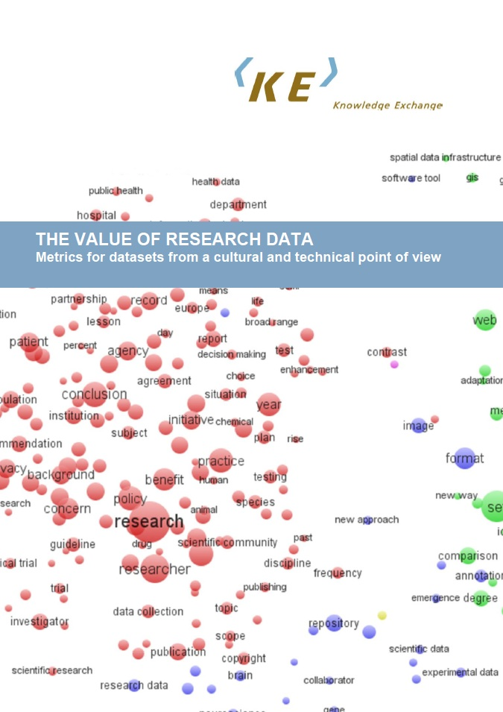
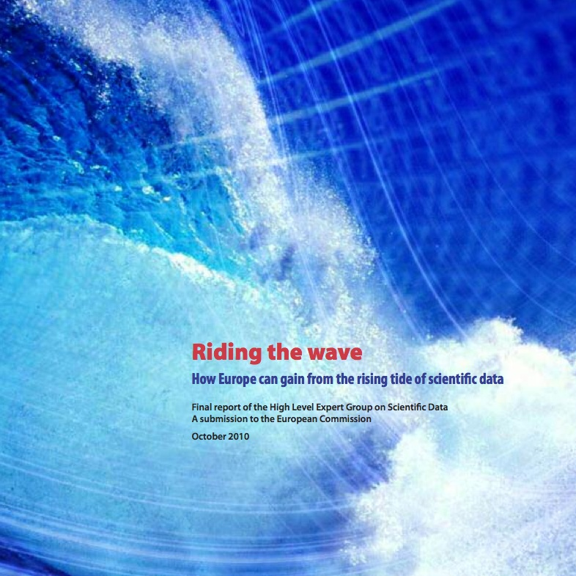
But a lot is happening

Slide 24
Scientific data
“Our vision is a scientific e-infrastructure that supports seamless access, use, re-use and trust of data. In a sense … the data themselves become an infrastructure – a valuable asset on which science, technology, the economy and society can advance.” (Neelie Kroes, 2011)
H2020 has a proposed DATA PILOT

Slide 25
H2020 Open Data pilot
Conceived, but only embryonic
It may be a ‘20%’ pilot, like the OA one in FP7
Responses from various organisations
For example, OpenAIRE/LIBER/COAR:http://www.openaire.eu/en/about-openaire/publications-presentations/publications/doc_view/585-horizon2020opendatapilot20130703final

Slide 26
Thank you for listening
aswan@talk21.com
www.sparceurope.org
www.openscholarship.org
www.openoasis.org
www.keyperspectives.co.uk

