Slide 1
Open Scholarship for doctoral studies
Dr Paul Ayris
Director of UCL Library Services and UCL Copyright Officer
Chief Executive, UCL Press
Adviser to LIBER (Association of European Research Libraries) on EU matters and Horizon 2020
Chair of the LERU community of Chief Information Officers
e-mail: p.ayris@ucl.ac.uk

Slide 2
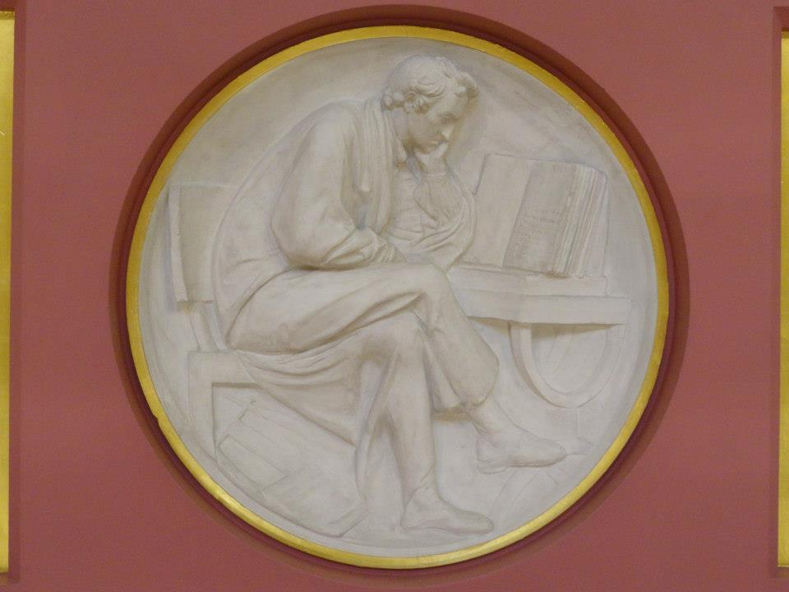
Contents
What is Open Scholarship?
Open Access to publications
Open data
Tools and Services for Open Scholarship
Conclusions
Plaster Relief by John Flaxman, Flaxman Gallery, UCL

Slide 3
Contents
What is Open Scholarship?
Open Access to publications
Open data
Tools and Services for Open Scholarship
Conclusions
Plaster Relief by John Flaxman, Flaxman Gallery, UCL

Slide 4


What is Open Scholarship?
Open Scholarship, called by the European Commission Science 2.0, is a new framework for doing research
Open scholarship encompasses open access, open data, open educational resources, and all other forms of openness in the scholarly and research environment
Open Scholarship website at http://www.openscholarship.org/jcms/c_6160/en/open-scholarship

Slide 5

Science 2.0 consultation
‘Science 2.0’ describes the on-going evolution in the modus operandi of doing research and organising science. These changes in the dynamics of science and research are enabled by digital technologies and driven by the globalisation of the scientific community, as well as the need to address the Grand Challenges of our times. They have an impact on the entire research cycle, from the inception of research to its publication, as well as on the way in which this cycle is organised.

Slide 6
Science 2.0 consultation
The three main objectives of the consultation are:
  to assess the degree of awareness amongst the stakeholders of the changing modus operandi
  to assess the perception of the opportunities and challenges
  to identify possible policy implications and actions to strengthen the competitiveness of the European science and research system by enabling it to take full advantage of the opportunities offered by Science 2.0
LERU Vice-Rectors (Research) are making a response

Slide 7
Contents
What is Open Scholarship?
Open Access to publications
Open data
Tools and Services for Open Scholarship
Conclusions
Plaster Relief by John Flaxman, Flaxman Gallery, UCL

Slide 8
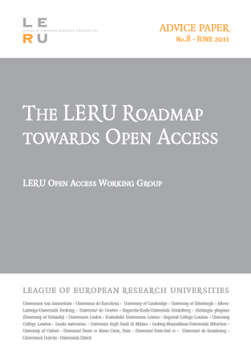
Open Access to publications
Open Knowledge is
  Any kind of information – sonnets to statistics, genes to geodata – that can be freely used, re-used and redistributed (2)
Open Scholarship refers
  To the research that generated Open Knowledge (2)
Benefits accrue to (5-16)
  Researchers
  Universities
  Society

Slide 9
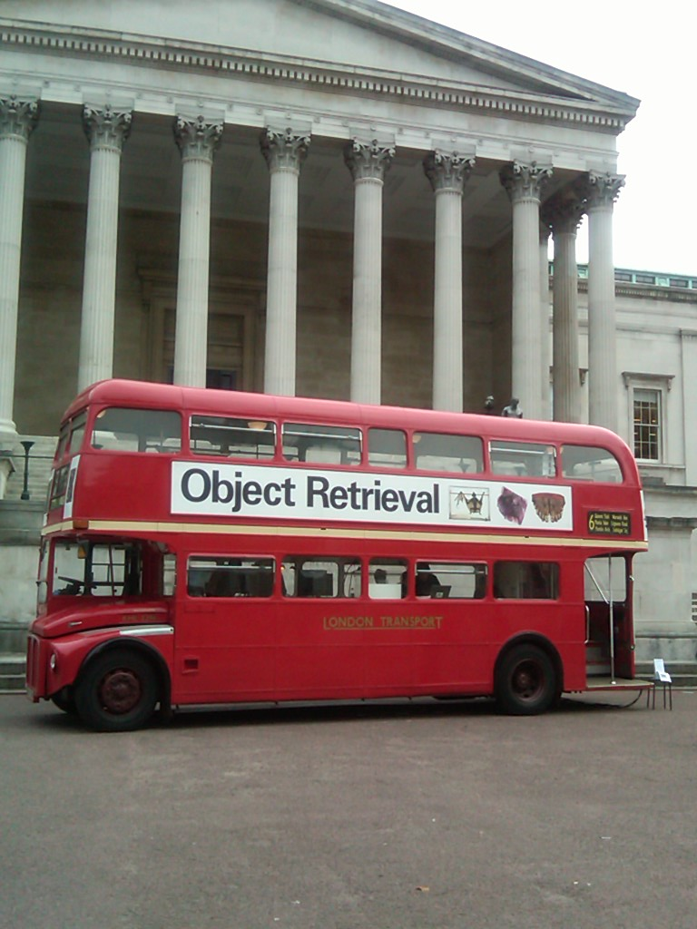
Open Access to publications
Benefits for researchers (6-10)
  Authors gain increased visibility
  Literature now used as data
  This visibility and usage are new –in a subscription world, subscriptions are a barrier to access
  Many lower-income countries report access to the literature as a barrier – despite efforts by commercial publishers
  University’s Mission is to create Knowledge and share it
UCL (University College London

Slide 10

Green route to Open Access (17-38, 52-3)
Self-archiving in a repository – institutional or subject-based
Researchers upload their own papers
  Some institutions have made it compulsory via an institutional mandate
Repositories offer a number of benefits
  They increase the availability of some published journal works with restrictions on reprinting or text mining
  Repositories also allow authors to keep track of who is downloading their data
All LERU institutions have an open access repository

Slide 11
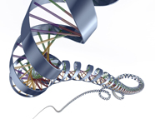
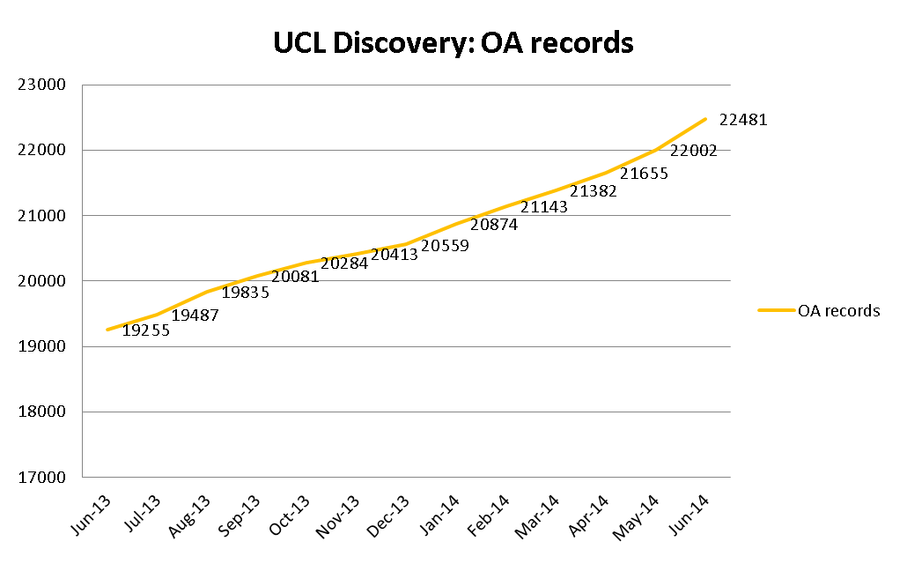
UCL Discovery: OA records to June 2014
All figures comprise local Green Full Text, and records with links to externally-held OA full text

Slide 12
UCL Discovery OA coverage, 2011–2014 (June)
Publication Year | Total records in Discovery | OA records in Discovery | OA records pending | Total OA | OA as % of all records
2011 | 16,731 | 2,007 | 47 | 2,054 | 12%
2012 | 16,428 | 2,199 | 75 | 2,274 | 14%
2013 | 16,219 | 1,796 | 341 | 2,137 | 13%
2014 | 5,463 | 496 | 918 | 1,414 | 26%
Includes OA ‘pending’, mainly comprising outputs for which Gold APC has been paid, but article is awaiting upload by Library team.
Recent Gold retro-conversions largely account for current ‘pending’ backlog

Slide 13

Gold route to Open Access (39-51)
Considered to be the most sustainable method in the long term
  Recommended by the Finch Report report, the gold route involves publishing in a fully open access journal or equivalent
Subjected to the same peer-review procedures as a traditional journal
Authors need to pay for their work to be published via an APC (Article Processing Charge)
  Research grants or institutional publications funds often meet this cost

Slide 14
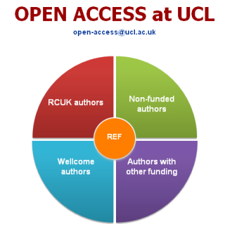
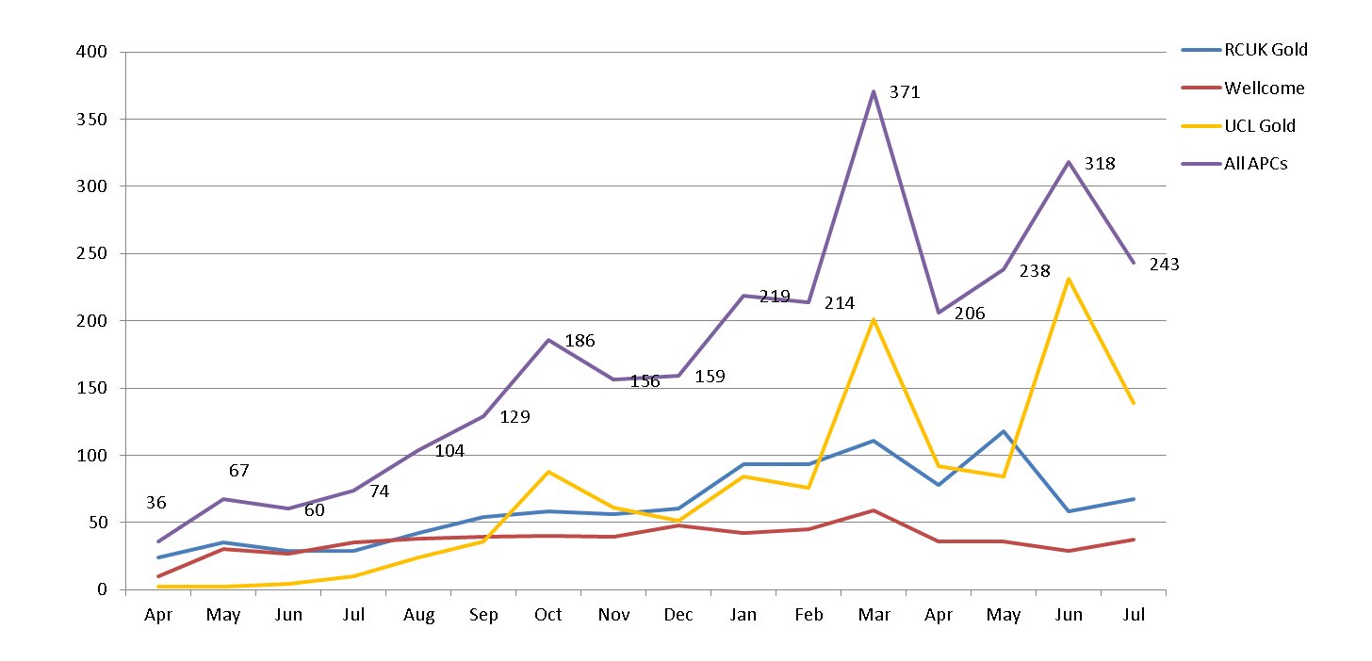
All APCs
3,137 APCs processed since April 2013
RCUK: 1,362 Wellcome: 590 UCL Gold: 1,185

Slide 15
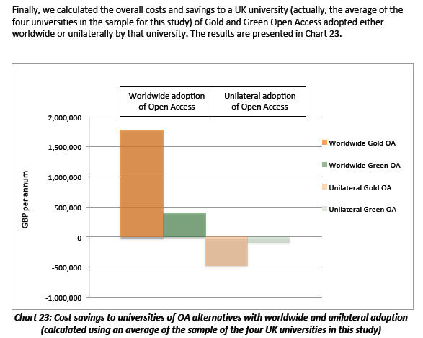
The Future – Green or Gold?
Houghton, J., and Swan, A., Going for Gold? The costs and benefits of Gold Open Access for UK research institutions: further economic modelling. Report to the UK Open Access Implementation Group (2012). See http://repository.jisc.ac.uk/610/.

Slide 16
Contents
What is Open Scholarship?
Open Access to publications
Open data
Tools and Services for Open Scholarship
Conclusions
Plaster Relief by John Flaxman, Flaxman Gallery, UCL

Slide 17


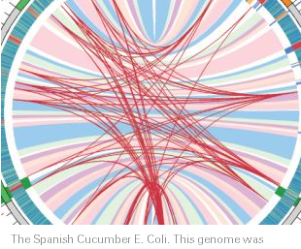
See Science as an open enterprise http://royalsociety.org/policy/projects/science-public-enterprise/report/

Slide 18
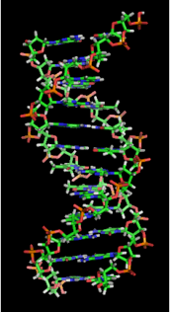
Open Data
Open data is the idea that certain data should be freely available to everyone to use and republish as they wish, without restrictions from copyright, patents or other mechanisms of control
Auer, S. R.; Bizer, C.; Kobilarov, G.; Lehmann, J.; Cyganiak, R.; Ives, Z. (2007). "DBpedia: A Nucleus for a Web of Open Data". The Semantic Web. Lecture Notes in Computer Science 4825. p. 722. doi:10.1007/978-3-540-76298-0_52. ISBN 978-3-540-76297-3.
http://en.wikipedia.org/wiki/File:DNA_orbit_animated.gif

Slide 19
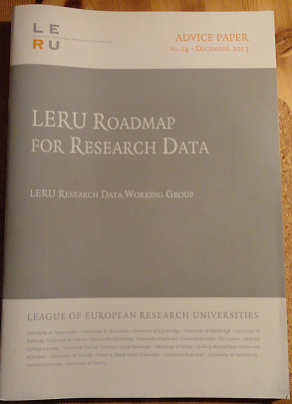
LERU Roadmap for Research Data
Overseen by Research Data Working Group
Pablo Achard (University of Geneva)
Paul Ayris (UCL, University College London)
Serge Fdida (UPMC, Paris)
Stefan Gradmann (University of Leuven)
Wolfram Horstmann (University of Oxford)
Ignasi Labastida (University of Barcelona)
Liz Lyon (University of Bath)
Katrien Maes (LERU)
Susan Reilly (LIBER)
Anja Smit (University of Utrecht)

Slide 20
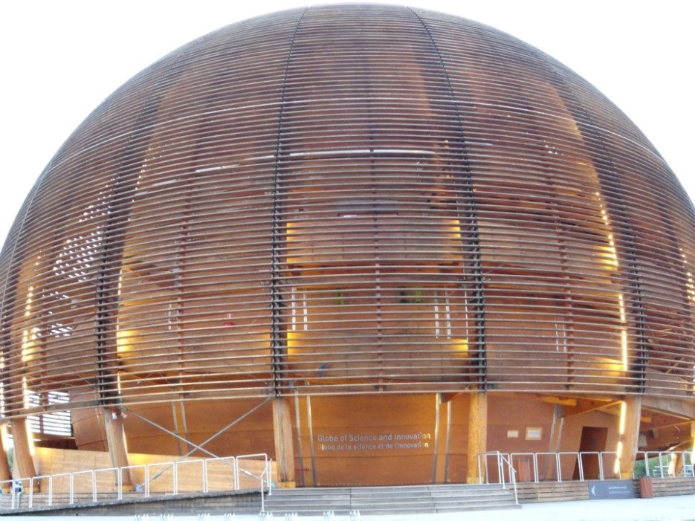
LERU Roadmap for Research Data
Policy and Leadership
Advocacy
Selection and Collection, Curation, Description, Citation, Legal Issues
Research Data Infrastructure
Costs
Roles, Responsibilities and Skills
Recommendations to different stakeholder groups
The Globe, Cern, Geneva

Slide 21
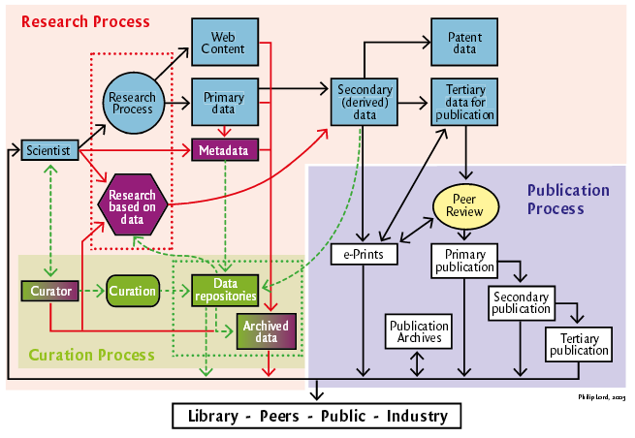
See http://www.ukoln.ac.uk/ukoln/staff/e.j.lyon/150.pdf

Slide 22
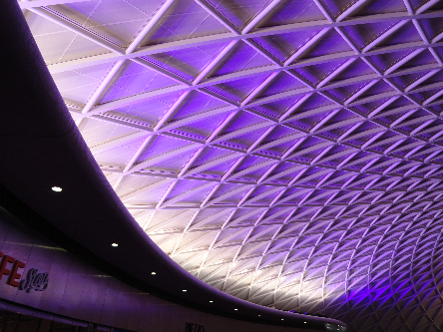
Key Messages
Each LERU university needs a Research Data Management Strategy
Researchers should have Research Data Management Plans
LERU universities need to bring stakeholders together
Benefits of ‘open data’ for sharing and re-use should be advocated and explored
King’s Cross, London

Slide 23
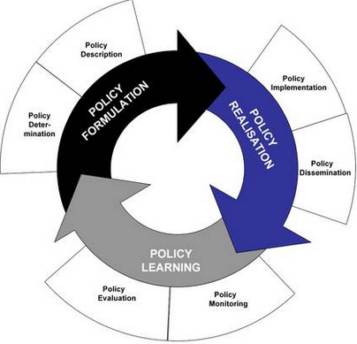
Policy Development
Case Study on Policy development from UCL
Drivers
  External funders
  Need to inform researchers
  Raise awareness of issues facing UCL researchers
Identifies roles and responsibilities
Data to be made open in the most open manner appropriate
See www.lanecrothers.net/politicalprof/the-policy-cycle-and-our-frozen-politics/
Researchers should have Data Management Plans
LERU slams lack of data policies – Research Europe

Slide 24
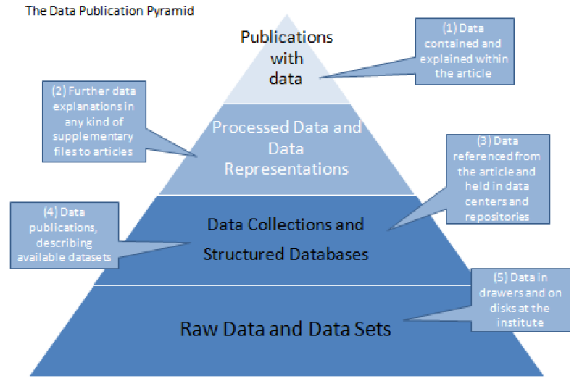
Data: Open or Closed?
Benefits
  Tackle Grand Challenges in Society more easily
  Better for research – interpretations can be checked
Dis-benefits
  Sharing of data not embedded in research culture
  Some data cannot be shared (data protection, security reasons)
Research community needs to decide…
See http://www.alliancepermanentaccess.org/wp-content/uploads/downloads/2011/11/ODE-ReportOnIntegrationOfDataAndPublications-1_1.pdf

Slide 25
Contents
What is Open Scholarship?
Open Access to publications
Open data
Tools and Services for Open Scholarship
Conclusions
Plaster Relief by John Flaxman, Flaxman Gallery, UCL

Slide 26
Tools and Services
Open Access publishing
Repository services
  LERU Law portal
  DART-Europe
  Copyright management
LEARN
LERU doctoral certificate?
Plaster Relief by John Flaxman, Flaxman Gallery, UCL

Slide 27
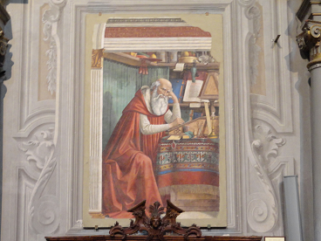
Open Access publishing
UCL Press
Journal publishing platform
  OJS (Open Journal Systems) overlaying UCL Discovery as storage layer
  Peer-reviewed journals
  Run by academic Editorial Committees
Research Monograph list
  10 titles in 2014-15 (Year 1)
  Using Open Monograph Press
Textbook infrastructure
  Being constructed with JISC project monies
Saint Jerome in his Study, fresco by Domenico Ghirlandaio, 1480. Church of Ognissanti, Florence
Digital delivery the norm
OA the basis for the Business Model
Innovative technical solutions for Monographs and Textbooks
Open up publishing to new communities

Slide 28

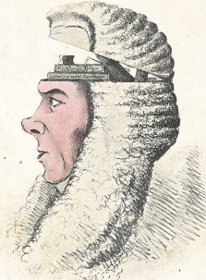
LERU OA Legal Portal
LERU has 21 research intensive universities as members in Europe – see http://www.leru.org
Portal being built by TEL (The European Library)
All LERU OA legal publications brought together into one interface
Value-Added Services, such as Text and Data Mining, also possible
A Box of Useful Knowledge
(Brougham Papers, UCL Library Services)

Slide 29
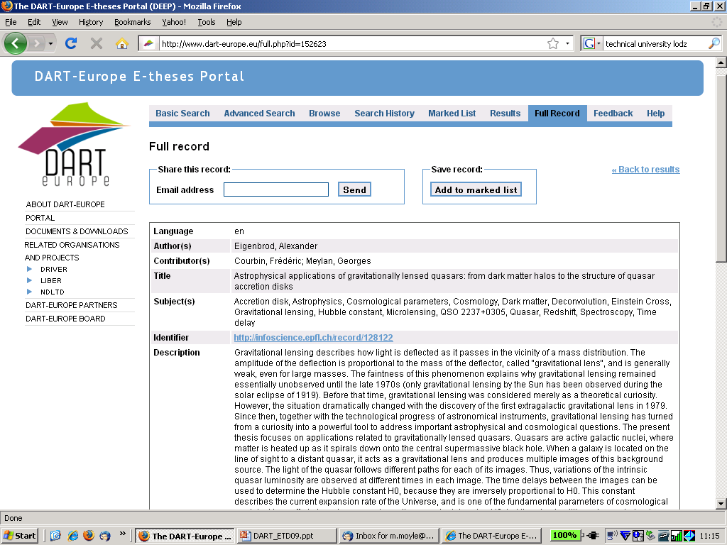
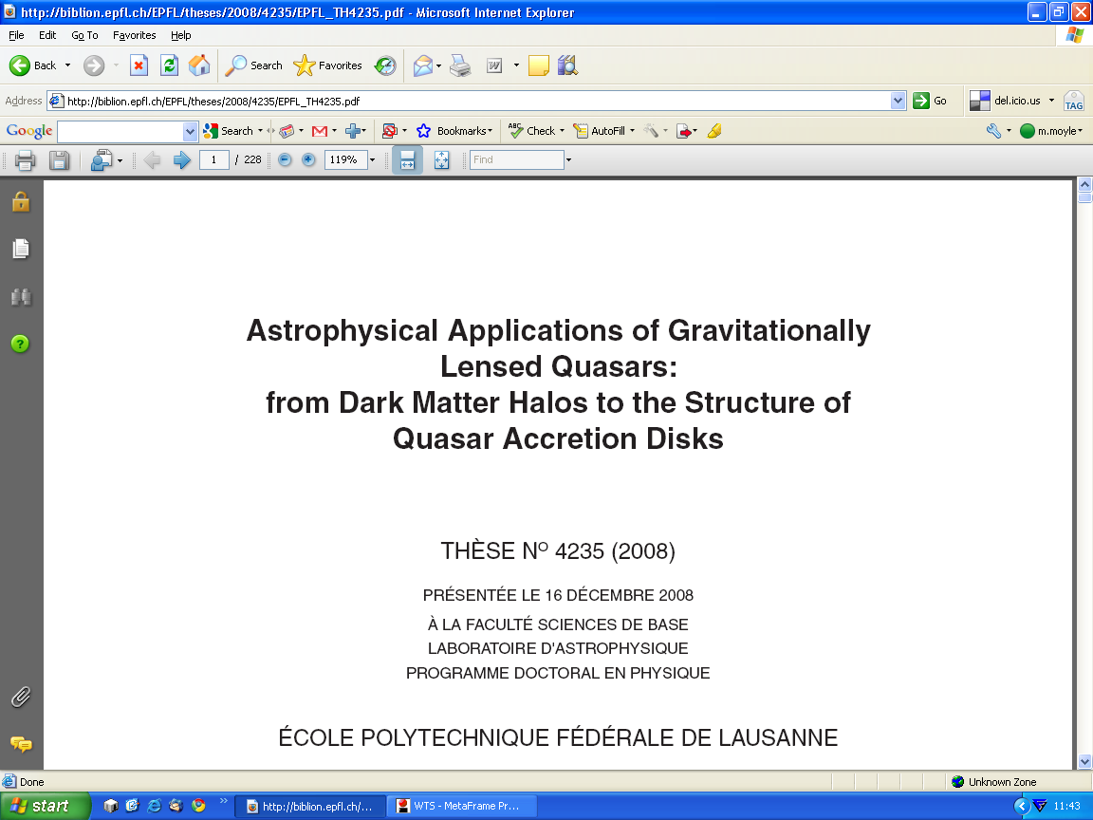
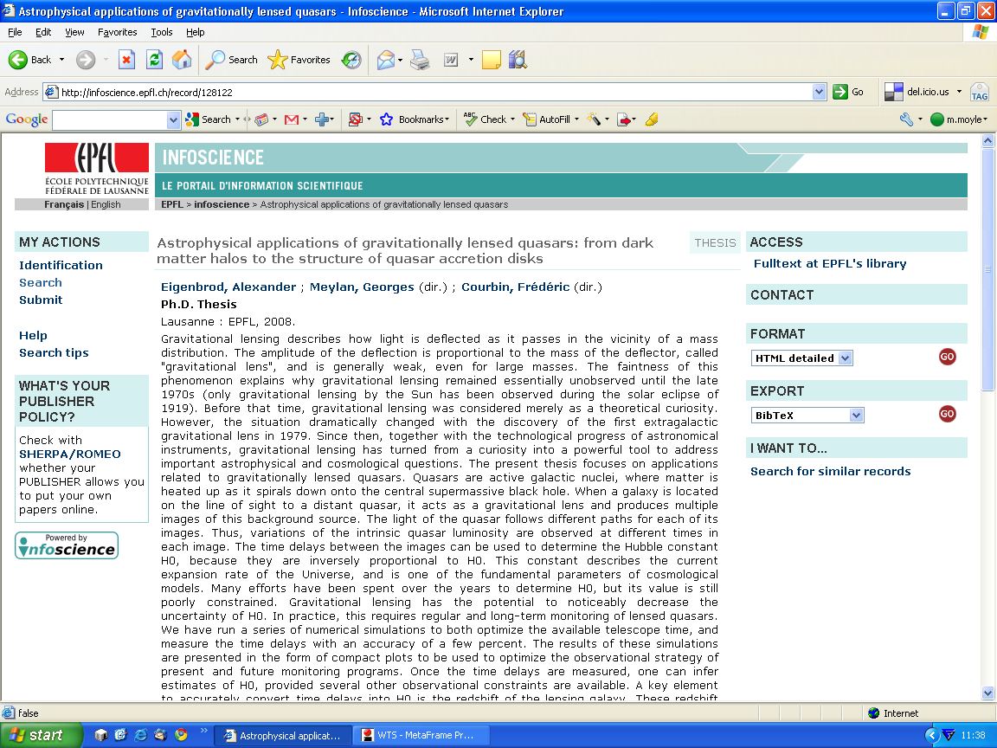
http://www.dart-europe.eu

Slide 30
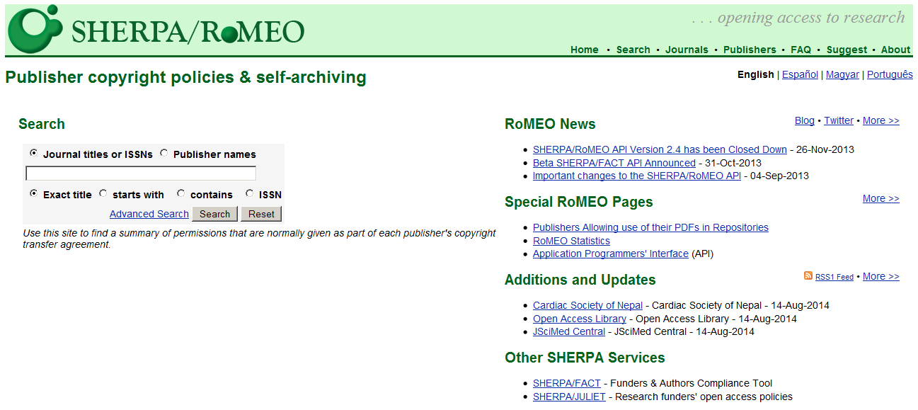
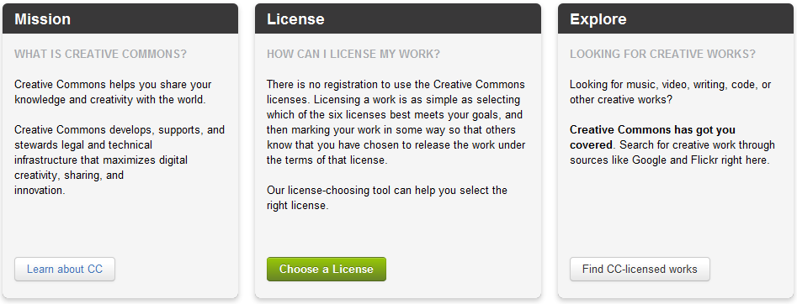

Copyright management
http://www.sherpa.ac.uk/romeo/

Slide 31
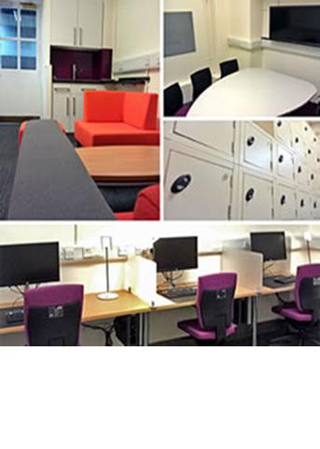
LEARN
LEaders Activating Research Networks
EU bid submitted under Horizon 2020 by LERU CIO Community
Advocates principles of LERU Roadmap for Research Data
  Model research data policy
  Toolkit advocating best practice in research data management
LEaders Activating Research Networks
  Could be adopted by any university in the world

Slide 32
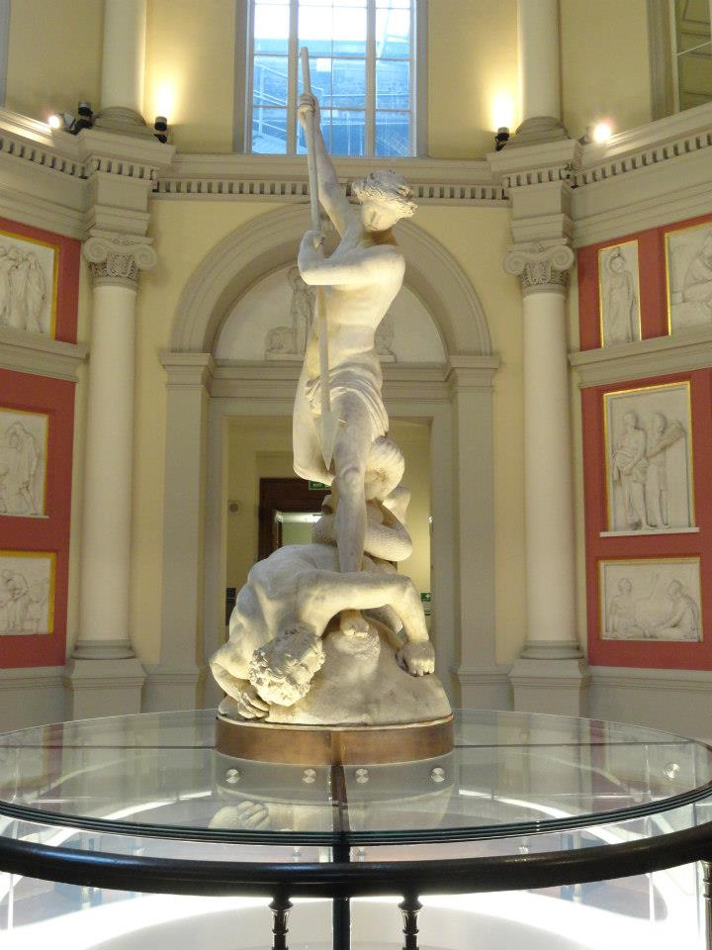
LERU doctoral certificate in Open Scholarship?
Certificate in Open Scholarship
  A new way of undertaking and disseminating research
  Should be taught as a support activity for all LERU research students
  Leading to a LERU Certificate marking completion of training
  Collaboration between LERU CIO and Doctoral Studies Communities
St Michael, by John Flaxman, UCL

Slide 33
Contents
What is Open Scholarship?
Open Access to publications
Open data
Tools and Services for Open Scholarship
Conclusions
Plaster Relief by John Flaxman, Flaxman Gallery, UCL

Slide 34
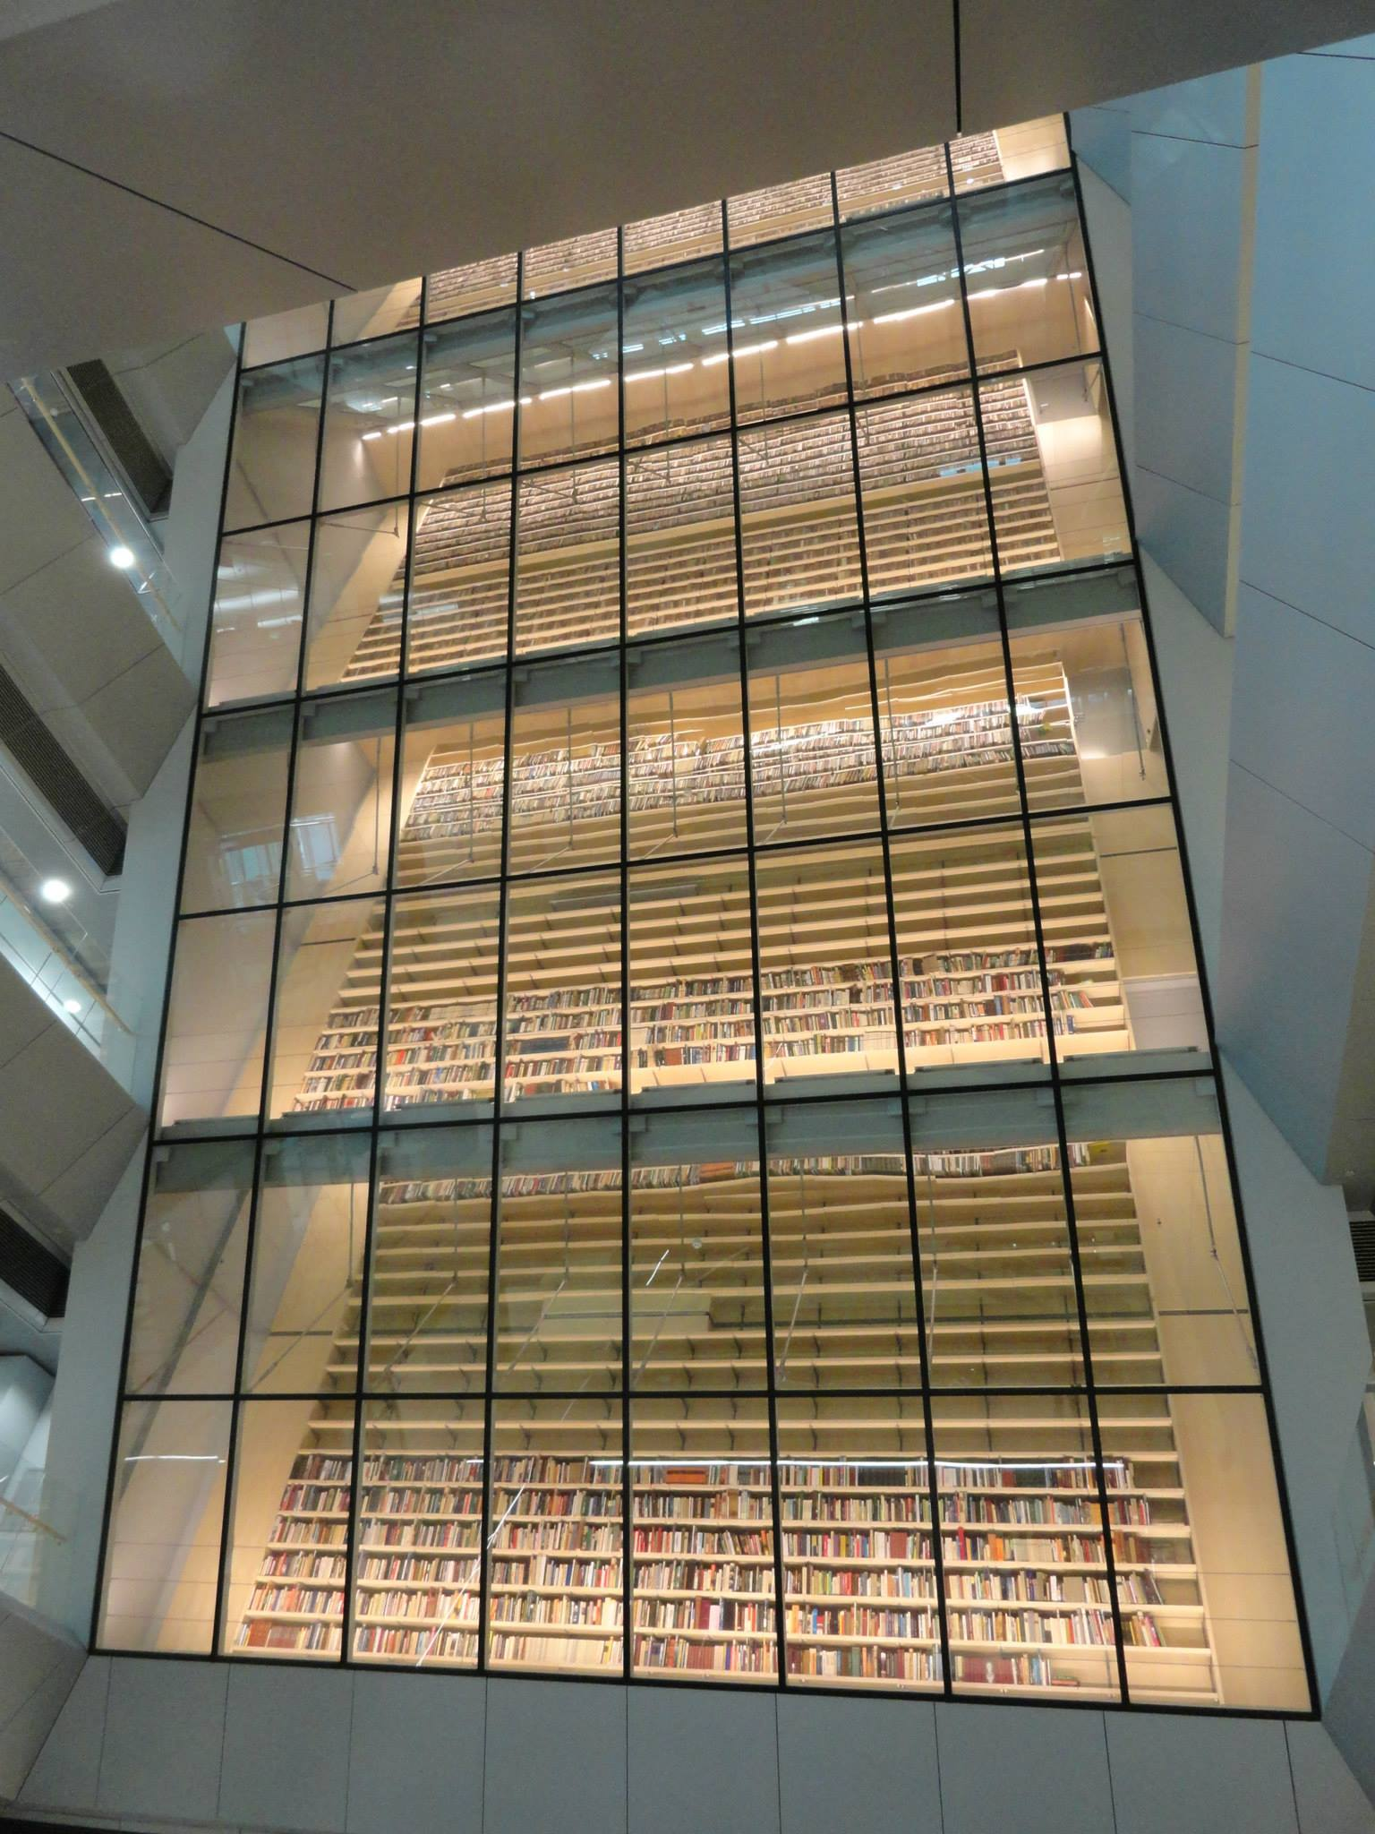
Conclusions
Open Scholarship is a new feature of the research landscape
Today we have discussed
  New means of dissemination
  Increased importance for research data
  Tools, Services and Training needed to move forwards
Thanks for listening
Time for discussion
National Library of Latvia, Riga

