Slide 1

Dr. Eileen Vizard CBE, MD, FRCPsych
Consultant Child & Adolescent Psychiatrist
Institute of Child Health, UCL, London
NSPCC National Child Assessment & Treatment Service (NCATS)

Slide 2
  The Nature and the Status of the Evidence
  on the Prevention of Child Sexual Abuse
  by Men and Boys

Slide 3
Definitions
Prevalence
Types of Abuse & Types of Abuser
Treatment Approaches & Outcomes
Status of the Evidence
Prevention – Is it possible?

Slide 4
Definitions
‘Sexual abuse’ involves any sexual activity where consent is not, or cannot be, given’ ISPCAN 2011
Sexual abuse of children is defined as ‘Sexually interfering with or assaulting a child’ Royal College of Psychiatrists, 2012
A ‘child’ is defined as a person under 18 years old Children Act, 1989

Slide 5
Definitions
Sexually abusive acts range from indecent touching of a child on private parts to penetrative sexual assaults and include the grooming and sexual abuse of children via technology and the internet (Vizard 2013).
Use of technology in child abuse raises radical Questions:
i. what constitutes CSA these days – ‘sexting’, performing sexual acts on Skype for peers/boyfriends/girlfriends etc
ii. What is now ‘normal’ sexual development e.g. the ‘pornification’ of childhood perceptions of adult sexuality – do grown ups have body hair………..?
For further information see CEOP (Child Exploitation and Online Protection), 2012; Byron, 2010; Livingstone, Haddon, Gorzig, & Olafsson, 2010.

Slide 6
Types of Abuse

Slide 7
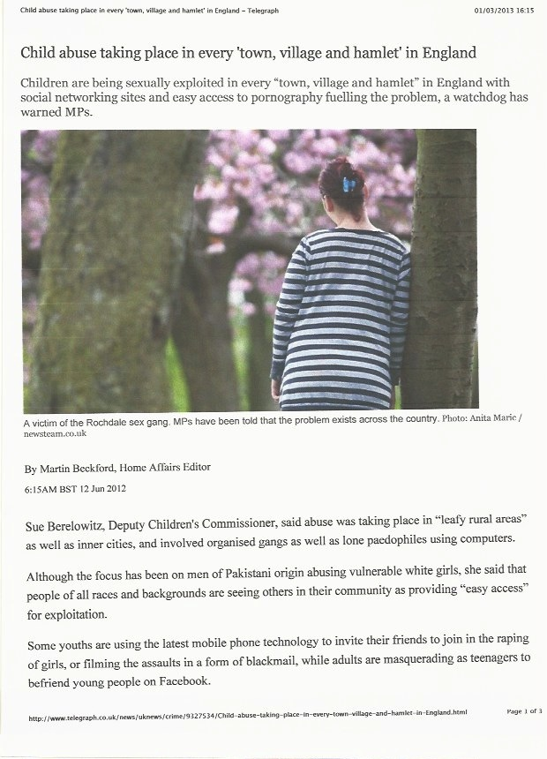

SEXUAL EXPLOITATION

Slide 8
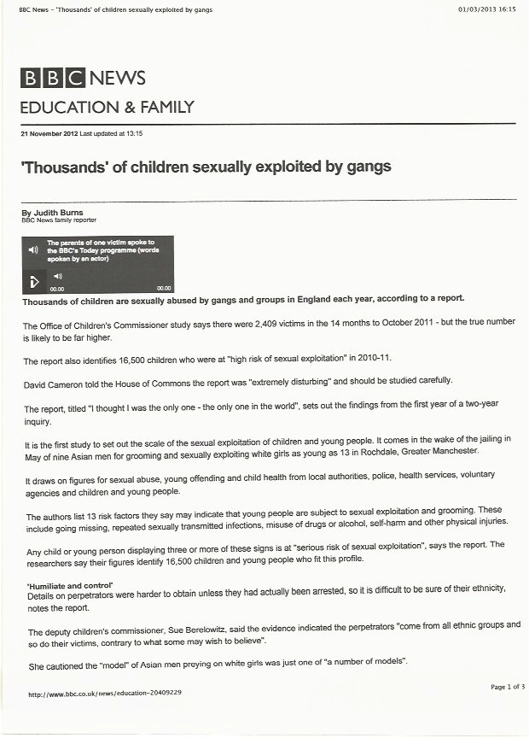
SEXUAL EXPLOITATION

Slide 9
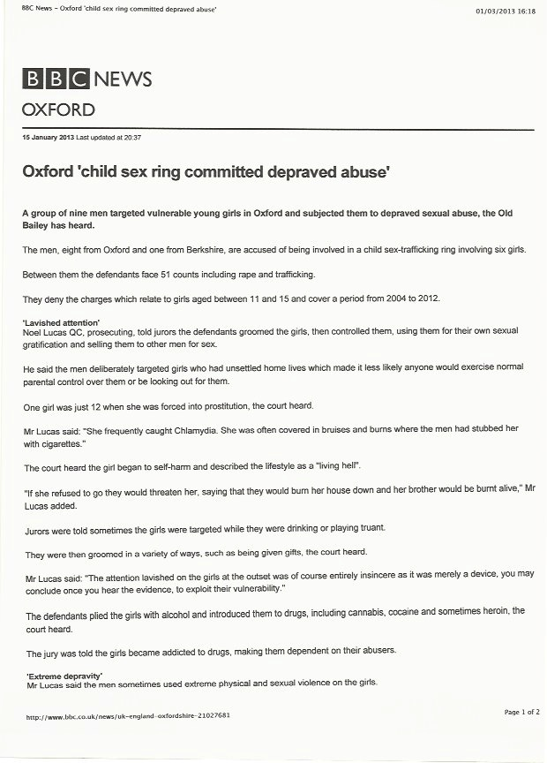
OXFORD ASIAN SEX RING

Slide 10
Types of Abuser

Slide 11
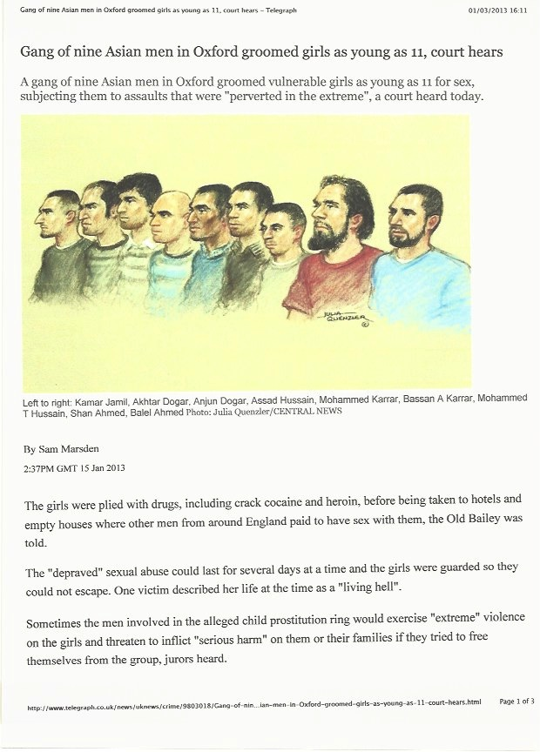
ETHNIC MINORITY
ABUSERS:
OXFORD ASIAN SEX RING

Slide 12
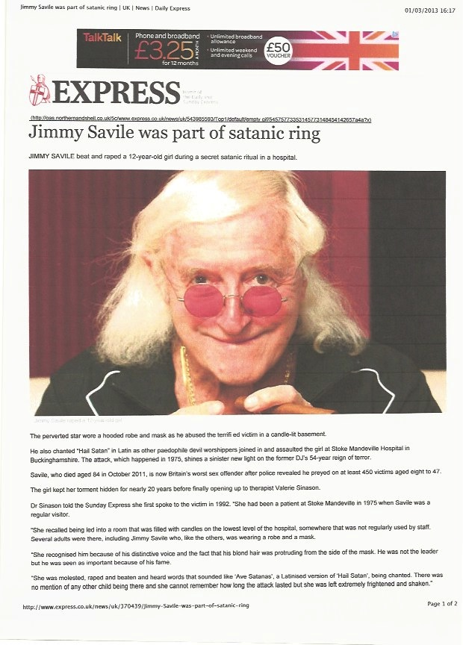
WHITE ABUSER:
SAVILE 1.

Slide 13
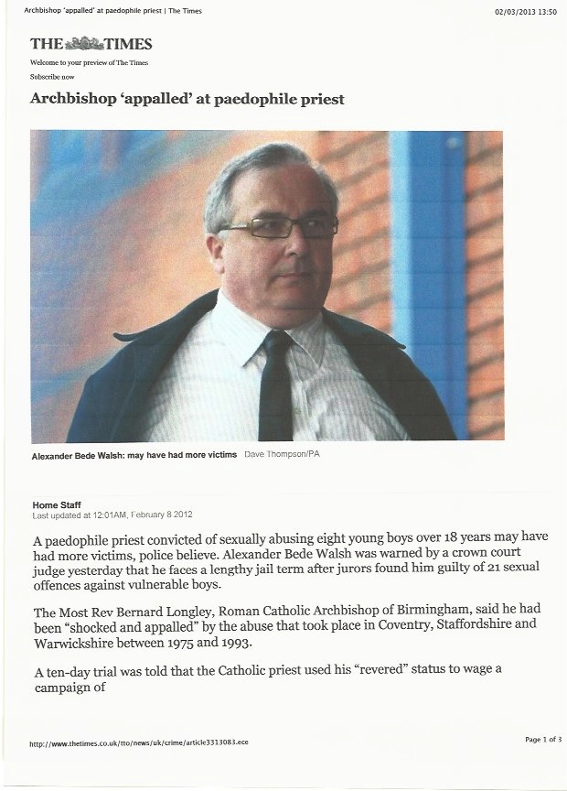

RELIGIOUS ABUSER:
PAEDOPHILE PRIESTS

Slide 14
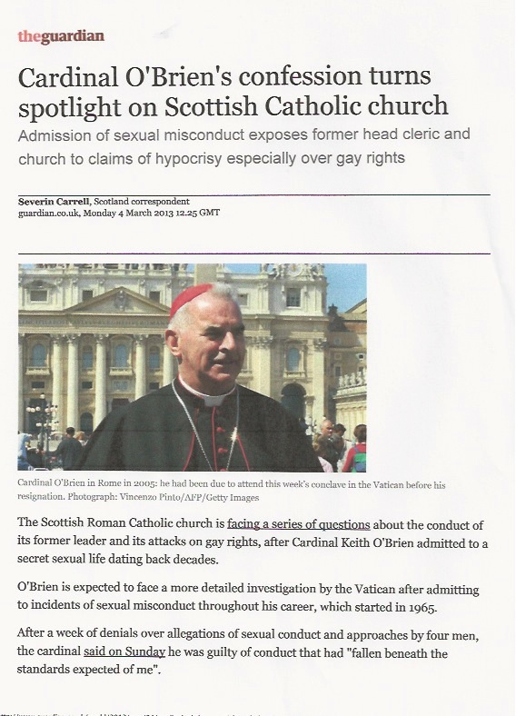
RELIGIOUS ABUSER:
HOMOSEXUAL ‘BIGOT OF THE YEAR’

Slide 15
And many other ‘sub-groups’
of abusers………..

Slide 16
But there is a real Professional fear of naming the sub-group:
‘It’s not that abuse by ‘ethnic’ or ‘religious’ abusers is more common/is really occurring because of ethnic or religious differences – must not offend or stereotype the sub-groups……………………..’ (typical professional attitude)
But what about the stereotypes in the Abuser’s attitude?
‘White trash’………...’Fresh Meat’ (attitudes of the Oxford & Bradford Asian abusers to their girl victims)
‘Gay marriage a threat to world peace and like slavery…………….’
(Cardinal Keith O’Brien’s attitude towards gays)

Slide 17
Prevalence

Slide 18
Prevalence
Reliable estimates of prevalence still hard to find (definitional & methodological problems).
Published statistics likely to be underestimates
Allnock 2009; Anderson 1993
So, a very mixed picture from research on CSA prevalence…........

Slide 19
Prevalence
Some recent prevalence estimates for CSA are still largely in line with earlier estimates:
Meta-analysis of 217 publications (1980-2008): N = 9M
Self report CSA prevalence 127/1000
Informant CSA prevalence 4/1000 Stoltenborgh 2011
National UK Prevalence study; contact sexual abuse:
16.5% (11-17 yrs); 24.1% (18-24 yrs)
57.5% of children >17yrs, CSA perpetrated by other children
Radford 2011

Slide 20
Prevalence
Earlier estimates:
796 New England College students > 21 yrs old
CSA prevalence 19.2% female; 8.6% male
Finklehor 1979; Baker & Duncan 1985; Russell 1983

Slide 21
Prevalence
But:
Recent evidence also supports a reduction in substantiated cases of CSA:
49% reduction (1990-2004)
Finklehor & Jones 2006; Department of Health 2003,2007; Radford 2011

Slide 22
Prevalence
Also:
Recent evidence confirms that many victims still tell no-one:
Sexual Assault by an adult: 34% didn’t tell
Sexual Assault by a peer: 82.7% didn’t tell
Radford 2011

Slide 23
Prevalence
Well……………………………
Not until he is safely dead anyway

Slide 24
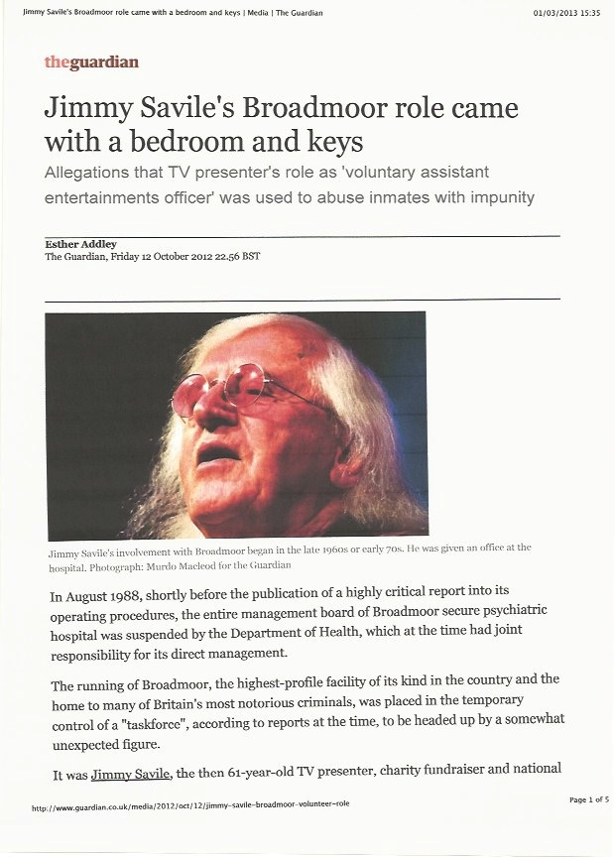

SAVILE 2.

Slide 25

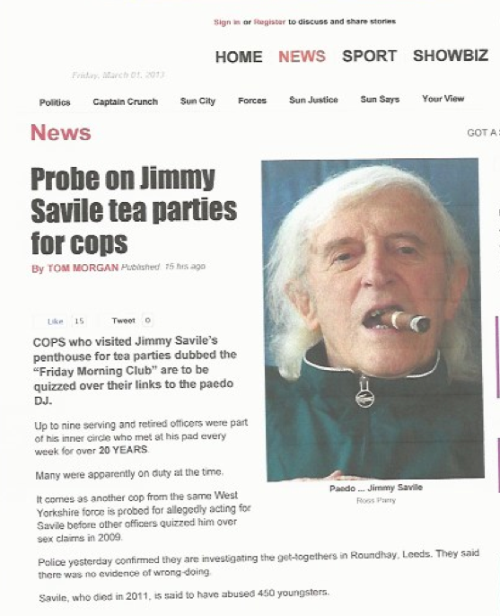
SAVILE 3.

Slide 26
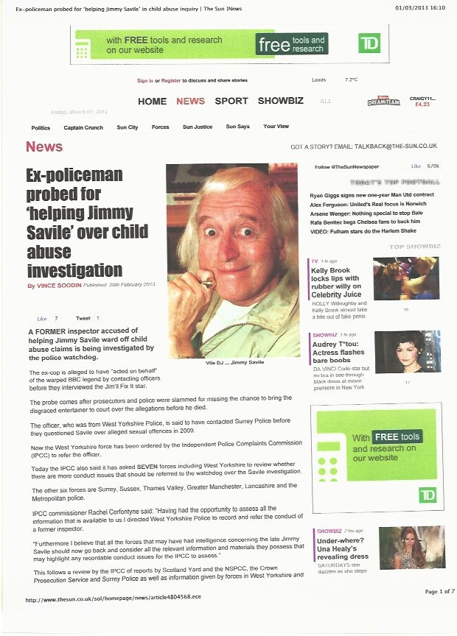
SAVILE 4.

Slide 27
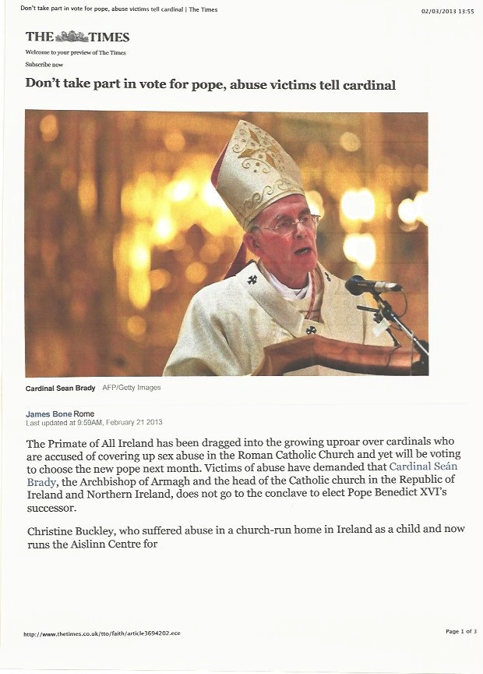
SYSTEMIC CORRUPTION:
IRISH ABUSE COVER UP

Slide 28
Prevalence
Such is the long lasting power of the abuser’s grooming & intimidation of his victims
Note the abuser’s highly effective manipulation of professionals through flattery, expert networking and abuse of his power
These qualities in the abuser, which keep thousands of victims silent, must cast doubt on the quality of our painstaking prevalence research – is it reliable?

Slide 29
Treatment Approaches & Outcomes

Slide 30
Treatment Approaches
Established & perfectly good treatment approaches for adult sex offenders have tended to be ‘templates’ for treatment approaches with juvenile sex offenders………………………
Good Lives Model (GLM) Ward & Connolly 2008 (35%); CBT approaches (90%); relapse prevention (60%) McGrath 2010
But there is a lack of any developmental framework for work with juveniles in these adult-derived programmes

Slide 31
Treatment Approaches
However, some adult risk assessment approaches now accept role of childhood developmental factors - ‘Key Developmental Variables’ in pathways towards offending
Roberts 2008; Craissati & Beech 2006
But not clear if these key developmental variables (child maltreatment, childhood emotional/behavioural difficulties & secure attachments) are routinely considered in delivering adult treatment programmes, nor worryingly, in programmes for juveniles.

Slide 32
Treatment Approaches
Meta-analyses and reviews of treatment approaches for adult sex offenders have generally concluded that men who complete treatment from late adolescence onward show less recidivism than controls and that CBT approaches show more robust effects than non behavioral approaches
Brooks-Gordon 2006; Losel & Schmucker 2005

Slide 33
Treatment Approaches
Meta-analyses and follow-up of RCTs, with children and young people showing sexually harmful behavior, support short-term, sexually abusive behavior-focused CBT interventions, particularly those such as multisystemic therapy (MST), which also include substantive input to caregivers
Borduin 2009; Carpentier2006; Letourneau 2008; Walker2004

Slide 34
Treatment Approaches
Younger age may improve outcomes depending on type of intervention:
10 yr prospective f/up RCT (N = 135) children aged 5-12 years old with SHB.
12 session group CBT c/w group play sessions for SHB children c/w control group non SHB
Future offences CBT group = 2%
  “ “ group play = 10%
  “ “ controls = 3% Carpentier 2006
  Conclusions: 1. Study supports short term CBT for younger children
  2. Does not support notion that children with SHB will grow up to be sex offenders……………but is even 10 years a long enough f/up?

Slide 35
Treatment Approaches
? Caution needed re MST outcomes:
‘it is premature to draw conclusions about the effectiveness of MST compared with other services’ Littell 2005
But…………………………
21.9 year f/up RCT for serious/violent juvenile
offenders showed that MST had significantly lower recidivism rates c/w IT (34.8% c/w 54.8%) Sawyer & Borduin 2011

Slide 36
Treatment Approaches
13 Adaptations of MST – 4 in later stages of development.
MST-PSB RCT effectiveness trial:
MST-PSB c/w TAU
The results showed ‘significant reductions in sexual behavior problems, delinquency, substance abuse, externalizing symptoms and out-of- home-placements’. Letourneau 2009
UK based MST-PSB adaptation underway in London

Slide 37
Outcomes
So what do we want to measure?
Recidivism after treatment?
Effectiveness of a particular form of treatment?
CBT vs IT vs MST vs etc etc……………
Manualised vs less structured……….
Or adult adjustment of the treated young person?
E.g. safe, non abusive parenting; employment choices; absence of mental illness/other risk factors

Slide 38
Outcomes
Meta-analysis of 9 treatment studies involving
N = 2986 juvenile sexual offenders over a 59 month period looked at treatment (MST, CBT & TAU) outcome as measured by recidivism:
treatment had a statistically significant effect in reducing recidivism Reitzel 2006
This finding supported by other studies
Borduin 2009; Carpentier 2006

Slide 39
Sexually Abusive Behaviour
Adult recidivism of convicted JSA’s
 | N | Follow-up period | % Sexual recidivism | % Non-Sexual recidivism | Outcome Ratio of Recidivism
Rubinstein et al (1993) | 19 | 8yrs total | 37% | 89% | Convictions (x2)
Sipe et al (1998) | 124 | 1 – 14 yrs Avg 6yrs | 10% | 37% | Convictions (x3)
Worling & Curwen (2000) | 148 | 2 – 10yrs Avg 6yrs | 13% | 66% | Convictions & charges (x5)
Langstrom (2002 | 117 | Avg 10yrs | 30% | 67% | Convictions (x2)
Nisbet et al (2004) | 303 | 4 – 13yrs Avg 7yrs | 9% | 61% | Convictions & charges (x6)
Gretton et al (2001 / 2005) | 253 | 5 – 14yrs Avg 9yrs | 17% | 51% | Convictions (x3)
Notes:
This is a table of the studies that have looked specifically at recidivism as an adult (e.g. after 18yrs) in samples of JSA’s. the ‘N’ refers to the sample size, the follow-up period range & average is in column two. The next two columns give the recidivism rates for sexual & non-sexual offending. The final column states the type of outcomes used in the study e.g, convictions &/or charges, & the figure in the brackets is the ratio of the non-sexual recidivism compared to sexual recidivism.

Slide 40
Outcomes
But recidivism as the default ‘outcome’ is a very blunt/misleading measure of sex offending – no < 10 year olds; few successful convictions so most sex crimes not recorded
With convicted adult sex offenders a very long f/up period (21 years) needed to get true, higher estimate of recidivism Cann 2004

Slide 41
Outcomes
Or do we want to (try to….) measure outcomes via effectiveness of a particular form of treatment………………………

Slide 42
Outcomes
UK Children’s Charity Action for Children Report on the Implementation and Results of an Outcomes Focused Evaluation of CSA interventions in the UK. Coren et al 2103

Slide 43
Outcomes
Data collected from 8 Action for Children projects treating N = 42 children with histories of CSA & of sexually inappropriate behaviour
Wide range of therapeutic approaches used: CBT, play therapy, counselling, support for carers
Single group, longitudinal pre-test post-test design. Standardised data collection; use of SDQ; histories of mental health, developmental & behavioural problems taken
Outcomes analysed under 3 headings: 1. Behavioural;2. Sleep, nightmares, Bedwetting and Education; 3. SDQ
Limitations acknowledged of lack of control group and uncertainty about which/any of the therapeutic elements contributed directly to positive outcomes. Very short ‘longitudinal’ f/up period from May 2008-November 2009
Results:
1. Moderate improvements in most outcomes for whole group
2. Statistically significant reduction in violent & aggressive behaviours;
3. Smaller improvements in sexually inappropriate behaviours & self harming.

Slide 44
Outcomes
Or do we want to measure outcomes via developmental pathways/trajectories to adult life/offending……………………….

Slide 45
Childhood Origins of Anti Social Personality Disorder
Developmental Trajectories
Adult
Offending
Good
Outcome
Infancy Childhood Adolescence Adulthood
‘Life-Course Persistent’ trajectory - early neuro-psychological and environmental risk
Early differences in cognitive, behavioural and personality functioning.
Similar presentation with ‘Adolescence Limited’ individuals during adolescent period Moffitt, 1993

Slide 46
“ Links between juvenile
sexually abusive behaviour
and emerging
severe personality disorder traits in childhood ”
Results of a 3 year Home Office funded study
November 2006
www.dspdprogramme.gov.uk/pages/publications/publications1.php
NCATS Research Team
Eileen Vizard
Nicole Hickey
Eamon McCrory
Lesley French

Slide 47
Early vs. Late onset trajectories
Developmental patterns of non-sexual anti-social behaviour
 | 0-3yrs | 4-6yrs | 7-10yrs | 11-17yrs
 | EO LO (n=93) (n=120) | EO LO (n=93) (n=120) | EO LO (n=93) (n=120) | EO LO (n=93) (n=120)
Insecure attachment | 13% 3%** | 36% 4%** | 52% 17%** | 61% 28%*
Physically aggressive | 24% 11%* | 41% 18%** | 70% 32%** | 72% 64%
Cruelty to animals | - - | 5% 0%* | 14% 1%* | 18% 9%
Impulsivity | - - | 19% 9%* | 32% 11%** | 51% 39%
Socially isolated | - - | 9% 5% | 26% 15%* | 63 55%
(*p=.05, ** p=.01)

Slide 48
ESPD vs. non-ESPD
Developmental continuity of non-sexual anti-social behaviour
 | 0-3yrs | 4-6yrs | 7-10yrs | 11-17yrs
 | ESPD Non- ESPD (n=54) (n=149) | ESPD Non-ESPD (n=54) (n=149) | ESPD Non-ESPD (n=54) (n=149) | ESPD Non-ESPD (n=54) (n=149)
Insecure attachment | 15% 4%** | 28% 17% | 56% 26%** | 67% 38%**
Physically aggressive | 30% 11%** | 46% 19%** | 76% 38%** | 89% 64%**
Cruelty to animals | - - | 7% 0%** | 13% 2%** | 28% 9%**
Impulsivity | - - | 26% 9%** | 43% 13%** | 74% 34%**
Fighting & stealing | - - | 9% 1%** | 24% 7%** | 66% 34%**
(*p=.05, ** p=.01)

Slide 49
ESPD vs. non-ESPD:
Lifetime conviction profile (n=196)
 | Whole Sample % n = 268 | ESPD % n=54 | Non-ESPD % n=142
Any convictions | 40 | 63 | 37 **
Sexual convictions | 15 | 20 | 17
Violent convictions | 23 | 44 | 19 **
Non-sexual/ Non-violent convictions | 33 | 54 | 31 **
(*p=.05, ** p=.01)

Slide 50
But could these convictions
have been avoided
by earlier intervention?

Slide 51

Targeting abusive and neglectful parenting and associated harmful Impacts – Modular Systemic Interventions
Understanding harmful effects of maltreatment
Identifying children’s needs, physical and emotional
Effective coping strategies and safety skills
Understanding Impact of trauma and abuse
Managing emotional problems
Ensuring Safety and Preventing Harm
Traumatic Stress - Emotional and cognitive coping, trauma narrative
Providing Good Quality Physical and Health Needs
Addressing disruptive and aggressive behaviours
Managing faltering growth and failure to thrive
CHILD’S DEVELOPMENTAL NEEDS
PARENTING CAPACITY
Assertiveness training
CHILD
Safeguarding &
promoting
welfare
Promoting Attachment, Attunement and Emotional Responsiveness
Managing Sexually harmful behaviour children and young people
Promoting skills play and education – one on one time
Enhancing children’s competence, education – a “Good Life”
Positive Parenting, Managing difficult behaviour, praise, rewards
Assertiveness Training
Relationships family, friends, school
Effective Instructions, shaping challenging behaviour
FAMILY & ENVIRONMENTAL FACTORS
Getting Support from Wider Family/Friends/ Community
Clarifying, Sharing and Reconciling the impact of abuse
Managing Conflict and Distortions in Family Life
Promoting Healthy Family Functioning – Communication, Mentalisation, Problem Solving
Coping with stress and link with abusive and neglectful parenting
Coping with negative perceptions of children

Slide 52
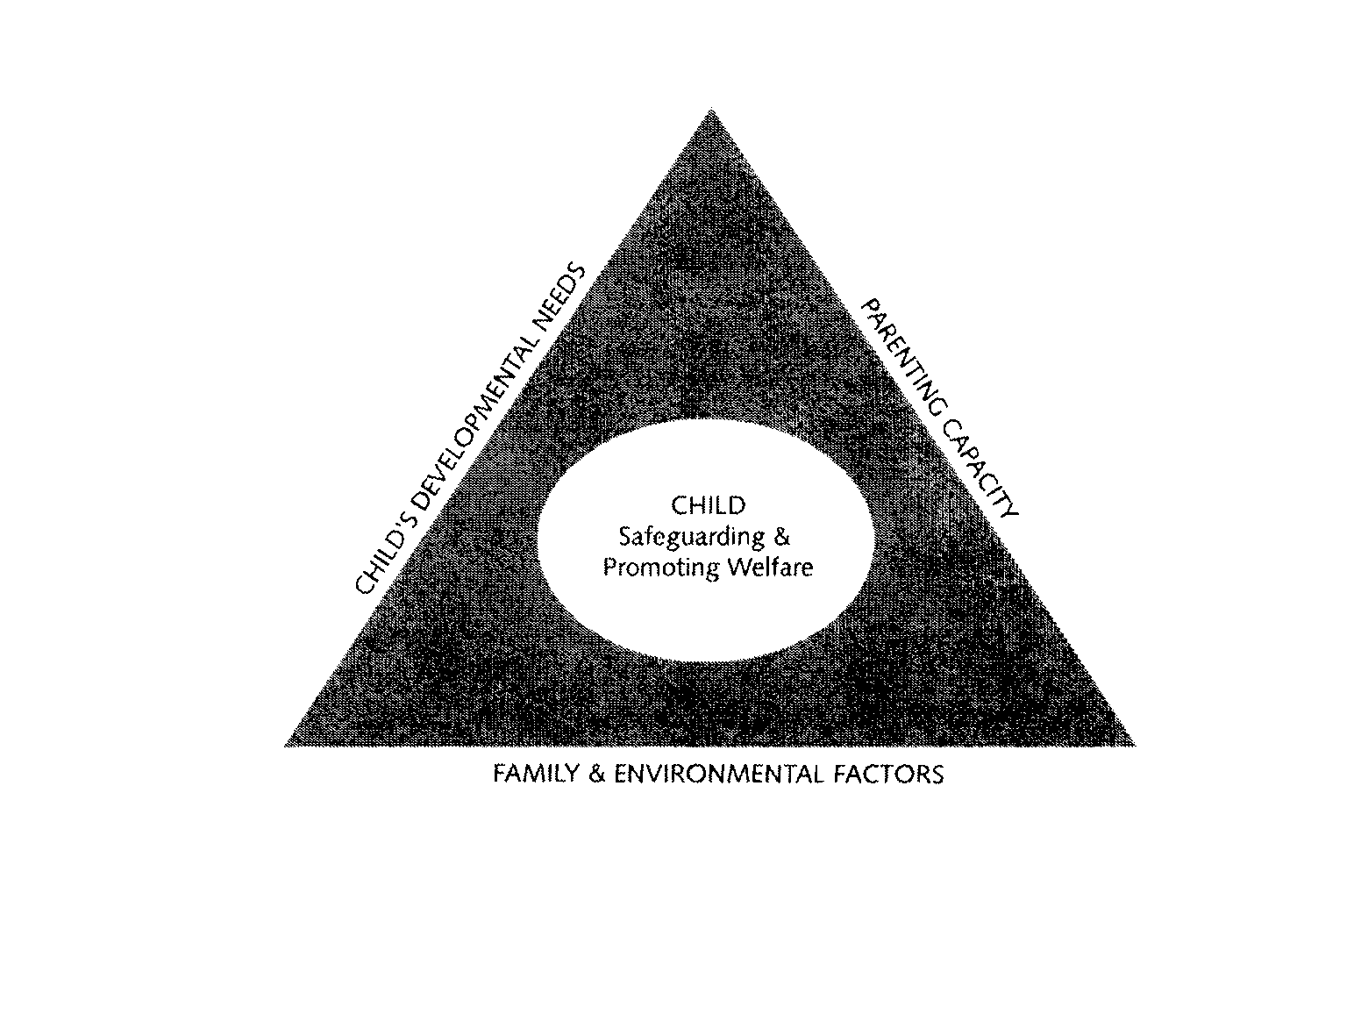
Assessment Framework (NCATS) Model for Sexually Harmful Behaviour
Vizard 2007
Parent(s)’ own history of abuse
Response to sexual behaviours
Understanding of normal child sexual development
Understanding of effects of c.s.a.
Recognition of differing needs of abusing/victim children
Physical management in the home
Capacity to protect
Capacity to change behaviour
Co-operation statutory agencies
Developmental history
History of abuse
Attachments & (dis)continuity of care
Peer relationships
Education history
Physical/mental health problems
Witnessing family violence
Are sexual behaviours
developmentally appropriate?
Pattern of sexual behaviour
problems
Risk assessment
Specialist assessments
History of of inter/intra familial abuse; Developmental family history
Identifying safe/unsafe adults in network
Social isolation v. supportive network; Assessment of risk to children; Placement issues

Slide 53
Status of the Evidence

Slide 54

No Shortage of Evidence
Chorpita et al. (2011) identified 395 evidence-based protocols in a recent review of over 750 non-pharmacological treatments tested in controlled clinical trials

Slide 55
Status of the SHB Evidence
Type of Evidence Status
Descriptive studies: Good Quality & Quantity for lower risk SHB: Good Quality & poor Quantity for higher risk SHB
Outcome studies:
Recidivism Fair Quality & Good Quantity
Treatment Efficacy Fair Quality & Limited Quantity
Adult Adjustment Poor Quality & Poor Quantity
Developmental
Trajectories (for SHB) Poor Quality & Poor Quantity

Slide 56
Status of the Evidence
Which areas of SHB research need more work?
Long term f/up of SHB cohorts into adult life (30 yrs +) to track psycho-social adjustment, behavioural disorders, parenting, abuse perpetration etc
Much longer f/up of treated SHB samples (20 yrs +) to compare outcomes across treatment modalities

Slide 57
Status of the Evidence
Which areas of SHB practice need more work?
Practitioner knowledge of key developmental variables & developmental trajectories in CBT to help improve client’s forward planning skills (e.g. by working with timelines & consequences of behaviour etc)
Integration of some treatment elements from victim work (e.g. working through PTSD symptoms) with offence specific elements in perpetrator work (e.g. PTSD repetition of trauma fuelling self pity and justifying distorted cognitions) to ensure that focus on harm caused by offending is not lost

Slide 58
Status of the Evidence
Which areas of SHB practice need more work?
Developing our understanding of the role of the internet in the sexualisation of our children and in reinforcing the sexual fantasies about children held by pereptrators

Slide 59
Prevention: Is it Possible?

Slide 60
It should be but somehow we don’t seem to be doing it
Are we, as a society, still in too much denial about the reality of SHB?
Perhaps we need to re-visit the wisdom of our predecessors in the field, here in Denver………………..

Slide 61
Kempe’s 6 stages of community recognition of child maltreatment (1978)
Stage 1 Denial of physical or sexual abuse
Stage 2 The battered child syndrome recognised
Stage 3 Physical abuse better managed – attention to neglect and failure to thrive
Stage 4 Recognition of emotional abuse, deprivation and neglect
Stage 5 Serious plight of sexually abused child recognised
Stage 6 Guaranteeing each child is wanted, loved and cared for, sheltered, fed, receives first class preventative services and health care

Slide 62
Prevention:
Is it Possible?
ISPCAN 2013 Survey on preventing CSA: working with men & boys
16 Key Findings – largely positive
Examples of preventive work in every world region but some countries have no prevention focused on men & boys
Q’s include:
Should prevention be widened to include all forms of violence or stay with CSA?
2. International co-operation re prevention

Slide 63
Prevention models do exist………

Slide 64
Blended Model
Prof. Ron Prinz, University of South Carolina
Universal approaches
All parents in target/high need areas
All parents of children with a defined problem
Targeted approaches
Maltreating parents
Offenders
Parents living in poverty
Single parents
Mental health
Tiered multilevel system of parenting support

Slide 65
Triple P System
Breadth of reach
Level 5
Level 2
Level 1
Level 4
Level 3
Intensity of intervention
Intensive family Intervention………................
Broad focused parenting skills training………...
Narrow focus parenting skills training………….
Brief parenting advice……………………………
Media and communication strategy…………….

Slide 66
Significant effects of Triple P
Triple P counties showed:
Lower rates of child out-of-home (foster care) placements
Lower rates of hospital-treated maltreatment injuries
Slowed growth of substantiated maltreatment

Slide 67
Prevention:
Is it Possible?
And having learned (again) from Kempe, we need to harness the tremendous power of social media and the internet to raise awareness of the corrupt use of these media by perpetrators in targeting and abusing children………………
The media can be of assistance in prevention and can push the most stubborn institutions into action

Slide 68
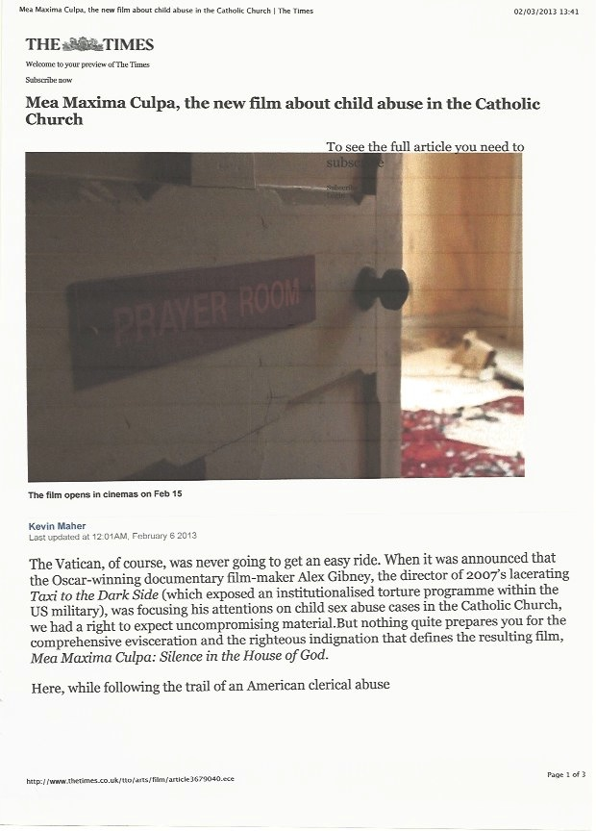
MEDIA ASSISTANCE WITH PREVENTION OF FUTURE ABUSE:
FILM COVERAGE OF CHURCH ABUSE

Slide 69
Prevention:
Is it Possible?
But when change takes an eternity
maybe guidance is better than nothing…..…........

Slide 70
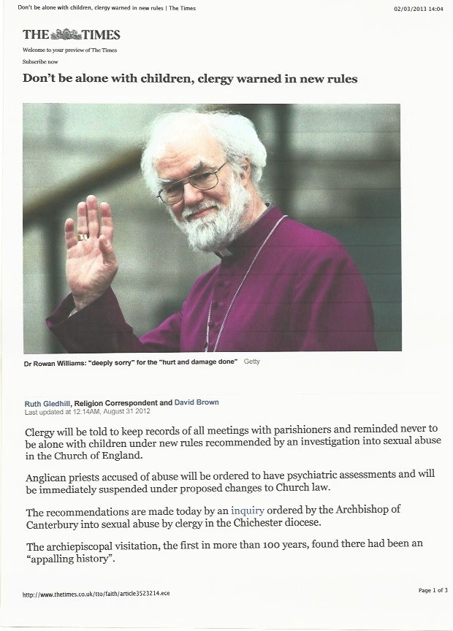
BETTER LATE THAN NEVER………
CHURCH OF ENGLAND GUIDANCE ON ABUSE

Slide 71
Thank You
e.vizard@ucl.ac.uk

Slide 72
Selection of References
Baker, A.W., & Duncan, S.P. (1985). Child sexual abuse: A study of prevalence in Great Britain. Child Abuse and
Neglect, 9, 457–467.
Borduin, C.M., Schaeffer, C.A., & Heiblum, N. (2009). A randomized clinical trial of multisystemic therapy with
juvenile sexual offenders: Effects on youth social ecology and criminal activity. Journal of Consulting and Clinical
Psychology, 77, 26–37.
Byron, T. (2010). Do we have safer children in a digital world? A review of progress since the 2008 Byron review. DCSF-00290.
Cann, J., Falshaw, L., & Friendship, C. (2004). Sexual offenders discharged from prison in England and Wales: A 21 year reconviction study. Legal and Criminological Psychology, 9, 1-10.
Carpentier, M.Y., Silovsky, J.F., & Chaffin, M. (2006). Randomized trial of treatment for children with sexual behavior problems: Ten year follow-up. Journal of Consulting and Clinical Psychology, 74, 482–488.
CEOP (Child Exploitation and Online Protection). (2012). A Picture of Abuse. A thematic assessment of the risk posed by those who possess indecent images of children. Executive Summary. 1–15. Available from: http://www.ceop.police.uk/Documents/ceopdocs/CEOP IIOCTA Executive Summary.pdf [last accessed 12 January 2013].
Coren, E., Thomae, M., Hutchfield, J. & Iredale, W. (2013). Report on the Implementation and Results of and Outcomes-focused Evaluation of Child Sexual Abuse Interventions in the UK. Child Abuse Review. Wiley Online Library. 22, 44-59.
Craissati, J., & Beech, A. (2006). The role of key developmental variables in identifying sex offenders likely to fail in the community: An enhanced risk assessment model. Child Abuse and Neglect, 30, 327–339.
Finklehor, D. (1979). Sexually victimized children. New York: Free Press.
Finklehor, D., & Jones, L. (2006). Why have child maltreatment and child victimzation declined? Journal of Social Issues, 62, 685–716.
ISPCAN (2011).ISPCAN ‘Denver Thinking Space’ 2011: Child Sexual Abuse. An international Perspective
On Responding to Child Sexual Abuse. Executive Summary p.10.
Letourneau, E., Henggeler, S.W., Borduin, C.M., Schewe, P.A., McCart, M.R., Chapman, J.E., & Saldana, L. (2009).
Multi- systemic therapy for juvenile sexual offenders: 1-Year results from a randomized effectiveness trial. Journal
of Family Psychology, 23, 89–102.
Littell, J.H., Campbell, M., Green, S., & Toews, B. (2005). Multisystemic therapy for social, emotional and behavioral
problems in youth aged 10–17. Cochrane Database of Systematic Reviews, 19, CD004797.

Slide 73
Selection of References
Livingstone, S., Haddon, L., Gorzig, A., & Olafsson, K. (2010). Risks and safety for children on the internet: The UK
report. Full Findings from the EU Kids Online Survey of UK 9– 16 Year Olds and their Parents. Available from:
http://www.eukidsonline.net [last accessed 12 January 2013].
Losel, F., & Schmucker, M. (2005). The effectiveness of treatment for sexual offenders: A comprehensive meta-
analysis. Journal of Experimental Criminology, 1, 117–146.
McGrath, R.J., Cumming, G.F., Burchard, B.L., Zeoli, S., & Ellerby, L. (2010). Current practices and trends in sexual
abuser management: The Safer Society 2009 North American Survey. Brandon, VT: Safer Society Press.
Reitzel, L.R., & Carbonell, J.L. (2006). The effectiveness of sexual offender treatment for juveniles as measured by
recidivism: A meta-analysis. Sex Abuse, 18, 401–421.
Roberts, A., Zhang, T., Yang, M., & Coid, J. (2008). Personality disorder, temperament, and childhood adversity:
Findings from a cohort of prisoners in England & Wales. Journal of Forensic Psychology and Psychiatry, 19, 460–483.
Royal College of Psychiatrists. (2012). Child abuse and neglect – The emotional effects: Information for parents,
carers and anyone who cares for young people. Mental health and growing up factsheet. Royal College of
Psychiatrists. March. Available from: http://www.rcpsych.ac.uk/expertadvice/
youthinfo/ parentscares/parenting/childabuseandneglect.aspx [last ac- cessed 12 January 2013].
Russell, D. (1983). Incidence and prevalence of intrafamilial and extrafamilial sexual abuse of female
children. Child Abuse and Neglect, 7, 133–146.
Stoltenborgh, M., Van Ijzendoorn, M.H., Euser, E.M., & Bakermans-Kranenburg, M.J. (2011). A global
perspective on child sexual abuse: Meta-analysis of prevalence around the world. Child
Maltreatment, 16, 79–101.
Vizard,E., Hickey,N., McCrory,E. (2007). Developmental trajectories associated with juvenile sexually
abusive behaviour and emerging severe personality disorder in childhood: The results of a three year U.K.
study. British Journal of Psychiatry, 190 (supplement), 27-32.
Vizard, E. (2013). Practitioner Review: The victims and juvenile perpetrators of child sexual abuse-
assessment and intervention. JCPP online. 12 Feb 2013. Last accessed 5.3.13
http://onlinelibrary.wiley.com/doi/10.1111/jcpp.12047/references
Ward, T. & Connolly, M. (2008). A human rights-based practice framework for sexual offenders. Journal of sexual
aggression. 14, 2, 87-98.

