Slide 1

Science 2.0: the view from LERU (League of European Research Universities)
Dr Paul Ayris
Director of UCL Library Services and UCL Copyright Officer
Chief Executive, UCL Press
Adviser to LIBER (Association of European Research Libraries) on EU matters and Horizon 2020
Chair of the LERU community of Chief Information Officers
e-mail: p.ayris@ucl.ac.uk

Slide 2
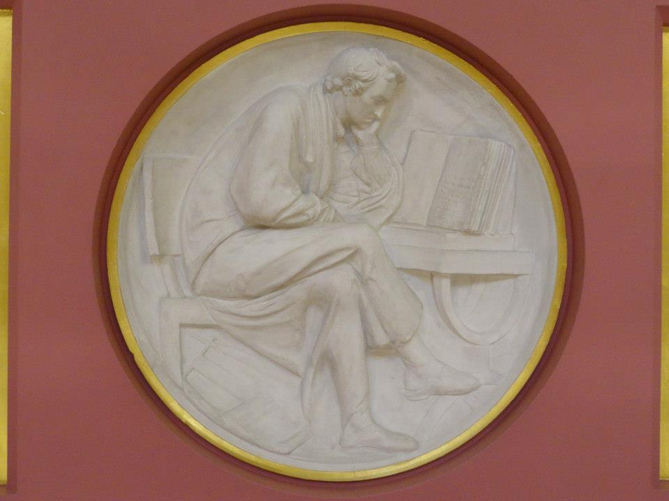
Contents
What is Science 2.0?
Open Access to publications
Open data
Other Tools and Services
Conclusions
Plaster Relief by John Flaxman, Flaxman Gallery, UCL

Slide 3


What is Science 2.0?
http://www.openscholarship.org/jcms/c_5012/en/home
Open Scholarship, called by the European Commission Science 2.0, is a new framework for doing research
Open scholarship encompasses open access, open data, open educational resources, and all other forms of openness in the scholarly and research environment
Open Scholarship website at http://www.openscholarship.org/jcms/c_6160/en/open-scholarship

Slide 4

Science 2.0 consultation
‘Science 2.0’ describes the on-going evolution in the modus operandi of doing research and organising science. These changes in the dynamics of science and research are enabled by digital technologies and driven by the globalisation of the scientific community, as well as the need to address the Grand Challenges of our times. They have an impact on the entire research cycle, from the inception of research to its publication, as well as on the way in which this cycle is organised.

Slide 5
Contents
What is Science 2.0?
Open Access to publications
Open data
Other Tools and Services
Conclusions
Plaster Relief by John Flaxman, Flaxman Gallery, UCL

Slide 6
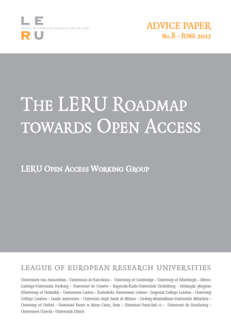
Open Access to publications
Benefits for researchers
  Authors gain increased visibility
  Literature now used as data
  This visibility and usage are new –in a subscription world, subscriptions are a barrier to access
  Many lower-income countries report access to the literature as a barrier – despite efforts by commercial publishers
  University’s Mission is to create Knowledge and share it

Slide 7
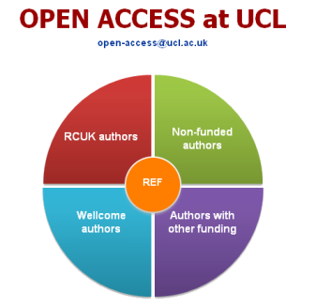
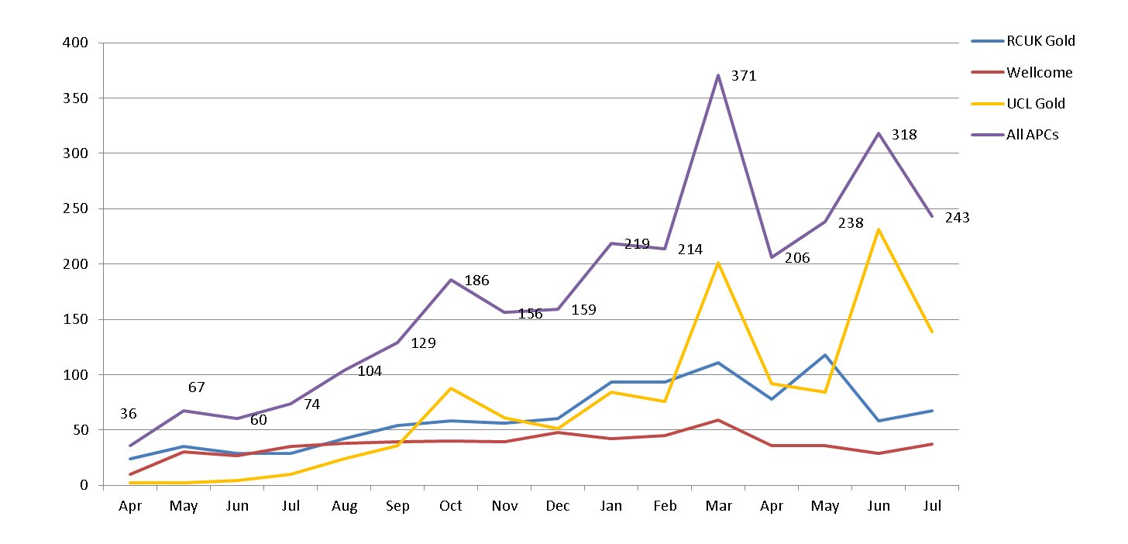
All APCs
3,137 APCs processed since April 2013
RCUK: 1,362 Wellcome: 590 UCL Gold: 1,185

Slide 8
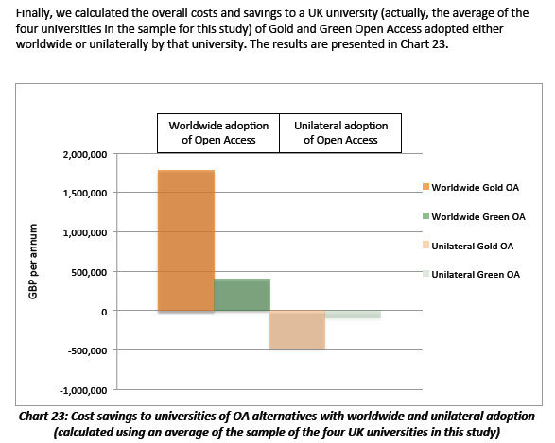
The Future – Green or Gold?
Houghton, J., and Swan, A., Going for Gold? The costs and benefits of Gold Open Access for UK research institutions: further economic modelling. Report to the UK Open Access Implementation Group (2012). See http://repository.jisc.ac.uk/610/.

Slide 9
Contents
What is Science 2.0?
Open Access to publications
Open data
Other Tools and Services
Conclusions
Plaster Relief by John Flaxman, Flaxman Gallery, UCL

Slide 10
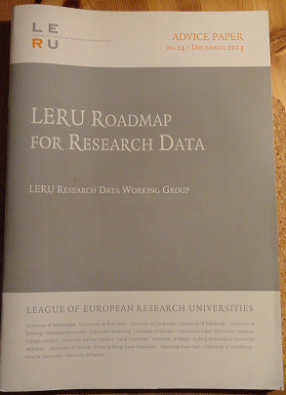
LERU Roadmap for Research Data
Overseen by Research Data Working Group
Pablo Achard (University of Geneva)
Paul Ayris (UCL, University College London)
Serge Fdida (UPMC, Paris)
Stefan Gradmann (University of Leuven)
Wolfram Horstmann (University of Oxford)
Ignasi Labastida (University of Barcelona)
Liz Lyon (University of Bath)
Katrien Maes (LERU)
Susan Reilly (LIBER)
Anja Smit (University of Utrecht)

Slide 11
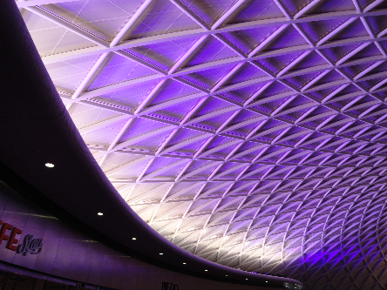
Key Messages
Each LERU university needs a Research Data Management Strategy
Researchers should have Research Data Management Plans
LERU universities need to bring stakeholders together
Benefits of ‘open data’ for sharing and re-use should be advocated and explored
King’s Cross, London

Slide 12
Contents
What is Science 2.0?
Open Access to publications
Open data
Other Tools and Services
Conclusions
Plaster Relief by John Flaxman, Flaxman Gallery, UCL

Slide 13
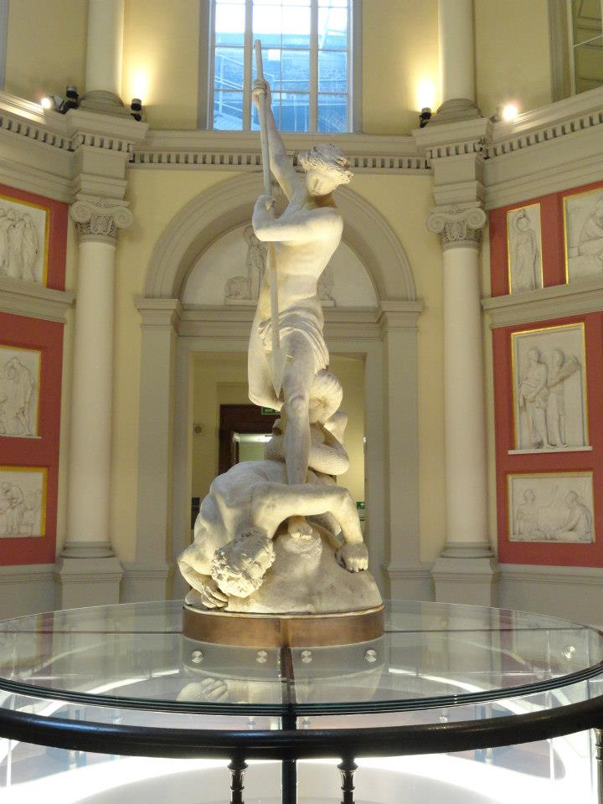
Other Tools and Services
Described in separate paper submitted with Science 2.0 Consultation
Issues still to be tied down
Alternative modes of peer review
  Which?
  Post publication peer review, with named reviewers?
    Not popular with academics
St Michael, by John Flaxman, UCL

Slide 14


Metrics and Altmetrics
San Francisco Declaration on Research Assessment (DORA)
  see http://am.ascb.org/dora/
  Not many universities have signed
  DORA rejects Journal impact factor as a mark of quality
U-Multirank not welcomed throughout Europe, certainly not in the UK
Altmetrics seen as a generalization of article level metrics,
  alternative to the widely used journal impact factor and personal citation indices like the h-index
  Too early for alternative approaches to win widespread support

Slide 15
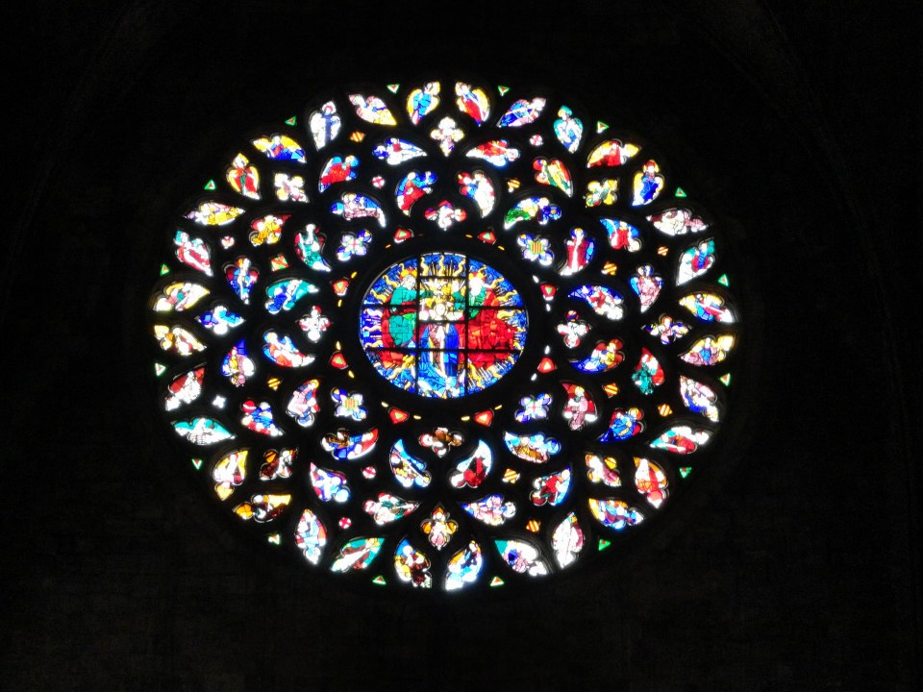
Citizen Science
There are many examples of crowdsourcing
City of Barcelona has created Citizen Science Office
  http://www.barcelonalab.cat/ca/projectes/oficina-ciencia-ciutadana/
Collaboration of the universities and their researchers
Santa Maria Del Mar, Barcelona

Slide 16
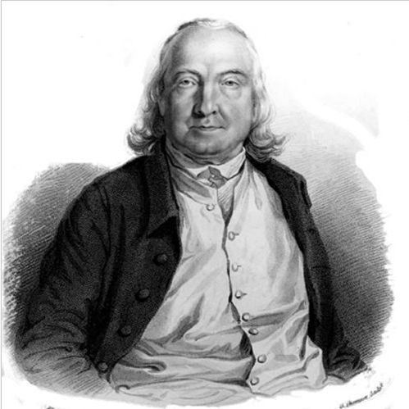
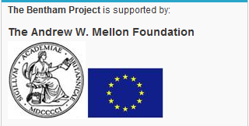
Writings of Jeremy Bentham
Jeremy Bentham, nineteenth century utilitarian philosopher
Main collection at UCL
Bentham MSS being digitised
  See http://blogs.ucl.ac.uk/transcribe-bentham/
11,140 MSS transcribed by volunteer help from across the world (17/10/14)

Slide 17
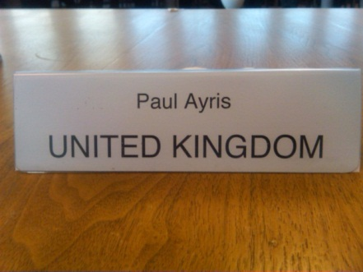
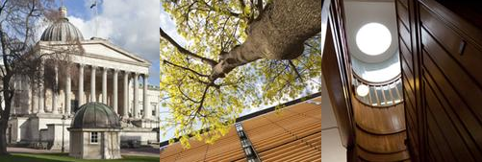
UCL Publishing model
Journal publishing platform
  OJS (Open Journal Systems) overlaying UCL Discovery as storage layer
  Peer-reviewed journals
  Run by academic Editorial Committees
Research Monograph list being launched in 2014-15
  10 titles in year 1
  Using Open Monograph Press
Textbook infrastructure
  Being constructed with JISC project monies
Open Access is an opportunity, not a threat
See http://www.ucl.ac.uk/library/ucl-press

Slide 18
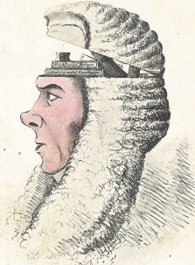
UCL Publishing model
Open Access business model
Sales via Print on Demand/enhanced e-models
Books will be peer reviewed before publication
Innovative technical solutions for Monographs and Textbooks
Open up publishing to new communities
Global impact for the University as an outcome
A Box of Useful Knowledge
(Brougham Papers, UCL Library Services)

Slide 19

Opportunities for Text Books
UCL academics, particularly in Physical Sciences and Engineering, produce their own textbooks
Open Access is a core value of UCL Press
Open Access to resources will be part of UCL’s new Education Strategy
UCL’s International Strategy will also embrace Open Scholarship as an offering to the global community
COLLEGE COLLECTION PERS
The Centenary edition of the College Magazine, June 1927

Slide 20
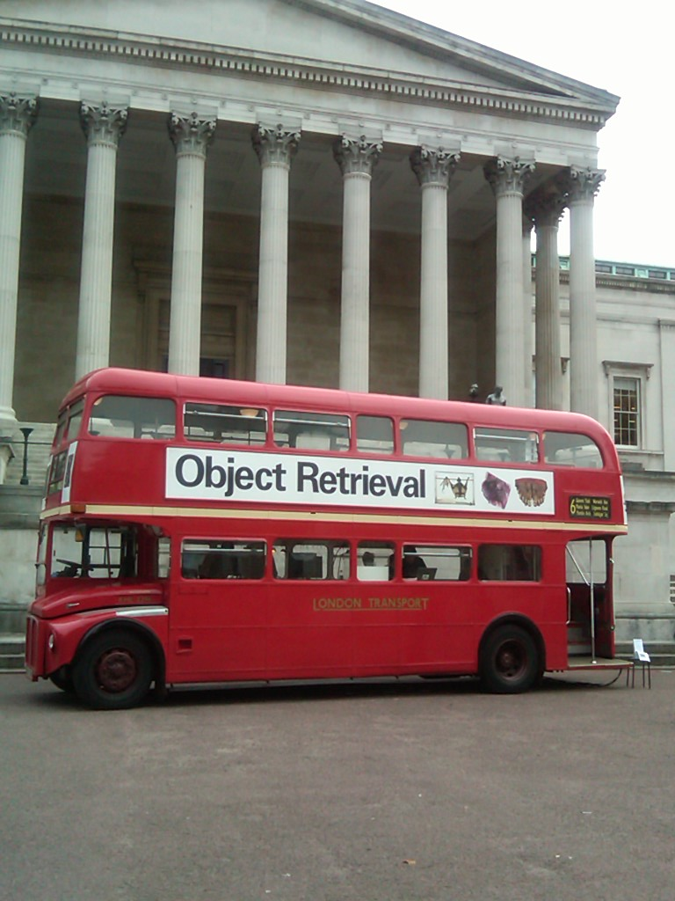
JISC Call - Institution as E-Text Book publisher
£75,000 awarded to UCL
To create an Open Access E-Textbook publishing platform
  To complement OJS for journals and OMP for monographs
2 textbooks being delivered as proof of concept
1 in Medical Sciences and 1 in Social Sciences

Slide 21
Contents
What is Science 2.0?
Open Access to publications
Open data
Other Tools and Services
Conclusions
Plaster Relief by John Flaxman, Flaxman Gallery, UCL

Slide 22
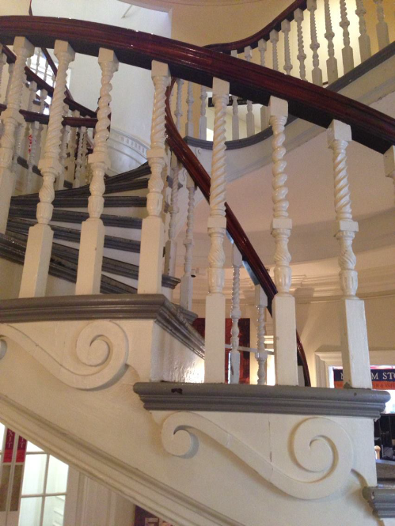
Next Steps
Open Scholarship (Science 2.0) is new feature in research landscape
LERU embraces
  New means of dissemination
  Increased importance for research data
Implications of other tools and services need more thought
Change is a process, not an event
Old State House, Boston, USA

