Slide 1




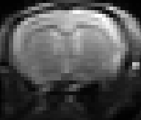



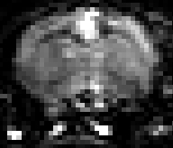
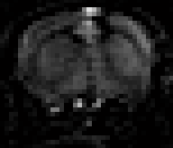
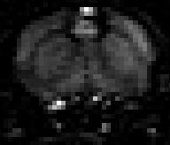

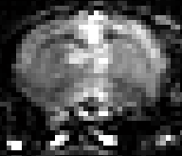

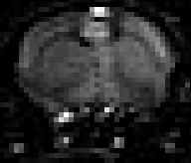
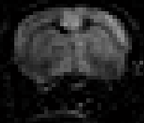
B0
b=20 (X)
b=20 (Y)
b=20 (Z)
TI =400ms
Control
8000
0
TI =500ms
TI =400ms
ΔM, ASL
300
0
TI =500ms
Figure 1
Representative control (rows 1-2) and ASL (rows 3-4) images (acquired following arterial spin labelling at TIs of 400 and 500ms) with no diffusion weighting (B0) and with diffusion gradients applied in the X, Y and Z directions.

Slide 2
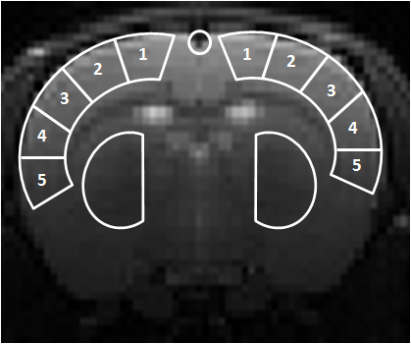
A
A
B
D*(X)
D*(Y)
ACA
D*(Z)
D* (mm/s²)
CP
CP
Y
Z
X
TI=400ms TI=500ms
C
D
TI = 400ms
TI = 500ms
D* (mm²/s)
1 2 3 4 5
1 2 3 4 5
Caudate Putamen
Caudate Putamen
Cortical ROI Number
Cortical ROI Number
Figure 2
T2 weighted spin echo image showing the anatomical location of the coronal imaging slice. Overlaid is a schematic representation of the ROIs from which mean D* estimates were taken: 5 bilateral cortical ROIs from medial to lateral; the caudate putamen (CP); anterior cerebral artery (ACA).
The estimated D* in X, Y and Z directions within the ACA at TIs of 500ms and 400ms.
The mean D* in X, Y and Z directions within cortical ROIs 1-5 and the CP at TI = 400ms.
The mean D* in X, Y and Z directions within cortical ROIs 1-5 and the CP at TI = 500ms.
Error bars represent the standard error of the mean across the 5 rats.

Slide 3
TI=400ms
D*_{Y} / D*_{X} [ratio]
TI=500ms
1 2 3 4 5
Cortical ROI Number
Figure 3
The ratio D*(Y) / D*(X) within the cortical ROIs (from medial to lateral) for TI=400ms and TI=500ms. Error bars represent standard error of the mean across the 5 rats.

Slide 4
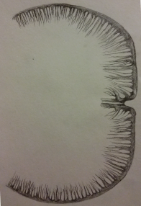
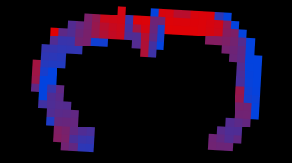
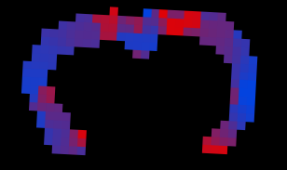
A
B
C
1.3
D_{Y}* / D_{x}*
[ratio]
0.7
Figure 4
A schematic drawing illustrating the pattern of the penetrating arterioles in a coronal slice of the rat brain cortex (A). Spatial maps of D*_{Y} / D*_{X} across the cortex for a single rat at TI = 400ms (B) and TI = 500ms (C).

Slide 5
Rat 1
Rat 2
Rat 3
Rat 4
Rat 5
2
0
D*_{Y} / D*_{X}
2
0
Cortical ROI Number
Supplementary Figure 1
D*_{Y} / D*_{X} estimates across the 5 cortical ROIs for each of the 5 rats at TI = 400ms. Top row: each individual line represents data acquired from 20 signal averages; Bottom row: the estimates acquired from the 80/100 average data.

