Slide 1
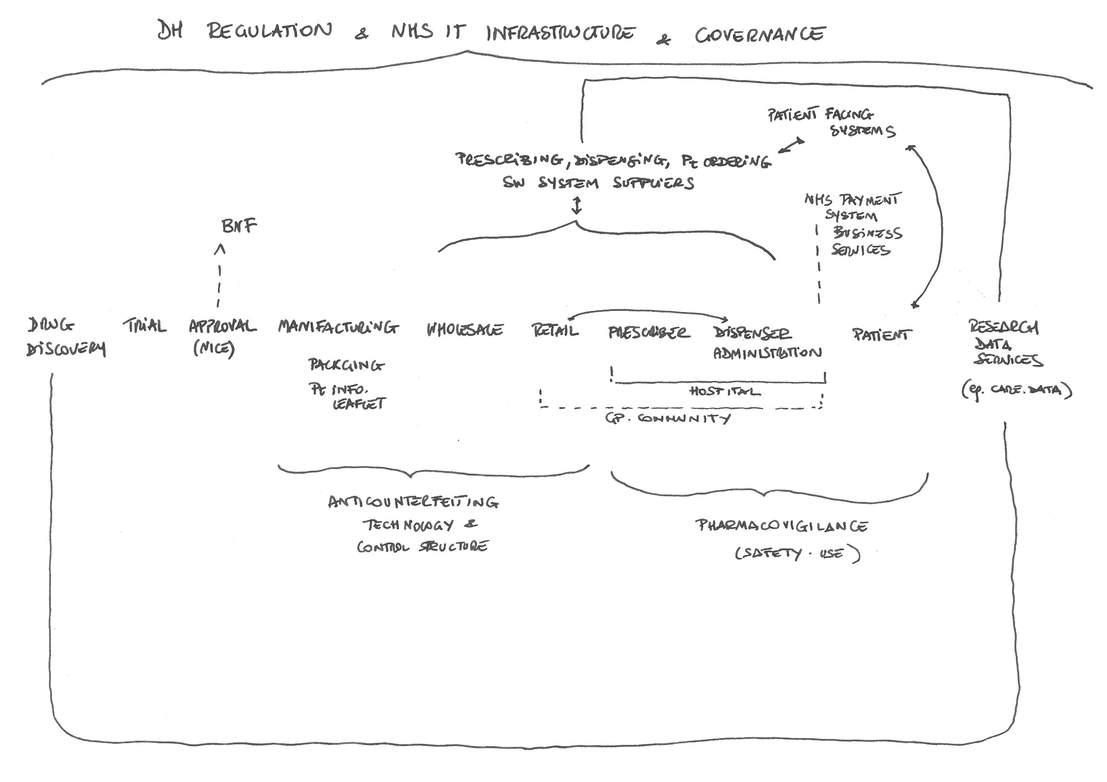
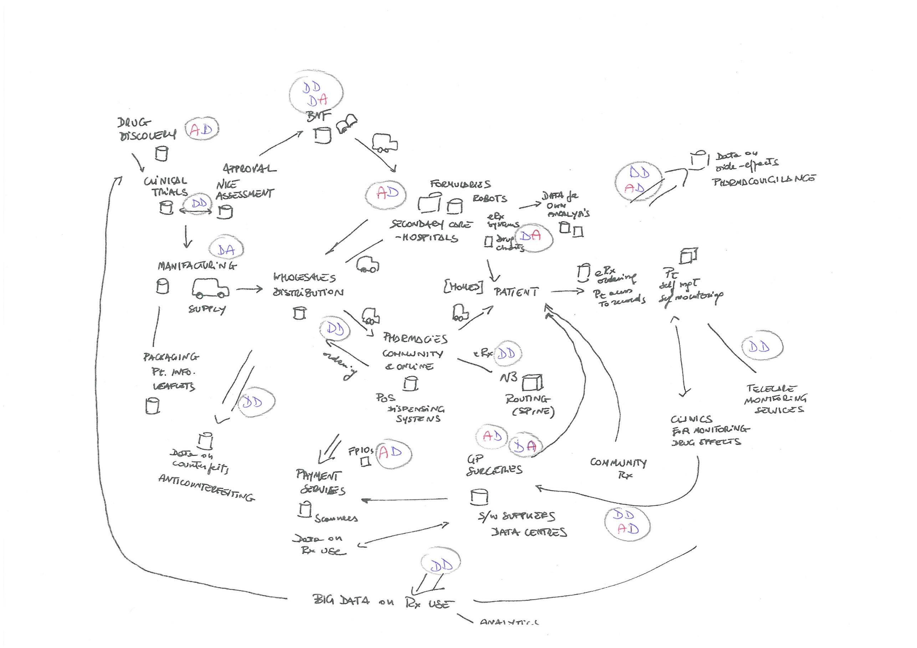
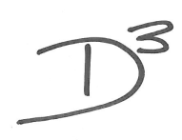
Delivering Digital Drugs
An Exploratory Study of the Digitalisation of Supply and Use of Medicines
Tony Cornford¹, Valentina Lichtner², Jane Dickson¹, Ralph Hibberd¹, Ela Klecun¹, Will Venters¹, Bryony Dean Franklin³
Medicines’ supply and use is increasingly digitalised; reliant on digital means and information. This poster presents exploratory research over five episodes of digitalisation of medicines across the supply network. We ‘follow the drug’ through this emerging field, suggesting possible maps of this new territory
A medicine can be seen as a hybrid artefact, part chemical, part data, part supply chain and logistics, part knowledgeable practice that is itself part embodied and part algorithmic.
This raises many complex intersecting questions including: what drives this process of digitalisation; what constitute appropriate functional uses of data - e.g. in prescribing, in research, in audit, in monitoring individual or population wide effectiveness or value for money, in monitoring side effects etc.
There are also substantial new issues of data stewardship, openness and ethical data governance practices.
5
2
4
1
3
Our methodology is cross-disciplinary and exploratory. It includes five case studies of the processes of digitalisation sampled along the chain of supply and use of medicines:
Anti-counterfeiting in the medicines supply networks
Hospital prescribing and supply of drugs and related data infrastructures
Pharmacovigilance and the monitoring for adverse effects of therapeutic drug use
Research data services, principally the aggregation of patient data for secondary use
Patient use of medicines and related patient-facing technology
2
Hospital prescribing and supply of drugs and related data infrastructures
Our research applys mix of qualitative data collection methods : interviews, observations and documentary analysis. The cases are explored both as single episodes and in their interconnections and cumulation.
We apply a tracer approach and ‘follow the drug’ through and between the cases. Drugs are taken as ‘tracers’ that can reveal digitalisation paths and flows within and across cases. Thus the ‘digitalisation of medicines’ is studied by ‘following the drugs’ from the moment they enter the market for clinical use, through their transit through pharmaceutical supply networks [case 1] to the process of prescribing and dispensing [case 2], to patient’s decision making [case 5], to the capture of aggregated data around the use of therapeutic drugs [case 4] and the outcomes of this use [case 3-4].
Tony Cornford
t.cornford@lse.ac.uk
for MEDINFO, August 2017
T. Cornford and V. Lichtner, (2014) Digital Drugs: An anatomy of new medicines, in: Information Systems and Global Assemblages: (Re)configuring Actors, Artefacts, Organizations. IFIP Advances in Information and Communication Technology,, B. Doolin, E. Lamprou, N.N. Mitev, and L. McLeod, eds., Springer, Auckland, New Zealand, 2014, pp. 149-162.
P. Combey, (1980) A tracer approach to the study of organizations, Journal of Management Studies 17, 96-126.
T. Cornford, T and V. Lichtner, V (2017) Digitalization of medicines: artefact, architecture and time [Editorial], BMJ Quality and Safety Published Online First: 03 June 2017. http://qualitysafety.bmj.com/content/early/2017/06/03/bmjqs-2017-006661.full
¹ Department of Management, London School of Economics, London, UK
² University of Leeds Business School, University of Leeds, Leeds, UK
³ UCL School of Pharmacy, University College London, London, UK
Delivering Digital Drugs
A project funded by Research Councils UK New Economic Models in the Digital Economy programme.
EP/L021188/1
http://digital-drugs.org/

