Slide 1
A
B
Figure 1 – Effect of bioreactor impeller speed on BM-hMSC growth over six days of culture in the DASbox controlled bioreactor, showing (A) the increased cell concentration in the bioreactor over six days at all impeller speeds, (B) the significant fall (p < 0.05) in total post-harvest cell number at the highest impeller speed. Control set-points are 100% dissolved oxygen and pH 7.4 with headspace aeration. Data shows mean ± SD, n = 3.

Slide 2
A
B
Figure 2 – Effect of impeller speed on A) the production of lactate dehydrogenase (LDH) and B) total protein concentration during microcarrier culture of BM-hMSCs in a controlled bioreactor. Showing no significant increase in LDH concentration or total protein at various impeller speeds, demonstrating low levels of cell damage during culture. Data shows mean ± SD, n = 3.

Slide 3
A
B
Figure 3 – Effect of bioreactor impeller speed on BM-hMSC metabolite flux over six days of culture in the DASbox controlled bioreactor, showing (A) per cell flux of ammonia and (B) yield of lactate from glucose. Control set-points are 100% dissolved oxygen and pH 7.4 with headspace aeration. Data shows mean ± SD, n = 3.

Slide 4
A
B
C
Figure 4 – Post-harvest characteristics of BM-hMSCs from controlled microcarrier culture compared to spinner flasks [14]. Showing (A) increased outgrowth kinetics, (B) reduced mean cell diameter and (C) maintained CFU efficiency at all impeller speeds. Data shows mean ± SD, n = 3.

Slide 5
A
B
Figure 5 – Effect of sparging (VVM = 0.1) with and without PluronicTM F68 on BM-hMSC growth over six days of controlled microcarrier culture compared to headspace aeration. Showing (A) significantly increased growth rate with headspace aeration (p < 0.05), and (B) reduced BM-hMSC attachment in sparged culture, particularly with the addition of PluronicTM F68.. Control set-points are 115 rpm impeller speed, 25% dO₂ concentration and pH 7.4. Data shows mean ± SD, n = 3.

Slide 6
A
B
C
D
Figure 6 – Effect of sparging (VVM = 0.1) with and without PluronicTM F68 compared to headspace aeration on BM-hMSC metabolite flux over six days of controlled microcarrier culture . Showing (A) similar glucose consumption rate, (B) increased lactate production, (C) significantly increased ammonia production rate (p < 0.05) and (D) similar yield of lactate from glucose in sparged culture (AWN: Don't agree that yield of lactate from glucose is similar. I think it increases; and it does not seem to be clearly discussed in the text) Control set-points are 115 rpm impeller speed, 25% dO₂ concentration and pH 7.4. Data shows mean ± SD, n = 3.

Slide 7
A
B
C
D
Figure 7 – Effect of sparging (VVM = 0.1) with and without PluronicTM F68 on BM-hMSC attachment and post-harvest characteristics after six days of controlled microcarrier culture compared to headspace aeration. Showing (A) significantly reduced harvest cell number (p < 0.05), (B) decreased CFU efficiency, (C) similar specific outgrowth rate and (D) significantly increased mean cell diameter in sparged culture (p < 0.05). Control set-points are 115rpm impeller speed, 25% dO₂ concentration and pH 7.4. Data shows mean ± SD, n = 3.

Slide 8
Impeller rate (rpm) | Culture volume (ml) | Power number¹ | Max dissipation rate/average dissipation rate¹ | Reynolds number | Impeller speed (s⁻¹) | Max specific energy dissipation rate (W/kg) | Kolmogorov scale of turbulence (µm)
80 | 100 | 1.5 | 18 | 1440 | 1.33 | 0.016 | 90
115 | 100 | 1.5 | 18 | 2070 | 1.92 | 0.046 | 68
150 | 100 | 1.5 | 18 | 2700 | 2.50 | 0.103 | 56
225 | 100 | 1.5 | 18 | 4050 | 3.75 | 0.346 | 41
Table 1 – Fluid dynamic characterisation of the DASGIP DASbox bioreactor platform at the various impeller speeds used in this study (impeller diameter of 0.03 m and a bioreactor diameter of 0.063 m). (Based on the procedure set out in Nienow et al. 2016 [17]).

Slide 9
Supplementary Figures

Slide 10
A
B
C
Supplementary figure 1 – Effect of impeller speed on the live metabolite concentrations during BM-hMSC expansion in controlled microcarrier culture at 100% dO₂ with headspace aeration. Showing (A) glucose, (B) lactate and (C) ammonia concentrations at various impeller speeds. Data shows mean ± SD, n = 3.

Slide 11
A
B
Supplementary figure 3 – Effect of aeration method on the metabolite flux of BM-hMSCs in controlled microcarrier culture. Showing no significant increase in (A) LDH concentration or (B) total protein with various aeration methods, demonstrating low levels of cell damage during culture. Control set-points are 115rpm impeller speed, 25% dO₂ concentration and pH 7.4. Data shows mean ± SD, n = 3.

Slide 12
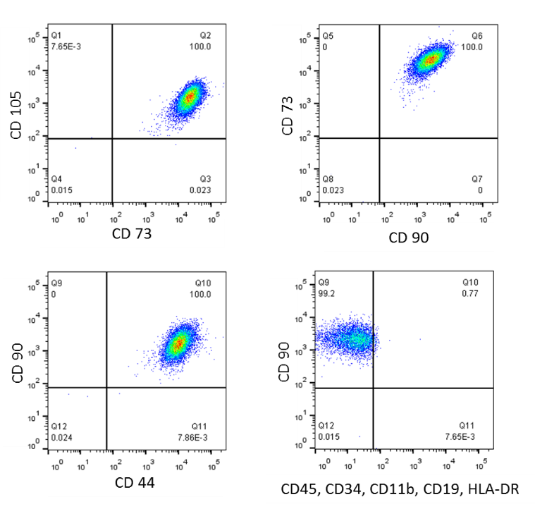
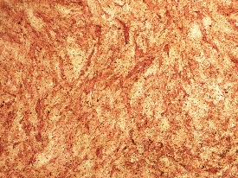
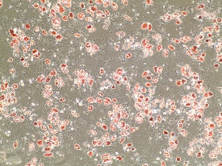
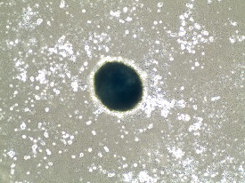
Osteogenic
250 µm
Adipogenic
250 µm
Chondrogenic
250 µm
Impeller speed (rpm) | % co-expression of immunophenotye markers
80 | 96.50 ± 0.14
150 | 96.80 ± 0.28
225 | 95.80 ± 0.14
Supplementary figure 2 - Verification of post-harvest immunophenotype and differential potential of BM-hMSCs used during this study in accordance with the ISCT minimum criteria.

