Slide 1
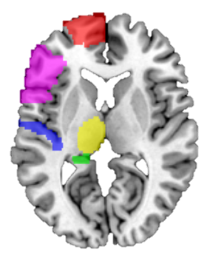
Figure 1. Locations of the masks and extracted ROIs time series
DLPFC, dorsolateral prefrontal cortex.

Slide 2
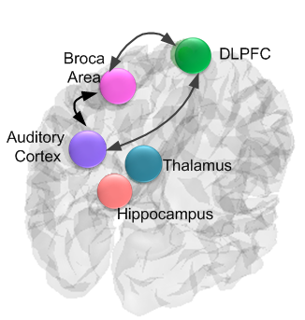
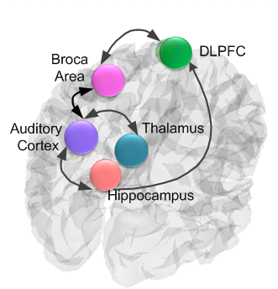
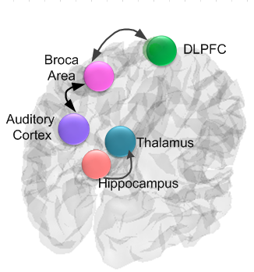
(a) AVHs
(b) Non-AVHs
(c) HCs
Figure 2. Significant effective connectivity (at the group level) among ROIs in the SZ patients and HCs.
Significant connectivities in the AVHs group (a), and Non-AVHs group (b), and HCs (c).

Slide 3
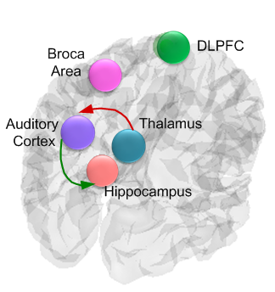
(a)
(b)
(c)
(d)
Figure 3. Significant effective connectivity (at the between group level) among ROIs between the SZ patients with and without AVHs and correlation analysis.
(a) Increased (red) and decreased (green) effective connections in the AVHs group as compared with Non-AVHs group. Correlations between the AHRS score and strength of connection from the thalamus to the auditory cortex (b), from the auditory cortex to the hippocampus (c), and from the Broca area to the auditory cortex (d).

Slide 4
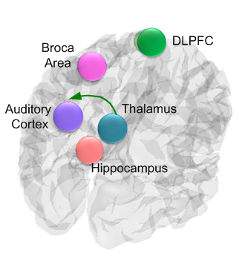
Figure 4. Decreased (green) effective connection in the Non-AVHs group as compared with HCs.
Notes:
C VS N

Slide 5
Figure 5. Proposed mechanism responsible for AVHs in SZ.
Thalamic-auditory cortical-hippocampal dysconnectivity may lead to increased activity of the auditory cortex and the pathological perception of internal sounds without presenting of auditory stimuli.

