Slide 1
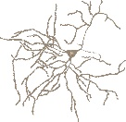
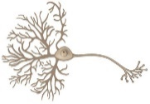
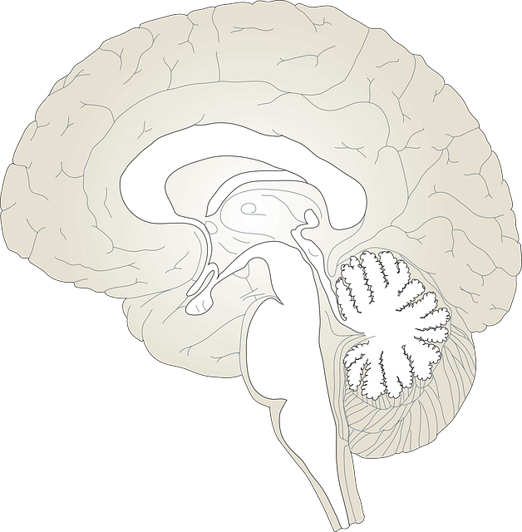

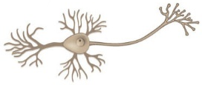
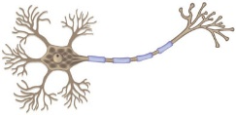
HD (ST)
MSN neurons
PD (OB, DMV, SNpc)
DA neurons
bvFTLD (ACC, FI)
VEN neurons
AD (LC, EC, HP)
Pyramidal neurons
ALS (MNC, SP, BS)
Motor neurons
Notes:
Figure 1. Regions and neurons vulnerable in neurodegenerative diseases. Early affected regions in different neurodegenerative diseases are indicated by different colors. AD, Alzheimer’s disease; PD, Parkinson’s disease; ALS, Amyotrophic Lateral Sclerosis‎; bvFTLD, behavior variant Frontotemporal lobar degeneration; HD, Huntington's disease; LC, locus coeruleus; EC, entorhinal cortex; HP, hippocampus; OB, olfactory bulb; DMV, dorsal motor nucleus of the vagus; SNpc, substantia nigra pars compacta; MNC, motor neocortex; SC, spinal cord; BS, brainstem; ACC, anterior cingulate cortex; FI, frontal insula; DG, Fascia dentata of the dentate gyrus; ST, striatum.

