Slide 1
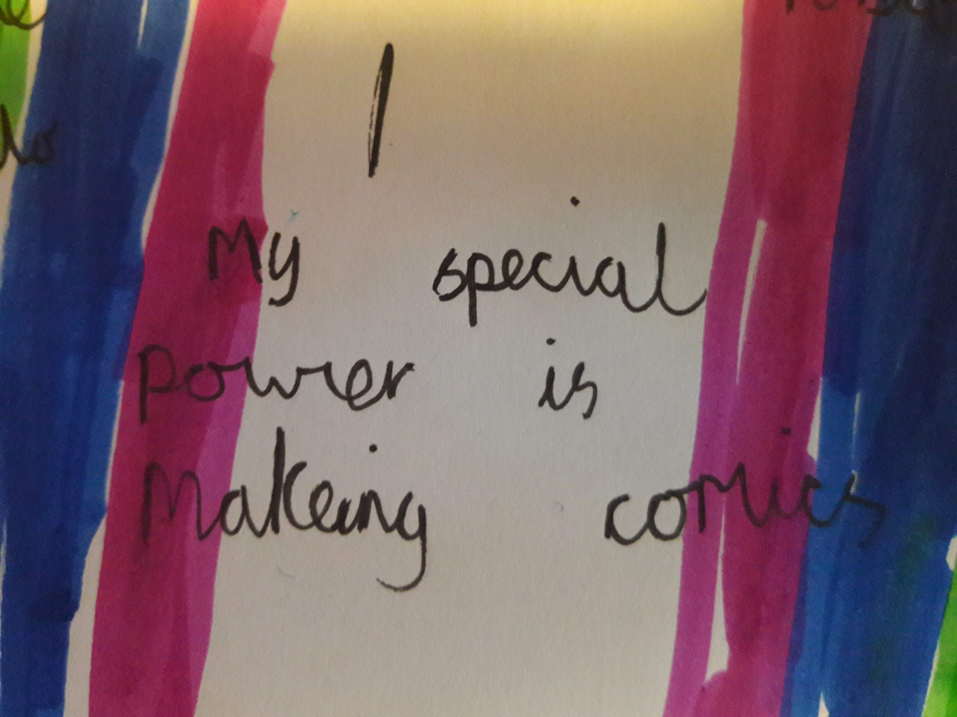

exploring children’s comic making in an after school club.
Helen Jones
PhD student at Goldsmiths University
Lecturer in Primary Education at Institute of Education, UCL
@eggyhelen
h.c.jones@ucl.ac.uk

Slide 2
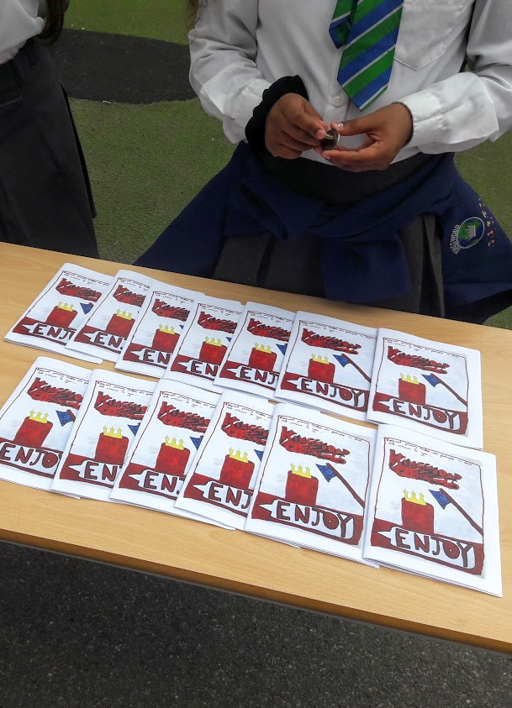
The Research Project
Can a comic club offer a third space for child-led reading and writing?
Do children want to write comics for each other to read?
WHY A CLUB?
A busy curriculum means children have little opportunity for writing/drawing about their own ideas in class
Affinity groups – a way of learning with like minded peers
A third space – clubs offer a space between home and school

Slide 3
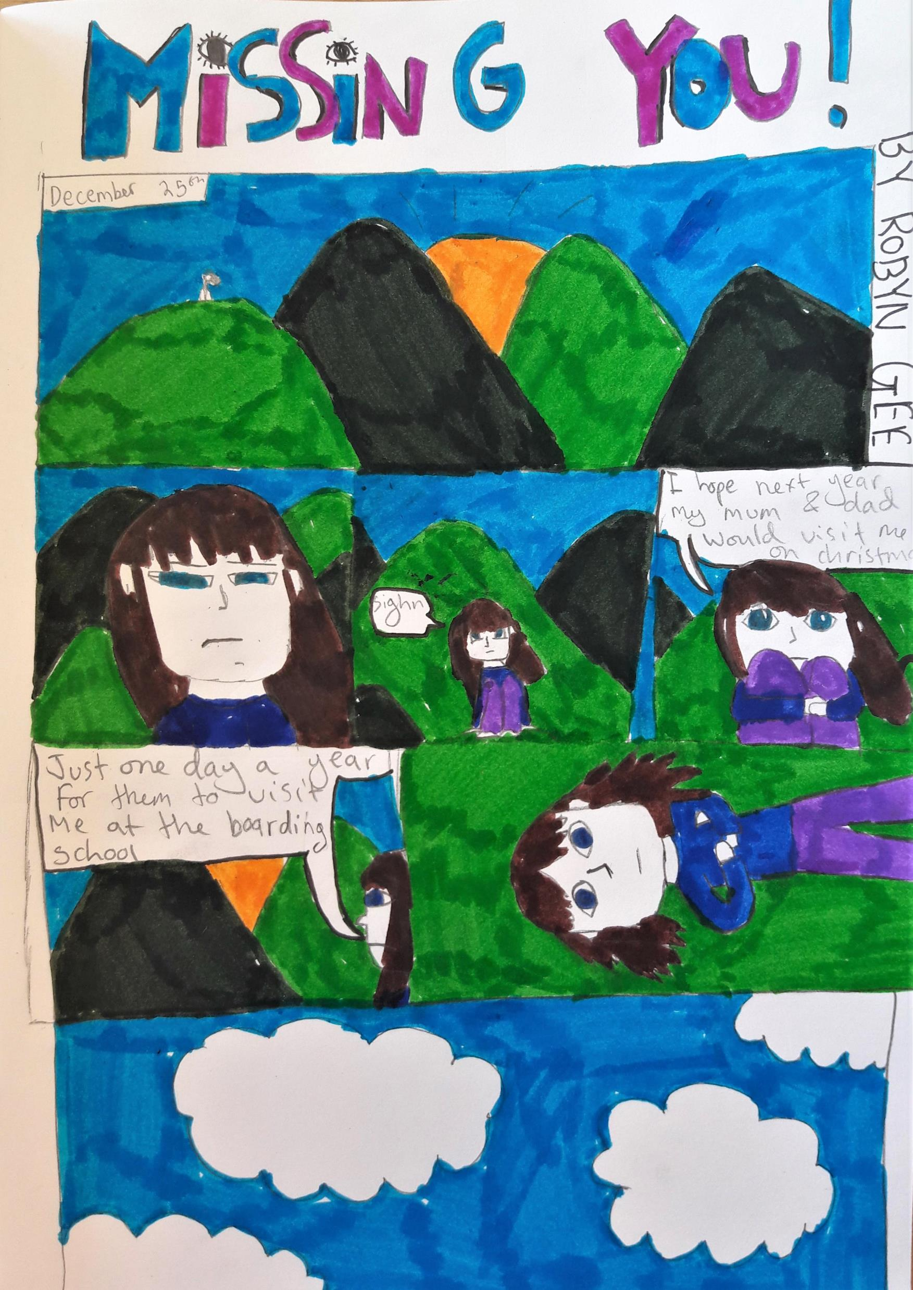
Starting the Club
After school I’m picking up from the playground when I hear a voice – “Summer’s mum, Summer’s mum…thank you, thank you, thank you!” Suddenly I get a big hug from Isiah. “Why thank you?” I ask back. “Because you are running comic club! I can’t wait!”
(Diary reflection, 18.04.19)
In the baseline questionnaire, all twenty-one children reported reading comic books, or comic-style books, outside of school, and seventeen of the children reported making comics. Of these, three stated they were prolific comic makers, and had produced multiple series of comics at home that they shared with family and friends. These initial findings demonstrated that the children coming to comic club had stories that they wanted to tell.

Slide 4
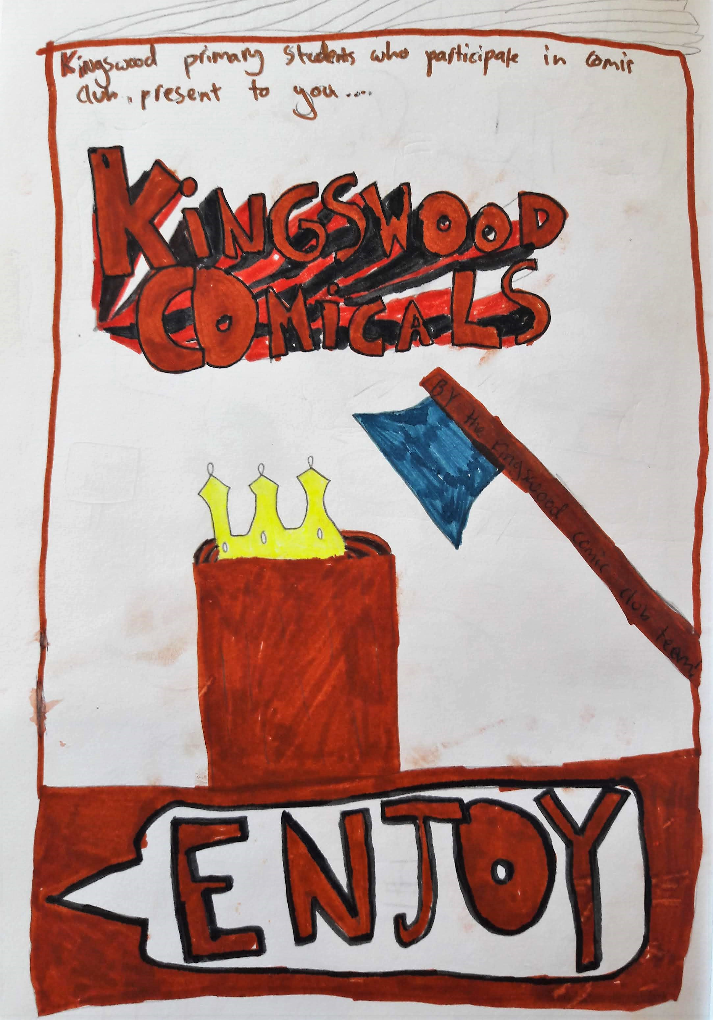
Self-motivated learning
Participation in the club was voluntary and reliant on the children’s desire to engage and share ideas (Wohlwend et al., 2018).
With a shared interest in comics, the children came to the club with a wealth of knowledge and ideas. From the start of the project, they were self-motivated to take the lead in the comics they chose to produce. The children were keen to create their own narratives, with their own characters and in their own graphic styles.
The ‘curriculum’ of the club could therefore use the children’s literacy worlds they brought with them as funds of knowledge (Dyson, 1993; Moll et al., 2013).

Slide 5
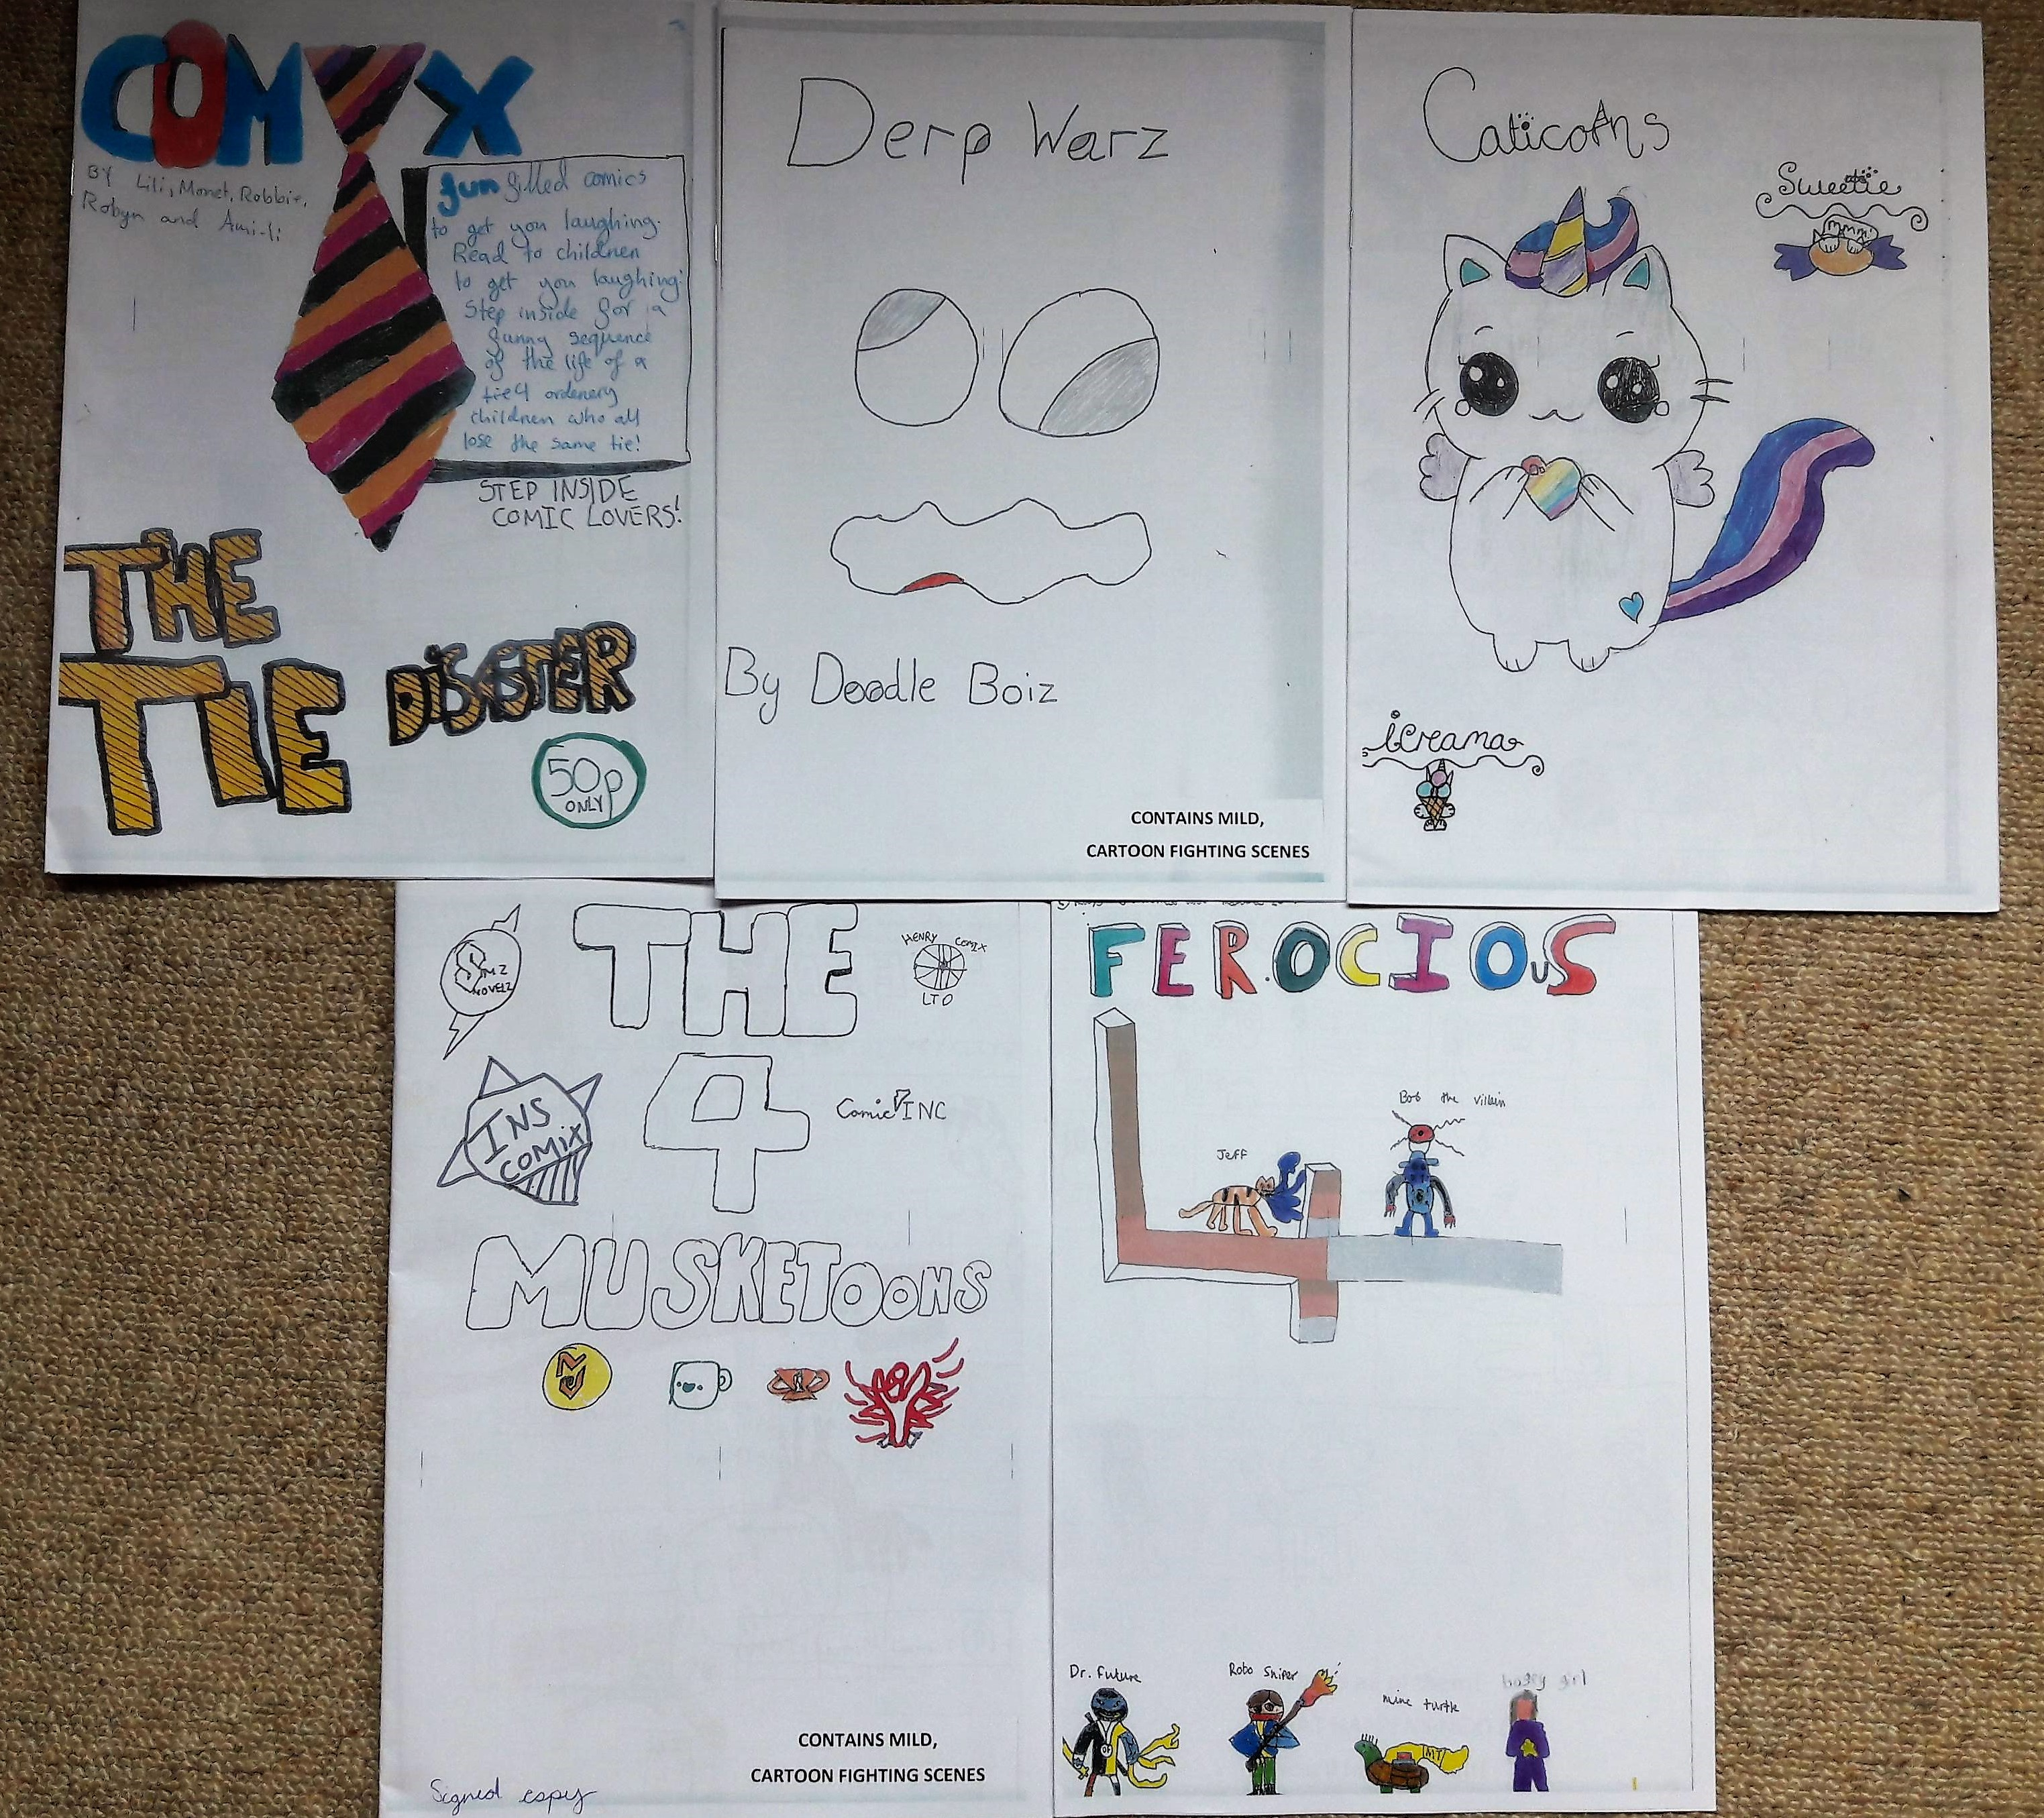
Developing group styles and identities
In order to create the comics for the fair, the children divided themselves into five groups in order to produce collaborative endeavours.
By giving the children choice and agency in the groupings, they were able to create smaller affinity groups within the larger affinity group of comic club - each with their own identity, developed through the narratives told and design choices made.
These distinct identities are reflected in the names of the comics chosen by the children: Caticorns, Derp Warz by Doodle Boiz, the Four Muskatoons, Ferocious Four and The Comix.

Slide 6
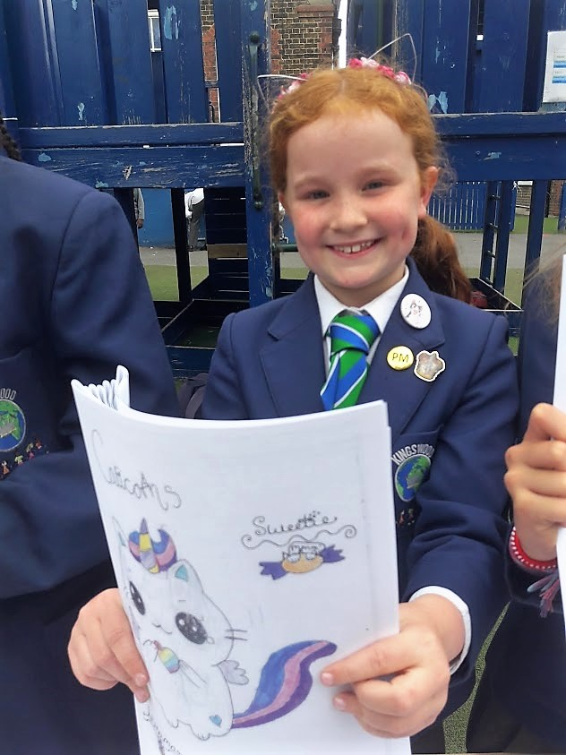
The comic Fair: publishing and selling comics
As commented by Bitz (2010), children will create comics with a heightened sense of self-identity if they know it will be read by others, and this became both a rewarding and nerve-wracking experience for many of the children in the club.
The children engaged very well with organising the comic fair, creating posters to advertise the event and working hard, often outside of the club hours, to get the comics completed in time to be published.

Slide 7
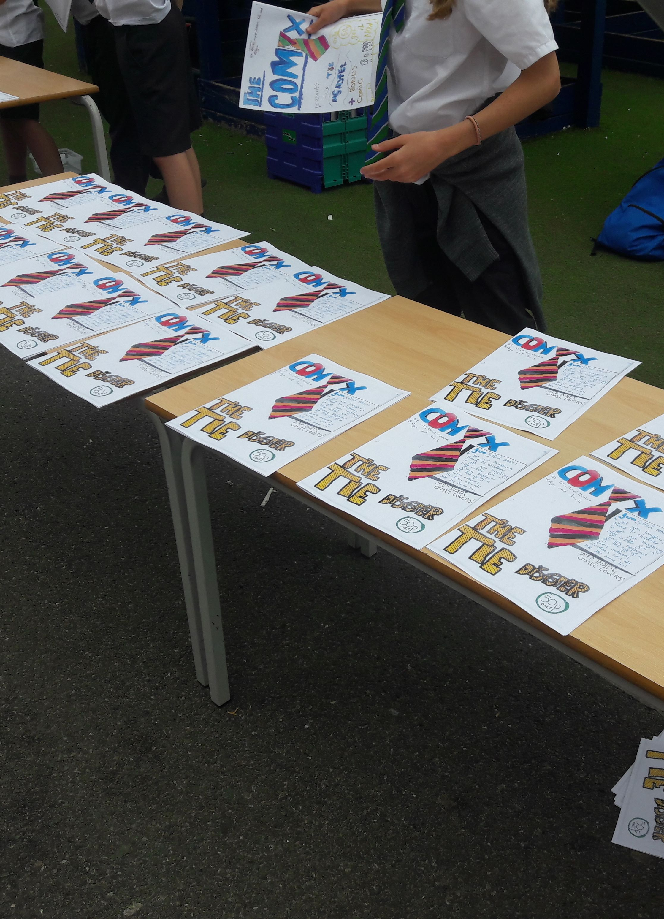
The comic fair: pro-comic makers!
“I enjoyed the comic fair sooo much, I feel like a pro-comic maker.”
- Comic club member
“Very funny, I loved it. Very inspiring. I will write my own.”
- Peer in Y5
“Adorable, I would love to do one based on my culture.”
- Parent
“These look amazing! Well done all the comic strip writers and illustrators. I can’t wait to put them in my book corner tomorrow.”
- Teacher

Slide 9
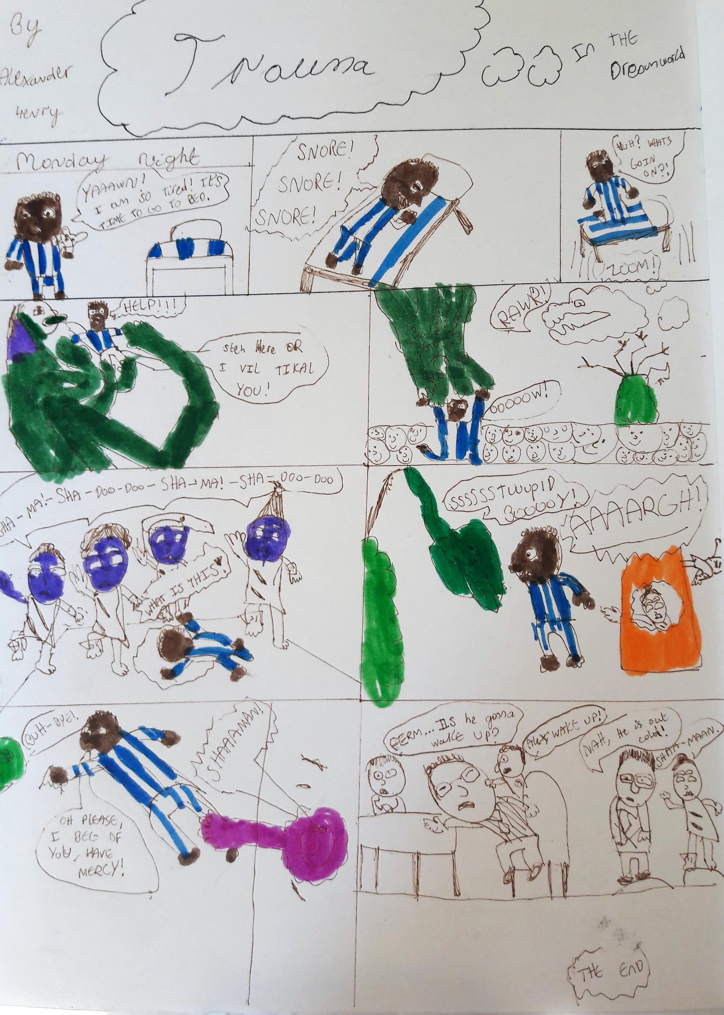
Why you should run a school comics Club…
Allow children to create comics based on their own ideas and the stories they want to tell.
Children voices can be heard.
Children’s comics reflect their backgrounds and interests.
Develop confidence, and self-belief that they can be successful comic creators with an audience who wants to buy their comics.
Collaborative, child-led learning.
“I’ve got a bone to pick with you…one of the children was half an hour late for school this morning…the reason they gave was that they couldn’t get out of bed as they were reading the comics they had from the comic fair!” - School Receptionist

