Slide 1
IMPROVING ENERGY SYSTEMS AND ENERGY ACCESS IN ETHIOPIA: AN INCLUSIVE APPROACH
Dr Gabrial Anandarajah
UCL Energy Institute, University College London, United Kingdom, g.anandarajah@ucl.ac.uk

Slide 2
Content
Introduction
Methodology
Energy services demand drivers and projection
Qualitative energy transition pathways
Energy system transition pathways
Conclusion

Slide 3
Introduction
Ethiopia is one of the least developed and least electrified countries in the world with an access rate of 44 percent
  the second highest electricity access deficit in Africa, with over 60 million people without access electricity from the grid.
  about 96 percent of urban households are connected to the grid, while only 27 percent of rural households have access to electricity services.
The Ethiopian Government has a very ambitious and challenging plan to make the country a middle-income country by 2025, with no increase in GHG emissions under its second Growth and Transformation Plan (GTP II).
The National Electrification Program 2019 (NEP2.0) sets another ambitious target of achieving universal electricity access by 2025 of which 65% is met with grid solutions and the remaining 35% is with off-grid technologies, mainly renewables.
The principal aim of this research is to develop possible transition pathways to modern energy in Ethiopia, specifically clean electricity by incorporating behavioural issues (social science) in energy system modelling.

Slide 4
Methodology
Unlocking barriers in the energy system planning process and policy analysis by developing energy system models that adopt an inclusive approach through stakeholder engagement.

Slide 5
Energy services demand drivers and projection
Carried out expert interviews using expert elicitation methods to identify:
  Appropriate drivers for scenarios of electricity demand projections and how they will progress over time
  to understand the types of technologies that will be in stock in the future compared with base case
This will influence the calculated tier consumptions (Multi-Tier Framework – MTF - for measuring energy access was first introduced in the 2013 Global Tracking Framework (GTF) report).
The LEAP Energy modelling tool has been used to project energy demand using the drivers and their growth rates which were the output of the expert interview analysis.

Slide 6
Interview findings
Households income/GDP/GDP Growth
  On average, by 2060, the experts expect Ethiopian median GDP growth be about 5%
Population Growth
  On average ,by 2060, the experts expect Ethiopian median Population growth be about 1.8%
Rate of urbanization,
  On average, by 2060, the experts expect Ethiopian median share of urban population be about 45%

Slide 7
Energy system pathway narratives – the workshop-based suggestion
Suggested name | Narrative
Business As Usual | Projects that have secured funding are included, minor delays affect known power plants or certain types of project. Low levels of institutional and system level reform.
High Ambition | Ethiopia outperforms its goals, builds a renewable energy-based system that serves as a regional hub for electricity trade, undergoes substantial institutional reform, attracts international investment through e.g. tariff reforms and retains the capacity – developing its own markets. This could be termed the best case scenario.
Ambition | A variation on High Ambition that explores the point at which the best case scenario starts to fail or get delayed.
Big Business | Makes the choice to favour industrial partners and big business over other consumers. While economic growth does happen, many of the characteristics of ambitious social change do not – including curbing the sector’s impact of the environment. This implies progress as well as slow downs compared to the BAU.
Slow Down | Is an undesirable future where the sector truly struggles to meet its targets. Most trends continue forward at current rates, institutions are fragmented, and large infrastructure projects that are required suffer long delays. Energy shortages and the use of fossil back up continue.
Source: Tomei, et al. 2021, Energy Supply Pathways for Ethiopia: Workshop report DOI: 10.5281/zenodo.4897717
Notes:
Objective of the narratives is to highlight what OSeMOSYS and energy modelling is typically used for
The narratives are supposed to be relative one to the other
Include additional climate change sensitivities
Link to water availability for the power sector

Slide 8
Energy system transition pathways
Five scenarios developed using OSeMOSYS- and ONSSET-Ethiopia models
Source: Usher, et. Al., 2021 Energy system development pathways for Ethiopia: Work Package 3 Final Report. DOI: 10.5281/zenodo.4646249

Slide 9
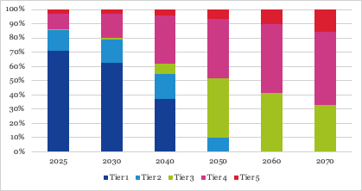
An example of Tiers: Residential demand Tier shares of total population – New Policies

Slide 10
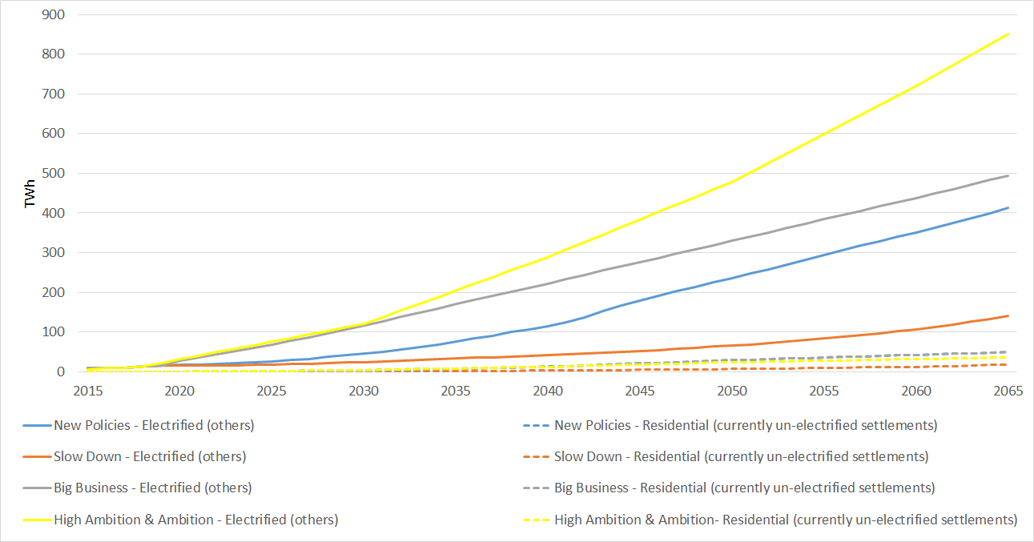
Evolution of electricity demand (GWh) in each scenario

Slide 11
On-grid vs off-grid
Electrification targets can be achieved at lower cost with off-grid technologies
Source: Energy system development pathways for Ethiopia: Policy Brief
DOI:10.5281/zenodo.4606547

Slide 12
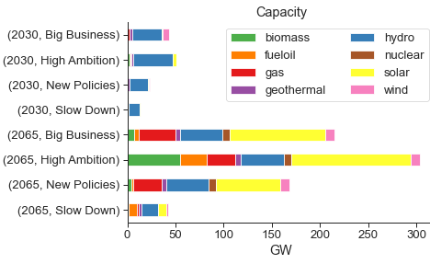
Technology split by scenarios for key years 2030 and 2065 (GW)
Supply side implications of electrification are significant – rapid growth in capacity is needed
A high level of ambition is required to meet the increase in electricity demands under all but the most pessimistic scenarios

Slide 13
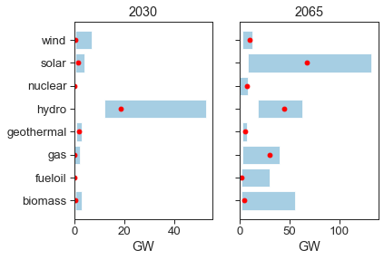
Ranges of technology capacity in 2030 and 2065
Before 2030, there is a clear role for the expansion of hydropower (12-45GW by 2030) across the range of scenarios explored, with a smaller, but significant, near term role for wind, solar, geothermal and natural gas.

Slide 14
Conclusions
This research developed five transition pathways to modern energy in Ethiopia, specifically clean electricity by incorporating behavioural issues (social science) in energy system modelling.
Ethiopia’s ambitious electrification targets can be achieved at lower cost with a greater role for off-grid technologies.
Aside from hydropower, there are significant roles for solar, wind, geothermal as well as natural gas generation technologies.
Significant revenue potential from energy trade opportunities could cover up to 30% of the costs of new electricity capacity in Ethiopia between 2015 and 2065.
The large expansion of hydropower will link Ethiopian energy security to the uncertain impacts of climate change.

Slide 15
Consumer behaviour
A household questionnaire survey (1400 urban households from 9 regions in Ethiopia) has been carried out in and around Addis Ababa to understand energy efficiency improvement opportunities.
Households mean energy expenditure constitutes about 4% of their income, which implies that energy expenditures constitute only small proportion of their monthly income and hence this may lower the motivation to adopt energy efficient technologies.
61% did one or more of energy efficiency and conservation activities which includes shifting baking and cooking time, adopting energy efficient technologies, turning off light bubs and other appliances when not in use, and reducing the number of light bulbs.
Most households (86%) use energy efficiency and conservations activities mainly to reduce energy expenses.
About 12% of the sample use these activities out of concern for climate and future generations.
As it is an ongoing project, we have not yet developed behavior scenarios.

Slide 16
Project Partners
Acknowledgement
Commonwealth & Development Office—UKAID supported this project. This is part of the Applied Research Program on Energy for Economic Growth (EEG), led by Oxford Policy Management. The views expressed in this paper do not necessarily reflect the UK government’s official policies.
University College London (UCL) - Project lead, United Kingdom: Gabrial Anandarajah, Elusiyan Eludoyin, Julia Tomei, Oliver Broad, Ben Milligan
KTH Royal Institute of Technology (KTH), Sweden: Mark Howells, Ioannis Pappis, Andreas Sahlberg.
Ethiopian Development Research Institute (EDRI), Ethiopia: Sied Hassen, Robel Seifemichael
Addis Ababa Institute of Technology (AAIT), Ethiopia: Solomon Teferi, Getachew Bekele, Tewodros Walle, Fitsum Salehuamlak

Slide 17
Thank you
g.anandarajah@ucl.ac.uk

