Slide 1
Figure 1
-
20
-
UKCTOCS
-
Intensity (arb. units)
10
-
-
-
-
-
-
-
-
-
-
-
-
0
-
150
-
-
100
-
UKOPS
-
50
-
-
-
-
-
-
-
-
-
-
-
-
0
2000
4000
6000
8000
m/z

Slide 2
Figure 2
Tiss et al.
(81)
52
17
8
4
49
5
4
Peng et al.
(21)
Villanueva et al.
(79)

Slide 3
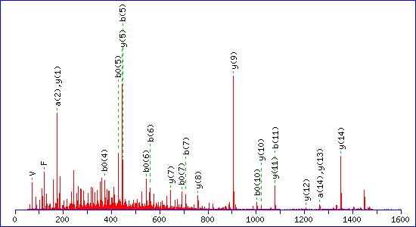
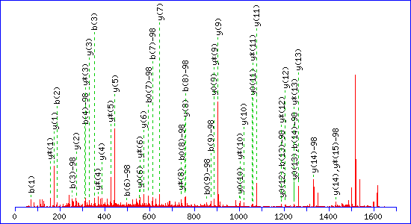
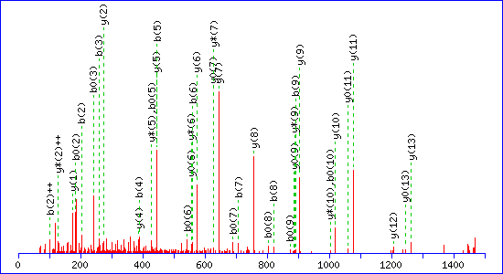
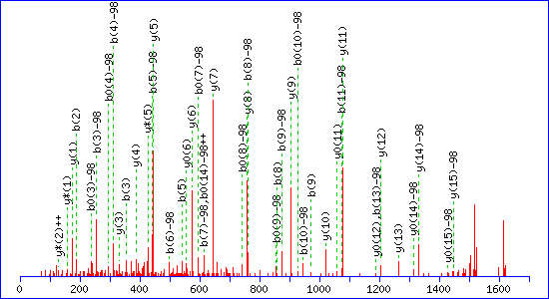
Figure S1
(a) MALDI-MS/MS, peak 1466.51
(b) MALDI-MS/MS, peak 1617.55
(c) ESI-MS/MS, peak 1466.51
(d) ESI-MS/MS, peak 1617.55

Slide 4
Figure S2

