Slide 1
New models for scholarly publishing
Dr Paul Ayris
Director of UCL Library Services and UCL Copyright Officer
President of LIBER (Association of European Research Libraries)
Chair, LERU (League of European Research Universities) Chief Information Officer community
e-mail: p.ayris@ucl.ac.uk

Slide 2
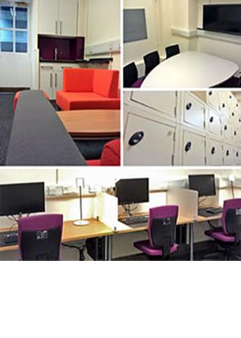
Contents
UCL Discovery
Current developments
RCUK Open Access policy
University as Publisher
Open Journals
Overlay journal system
Open Access Monographs
Conclusions?

Slide 3
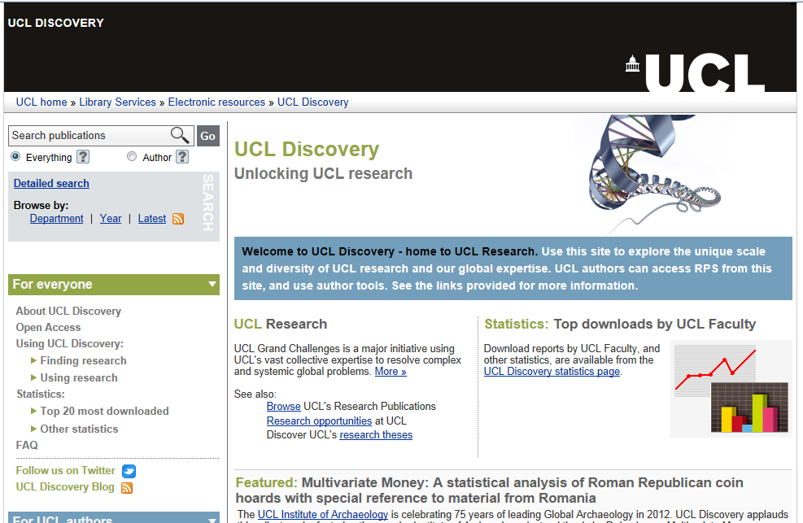
UCL Discovery
Aim: to make this a full
record of UCL research
273,000 records
12,000 Green full text

Slide 4
UCL Discovery
3,189,002 downloads from UCL’s OA repository (29 May)
 | Q1 | Q2 | Q3 | Q4 | Total
2013 | 334,159 | 218,290
2012 | 213,402 | 245,836 | 229,864 | 349,688 | 1,038,790
2011 | 146,748 | 155,152 | 107,601 | 175,464 | 584,965
2010 | 117,514 | 133,024 | 128,924 | 146,690 | 526,114
UCL’s ‘Top 50’ for Q1 2013 is available at: http://discovery.ucl.ac.uk/past_stats/2013-Q1.html
UCL’s ‘Top 20’ for each Faculty for Q1 2013 is available from: http://discovery.ucl.ac.uk/past-statistics.html

Slide 5
RCUK Open Access policy
RCUK has issued new policy on Open Access
See http://www.ucl.ac.uk/library/publications/
The RCUK Policy on Open Access aims to achieve immediate, unrestricted, on‐line access to peer‐reviewed and published research papers, free of any access charge
Video presentation at http://www.youtube.com/watch?v=kV4lIOk1zIs&feature=player_embedded
UCL has compiled detailed guidance on what UCL authors should do

Slide 6
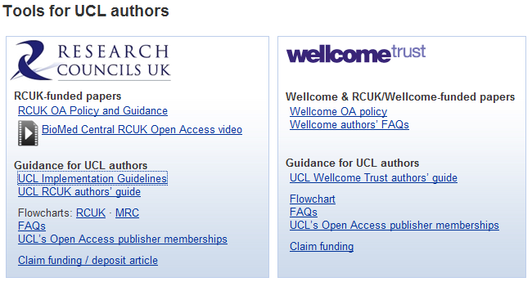
Tools for UCL authors

Slide 7
What are the basics?
Compliant journals are either ‘Gold’ – offering Open Access from the publisher’s site, often in exchange for an ‘Article Processing Charge’ (APC) – or ‘Green’, supporting the deposit of research in institutional repositories such as UCL Discovery
UCL encourages its authors to comply with the RCUK Policy on Open Access by following UCL’s ‘Green’ Open Access mandate and depositing copies of research papers in UCL Discovery

Slide 8
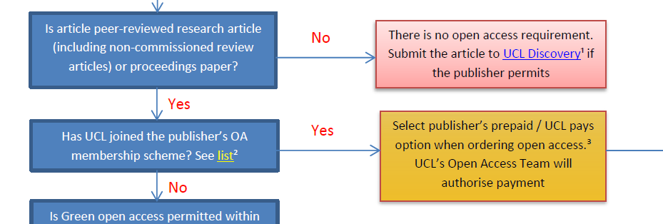
Further Tools
Flowcharts, based on source of funding, to guide decision making

Slide 9
UCL’s Open Access payment schemes
UCL Library Services administers APC payments for UCL authors
UK HEIs are taking up discounted APC schemes with publishers to ease transition to full OA
See https://www.ucl.ac.uk/library/UCL/pub-schemes.shtml

Slide 10
Contents
UCL Discovery
Current developments
RCUK Open Access policy
University as Publisher
Open Journals
Overlay journal system
Open Access Monographs
Conclusions?

Slide 11
University as Publisher
Press will act as umbrella for all in-house publishing activity in UCL
Open Access publishing activity will start with UCL Press imprint
UCL Press now a department of the Division of Library Services

Slide 12
Existing publishing activity
Small independent presses
Mainly in the Humanities
Some Social Science activity
Often lack:
Business Planning
Marketing Strategy
No sense of corporate identity
UCL Press to act as umbrella for shared services

Slide 13
Contents
UCL Discovery
Current developments
RCUK Open Access policy
University as Publisher
Open Journals
Overlay journal system
Open Access Monographs
Conclusions?

Slide 14
Overlay journals
Overlay journals system developed
Full-text resides in UCL Discovery and the overlay layer for presentation uses OJS
Partnership between UCL Library Services and academic Departments
Service will be promoted to UCL in 2013-14
See Slovo from UCL SSEES postgraduates at http://ojs.lib.ucl.ac.uk/index.php/Slovo

Slide 17
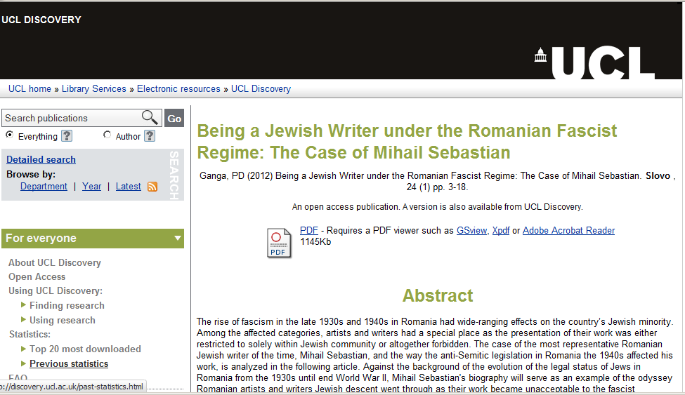
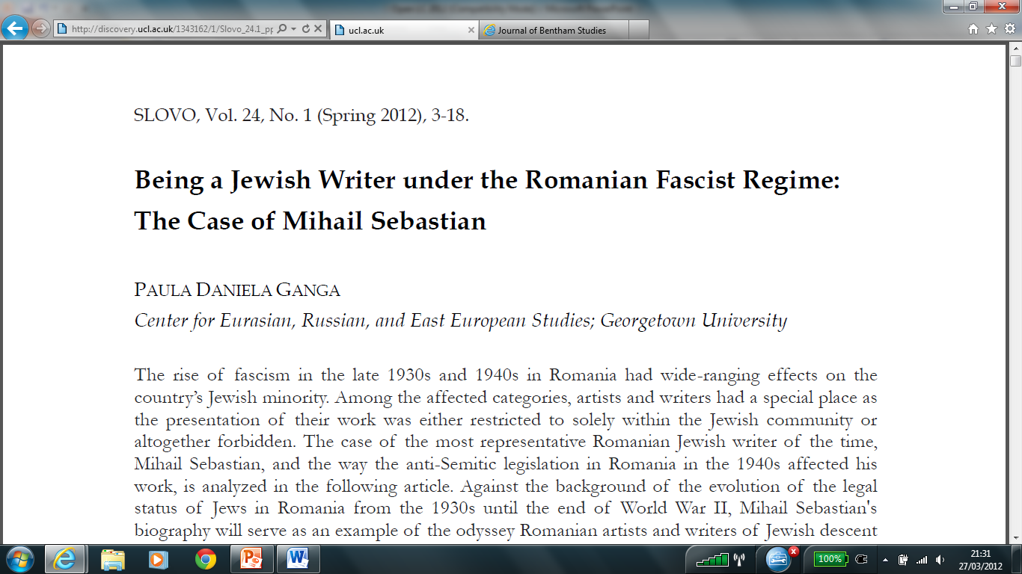

Slide 18
Current benefits to adopters
Access to centrally-maintained journal management software
Ease of use
Optionally, supports a range of journal management functions
Supports rolling publication, if desirable
Use of UCL Discovery for storage and dissemination
High visibility of articles
Stable URLs
Customisable download of reports
Access to repository tools for dissemination, embedding
Support from UCL Library Services in a range of areas including OJS configuration, repository upload, formats, encoding, rights and licensing
Long-term hosting and digital preservation

Slide 19
Contents
UCL Discovery
Current developments
RCUK Open Access policy
University as Publisher
Open Journals
Overlay journal system
Open Access Monographs
Conclusions?

Slide 20
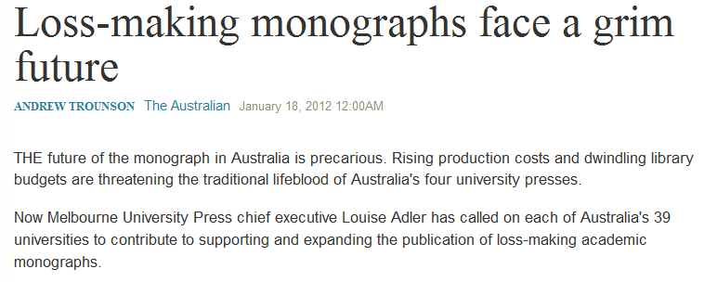
What is the problem with monograph publishing?
See http://www.theaustralian.com.au/higher-education/loss-making-monographs-face-a-grim-future/story-e6frgcjx-1226246679624

Slide 21
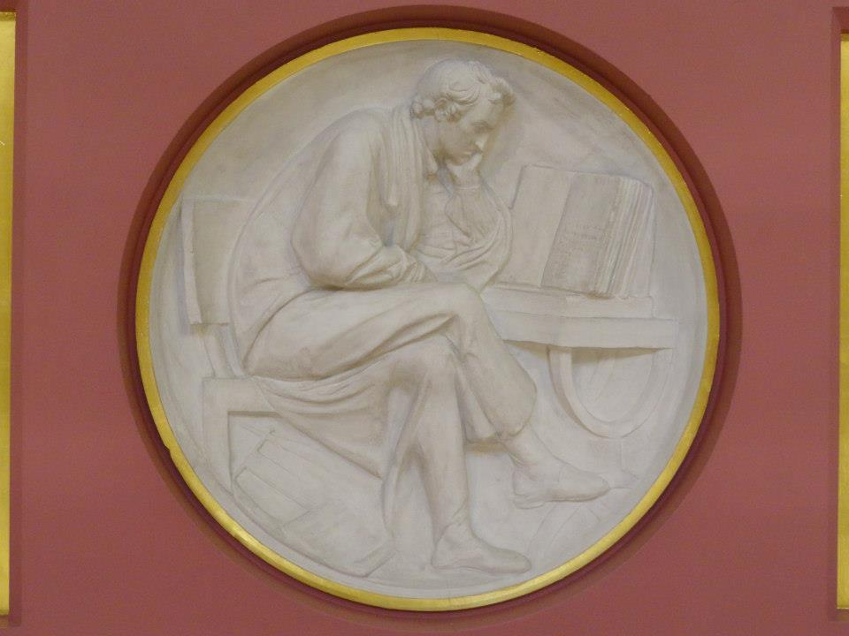
Monograph Publishing
Open Access is solution to broken Business Model
University Press takes on role as monograph publisher
Long form monographs, peer reviewed
Short monographs in AHSS – new publishing format
Flaxman Gallery, UCL

Slide 22
Shared European infrastructure for monographs?
19 European partners, led by UCL in discussion
Aim is to put in place a framework which will allow European universities to become publishers themselves
With access to a shared publishing infrastructure and using Open Access business models to support the production of research monographs in the Arts, Humanities and Social Sciences
OAPEN could provide much of the technical infrastructure
Scaleable solution for ALL European Universities?

Slide 23
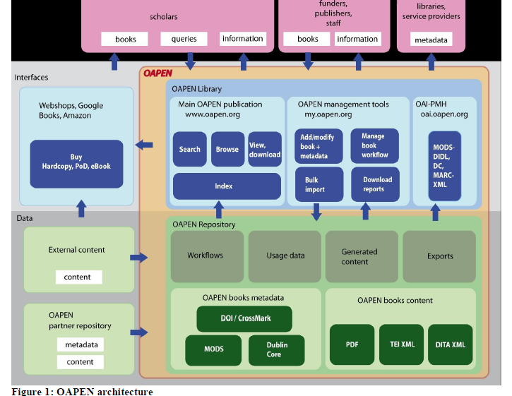

Slide 24
What could be achieved?
OUTPUTS
Shared publishing infrastructure Shared by 19 partners Scaleable to all European Universities
Advocacy for new solutions to solve monograph crisis
Marketing frameworks
Business Modelling activities
At least 180 OA monographs in 35 series

Slide 25
Indicative series in European collaboration
35 series titles proposed in total | Subject area
Media History and Film Theory | Media studies, Film theory
Spirituality Studies in Theology | Theology
World Oral Literature Series | Literary Studies
Iranian Studies | Middle Eastern Studies
Law, Governance and Development Research | Law, International Studies
Interdisciplinary Issues - Art, City, Society | Urban Studies
New Ideas in Human Interaction | Linguistics

Slide 26
Contents
UCL Discovery
Current developments
RCUK Open Access policy
University as Publisher
Open Journals
Overlay journal system
Open Access Monographs
Conclusions?

Slide 27
Conclusions?
In an Open Access world, Library can:
Manages research publication payments
Act as publisher for
Journals
Monographs
New publication formats
Octagon Gallery looking up into Dome, UCL

