Slide 1
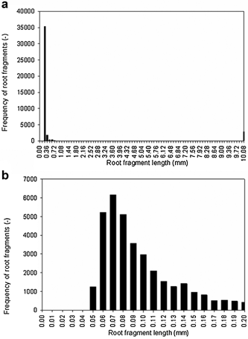
Breakage of transgenic tobacco roots for monoclonal antibody release in an ultra‐scale down shearing device
Biotechnology and Bioengineering Volume 111, Issue 1, pages 196-201, 20 SEP 2013 DOI: 10.1002/bit.25006 http://onlinelibrary.wiley.com/doi/10.1002/bit.25006/full#bit25006-fig-0001
Notes:
Histogram of lengths of (a) roots and fragments after 120 s shearing at 75 s⁻¹ in the shearing device, showing a typical bimodal distribution, (b) fragment lengths for fragments up to 0.2 mm in length.
© This slide is made available for non-commercial use only. Please note that permission may be required for re-use of images in which the copyright is owned by a third party.

