Slide 1
LERU Roadmap for Research Data
Dr Paul Ayris
Director of UCL Library Services and UCL Copyright Officer
Chief Executive, UCL Press
President of LIBER (Association of European Research Libraries)
Chair, LERU Chief Information Officer Community
e-mail: p.ayris@ucl.ac.uk

Slide 2
Contents
The importance of Research Data
LERU Research Data Roadmap
Next Steps for LERU

Slide 3
Contents
The importance of Research Data
LERU Research Data Roadmap
Next Steps for LERU

Slide 4
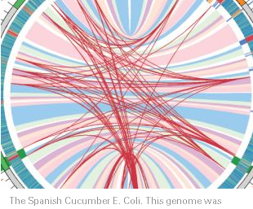
See Science as an open enterprise http://royalsociety.org/policy/projects/science-public-enterprise/report/

Slide 5
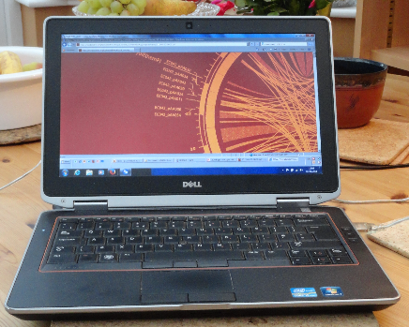
Technological change
Modern computers permit massive datasets to be assembled and explored in ways that reveal inherent but unsuspected relationships. This data-led science is a promising new source of knowledge (p. 7)
The emergence of linked data technologies creates new information through deeper integration of data across different datasets with the potential to greatly enhance automated approaches to data analysis (p. 7)

Slide 6
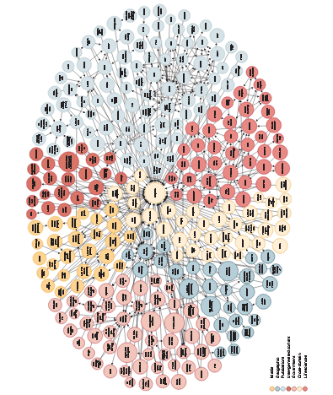
Map of Interlinked Data
W3C (2012). Available at: http://www.w3.org/wiki/SweoIG/TaskForces/CommunityProjects/LinkingOpenData

Slide 7
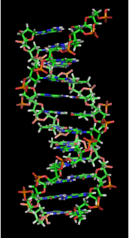
Open Data
Open data is the idea that certain data should be freely available to everyone to use and republish as they wish, without restrictions from copyright, patents or other mechanisms of control
Auer, S. R.; Bizer, C.; Kobilarov, G.; Lehmann, J.; Cyganiak, R.; Ives, Z. (2007). "DBpedia: A Nucleus for a Web of Open Data". The Semantic Web. Lecture Notes in Computer Science 4825. p. 722. doi:10.1007/978-3-540-76298-0_52. ISBN 978-3-540-76297-3.
http://en.wikipedia.org/wiki/File:DNA_orbit_animated.gif

Slide 8
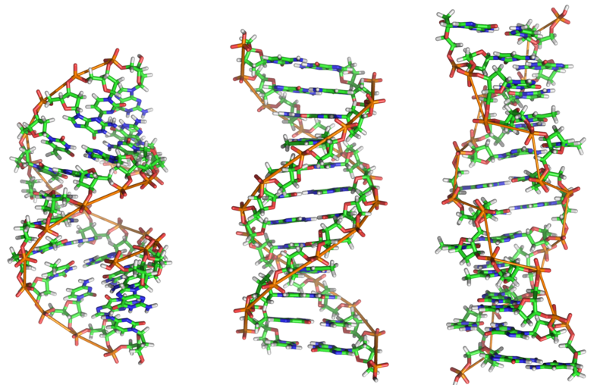
Human Genome Project
Aim: To determine the sequence of chemical base pairs which make up human DNA, and to identify and map the total genes of the human genome
See http://en.wikipedia.org/wiki/DNA
Benefits – felt from molecular medicine to human evolution
Better understanding of disease
Design of medication and prediction of their effects
Commercial development of genomics research

Slide 9
Contents
The importance of Research Data
LERU Research Data Roadmap
Next Steps for LERU

Slide 10
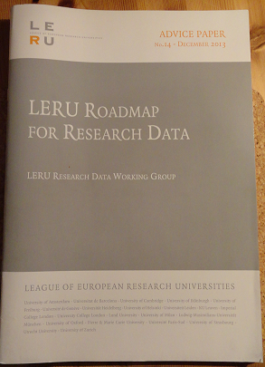
LERU Roadmap for Research Data
Overseen by Research Data Working Group
Pablo Achard (University of Geneva)
Paul Ayris (UCL, University College London)
Serge Fdida (UPMC, Paris)
Stefan Gradmann (University of Leuven)
Wolfram Horstmann (University of Oxford)
Ignasi Labastida (University of Barcelona)
Liz Lyon (University of Bath)
Katrien Maes (LERU)
Susan Reilly (LIBER)
Anja Smit (University of Utrecht)

Slide 11
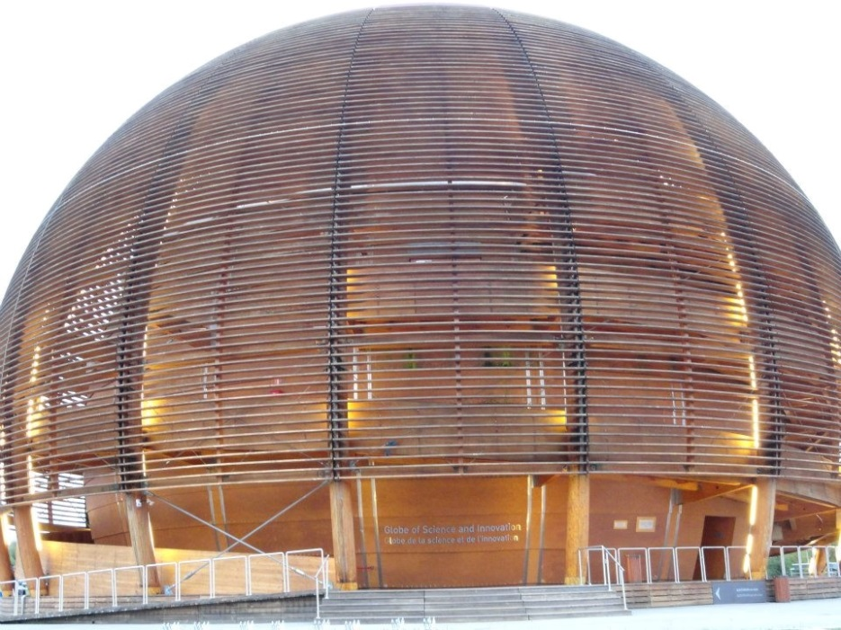
LERU Roadmap for Research Data
Policy and Leadership
Advocacy
Selection and Collection, Curation, Description, Citation, Legal Issues
Research Data Infrastructure
Costs
Roles, Responsibilities and Skills
Recommendations to different stakeholder groups
Cern, Geneva

Slide 12
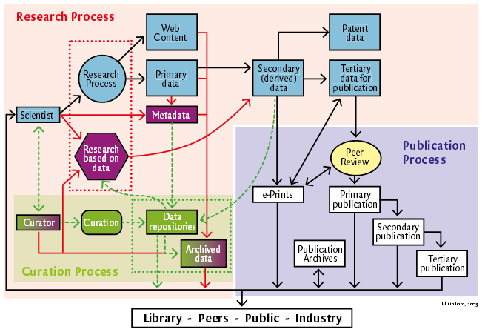
See http://www.ukoln.ac.uk/ukoln/staff/e.j.lyon/150.pdf

Slide 13
Key Messages
Each LERU university needs a Research Data Management Strategy
Researchers should have Research Data Management Plans
LERU universities need to bring stakeholders together
Benefits of ‘open data’ for sharing and re-use should be advocated and explored
New role of Data Scientist is emerging
King’s Cross, London

Slide 14
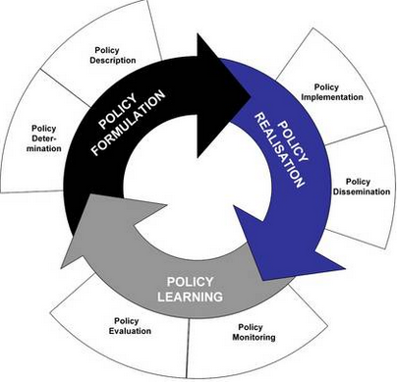
Policy Development
Case Study on Policy development from UCL
Drivers
External funders
Need to inform researchers
Raise awareness of issues facing UCL researchers
Identifies roles and responsibilities
Data to be made open in the most open manner appropriate
See www.lanecrothers.net/politicalprof/the-policy-cycle-and-our-frozen-politics/
Researchers should have Data Management Plans
LERU slams lack of data policies – Research Europe

Slide 15
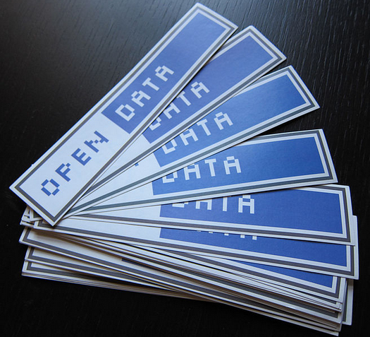
Open Data
Open Data allows research data to be shared and re-used
Avoids costly duplication of research activity
Provides greater transparency in research activity
Potential to speed discovery of solutions to societal Grand Challenges, such as health care & environmental science
Can all research data be open?
Certain categories probably cannot
National security
Data protection
Commercial Funder requirements
http://en.wikipedia.org/wiki/File:Open_Data_stickers.jpg

Slide 16
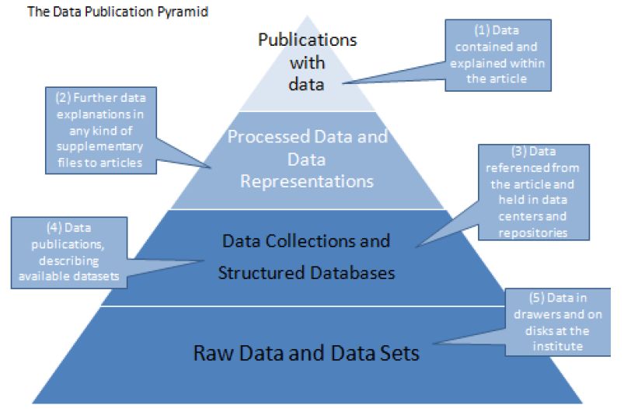
Data management
Which of these layers of research data need to be
curated for a fixed term?
preserved for the long term?
thrown away?
LERU Roadmap identifies this as an area for future study
The ODE Data Publication Pyramid at
http://www.alliancepermanentaccess.org/wp-content/uploads/downloads/2011/11/ODE-ReportOnIntegrationOfDataAndPublications-1_1.pdf

Slide 17
Collaboration a way forward
LERU Rectors see this as an area for study
Collaboration between Dutch institutions
Focus is on research data which lies behind publications
Each university and faculty has its own Dataverse installation
Support services offered by libraries in Dutch universities
See http://www.syndromic.org/communities
Utrecht, Tilburg, Erasmus University Rotterdam, Maastrict, Groningen, 3TU Datacentrum and Netherlands Institute of Ecology

Slide 18
Contents
The importance of Research Data
LERU Research Data Roadmap
Next Steps for LERU

Slide 19
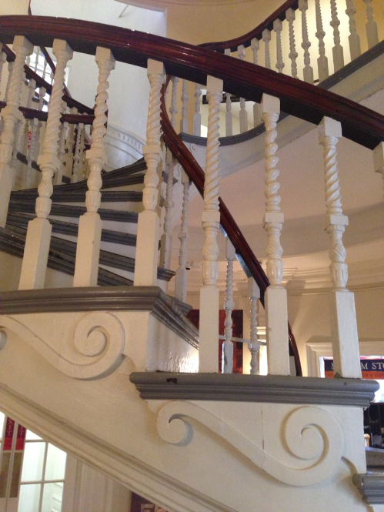
Next Steps
Changes advocated by Roadmap are far-reaching
Communicate findings of the Roadmap
LERU to retain Research Data Working Group to oversee implementation
LERU Rectors have suggested Data Pilot(s), with Horizon 2020 funding
Working Group to consider options
Old State House, Boston, USA

Slide 20
Finally
If you have been
Thanks for listening
Happy to hear questions

