Slide 1
Licensing and Copyright for education and research
Dr Paul Ayris
Director of UCL Library Services and UCL Copyright Officer
Chief Executive, UCL Press
President of LIBER (Association of European Research Libraries)
Chair of the LERU community of Chief Information Officers
e-mail: p.ayris@ucl.ac.uk

Slide 2
Contents
Licensing for education
Overseas campuses
MOOCS/SPOCS
Text and Data Mining for education and research
Conclusions
Plaster Relief by John Flaxman, Flaxman Gallery, UCL

Slide 3
Contents
Licensing for education
Overseas campuses
MOOCS/SPOCS
Text and Data Mining for education and research
Conclusions
Plaster Relief by John Flaxman, Flaxman Gallery, UCL

Slide 4
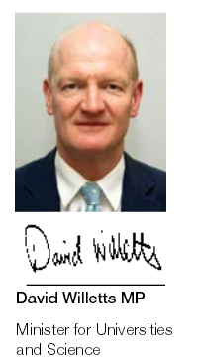
Overseas campuses/MOOCs/SPOCs/ CPD Short Courses
The explosive growth in Massive Open Online Courses (MOOCs) and their global reach has opened up a new door to education. We need to make sure it is a door to our universities and colleges
International Education: Global Growth and Prosperity (July, 2013)
https://www.gov.uk/government/uploads/system/uploads/attachment_data/file/229844/bis-13-1081-international-education-global-growth-and-prosperity.pdf

Slide 5
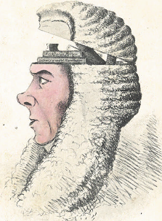
Overseas campuses - UK case studies
Students need to register centrally
JISC Collections in UK use Model Licence
EXCLUDES students registered at a Partner Organisation
A Box of Useful Knowledge
(Brougham Papers, UCL Library Services)

Slide 6
Issues for overseas campuses
University College London
Students at partner institutions need to be covered by a Extension to the Licence
Decision Tool - http://www.jisc-collections.ac.uk/News/Decision-Tool---Users-at-Partner-Organisations/
Most publishers (not all) accepting concept of small uplift to allow access
But publisher may not have right to grant access to resources in every country
Most (not all) publishers use JISC Model Licence
Some publisher licences exclude overseas campuses
Some publishers want to handle Additional Users on an institution by institution basis without the JISC Model Licence

Slide 7
Issues for MOOCS/SPOCS
Solutions?
Open Access CC licences work well for MOOCS
International agreements needed to identify requirements of universities and their students
Commercial providers need to be engaged at an international level to agree Terms and Conditions
Who is responsible for leading these discussions?
No agreement on how to provide licenses
Registering students centrally is a challenge for Short Courses (2-3 days)
Some MOOC providers arrange licensing for content they provide
CCC (Copyright Clearance Centre (US licensing body) has MOOCS licencing solution. This puts the burden of fee payment back on the MOOC students, rather than university:
http://www.copyright.com/moocs

Slide 8
Contents
Licensing for education
Overseas campuses
MOOCS/SPOCS
Text and Data Mining for education and research
Conclusions
Plaster Relief by John Flaxman, Flaxman Gallery, UCL

Slide 9
Text and Data Mining (TDM) – what is it?
TDM derives information from machine-read material
It works by copying large quantities of material, extracting the data, and recombining it to identify patterns
Essential aspect of Science 2.0 or Open Science
LIBER TDM Factsheet at http://www.libereurope.eu/sites/default/files/Text%20and%20Data%20Mining%20Factsheet.pdf

Slide 10
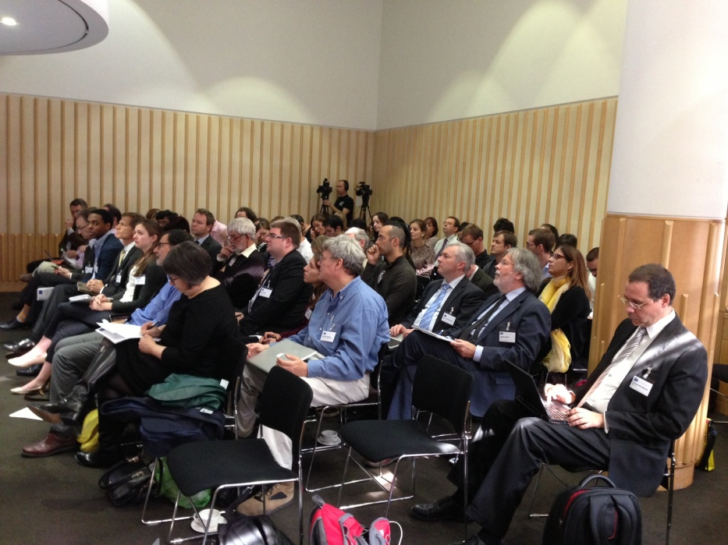
TDM
Less TDM activity is undertaken in Europe than other parts of the globe, partly because of European copyright frameworks
Publishers offering licences for TDM which many researchers deem restrictive
EU TDM Expert Group has argued for an Exception for TDM in EU copyright laws
LIBER TDM Workshop, London 2013
Or a broader change in the form of an open norm or an interpretive instrument

Slide 11
Contents
Licensing for education
Overseas campuses
MOOCS/SPOCS
Text and Data Mining for education and research
Conclusions
Plaster Relief by John Flaxman, Flaxman Gallery, UCL

Slide 12
Conclusions
International agreements needed to deal with new licensing issues for Higher Education
EU copyright reform needed to support education and research
University College London

